Slide 1
CS447 Recitation #4: 2/11/18
These slides are available online:
https://github.com/kc13/CS447JB
Agenda: Pre-exam Review

Slide 2
Binary to Hexadecimal
Example: What is 0111101001011110₂ in base 16?

Slide 3
Binary to Hexadecimal
Example: What is 0111101001011110₂ in base 16?
0111 1010 0101 1110

Slide 4
Binary to Hexadecimal
Example: What is 0111101001011110₂ in base 16?
0111 1010 0101 1110
Each half-byte as base 10: 7 10 5 14

Slide 5
Binary to Hexadecimal
Example: What is 0111101001011110₂ in base 16?
0111 1010 0101 1110
Each half-byte as base 10: 7 10 5 14
Each half-byte as base 16: 7 a 5 e
0111101001011110₂ = 0x7a5e

Slide 6
Endianness
t0 | 0x0105a12c
Example: Assume we want to place the value in t0 into memory, starting at byte address 4. How would the layout of this value appear in the memory of a Little Endian system?

Slide 7
Endianness
t0 | 0x0105a12c
Example: Assume we want to place the value in t0 into memory, starting at byte address 4. How would the layout of this value appear in the memory of a Little Endian system?

Slide 8
Endianness
t0 | 0x0105a12c
Example: Assume we want to place the value in t0 into memory, starting at byte address 4. How would the layout of this value appear in the memory of a Little Endian system?
Memory addresses (as decimal)
4
5
6
7

Slide 9
Endianness
t0 | 0x0105a12c
Example: Assume we want to place the value in t0 into memory, starting at byte address 4. How would the layout of this value appear in the memory of a Little Endian system?
Memory addresses (as decimal)
4 | 2c
5 | a1
6 | 05
7 | 01

Slide 10
Endianness
t0 | 0x0105a12c
Example: Assume we want to place the value in t0 into memory, starting at byte address 4. How would the layout of this value appear in the memory of a Big Endian system?
Memory addresses (as decimal)
4 | 01
5 | 05
6 | a1
7 | 2c

Slide 11
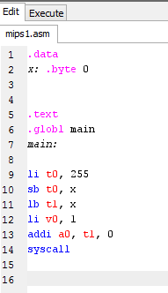
Tracing/debugging: Stores and loads
The following MIPS instructions were run on MARS. Why was the output of the syscall -1? How can we ensure that t1 contains 255?

Slide 12
Tracing/debugging: Stores and loads
The following MIPS instructions were run on MARS. Why was the output of the syscall -1? How can we ensure that t1 contains 255?
Byte-length representation is 11111111₂. The word-length representation is 00000000000000000000000011111111₂.

Slide 13
Tracing/debugging: Stores and loads
The following MIPS instructions were run on MARS. Why was the output of the syscall -1? How can we ensure that t1 contains 255?
Byte-length representation is 11111111₂. The word-length representation is 00000000000000000000000011111111₂.
lb will perform sign extension on 11111111₂, such that t1 = 11111111111111111111111111111111₂ = -1

Slide 14
Tracing/debugging: Stores and loads
The following MIPS instructions were run on MARS. Why was the output of the syscall -1? How can we ensure that t1 contains 255?
Byte-length representation is 11111111₂. The word-length representation is 00000000000000000000000011111111₂.
lb will perform sign extension on 11111111₂, such that t1 = 11111111111111111111111111111111₂ = -1
lbu would be more appropriate here. It would zero-pad the 11111111₂ value, resulting in 00000000000000000000000011111111₂.

Slide 15
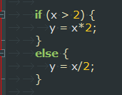
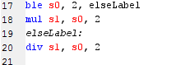
Tracing/debugging: Branches
Imagine we want to translate the Java code on the left to equivalent MIPS instructions (using registers s0 and s1 for x and y). What is the error in the instructions on the right?

Slide 16
Tracing/debugging: Branches
Imagine we want to translate the Java code on the left to equivalent MIPS instructions (using registers s0 and s1 for x and y). What is the error in the instructions on the right?
This instruction will always be executed. The program will always read the next instruction in memory, unless told to jump around it. A label alone does not tell the program to execute the jump.

Slide 17
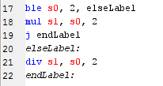
Tracing/debugging: Branches
Correct translation:

Slide 18
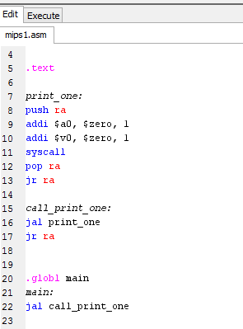
Tracing/debugging: Functions
In the following code, the “call_print_one” function does not store and restore the contents of the return address register (ra). In what sequence are the instructions executed, and where (and why) does the program get stuck?

Slide 19
Tracing/debugging: Functions
In the following code, the “call_print_one” function does not store and restore the contents of the return address register (ra). In what sequence are the instructions executed, and where (and why) does the program get stuck?

Slide 20
Tracing/debugging: Functions
In the following code, the “call_print_one” function does not store and restore the contents of the return address register (ra). In what sequence are the instructions executed, and where (and why) does the program get stuck?

Slide 21
Tracing/debugging: Functions
In the following code, the “call_print_one” function does not store and restore the contents of the return address register (ra). In what sequence are the instructions executed, and where (and why) does the program get stuck?

Slide 22
Tracing/debugging: Functions
In the following code, the “call_print_one” function does not store and restore the contents of the return address register (ra). In what sequence are the instructions executed, and where (and why) does the program get stuck?

Slide 23
Tracing/debugging: Functions
In the following code, the “call_print_one” function does not store and restore the contents of the return address register (ra). In what sequence are the instructions executed, and where (and why) does the program get stuck?
Stuck: The ra register still contains the return address that the “print_one” function used (line 17). Adding the “push” and “pop” statements will ensure that the correct ra value (23) is available for the jr statement in “call_print_one”.

