Slide 1
CS447 Recitation #3: 2/2/18 and 2/5/18
These slides are available online:
https://github.com/kc13/CS447JB
Agenda:
Office hours 5-6 pm today
Make sure to download the newest Mars version
Filename = Mars_2184_a
Review of function calling conventions (relevant for lab #3)
Highlights of lab #3

Slide 2
Review of function calling conventions
Hypothetical function: add three integers
In Java:
public int addThreeInts (int i, int j, int k) {
return (i + j + k);
}

Slide 3
Converting to a MIPS function
Hypothetical function: add three integers
In Java:
public int addThreeInts (int i, int j, int k) {
return (i + j + k);
}
In MIPS:
(without
push/pop)
addThreeInts:
sub sp, sp, 4
sw ra, (sp)
add t0, a0, a1
add v0, a2, t0
lw ra, (sp)
add sp, sp, 4
jr ra
#label (jump target for jal)
#decrement stack pointer by 1 word
#store return address on stack
#add i and j
(stack)
#add i+j to k and set return value
#retrieve return address
#increment stack pointer
#return to instruction following function call

Slide 4
Converting to a MIPS function: Using new pseudo-ops
Hypothetical function: add three integers
In MIPS:
addThreeInts:
sub sp, sp, 4
sw ra, (sp)
add t0, a0, a1
add v0, a2, t0
lw ra, (sp)
add sp, sp, 4
jr ra
#label (jump target for jal)
#decrement stack pointer by 1 word
#store return address on stack
#add i and j
push ra
#add i+j to k and set return value
#retrieve return address
#increment stack pointer
#return to instruction following function call
pop ra
Note: The push/pop operations are not strictly required for this function. They are only critical when a function calls another function. They’re included here to help illustrate the concept.

Slide 5
Converting to a MIPS function: What changes will we need to make if we use a saved register (s0 - s7)?
addThreeInts:
sub sp, sp, 4
sw ra, (sp)
add s0, a0, a1
add v0, a2, s0
lw ra, (sp)
add sp, sp, 4
jr ra

Slide 6
Converting to a MIPS function: What changes will we need to make if we use a saved register (s0 - s7)?
addThreeInts:
sub sp, sp, 8
sw ra, (sp)
sw s0, 4(sp)
add s0, a0, a1
add v0, a2, s0
lw ra, (sp)
add sp, sp, 4
jr ra
Equivalent to push ra, push s0

Slide 7
Converting to a MIPS function: What changes will we need to make if we use a saved register (s0 - s7)?
addThreeInts:
sub sp, sp, 8
sw ra, (sp)
sw s0, 4(sp)
add s0, a0, a1
add v0, a2, s0
lw s0, 4(sp)
lw ra, (sp)
add sp, sp, 8
jr ra
Equivalent to push ra, push s0
Equivalent to pop s0, pop ra

Slide 8
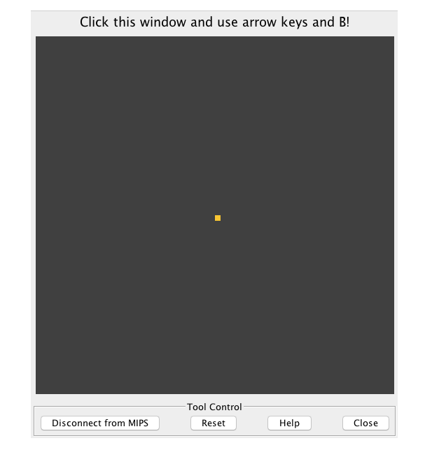
Lab #3 highlights

Slide 9
Lab #3 highlights
Section 1: Getting set up with the Keypad and LED simulator tool.
Instructions are provided; pay special attention to the following:
Be sure to type .include “led_keypad.asm” at the top of your file.
Remember the quotes!
Make sure the led_keypad.asm file is present in your working directory (it can be downloaded from the Github page with the instructions for the lab).
The led_keypad.asm file contains several named constants and functions that will be useful for you.
The .include directive (see MARS help) allows you to access those constants and functions without having to copy them into your own asm file.

Slide 10
Lab #3 highlights
Next section: Creating an infinite loop with a “sleep” syscall
This is syscall 32.
The time to sleep (in milliseconds) will go into register a0.
a0 will expect an integer. It is OK to round the # of milliseconds required to approximate the rate of 60 iterations / second.

Slide 11
Lab #3 highlights
Next section: Creating the draw_dot function to add to the loop
This function largely serves as a wrapper to call the display_set_pixel function in led_keypad.asm.
Before calling display_set_pixel, you will need to set the values of three argument registers (see the comments above the function)
Remember:
Use li (or addi in combination with the $zero register) to put an immediate value (i.e., a number supplied on the instruction line) into a register.
Use lw <register>, <variable_label> to place a variable’s value into a register.
You don’t need to do go through the load address routine if you’re just loading a single word variable (la is more helpful for arrays).

Slide 12
Lab #3 highlights
Next section: Making the dot appear
In your main loop, call draw_dot
This will write data to memory concerning the pixel to draw.
After draw_dot, call display_update_and_clear
This will implement the changes to the display.

Slide 13
Lab #3 highlights
Next section: Moving the dot around
Create the check_input function.
It will use the input_get_keys function from led_keypad.asm to retrieve the identity of the key that the user is pushing down.
Use the returned keypress information to direct the dot
This will involve manipulating the value of either dot_x or dot_y
Since the manipulations of dot_x/dot_y depend on the keypress, you can expect a lot of conditional instructions and labels
Remember, to change a variable’s value:
Load it into a register (lw <register>, <variable_name>)
Change the value in the register
Store that new value (sw <register>, <variable_name>)

Slide 14
Lab #3 highlights
Next section: Moving the dot around
Once your dot-moving code is done, you can test it out. (Just see the note in the instructions about clicking the display first).

Slide 15
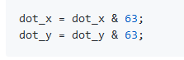
Lab #3 highlights
Final section: Allowing dot movement to “wrap around” the screen
You are asked to add the equivalent of the following lines to the end of your check input function:
In these steps, you’ll be applying “and” masks. The next few slides explain what this entails, and why it’s done.

Slide 16
Lab #3 highlights
The problem:
The display grid is 64 x 64 (see top of led_keypad.asm)
If dot_x grows to > 63, we essentially want to find dot_x % 63 to get the appropriate value for the wraparound effect (same applies to dot_y).
If dot_x or dot_y becomes negative, we want to reset it to a value equal to 64 + dot_x (or dot_y)
Bitwise AND with 63 will make both of these effects happen.

Slide 17
Lab #3 highlights
Bitwise AND with 63 (example with dot_x value of -1):
11111111 # -1 in binary two’s complement
& 00111111 # 63
---------
00111111 # 63 = 64 - 1
# AND only outputs 1 when both input bits = 1

Slide 18
Lab #3 highlights
Bitwise AND in MIPS (see also MARS help):
For inputs in t0 and t1, output in t2:
and t2, t0, t1
For an input immediate value 63 and an input in t0, output in t1:
andi t1, t0, 63

