Slide 1
CS447 Recitation: 3/30/18 and 4/2/18
These slides are available online:
https://github.com/kc13/CS447JB
Agenda: Lab #8 Overview

Slide 2
Lab #8: Create a register file
Similarities to MARS/MIPS:
Two read ports
One write port
Differences:
16 bits wide (not 32)
Only 8 registers
A designated register (r7) will auto-increment or auto-decrement if specific input pins are set to request this
Otherwise it will behave normally

Slide 3
Lab #8: Components (subcircuits)
Their use is encouraged for this lab.
This will be useful preparation for the project.
To add a new canvas to Logisim, remember that you can click the green “+” sign.

Slide 4
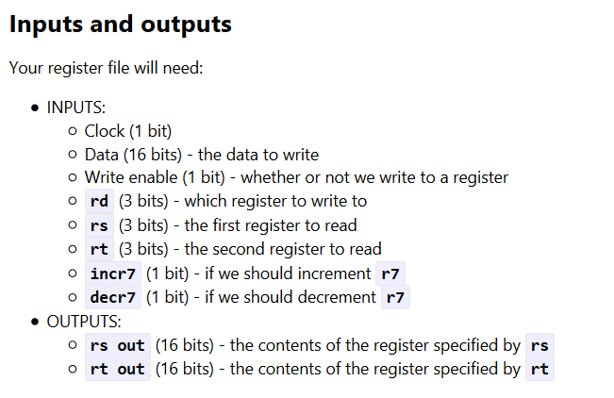
Lab #8: Inputs and Outputs
In a new subcircuit for the register file:
→ Labels will make it easier to identify these pins from outside the subcircuit.

Slide 5
Lab #8: Registers
Create 8 of them
For now, r7 can be treated like the others
Make sure that they can hold 16 bits
Remember to hook them up to the clock (triangle-shaped pin).

Slide 6
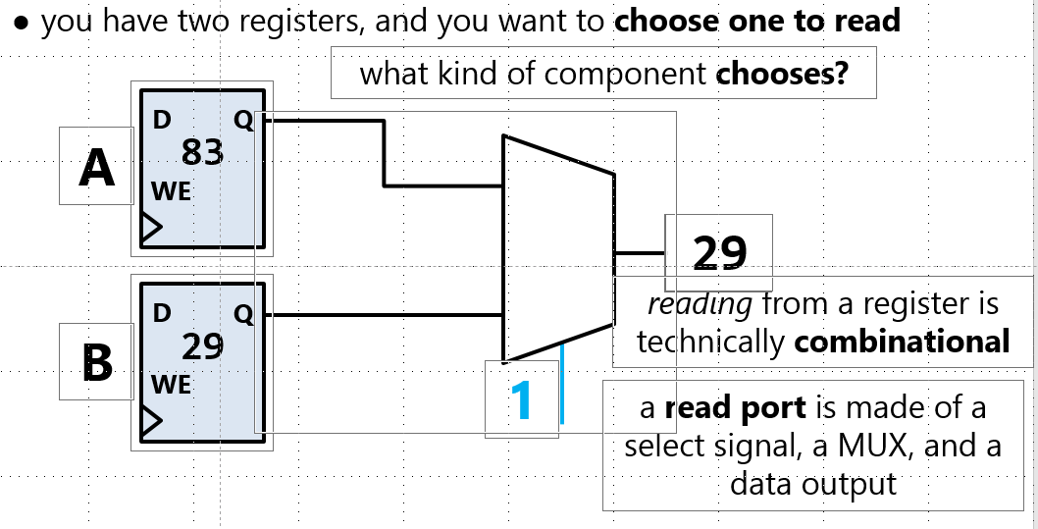
Lab #8: Register read ports
From slide 8 in slide deck #17:
Differences between this figure and the lab:
You’ll need two read ports.
There will be 8 registers. The bit width of the select bits attribute of the MUXes will need to be 3 (to match rs and rt). Registers will be numbered 000 to 111, in binary.

Slide 7
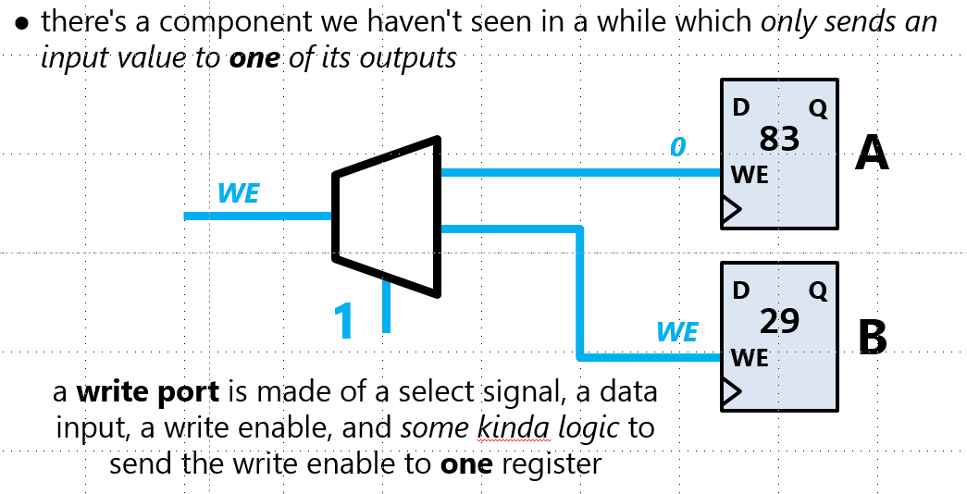
Lab #8: Register write port
From slide 11 in slide deck #17:
Reminders:
The trapezoid-shaped component is a demultiplexer.
WE = write enable; set to 1 when you want to write
Make sure to adjust the selection bits width on the DMX
The input to the selection pin (rd) will determine which register is chosen for the write.

Slide 8
Lab #8: Making adjustments to register 7 (r7)
This register will be designed to do post- and pre-increments, but only when requested.
Otherwise it will behave normally.
The incr7 and decr7 pins will control this behavior.
If incr7 = 1, then
writes to r7 should be enabled
Even if r7 is not selected as the rd
Even if the write enable input pin = 0
the value in r7 should be incremented to r7 + 1
the data input to r7 should be ignored
This is conceptualized as being like a postincrement operation in another language (i.e., x++).

Slide 9
Lab #8: Making adjustments to register 7 (r7)
If decr7 = 1, then:
writes to r7 should be enabled,
even if r7 is not selected as the rd
Even if the write enable input pin = 0
the value in r7 should be decremented to r7 - 1
the data input to r7 should be ignored
In addition, the output from decr7 should be updated to r7-1 immediately.
This is analogous to predecrement in other programming languages (i.e., --x).
For your circuit, this implies that you will need to add logic to determine whether the current register’s contents (r7) or the register’s contents minus 1 (r7-1) should be sent to the read ports.

Slide 10
Lab #8: Making adjustments to register 7 (r7)
Testing this behavior:
Set rs and rt to 111 to read register 7.
Turn incr7 on
The contents of r7 should increase even when the write enable pin = 0
Turn off incr7 and turn on decr7.
r7 should auto-decrement, even when the write enable pin = 0
On the output pins, you should see the value auto-decrease immediately
Final test: Try to both write a value to one register, and perform autoincrement on r7 at the same time.

