Slide 1
CS447 Recitation #5: 2/16/18 and 2/19/18
These slides are available online:
https://github.com/kc13/CS447JB
Agenda:
Monday office hours will be shifted to 2-4 pm on 2/19
Lab #4 Overview

Slide 2
Lab #4: General overview
Each MIPS instruction must be converted into binary.
→ Each instruction must be 32 bits long.
The full set of rules governing this conversion may be found in the “MIPS green sheet”.
Not required for this lab, but if you’re interested, it is available in the Github repository cited on the first slide.
It can also be found in the textbook, and is easy to find elsewhere online.

Slide 3
Lab #4: Revisiting bitfields
The binary representation of the instruction will hold its different components (instruction name, registers, any immediate values, etc.) in separate fields of the 32-bit instruction.
Instructions typically follow one of a few possible instruction formats (available on the Green Sheet) in determining what goes in which field.

Slide 4
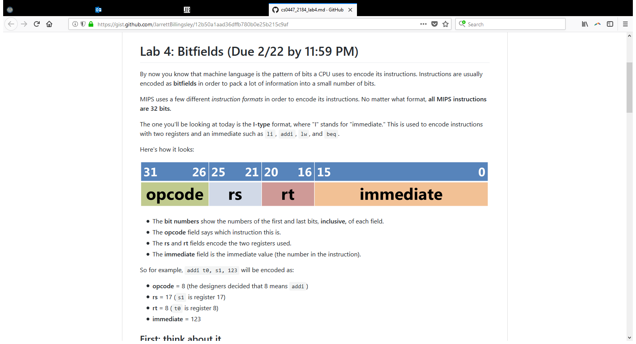
Lab #4: Revisiting bitfields
Lab #4 focuses on the Immediate Type (I-Type) instruction.
Instructions like lw and beq quality as I-Type instructions because their labels can be converted to addresses in the instruction memory (which are numeric).

Slide 5
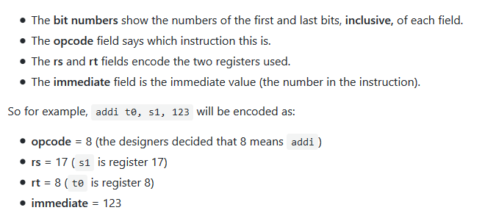
Lab #4: Revisiting bitfields
5 bits long, can be found on the Green Sheet
rs = source, rt = destination, note order swap
note width is limited to 16 bits
Mapping from registers → numbers is on the Green Sheet

Slide 6
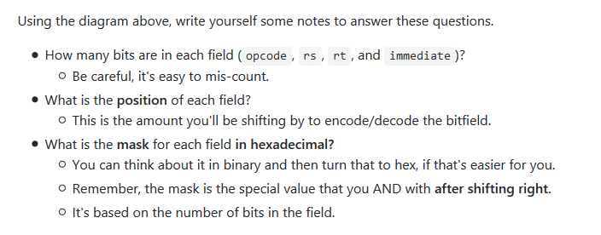
Lab #4:
Example to mask out rt, if the hex number corresponding to this instruction is in t0:
srl t1, t0, 16 #puts rt into bits 4-0 of t1
andi t2, t1, 0x1F #zeroes out any bits higher than position 4

Slide 7
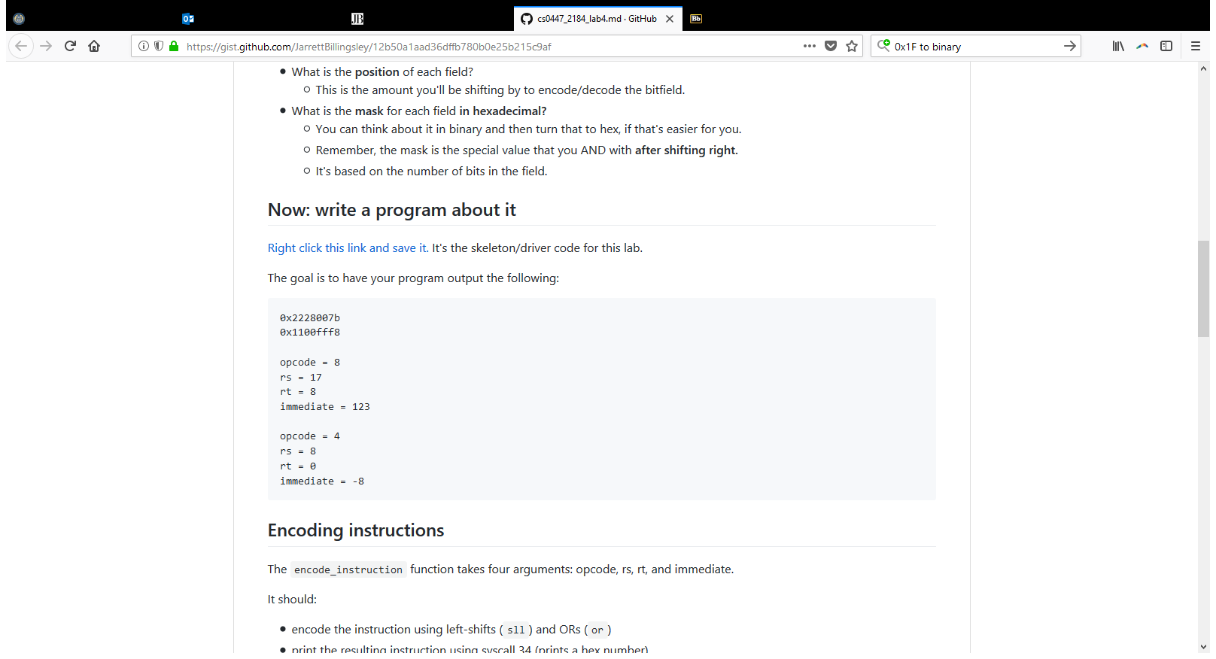
Lab #4: Assignment details
Download lab4.asm
Fill in two functions:
encode_instruction: will take in the values of the opcode, rs, rt, and immediate, join them into a single 32-bit string, and print the result as a hexadecimal.
decode_instruction:
Will take in a 32-bit value, break it down into the same four components, and print those values (in base 10)

Slide 8
Lab #4: encode_instruction
Opcode, rs, and rt can be shifted into place with sll (immediate is already in the correct position).
Results can be combined with an or (this will probably involve a few separate or instructions).
The function will have to be able to handle negative immediate values. Here’s the example from the lab in 32-bit binary Two’s complement:
-8₁₀ =11111111 11111111 11111111 1111000
The 1’s in the upper 16 bits will be a problem when you use or to combine with the opcode/rs/rt.
You’ll use a mask to get rid of those 1’s.

Slide 9
Lab #4: decode_instruction
This can use the srl and andi combination presented previously.
You’ll be using the print string syscall to print the string part of the output. This will require loading memory addresses for those strings (already provided for you in .data) and placing them in a0. Note this will require you to back up the argument value that the function received in a0.

Slide 10
Lab #4: decode_instruction
Again, you’ll be asked to work with an instruction that contains a negative immediate value.
This requires doing the opposite of what was done for encode_instruction: You need to fill in the top bits with 1’s, but only when bit 15 contains a 1.
The instructions describe how to do this with sll and sra (which will fill in with 1’s if the top bit is a 1).

