Slide 1
CS447 Recitation: 3/23/18 and 3/26/18
These slides are available online:
https://github.com/kc13/CS447JB
Agenda: Lab #7 Overview
Image credits: Some images are from slide deck #14 from the lecture slides

Slide 2
Lab #7: Building a Multiplication circuit
Recap of Lecture discussion of multiplication grade school algorithm:
1111
x 0100
---------
0000
0000
1111
0000
-----------
0111100 = 60₁₀
Check the appropriate bit of the multiplier on each iteration (0 or 1?)
Add 0 or the multiplicand (shifted for each new iteration)
Maintain a running sum

Slide 3
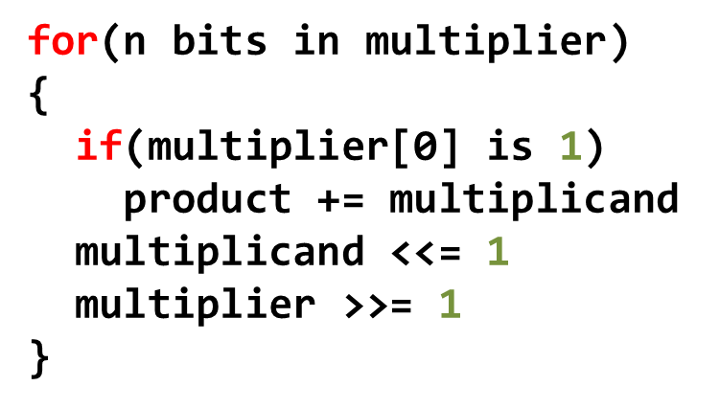
Lab #7: Building a Multiplication circuit
Pseudocode from class:
1111
x 0100
---------
0000
0000
1111
0000
-----------
0111100 = 60₁₀

Slide 4
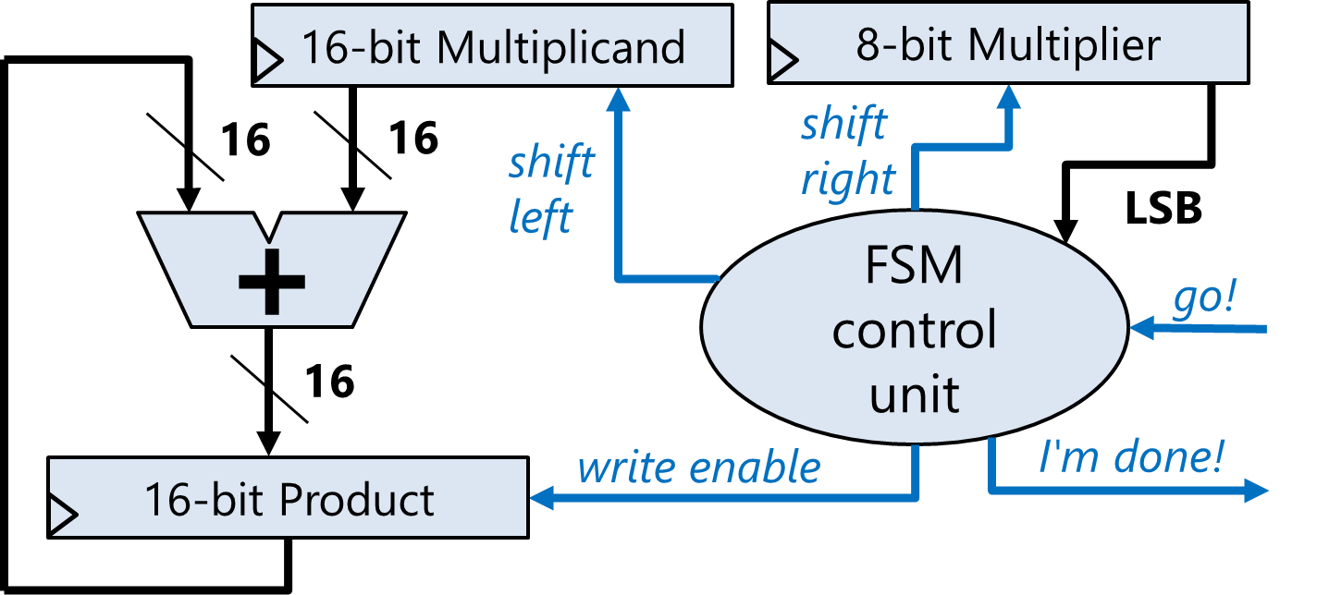
Lab #7: Building a Multiplication circuit
Proposed circuit from class
1111
x 0100
---------
0000
0000
1111
0000
-----------
0111100 = 60₁₀

Slide 5
Lab #7: Building a Multiplication circuit
Proposed circuit from class
1111
x 0100
---------
0000
0000
1111
0000
-----------
0111100 = 60₁₀

Slide 6
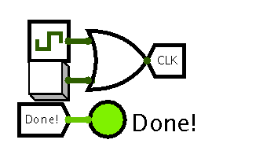
Lab #7: Building a Multiplication circuit
For the lab, you will:
Design a circuit to multiply two 8-bit numbers
First step is to create the following:
The instructions explain these components in more detail.
They’ll help in interacting with your circuit, and will make more sense after you build the rest of it.
Note that you can choose the “off” and “on” colors of the LED (green circle) yourself. It won’t appear in the “on” color until it receives a ‘1’ input.

Slide 7
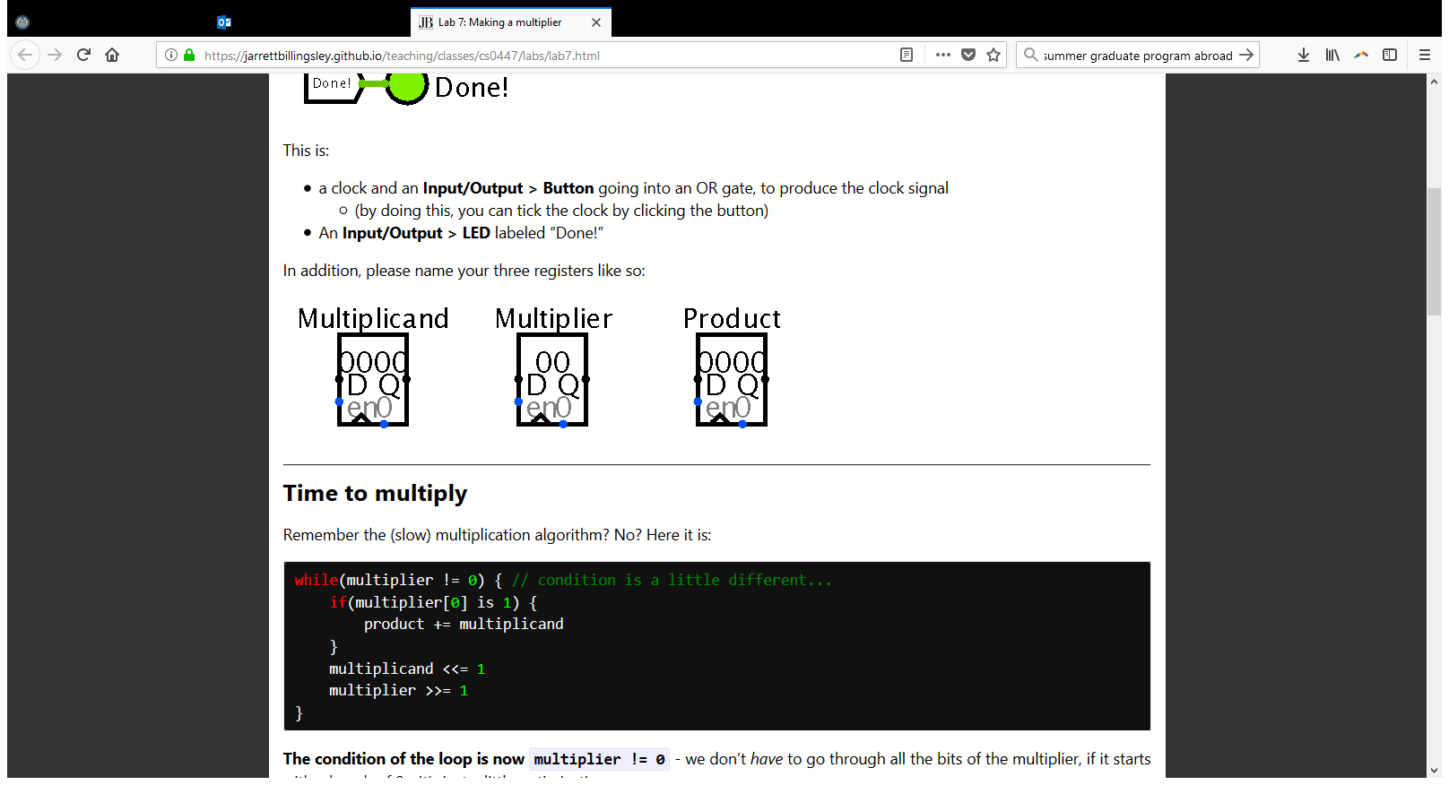
Lab #7: Building a Multiplication circuit
Next steps:
Create three registers:
You’ll need to adjust the data width.
It may help to refer to the sample circuit on the earlier slide.

Slide 8
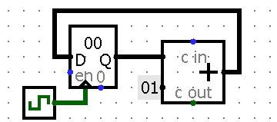
Lab #7: Building a Multiplication circuit
Next steps:
For the multiplicand and multiplier registers:
You need to implement a shift by 1 for each clock tick.
See the circuit from the earlier slide for a reminder of the shift directions.
The simple_counter circuit from Lab #6 gives a hint as to how to set up a regular adjustment in the register’s value – just be sure to replace the adders with shifters that go in the appropriate direction.
Don’t forget to connect each register with the clock.

Slide 9
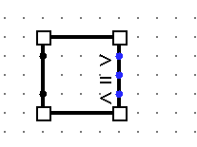
Lab #7: Building a Multiplication circuit
Next steps:
The circuit needs to indicate when the multiplication is done.
The process is done when the contents of the multiplier register = 0
The lab suggests using the Comparator component in “Arithmetic” for this step.
Remember Help > Library Reference can be
useful in understanding new components.
Once the multiplication is done, you should disable the registers (remember they have an “enable” pin), and also send a ‘1’ input to turn on the LED.

Slide 10
Lab #7: Building a Multiplication circuit
Next steps:
Wire up the registers to perform the multiplication. Here’s the previous circuit image for reference:
On each clock tick, you’ll use the LSB of the multiplier to determine whether you should allow the current value of the multiplicand register to add to the current value of the product register.
Use a splitter to pull out the LSB of the multiplier. (Note the example in the instructions is for the MSB).

