Slide 1
CS447 Recitation: 3/30/18 and 4/2/18
These slides are available online:
https://github.com/kc13/CS447JB
Agenda: Lab #8 Overview

Slide 2
Lab #8: Create a register file
Similarities to MARS/MIPS:
Two read ports
One write port
Differences:
16 bits wide (not 32)
Only 8 registers
A designated register (#7) will auto-increment or decrement, depending on the actions taken on another register

Slide 3
Lab #8: Components (subcircuits)
Their use is encouraged for this lab.
To add a new canvas to Logisim, remember that you can click the green “+” sign.

Slide 4
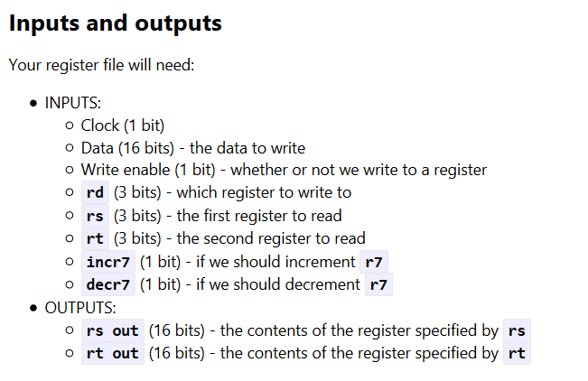
Lab #8: Inputs and Outputs
In a new subcircuit for the register file:
(These are all input or output pins, except for the clock)
Labels will make it easier to identify these pins from outside the subcircuit.

Slide 5
Lab #8: Registers
Create 8 of them
Make sure that they can hold 16 bits
Remember to hook them up to the clock (triangle-shaped pin).

Slide 6
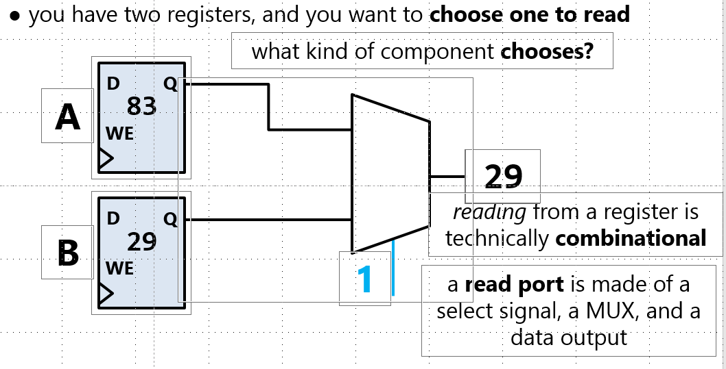
Lab #8: Register read ports
From slide 8 in slide deck #17:
Differences for this lab:
You’ll need two of these.
There will be 8 registers. The bit width of the select bits attribute of the MUX will need to be wide enough to uniquely specify the 8 registers.

Slide 7
Lab #8: Register read ports
From slide 8 in slide deck #17:
Differences for this lab:
You’ll need two of these.
There will be 8 registers. The bit width of the select bits attribute of the MUX will need to be wide enough to uniquely specify the 8 registers (= the width of rs and rd).

Slide 8
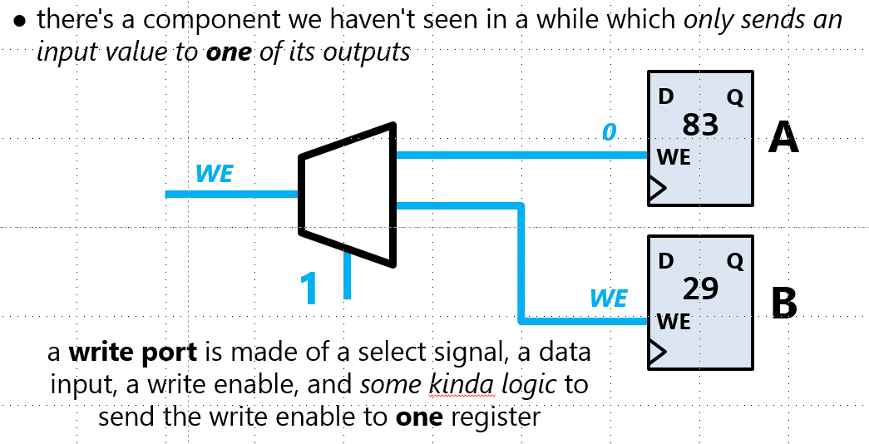
Lab #8: Register write port
From slide 11 in slide deck #17:
Reminders:
The components is a demultiplexer.
WE = write enable; set to 1 when you want to write
Make sure to adjust selection bits width on the DMX
The input to the selection pin will determine which register is chosen for the write.

Slide 9
Lab #8: Making adjustments to register 7 (r7)
This register will be designed to do post- and pre-increments.
The incr7 and decr7 pins will control this behavior.
If incr7 = 1, then ‘write enable’ for r7 should be turned on, and the value in r7 should be incremented by 1 (even if r7 is not selected as the rd).
If decr7 = 1, then ‘write enable’ for r7 should be turned on, and the value in r7 should be decremented by 1 (even if r7 is not selected as the rd).
The output of r7 should be r7 – 1
This is analogous to predecrement in other programming languages (i.e., --x).
If incr7 = 0 and decr7 = 0, r7 behaves like a normal register.

Slide 10
Lab #8: Making adjustments to register 7 (r7)
Testing this behavior:
Set rs and rt to 111 to read register 7.
Turn incr7 on
The contents of r7 should increase even when incr7 is off.
Turn off incr7 and turn on decr7.
r7 should auto-decrement, even with write enable off
On the output pins, you should see the value auto-decrease.
Final test: Try to both write a value to one register, and perform autoincrement on r7 at the same time.

