Slide 1
CS447 Recitation #2: 1/26/18
These slides are available online:
https://github.com/kc13/CS447JB
Agenda for today: Overview of Lab #2

Slide 2
Lab #2 Highlights: Section 1
This section focuses on creating and retrieving variable values from main memory.
In the .data section you will be asked to create variables of different sizes: 1 byte, 1 half (a.k.a. halfword, = 2 B) and 1 word (= 4 B)
Resources:
Slide 15 of “04 Memory and Addresses”
The “directives” tab of Mars Help

Slide 3
Lab #2 Highlights: Section 1 continued
When retrieving the variable values, remember that there are signed and unsigned options for some of the load instructions.
In Mars, see Help → Extended (pseudo) instructions

Slide 4
Lab #2 Highlights: Section 1 continued
When retrieving the variable values, remember that there are signed and unsigned options for some of the load instructions.
In Mars, see Help → Extended (pseudo) instructions,
or Memory and Addresses 25-26

Slide 5
Lab #2 Highlights: Sections 2 and 3
Across sections 2 and 3, you will be asked to
create an array and a named constant
create a loop that iterates 5 times, and
create a loop body that asks the user for a value on each iteration, and then places each value in the next available position in the array

Slide 6
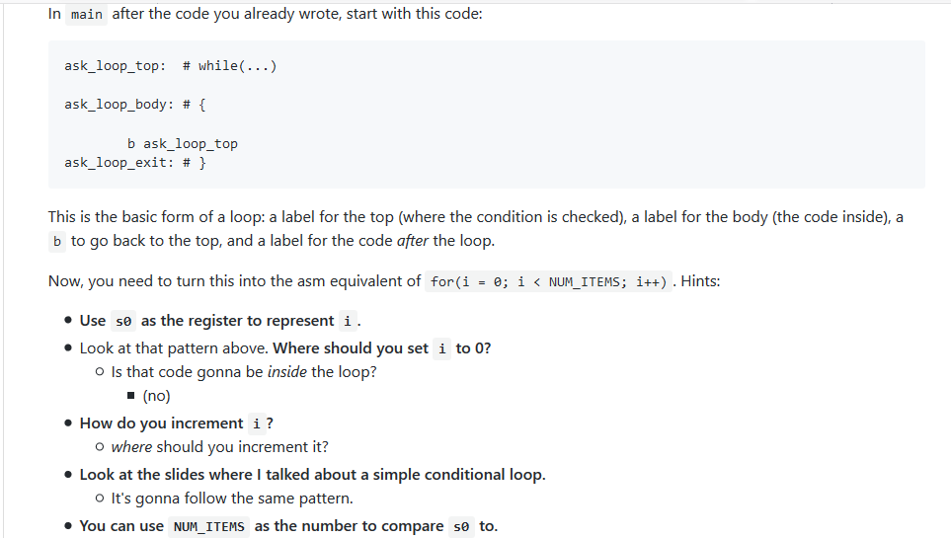
Lab #2 Highlights: Section 2
Creating the loop: The instructions provide a specific structure that should be used in creating a loop that iterates NUM_ITEMS (here, 5) times.
See slide 21 of Arrays, Loops, and Conditionals, and the Extended instructions Help in MARS
Note: If you get stuck in an infinite loop, you will have force quit MARS.

Slide 7
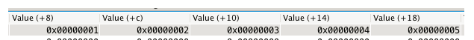
Lab #2 Highlights: Section 3
For each iteration of the loop:
Read an integer from the user (syscall 5); the suggestion to try the popup dialog is helpful.
Store an integer in a position of the array corresponding to the iteration of the loop, resulting in:

Slide 8
Lab #2 Highlights: Section 3
How do we make this happen?
The user’s integer will be in v0.
You can store this into a location in memory using an instruction of the following format:
sw s0, (<register_holding_memory_address>)
Note the parentheses are required (see Instructions help in MARS); the angle brackets are my notation for generic values and not required
Let’s say we’re using t2 to hold the memory address of the array location we want to access. How do we know what that memory address is?
The following will get you the address of the initial array element:
la <some_register>, values
You need to add offsets to this address to get the addresses of the subsequent elements.
Each element slot is one word (= 4 bytes) wide. Remember that MIPS uses byte addressing.

