Slide 1
CS447 Recitation #4: 2/12/18
These slides are available online:
https://github.com/kc13/CS447TK
Agenda for today: Overview of Lab #5

Slide 2
Lab #5 overview
Instructions PDF organization:
Page 1: Review of recursive functions
Page 2: Recursive functions in MIPS, factorial example
Page 3: Instructions on how to complete lab05.asm (available on Courseweb)

Slide 3
Lab #5: Factorial computation as an example recursive function

Slide 4
Lab #5: Factorial computation as an example recursive function
Recurrence relation: How do we write this as a function that calls itself?

Slide 5
Lab #5: Factorial computation as an example recursive function
Recurrence relation: How do we write this as a function that calls itself?
=
(n - 1) * (n - 2)!
=
(n - 2) * (n - 3)!
…
Base case: (n-(n-1)) * (0)!

Slide 6
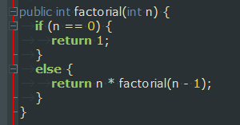
Lab #5: Factorial computation as an example recursive function
Recurrence relation: How do we write this as a function that calls itself?
=
(n - 1) * (n - 2)!
=
(n - 2) * (n - 3)!
…
Base case: (n-(n-1)) * (0)!

Slide 7
Lab #5: Factorial function in MIPS

Slide 8
Lab #5: Adding recursive functions to lab05.asm
- The program will ask the user for integers ≥ 0 to serve as arguments for three functions: “sum”, “pow”, and “Fibonacci”
- The user interface and function calls have been already prepared. All that remains is to write the functions.
- Functions will not be tested with negative values.

Slide 9
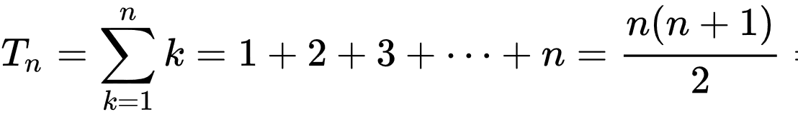
Lab #5, function #1: Sum
Sum(n) will compute:
This is essentially the nth triangular number:
Formula credit: Wikipedia
Example: sum(5) = 5 + 4 + 3 + 2 + 1 = 15
Note that this operation is very similar to factorial(n), with two main differences:
→ * is replaced with +
sum(0) = 0 (and 0! = 1)
The factorial example may be a helpful, but incomplete model for your sum function.

Slide 10
Lab #5, function #2: Pow
Unlike the exponentiation done for lab #3, you will be required to implement this recursively.
Recurrence relation:
Base case: y = 0
Note that what changes across function calls is a counter variable of how many operations remain; the operands of the multiplication do not change.

Slide 11
Lab #5, function #3: Fibonacci
Computes the Fibonacci sequence:
0, 1, 1, 2, 3, 5, 8, 13, 21, 34, 55….
Recurrence relation for n ≥ 2
F(n) = F(n-1) + F(n-2)
Base case:
F(0) = 0
Base case:
F(1) = 1
Undefined for n < 0

Slide 12
Simple pseudocode for a recursive Fibonacci function¹:
0, 1, 1, 2, 3, 5, 8, 13, 21, 34, 55….
fib(n):
if n = 0: return 0
else if n ≤ 2: return 1
else: return fib(n-1) + fib(n-2)
_fibonacci:
…
…
…
jal _fibonacci
…
jal _fibonacci
…
…
…
jr $ra
Implies two recursive “jal _fibonacci” calls
Both return values in $v0. Make sure to back up the result of the first call before calling the second!
1. See http://video.mit.edu/watch/introduction-to-algorithms-lecture-19-dynamic-programming-i-fibonacci-shortest-paths-14225/, at approximately 7:00

Slide 13
Summary:
Lab 5 requires you to write 3 functions: sum(n), pow(x,y), and fibonacci(n)
All functions must use recursion.
The functions’ success will depend on the use of proper calling conventions (backing up $s registers / $ra, etc).

Slide 14
Completion during recitation:
You will be asked to run the program twice, with different test values that will be provided.
Assignments must be submitted via Courseweb, even if checked off during recitation.

