Slide 1
CS447 Recitation #9: 4/2/18
These slides are available online:
https://github.com/kc13/CS447TK
Agenda for today:
Overview of Lab #10

Slide 2
Lab #10 overview: Building a miniature MIPS processor
MiniMIPS Specifications:
Two registers (8 bits)
Only ALU and “set” instructions
All instructions have a destination register
All use the same instruction format

Slide 3
MiniMIPS instruction set
$r = 0 if rd = A; $r = 1 if rd = B
MiniMIPS instruction format
- 16 bits long
- Addresses for instructions are 8 bits long

Slide 4
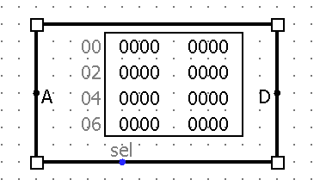
Steps #1-2: Create the instruction memory
ROM component
A = Instruction address input (use default 8 bit width)
Note hex format
D = Data output (16 bit instructions; be sure to adjust to 16).
Note hex format, two values per row in display
Right click to edit values
“sel”: wire a constant of ‘1’ to this

Slide 5
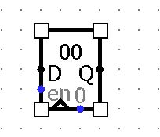
Steps #3-4: Create the program counter register ($PC)
Default bit width = 8
OK for 8-bit wide addresses
Address can be fetched from Q pin, and sent to A pin of ROM.
How do we update the register to fetch the next address?
Use a loop from Q to D, an adder, and a constant.
Constant = 1 (not 4), because our addresses are only one byte wide (not one word wide).
Wire in a constant 1 to the enable pin (can reuse input to ROM), to enable writes.

Slide 6
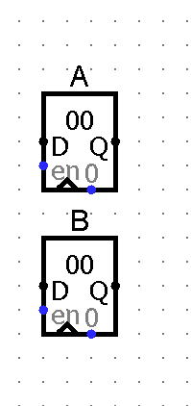
Step #5: Create the registers
Again, default bit width of 8 works.

Slide 7
Step #6: Build a 4-function ALU
Somewhat like Lab #8 (see figure), except:

