Slide 1
CS447 Recitation: 11/4/16 (Lab #9, Week 10)
These slides and the lab are available online:
https://github.com/kc13/CS447
Agenda for today:
Sign-in sheet
Overview of lab

Slide 2
Lab #9 Objective: Build a small register file in Logisim, and test it within a separate circuit.
Differences from Lab #8:
We’ll use the built-in Logisim registers
You will need to introduce control signals to selectively write to/read from individual registers.

Slide 3
Preview of the test circuit (Logisim Demo)

Slide 4
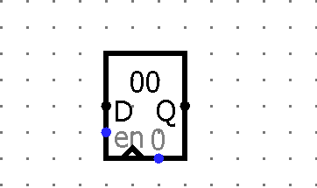
New components for this lab
Register

Slide 5
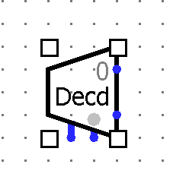
New components for this lab
Decoder

Slide 6
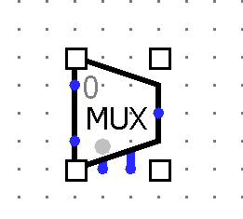
New components for this lab
Multiplexer (MUX)

Slide 7
Lab submission:
If you get done during recitation, an in-class demo is helpful but not required.
Regardless of when you finish, you must submit your work via Courseweb by 11:59 pm on Monday, 11/7.

