Slide 1
CS447 Recitation: 9/23/16 (Lab #3, Week 4)
These slides are also available online:
https://github.com/kc13/CS447
Agenda for today:
Info regarding online lab access, submission, lab grades
Lab #3 overview
Sign-in sheet

Slide 2
Online access to lab assignments
For this and future recitations, the labs will be made available online, instead of as hardcopy handouts.
See the same Github repository where the slides are located (this is now linked to the course website)
These will be available by the start of the Friday 9:00 a.m. recitation.

Slide 3
Submission and Grading
Labs should continue to be submitted online, via Courseweb.
Submission must occur no later than 11:59 pm on the same day on which recitation is held.
If you finish during recitation, please notify the TA.
When each lab is graded, the grade should become visible in Courseweb.

Slide 4
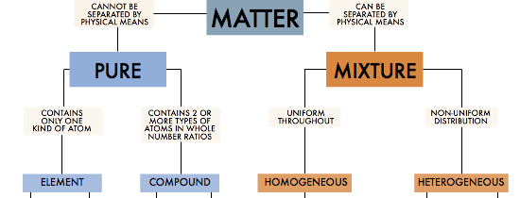
Lab #3 → Objective: Use MIPS to implement a program with complex conditional operations.
Context: Yes/No decision tree --
Figure 1. Source: https://students.ga.desire2learn.com/d2l/lor/viewer/viewFile.d2lfile/1798/12889/matter4.html. Additional reference: http://www.kentchemistry.com/links/Matter/ClassifiyingMatter.htm.

Slide 5
Basic tree terminology
Root node
Left child of root node
edge
traversal
Right child of ‘Pure’, and a leaf node

Slide 6
Convenient traversal representation for trees with binary decisions:
Use a bit string with 0 = left, 1 = right, and follow the digits from left to right, starting at the root.
Depicted here:
‘01’
traversal

Slide 7
Lab3.asm (available on Github):
Existing code asks user to answer two questions about a sample of matter.
The answers are converted to a bit string representing the traversal through the tree (such as ‘01’) and stored in $t0.

Slide 8
Modifications to make to lab3.asm:
Use the user’s input (as encoded in $t0) to determine both the first level and second level classifications, and print this information to the I/O window.
Welcome to the matter classification program! Can substances within the sample be separated by physical means? (no = 0, yes = 1) 0 Does the sample contain more than one kind of atom? (no = 0, yes = 1) 1 This is a pure substance. It is a compound.

