Slide 1
CS447 Recitation: 10/28/16 (Lab #7, Week 8)
These slides and the lab are available online:
https://github.com/kc13/CS447
Agenda for today:
Sign-in sheet, administrative announcements
Overview of lab

Slide 2
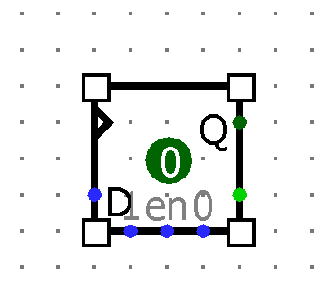
Lab #8 Objective: Create and use an 8-bit register in Logisim.
→ Each bit will be stored in a separate D Flip-Flop
Image source: Patterson & Hennessy textbook (2009)

Slide 3
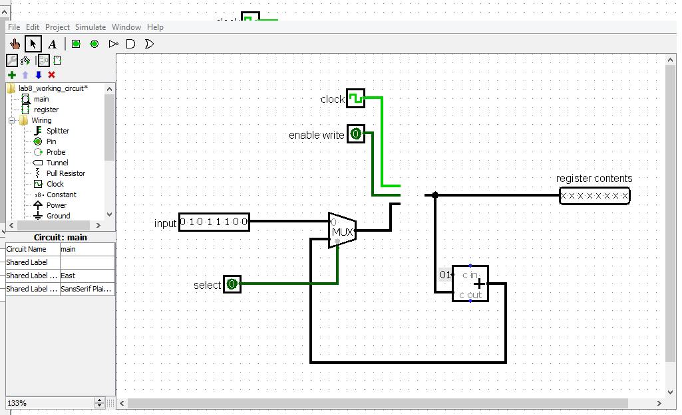
Use of the register:
Download lab8_starter_circuit.circ:

Slide 4
How the main circuit works (Logisim demo)

Slide 5
Lab submission:
If you get done during recitation, an in-class demo is helpful but not required.
Regardless of when you finish, you must submit your work via Courseweb by 11:59 pm on Thursday, 11/3.

