Slide 1
CS447 Recitation: 11/18/16 (Lab #11, Week 12)
These slides and the lab are available online:
https://github.com/kc13/CS447
Agenda for today:
Sign-in sheet, grading update
Overview of lab

Slide 2
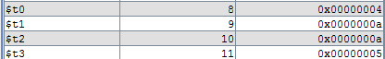
Lab #11 Objective: Fetch, decode, and implement instructions
.text
addi $t0, $t0, 4
addi $t1, $t1, 10
addi $t2, $t0, 6
addi $t3, $t1, -5

Slide 3
Text → Hex
.text
addi $t0, $t0, 4
addi $t1, $t1, 10
addi $t2, $t0, 6
addi $t3, $t1, -5
v2.0 raw
21080004
2129000a
210a0006
212bfffb

Slide 4
Some of the important differences from Project #2
.text
addi $t0, $t0, 4
addi $t1, $t1, 10
addi $t2, $t0, 6
addi $t3, $t1, -5
v2.0 raw
21080004
2129000a
210a0006
212bfffb
only addi and 4 registers
32 bits instead of 16
(data also = 32 bits)

Slide 5
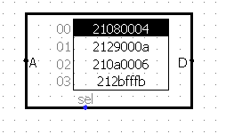
How do we implement this in Logisim?
Load the hex file into a ROM component
Update and use $PC to help fetch instructions
Create a register file with 4 registers (OK to modify Lab #9 for this)
We are addressing at the level of 32-bit words. We only need to update $PC by 1 on each clock cycle.

Slide 6
How do we implement this in Logisim?
4. Separate the bits corresponding to the different bit fields, and correct for numbering/bit width differences between our register file and MIPS.
Subtract 8 and shrink to bit width of 2.

Slide 7
How do we implement this in Logisim?
Get the value of register rs from the register file.
Sign extend the immediate value to 32 bits.
Add the rs value and the immediate value.
Write the result to register rt.
After running the simulation, check the results in the registers.

Slide 8
Logisim Demo

Slide 9
Other things to keep in mind:
Restart if Logisim is exhibiting inexplicably odd behavior.
If the registers don’t appear to be updated to new values, and no problems can be found with the circuit:
Either restart, or
Send outputs to main to make the registers’ contents visible there (sometimes probes in main will show the correct values).

Slide 10
Lab submission:
If you get done during recitation, an in-class demo is helpful but not required.
Regardless of when you finish, you must submit your work via Courseweb by 11:59 pm on Tuesday, 11/22.

