Slide 1
CS447 Recitation: 11/10/16 (Lab #10, Week 11)
These slides and the lab are available online:
https://github.com/kc13/CS447
Agenda for today:
Sign-in sheet
Overview of lab

Slide 2
Lab #10 Objective: Build a finite state machine in Logisim.
Overview:
Finite State Machines (FSMs) enable behavior that is sensitive to the circuit’s history.
We will implement a worked FSM example from the textbook (Appendix B).
This is a Moore machine (outputs depend on state only).

Slide 3
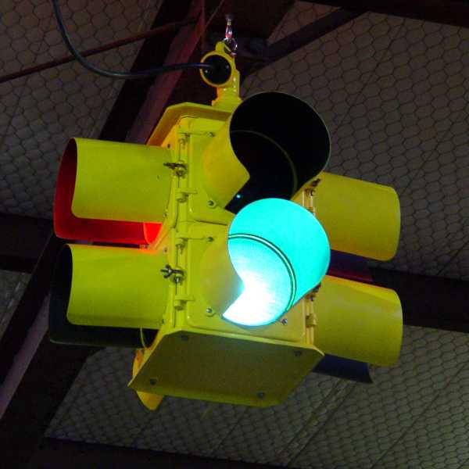
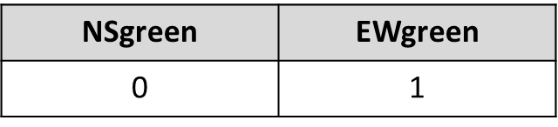
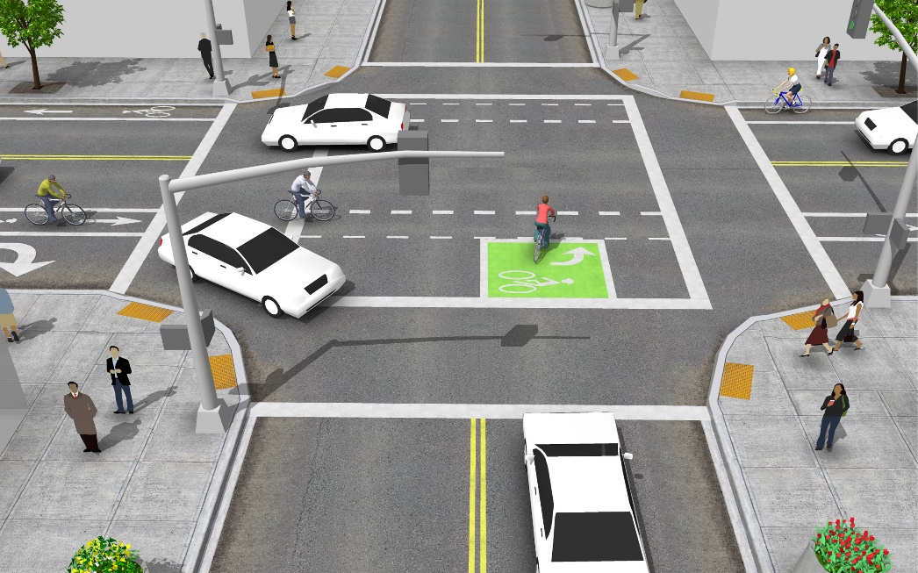
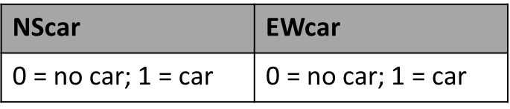
Example FSM:
Assume a controller that can switch between
two values of state:
The state value dictates the current output:
Sensors under the roads provide inputs regarding the presence / absence of cars.

Slide 4
State Transition Table:
Basic idea: When a car shows up on either road, switch the light for that road to green, and the other light to red.

Slide 5
State Transition as a Logical Expression:
Recreate using logic gates in Logisim.

Slide 6
Logisim Demo

Slide 7
Some things to keep in mind
The “Door FSM.circ” file may be a helpful reference, but realize that there are also important differences between that FSM and the one we’re building here.
State is a single variable. It can take two values (0 = NSgreen, 1 = Ewgreen). It is stored in a memory element.
Output is not the same thing as State. There are two output variables, corresponding to the settings of the EWlite (green/red) and the NSlite.

Slide 8
Lab submission:
If you get done during recitation, an in-class demo is helpful but not required.
Regardless of when you finish, you must submit your work via Courseweb by 11:59 pm on Thursday, 11/17.

