Slide 1
CS447 Recitation #10: 7/25/18
These slides are available online:
https://github.com/kc13/CS447
Agenda for today:
Overview of Lab #10
Please sign in.

Slide 2
Lab #10 overview: Building a miniature MIPS processor
MiniMIPS Specifications:
Two registers (8 bits)
Only ALU and “set” instructions
All instructions have a destination register
All use the same instruction format

Slide 3
MiniMIPS instruction set
$r = 0 if rd = A; $r = 1 if rd = B
MiniMIPS instruction format
- 16 bits long
- Addresses for instructions are 8 bits long

Slide 4
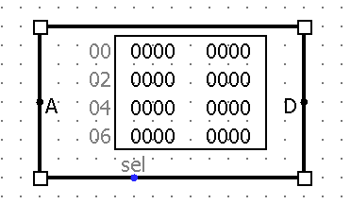
Steps #1-2: Create the instruction memory
ROM component
A = Instruction address input (use default 8 bit width)
Note hex format
D = Data output (16 bit instructions; be sure to adjust to 16).
Note hex format, two values per row in display
Right click to edit values (or poke a field and start typing)
“sel”: wire a constant of ‘1’ to this; it will enable the ROM

Slide 5
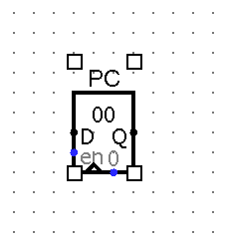
Steps #3-4: Complete the “fetch” circuitry
Create the PC register.
Default 8-bit data width is good for our 8-bit addresses.
Use output of this register to supply the address information to the ROM
How can we update the address on each clock cycle?
To update: Use a loop (Q to D), an adder, and a constant. How large should the constant be?
Constant = 1 (instruction addresses are 1 byte long, not 1 word long)
Make sure writes are enabled (can reuse constant of 1 used for ROM)

Slide 6
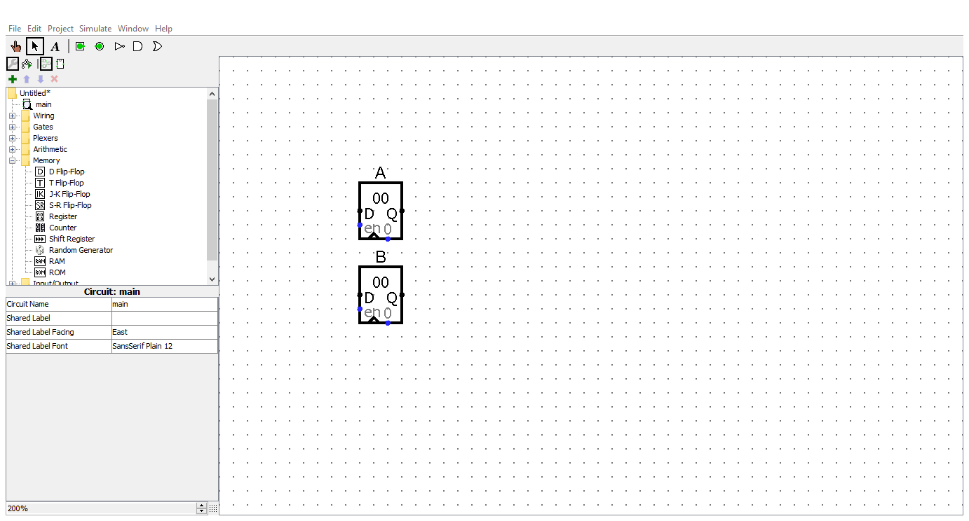
Step #5: Create the two data registers.
Again, default 8-bit with works.

Slide 7
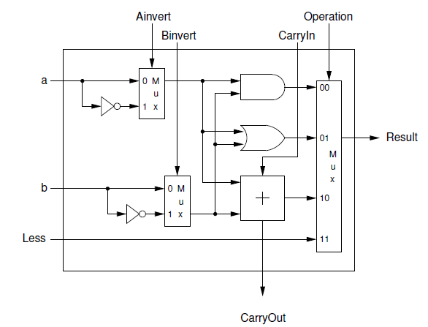
Step #6: Create the ALU
Somewhat like the Lab #8 ALU (see figure), with a few differences:
All inputs/outputs/operations should act on 8 bits, not 1.
No need for a set less than operation (just and/or/add/sub)
Subtraction can be implemented with the built-in component.
It will be in a subcircuit
The subcircuit will need some labeled input/output/selection pins to allow the ALU to be accessed from outside

Slide 8
Step #7: Continue wiring the circuit together
ALU inputs: Directly from the A and B registers
Writes to A and B registers:
Can be from either:
ALU output
Immediate supplied to set instruction
MUXes can be placed before each of the registers to select either of these inputs for the write

Slide 9
Step #8: Split up the instruction into its bitfields
Use a splitter to pull out the three subfields that you need from the instruction (from the ROM).

Slide 10
Step #9: Build the circuitry to decode the instruction + create the control signals
A figure is provided for you:
This circuit will take the 4 input bits of the opcode, and map them onto a two-bit input for the ALUop MUX, and a 1 bit input to decide whether to write the immediate value or ALU output to the register file.
The circuit can be derived by finding the logical expression for the truth table mapping the opcodes to the desired MUX inputs.

Slide 11
Steps #10-12: Wire the remaining components together
Inputs/outputs/selection signals to the appropriate pins
Use the $r subfield (from the splitter), combined with logic gates, to write to the appropriate register (note writes occur on every cycle).
Add the clock + connect it to all the registers

Slide 12
Steps 13-14: Test
Add some instructions to the first few entries of the ROM
You’ll need to get the equivalent hex representation for each instruction
Use “Simulation Enabled” in the Simulate menu to automate the clock and watch the processor work.

Slide 13
Demo during class
To get checked off during recitation, you’ll be asked to demonstrate that one of each of the five instructions works (writing to either the A or B registers).
Remember to submit via Courseweb, and remember to sign in.

