Slide 1
CS447 Recitation #4: 6/6/18
These slides are available online:
https://github.com/kc13/CS447
Agenda for today:
Overview of Lab #4
Be sure to download lab04.asm from Courseweb, and view the full instructions that are available in the PDF file.
Please remember to sign in!

Slide 2
Lab #4 overview
Handout organization:
Pages 1-2: Descriptions of syscall 9 (dynamic memory allocation) and syscall 8 (read string)
Page 2: Reminder of function calling conventions
Page 3: Description of four functions that you must complete for Lab #4 (see lines 110-163 of lab04.asm)
Pages 3-4: Description of what the provided code does, and what the program should do when it is finished.

Slide 3
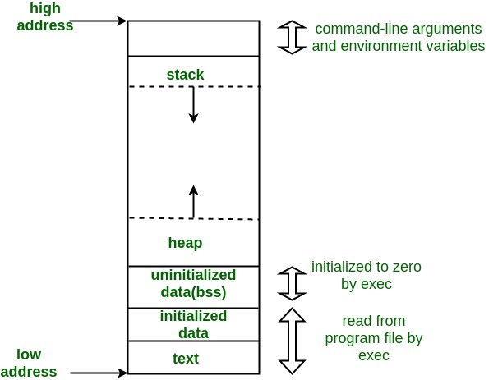
Memory allocation
Different segments of memory are allocated to different components of a running program.
Dynamic segments:
stack: used to store data during function calls (will allocate by manipulating the $sp register in MIPS)
heap: Used for other unpredictable memory
needs (e.g., those which depend on inputs received during runtime). Will allocate with syscall 9 in MARS.
Static segments:
- text (instructions, like .text in MARS)
- Variables for which the allocation needs are known in advance (e.g., global variables, like those stored in .data in MARS)
Image credit: https://www.geeksforgeeks.org/memory-layout-of-c-program/

Slide 4
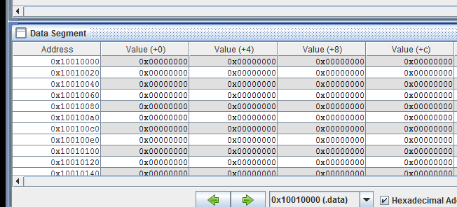
Example allocations in MIPS: Static
Example of static memory allocation. Space will be reserved in the data segment in the next available set of 100 bytes (starting at 0x10010000 in MARS).
Example use:
Image credit: https://www.geeksforgeeks.org/memory-layout-of-c-program/

Slide 5

Example allocations in MIPS: Heap
Example dynamic allocation, from the heap, with enough space for 21 bytes. Space will be reserved in another region of the data segment:
Shortcut to heap addresses
Image credit: https://www.geeksforgeeks.org/memory-layout-of-c-program/

Slide 6
Example allocations in MIPS: Stack
Example of backing up / restoring register values to/from the stack (MIPS slides from lecture, slide 82). Note that the example assumes that the function is a leaf procedure; additional stack manipulation is required for non-leaf procedures (see slides 84-85).
Image credit: https://www.geeksforgeeks.org/memory-layout-of-c-program/

Slide 7
Reading strings from the I/O window with syscall 8
Input stored in buffer will include line feed character (\n, ASCII value = 10):

Slide 8
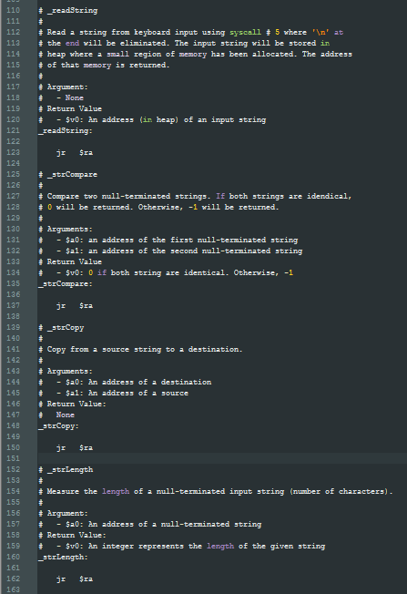
Requirements for Lab #4
You will need to fill in the code for 4 functions that may be found at the bottom of lab04.asm.
The functions will need to follow all calling conventions. Beyond what has been implemented or described in the comments, pay special attention to:
-- backing up any $s register values on the stack, if your function uses $s registers
-- restore those $s values before the jr $ra line
-- be sure to set the values of any return arguments ($v registers) before jr $ra
-- for non-leaf functions, back up $t values before function calls, and restore them afterwards
-- also be sure to backup/restore $ra at the start/end of the function

Slide 9
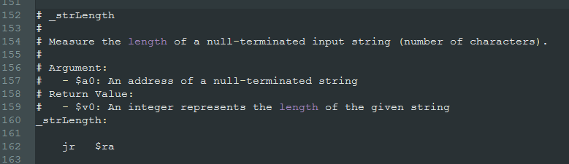
Functions in detail: strLength
Tips:
lbu can be helpful for reading in individual ASCII characters
And for checking whether the current byte is NUL (0x00)
Length result should not include the NUL character.
Variable addressing (for incrementing in a loop):
lbu $t0($t1) is not recognized as valid syntax
One option: lbu 0($t1), where $t1 is incremented by one byte on each loop

Slide 10
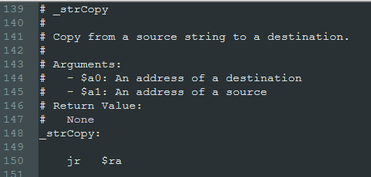
Functions in detail: strCopy
Tips:
The NUL byte at the end should be copied.
lbu and sb may be helpful instructions

Slide 11
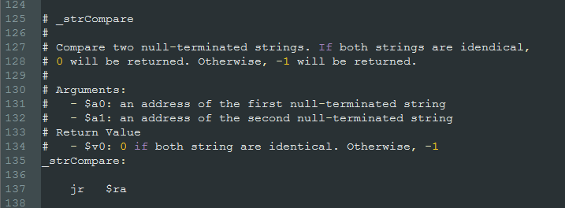
Functions in detail: strCompare
Tips:
lbu and beq/bne might be helpful

Slide 12
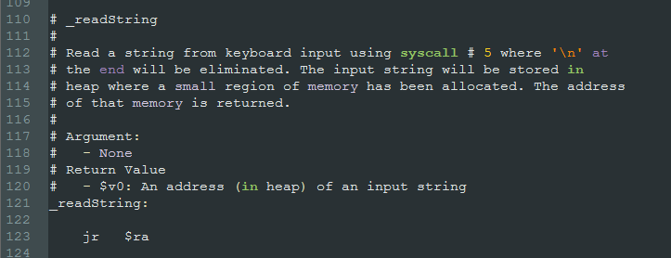
Functions in detail: readString
Syscall 8
Steps:
Call syscall 8:
$a0 = address of input buffer
You can use the “buffer” space that has already been allocated for you in .data.
$a1 = maximum number of characters to read
Check size of “buffer”

Slide 13
Functions in detail: readString
Steps:
Eliminate the line feed character at the end (0x0A).
You will first need to find the line feed character
Once you find its location in memory, overwrite it with a NUL byte

Slide 14
Functions in detail: readString
Steps:
Allocate heap space for storing the string.
Use syscall 9:
$a0 = # of bytes to allocate
You are required to use strLength to determine this value.
Add 1 extra byte to make room for the NUL character.
$v0 = address of allocated memory from heap
You are required to use strCopy to copy the input string in “buffer” to the address returned from syscall 9.
The heap address is also the value that should be returned by the readString function.
readString will be a non-leaf function. Follow appropriate calling conventions.

Slide 15
What the program should do
Read in string, and store it to the heap with readString, which will return the heap address where the string was stored.
All the strings can be fetched using the addresses that readString returned.
Will make use of strCompare.

Slide 16
Final points:
If you encounter problems, it might be helpful to debug your functions in a much simpler/shorter program, and then return to lab04.asm once they’re working.
Your code must work in the version of MARS provided for this class (under Lab #1 in Courseweb).
For demos during recitation:
Demonstrate 2 runs
Use varying numbers of strings, with varying lengths
Check for strings that are and are not present.

