Slide 1
CS447 Recitation #5: 6/13/18
These slides are available online:
https://github.com/kc13/CS447
Agenda for today:
Overview of Lab #5
Download lab05.asm starter code from Courseweb
Remember to sign in!

Slide 2
Lab #5 overview
Instructions PDF organization:
Page 1: Review of recursive functions
Page 2: Recursive functions in MIPS, factorial example
Page 3: Instructions on how to complete lab05.asm (available on Courseweb)

Slide 3
Lab #5: Factorial computation as an example recursive function

Slide 4
Lab #5: Factorial computation as an example recursive function
Recurrence relation: How do we write this as a function that calls itself?

Slide 5
Lab #5: Factorial computation as an example recursive function
Recurrence relation: How do we write this as a function that calls itself?
=
(n - 1) * (n - 2)!
=
(n - 2) * (n - 3)!
…
Base case: (n-(n-1)) * (0)!

Slide 6
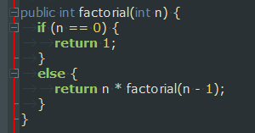
Lab #5: Factorial computation as an example recursive function
Recurrence relation: How do we write this as a function that calls itself?
=
(n - 1) * (n - 2)!
=
(n - 2) * (n - 3)!
…
Base case: (n-(n-1)) * (0)!

Slide 7
Lab #5: Factorial function in MIPS

Slide 8
Lab #5: Adding recursive functions to lab05.asm
- The program will ask the user for integers ≥ 0 to serve as arguments for three functions: “sum”, “pow”, and “Fibonacci”
- The user interface and function calls have been already prepared. All that remains is to write the functions.
- Functions will not be tested with negative values.

Slide 9
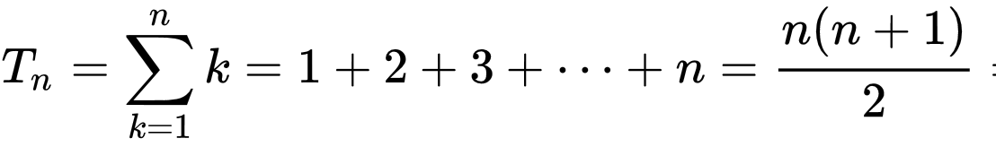
Lab #5, function #1: Sum
Sum(n) will compute:
This is essentially the nth triangular number:
Formula credit: Wikipedia
Example: sum(5) = 5 + 4 + 3 + 2 + 1 = 15
Note that this operation is very similar to factorial(n), with two main differences:
→ * is replaced with +
sum(0) = 0 (and 0! = 1)
The factorial example may be a helpful, but incomplete model for your sum function.

Slide 10
Lab #5, function #2: Pow
Unlike the exponentiation done for lab #3, you will be required to implement this recursively.
Recurrence relation:
Base case: y = 0
Note that what changes across function calls is a counter variable of how many operations remain; the operands of the multiplication do not change.

Slide 11
Lab #5, function #3: Fibonacci
Computes the Fibonacci sequence:
0, 1, 1, 2, 3, 5, 8, 13, 21, 34, 55….
Recurrence relation for n ≥ 2
F(n) = F(n-1) + F(n-2)
Base case:
F(0) = 0
Base case:
F(1) = 1
Undefined for n < 0

Slide 12
Simple pseudocode for a recursive Fibonacci function¹:
0, 1, 1, 2, 3, 5, 8, 13, 21, 34, 55….
fib(n):
if n == 0: return 0
else if n ≤ 2: return 1
else: return fib(n-1) + fib(n-2)
_fibonacci:
…
…
…
jal _fibonacci
…
jal _fibonacci
…
…
…
jr $ra
Implies two recursive “jal _fibonacci” calls
Both return values in $v0. Make sure to back up the result of the first call before calling the second!
1. See https://youtu.be/OQ5jsbhAv_M?t=7m

Slide 13
Summary:
Lab 5 requires you to write 3 functions: sum(n), pow(x,y), and fibonacci(n)
All functions must use recursion.
The functions’ success will depend on the use of proper calling conventions (backing up $s registers / $ra, etc).

Slide 14
Completion during recitation:
You will be asked to run the program twice, with different test values that will be provided.
Assignments must be submitted via Courseweb, even if checked off during recitation.
Remember to sign in!

