Slide 1
CS447 Recitation #1: 5/16/18
These slides are available online:
https://github.com/kc13/CS447
Agenda for today:
Overview of the recitation
Review of Lab #1

Slide 2
Contact info
TA: Karin Cox
Recitations: W 2:30-3:20 pm, 3:30 - 4:20 pm
Email: kmc51@pitt.edu
Office: 6150 Sennott Square
Office hours: TBD

Slide 3
Recitation format (following from the Labs/Recitation section of the syllabus):
A sign in sheet will be passed around at the beginning of lab. Be sure to sign in!
If you do not attend the recitation corresponding to a lab, 50% will be deducted from that lab.
Submit all labs, via Courseweb, by the deadline.
Labs can also be “checked off” during recitation. However, the lab should still be submitted through Courseweb.
A brief presentation on the lab will be given at the start of class. The rest of the time will be available for individual questions.

Slide 4
Where to access recitation slides (optional):
Github repository:
https://github.com/kc13/CS447
This repository will include recitation slides, and possibly other material. Use of this information is optional. The lab instructions provide all the information that is essential for completing the lab.
Be sure to choose the “CS447” repository (other repositories are for older sections or other courses).

Slide 5
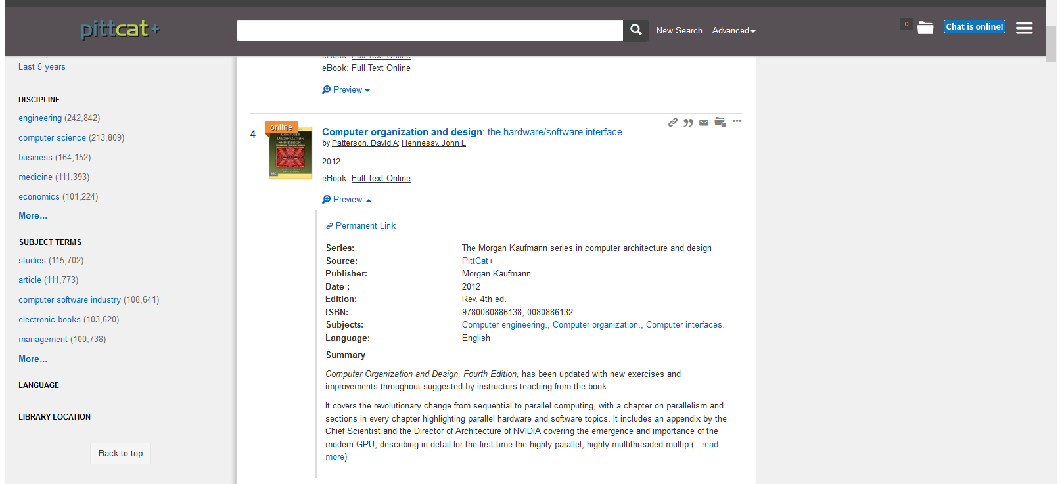
FYI:
The 4th edition of the textbook is available as an e-book through the library:
Note that the 2017 e-book is for ARM (not MIPS).

Slide 6
Lab #1 highlights
Handout organization:
Page 1: MARS installation info
Pages 1-2: Write and run a simple MIPS program
Page 3-5: Installing and using a MARS tool

Slide 7
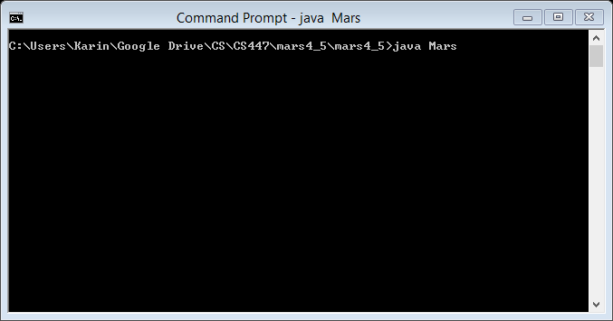
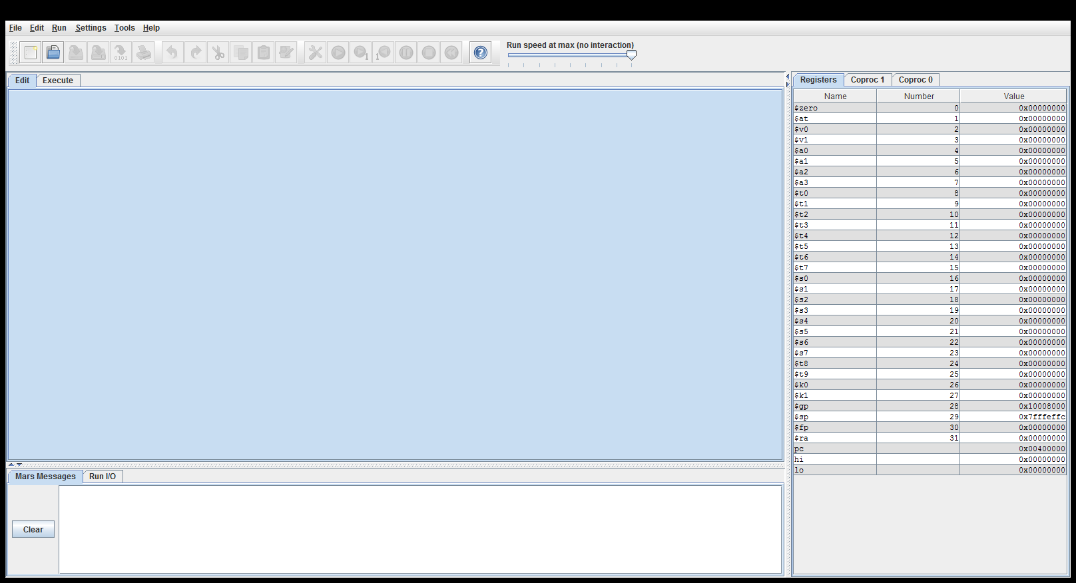
Lab #1: Launching MARS
Please ask for help if you’re having trouble with installation.
MARS should also be present on the lab machines.
It can be opened from the command line:

Slide 8
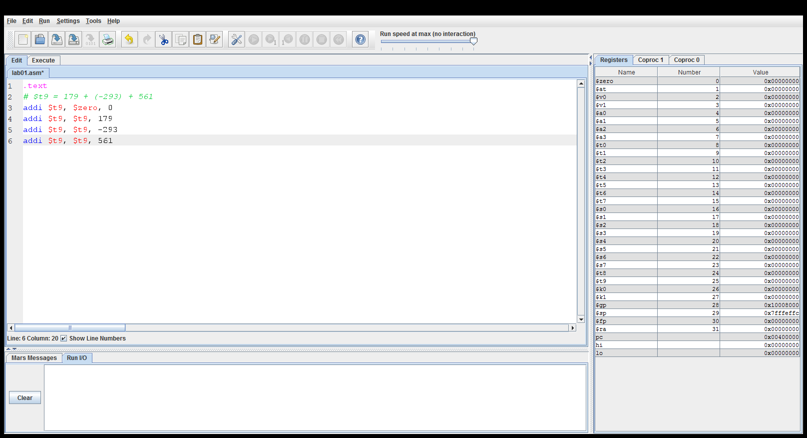
Lab #1: Writing a simple MIPS assembly program
Assemble (convert to machine code)
32-bit registers (not all general purpose)
Execute
Settings → Editor allows increase of font size
.text is a directive that indicates that the following lines are program instructions; see Help menu for the full list of directives (which may be helpful later in the term), and also for a detailed list of MIPS instructions
I/O window will output both useful status messages and anything your program prints to the display (nothing for this lab); note the triangles above the box will hide/unhide this.

Slide 9
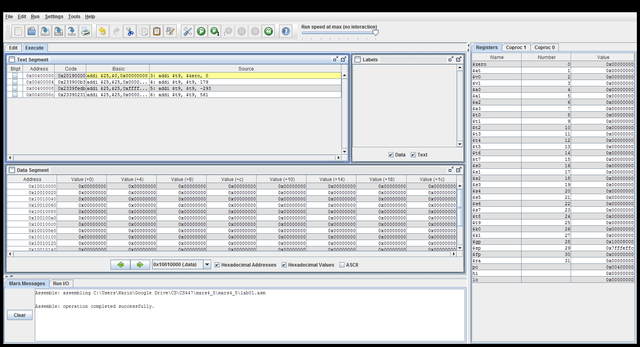
Under the Execute tab (after assembling):
Highlights executed instructions; shows addresses in instruction memory
Breakpoints can be set for debugging
Contents of main memory (more interesting later; this lab only uses registers)
Options that affect the format in which register and memory values are displayed

Slide 10
Installing and using a MARS tool:
MARS tools are Java programs that allow the addition of extra functionality to the simulator.
They often display some kind of graphical output that is conditionalized on the value of a designated register.

Slide 11
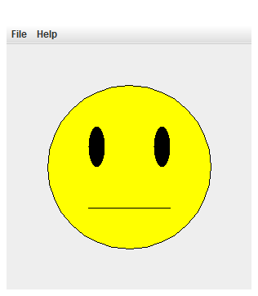
Installing and using a MARS tool:
Extract the PositiveZeroNegative.zip contents (a set of .class files) into the “tools” folder under “mars”.
Relaunch MARS.
Choose the Smiley Face tool from the Tools menu.
The expression of the face will change,
depending on whether $t9 <, >, or = 0.

Slide 12
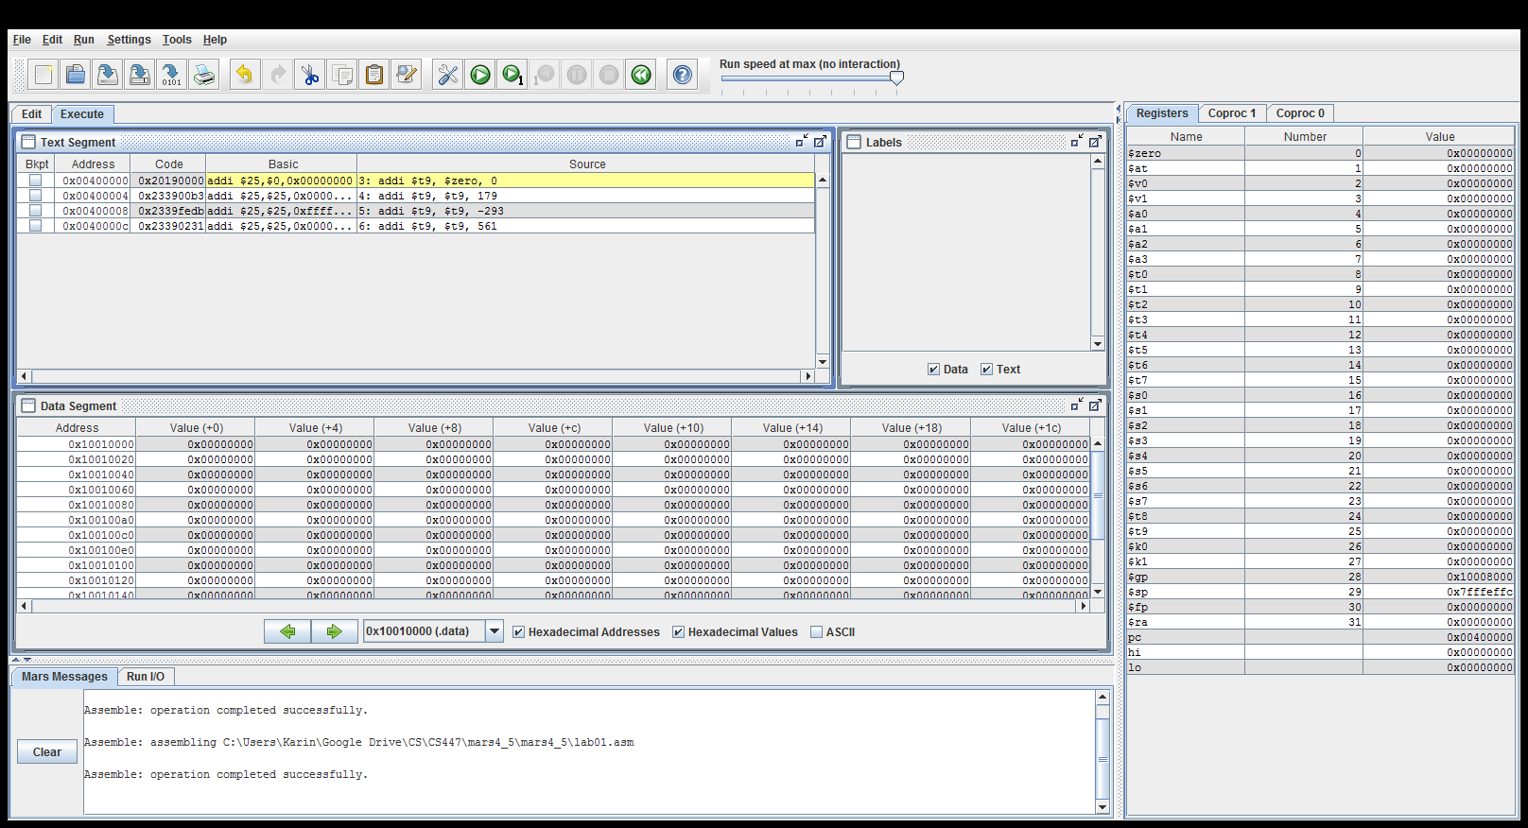
Installing and using a MARS tool:
You can watch the expression change by running the program gradually with the step or slider options.

Slide 13
Installing and using a MARS tool:
Final task:
Add instructions that will automatically loop through the arithmetic program you’ve created.
Add short delays between instructions, so the expression changes can be observed.

Slide 14
To add a loop:
j (“jump”) instructions can be used to create unconditional loops:
top_of_loop: # label for jump target
# arbitrarily named, with : at end
<loop body here>
j top_of_loop
Note: If you want to test this loop before you add the pauses, you might want to use the Step or Slider options. A full speed infinite loop might cause MARS to freeze (requiring a forced exit).

Slide 15
To add the pauses:
To “sleep” in MARS, we will need a system call (i.e., a function beyond the capabilities of the MIPS instruction set).
See the “Syscalls” tab under Help
Typical syscall routine:
Load the syscall’s code number (e.g., by adding) into $v0
Load any required arguments into the specified registers (often $a0, $a1)
Type “syscall”

Slide 16
To add the pauses:
To “sleep” in MARS, we will need a system call (i.e., a function beyond the capabilities of the MIPS instruction set).
See the “Syscalls” tab under Help
Typical syscall routine:
Load the syscall’s code number (e.g., by adding) into $v0
Load any required arguments into the specified registers (often $a0, $a1)
Type “syscall”
For the sleep syscall:

Slide 17
To finish the lab:
Within your loop body, add the sleep syscall lines to pause after each of the instructions within your loop.
You should be able to run at full speed and watch the facial expressions change.

Slide 18
Reminders:
Remember to sign in!
You can get your lab checked off, if you are done.
Submit the lab via Courseweb by the posted deadline, even if you get your lab checked off in class.

