Slide 1
CS447 Recitation #7: 6/27/18
These slides are available online:
https://github.com/kc13/CS447
Agenda for today:
Project #1: Grades will be available sometime next week
Overview of Lab #7
Be sure to access the instructions and lab07.circ on Courseweb.
Be sure to sign in!

Slide 2
Lab #7 overview
Instructions PDF organization:
Pages 1-3:
Background on Logisim’s 7-segment display (p. 1)
Truth table mapping 4-bit binary representations to 8 input bits required for display (p. 2)
Example Karnaugh map relating binary input values to illumination of one display segment (p. 1-3)
Instructions for first part of lab (writing out all the K-maps, p. 3)
Pages 3-5:
Second part of lab: Implementation of the K-maps in the lab07.circ starter file to illuminate two 7-segment displays.

Slide 3
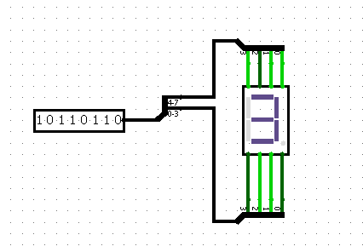
7-segment display
From instructions PDF:
From Logisim:
Binary input to display a specific decimal value ≠ binary representation of that value.
Goal: Design a logic circuit (using Karnaugh maps) to relate 4-digit binary values to 8-bit display inputs.

Slide 4
Truth table
There will be eight Karnaugh maps (one for each display segment, including the decimal point).
For anything > 9, output “E.”

Slide 5
Example of generating the K-map for segment A:
We can start by creating a table with 2-bit Gray Codes on the rows and columns (for the 4-bit inputs):
Remember that only 1 bit can change on each row (swap 2 and 3).
Next, fill in the appropriate “A” segment values for each of the possible 4-bit inputs.

Slide 6
Identify rectangular groupings of 1’s on the table:
Recap of the rules for the rectangles:
Area (i.e., # of enclosed cells) must = a power of 2 (1,2,4,8,16…).
Each enclosed cell must contain a 1.
Each rectangle should be as large as possible.
Rectangles may overlap with each other.
Rectangles may wrap around edges and corners (example below):
1 | 0 | 0 | 1
0 | 0 | 0 | 0
0 | 0 | 0 | 0
1 | 0 | 0 | 1

Slide 7
Read out the Boolean expression from the table:
b3 + b2⌐b1 + b1⌐b0 + ⌐b2b1
Submit the K-maps and expressions as part I of the lab assignment:
This can be done by hand and scanned into a PDF, or prepared as a docx file (xlsx and ppt also OK).
Remember to submit the tables and the corresponding Boolean expressions for all eight output signals (A-H).

Slide 8
Part II: Implement K-maps in Logisim
Open the lab07.circ starter file.
In the “BCD to Seven Segment” circuit, you will see the implementation for the Boolean expression for A.
Expand the input lines, and add the appropriate logic gates to implement the Boolean expressions for B-H (output pins are already provided).
b3 + b2⌐b1 + b1⌐b0 + ⌐b2b1

Slide 9
Part II: Use the K-maps to convert binary inputs to display outputs
You’ll be recreating this image from the handout:
To display 2 decimal numbers,
enter the 4-bit binary representation in the top/bottom
4 bits for the left/right displays:
BCD to Seven Segment subcircuits

Slide 10
Submission
Remember to submit the tables and expressions for the Karnaugh map, in addition to the completed lab07.circ. Please submit these as a single .zip file.
For demos in recitation:
Show the completed tables/expressions.
Show the circuits, and demonstrate that the displays work.
Remember to sign in!

