Slide 1
CS447 Recitation #2: 5/23/18
These slides are available online:
https://github.com/kc13/CS447
Agenda for today:
Review of Lab #2

Slide 2
Office hours
Office: 6150 Sennott Square
Office hours: W 4:30-6:00 pm, F 3:00-5:45 pm

Slide 3
Reminders
Be sure to sign in!
If you do not attend recitation, 50% will be deducted from that week’s lab.
Submit all labs, via Courseweb, by the deadline.
Labs can also be “checked off” in class. However, the lab should still be submitted through Courseweb.
Lab instructions are always on Courseweb. These slides are optional extra material, and do not provide all the details you need to complete the lab.

Slide 4
Lab #2 highlights
Handout organization:
Pages 1-4: Lots of helpful background information and examples
Three major themes: syscalls, jumps/branches, and comparisons
Pages 4-5: Description of the Lab assignment
The “Higher/Lower Game”

Slide 5
Lab #2: Syscalls
Will require interacting with main memory (see next slide)
Syscall code is overwritten
Exclusive upper bound

Slide 6
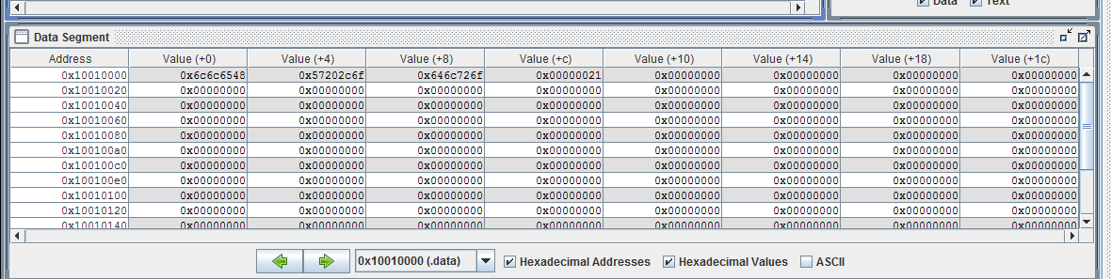
Lab #2: Syscall #4 (print string)
Example use + info from Directives tab:
.data: “Subsequent items stored in Data segment at next available address”
.asciiz “Store the string in the Data segment and add null terminator”

Slide 7
Lab #2: Jumps/Branches
Unconditional jumps: See lab #1
j some_label_name
Label name must end with :

Slide 8
Lab #2: Jumps/Branches
Conditional branches:
Will jump to a label if the stated condition is true.
Example:
bne $s0, $zero, someLabel
bne = branch if not equal
Branch (jump) to someLabel if $s0 ≠ 0
beq = branch if equal

Slide 9
Lab #2: Comparisons, and their use with branches
Set less than: See lecture slides for more info
Example:
slt $t2, $t1, $t0
If $t1 < $t0, set $t2 to 1
Otherwise, set $t2 to 0
To inform a branching decision:
Example:
slt $t2, $t1, $t0
beq $t2, $zero, someLabel
Will branch to “someLabel” when $t1 ≥ $t0

Slide 10
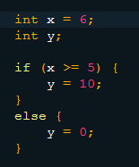
Lab #2: Comparisons/Branches for if/else logic
Java:
MIPS:
What will be the value of $t1 if we stop here?
.text
# using $t0 for x
addi $t0, $zero, 6
# $t2 to hold comparison value
addi $t2, $zero, 5
# $t3: is x < 5?
slt $t3, $t0, $t2
# jump if x < 5
bne $t3, $zero, elseCondition
addi $t1, $zero, 10
j endLabel
These lines will still be executed! MIPS does not jump around labels unless you tell it to jump. This is one of the most common MIPS errors.
Adding a jump/label combination will fix the problem.
elseCondition:
addi $t1, $zero, 0
endLabel:

Slide 11
Lab #2: Higher/Lower Game
General requirements:
Generate a random number between 0-9 (inclusive)
Give the user up to three opportunities to guess the correct number, using the messages provided in the example runs.
Terminate the program when the number is correctly guessed, or after three guesses.

Slide 12
Lab #2: Higher/Lower Game: General organization + tips
There are several text messages to be printed.
These will need to be created in the .data section, using labels and the .asciiz directive.
Tip: To ensure that a line break appears after a message, end the message with “\n” when you specify it in the .data section.

Slide 13
Lab #2: Higher/Lower Game: General organization + tips
At the start of the program, you will need to generate a random number:
First, you will get the system time (syscall 30).
Second, you will use the lower order bits of the system time as a seed to initialize the random number generator (RNG); this is syscall 40.
Any ID # for the RNG is fine.
Note syscall 30 will return the lower order bits in $a0, but syscall 40 will expect this number to be in $a1, because the ID is in $a0.

Slide 14
Lab #2: Higher/Lower Game: General organization + tips
At the start of the program, you will need to generate a random number:
Syscall 42 can be used to generate the random integer.
Be sure to give it the same ID # you assigned to the RNG.
Remember that the upper bound is exclusive (so 10, in this case).

Slide 15
Lab #2: Higher/Lower Game: General organization + tips
The user will need to be presented a game that runs up to three times.
You might consider using the following:
One register to maintain a count of attempts
Jumps and/or branches, and comparison instructions to determine whether the maximum # of attempts has been reached.

Slide 16
Lab #2: Higher/Lower Game: General organization + tips
You will need to both display and read information.
Consider syscalls 1, 4, and 5
Remember that 5 (read integer) will put the input integer into $v0.

Slide 17
Lab #2: Higher/Lower Game: General organization + tips
You will need to display messages that depend on how the user’s number compares to the actual number.
You might consider several labels, comparisons, branches, and jumps for this.
For testing/debugging:
For unknown reasons, the random number you generated may not be visible in the register at the time you input the integer, if you execute at full speed. You may be able to see it if you step through the program.

Slide 18
Lab #2: Higher/Lower Game: General organization + tips
You will need to terminate the program properly.
This can be done with syscall 10.
Final reminder: MIPS will continue to execute the next instruction on the screen (that is, immediately below, at the next memory address) unless you tell it to do otherwise with a jump or branch.

Slide 19
Lab #2: In class check-off
If you are finished, your lab can be checked during recitation.
You will be asked to run it twice, and briefly show your MIPS code.
Remember you must still submit on Courseweb!

