Slide 1
CS449 Lab 6/27/20 and 6/29/20
These slides will be available online:
https://github.com/kc13/CS449
Agenda for today
Review of answers to Cache Tutorial

Slide 2
Cache tutorial
Example:
64 Gi-bits = 2^{log2(64)} x 2³⁰ = 2³⁶

Slide 3
Cache tutorial
Example:
2³⁴ birds = 2⁴ x 2³⁰ = 16 Gi-birds

Slide 4
Cache tutorial – Accessing a cache (from the lecture slides)
The cache is divided into sets, sets are divided into lines, each line contains 1 block, and blocks contain bytes.

Slide 5
Cache tutorial – Accessing a cache (from the lecture slides)
The number of sets per cache, lines per set, and bytes per block is related to the bit width of the address used to retrieve data from the cache. An address bit width of m bits can accommodate 2^{m} unique addresses.

Slide 6
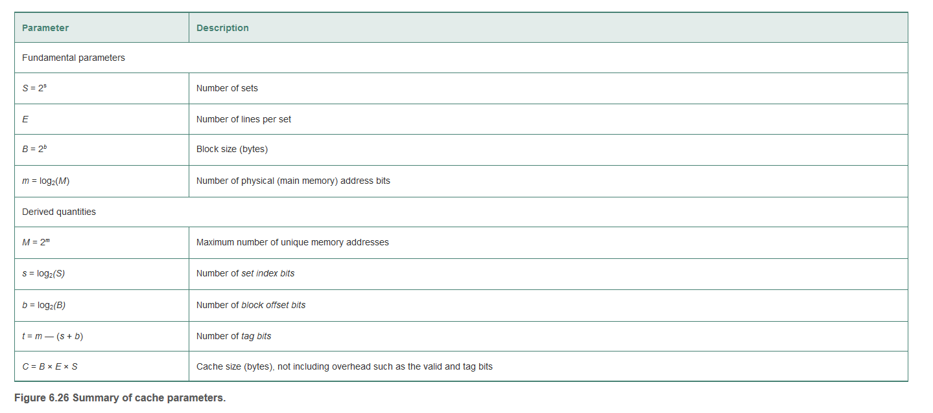
Cache tutorial – textbook table

Slide 7
Returning to the cache tutorial questions
Index bits = log2(# sets) = 4
Offset bits = log2(# bytes per block) = 2
Tag bits = address width m - index bits s - offset bits b = 6

Slide 8
Returning to the cache tutorial questions
tag: 1E; set: B, offset: 0: The tag matches, but the block is not valid → Miss/no data
tag: 0; set: 9, offset: 0: Tag matches, block is valid, return byte B0
tag: 26; set: 7, offset: 3: Not valid and no data

Slide 9
Cache tutorial page 2
Index bits = log2(# sets) = 3
Offset bits = log2(# bytes per block) = 2
Tag bits = address width m - index bits s - offset bits b = 7

Slide 10
Cache tutorial page 2
tag: 21; set: 5, offset: 1: Valid, tag matches, return byte B1
tag: 1C; set: 2, offset: 0: Neither of the two tags match
tag: 6; set: 4, offset: 3: Tag matches, but not valid

Slide 11
Cache tutorial page 2
Index bits = 0 (fully associative – there is only 1 set)
Offset bits = log2(# bytes per block) = 2
Tag bits = address width m - index bits s - offset bits b = 10

Slide 12
Cache tutorial page 2
tag: 77; set: 0, offset: 1: Tag matches, valid, return byte B1
tag: 1C6; set: 0, offset: 1: Tag matches, valid, return byte B1
tag: AA; set: 0, offset: 2: None of the tags match AA

Slide 13
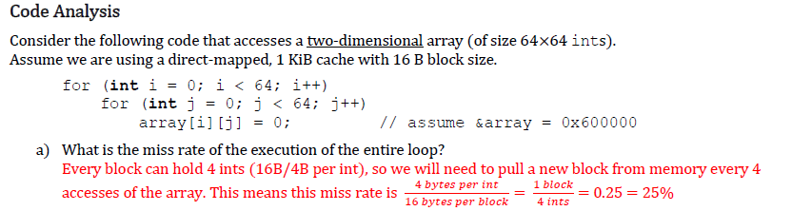
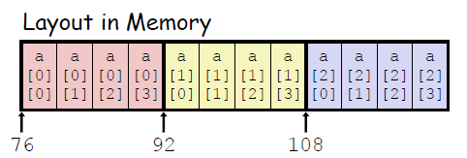
Cache tutorial page 2 – Code analysis section
Assume cache starts empty
Remember how 2D arrays are laid out in memory (image from lecture slides, for a 3 x 4 array). The miss rate would be higher if we iterated through rows in each column.
Miss rate = #misses/#references, we’ll miss once for every 4 ints we read in

Slide 14
Cache tutorial page 2 – Code analysis section
See comments on loop switching on previous slide
Switching to a narrower/wider datatype would imply that more/fewer values would fit within each block, implying a lower/higher miss rate.
Linked lists would make the situation less predictable (memory locations might not be contiguous…)

Slide 15
Cache tutorial pages 2-3 – Code analysis section
Summary: A larger cache won’t improve the miss rate, since we need to fetch each new block regardless.

Slide 16
Cache tutorial pages 2-3 – Code analysis section
Summary: Since we’re moving through contiguous locations in memory, the new blocks will map onto different sets (switching to 2-way associative would make more of a difference if we were frequently pulling in blocks with conflicting set indices).

Slide 17
Cache tutorial pages 2-3 – Code analysis section
Summary: Larger blocks → less frequent fetches from lower levels of memory hierarchy → lower miss rate.

Slide 18
Cache tutorial pages 2-3 – Code analysis section

Slide 19
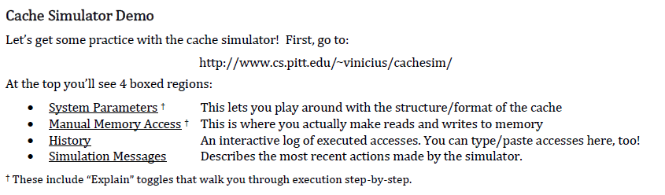
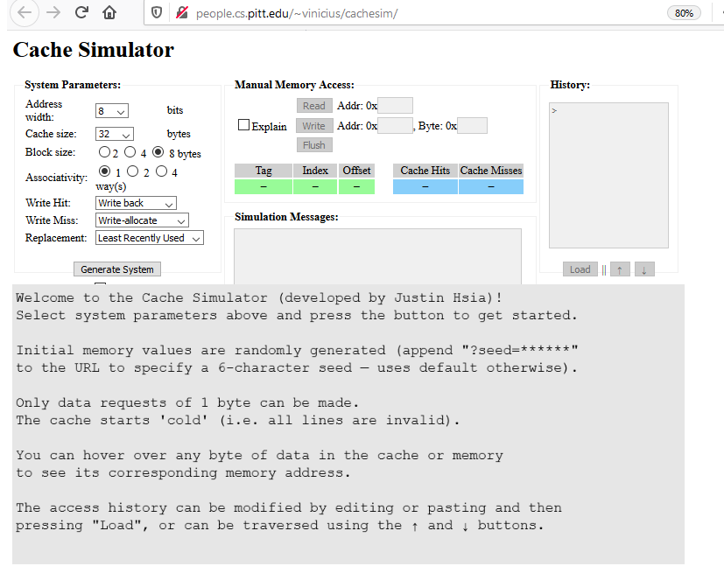
Cache tutorial page 4

Slide 20
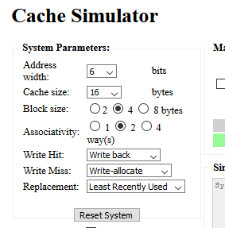
Cache tutorial page 4
Address Width of 6 bits implies largest address will be 63 (0011 1111). Cache size formula is C = block size * associativity * # of sets, so here # of sets = 16/8 = 2.
This can be confirmed by clicking “Generate System.”

Slide 21
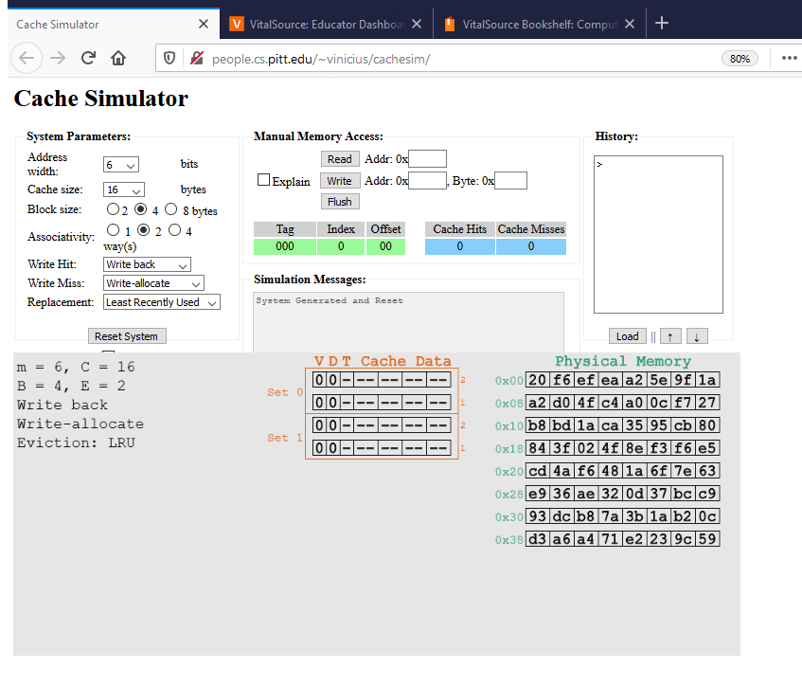
Cache tutorial page 4
To the left: view of simulator before submitting the read. How to predict for (b)?
0x2A as 6-bit binary =
101010
2 bits for offset and 1 bit for set implies 3 bits for tag.
First 3 bits = 101 (answer to ii)
Set bit = 0 (answer to (i))
Blocks are aligned at multiples of 4 bytes; the byte at address 0x2A falls within the block spanned by bytes 0x28-0x2B.

Slide 22
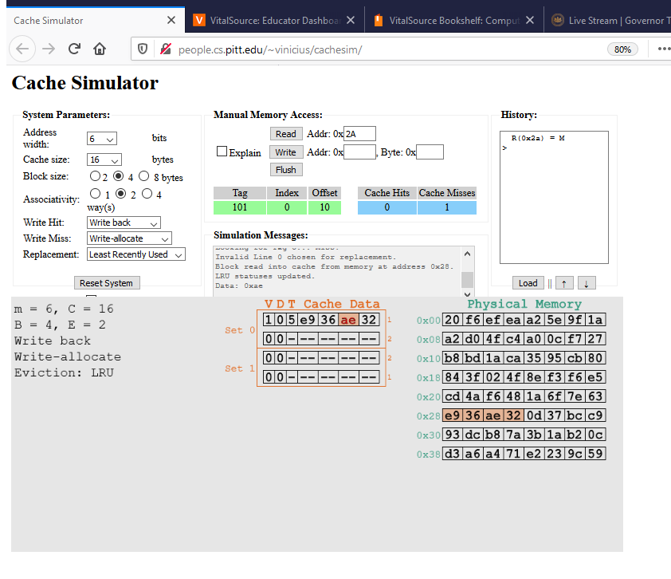
Cache tutorial page 4
To the left: view of simulator after submitting the read of 0x2A.
How do we make the predictions for (c)(i) and (ii)?
Again, just break down the address into six bit binary:
0x1B = 011011
Tag bits are 011, set = 0

Slide 23
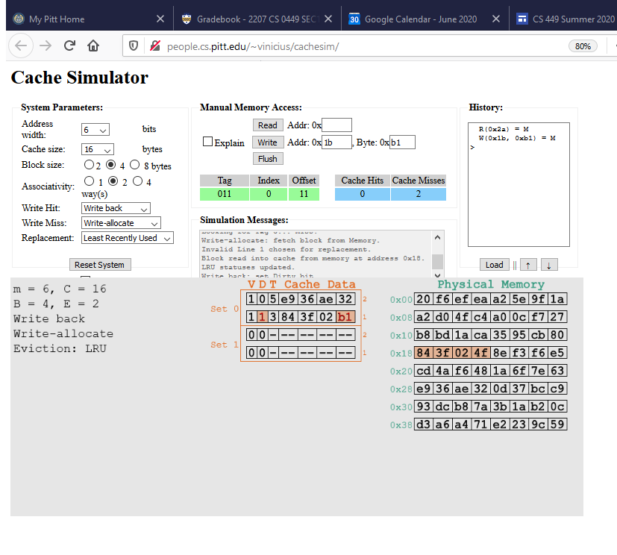
Cache tutorial page 4
To the left: view of simulator after submitting the write of 0xb1 to 0x1b.
The dirty bit indicates that we have only written the new value in the cache memory, but not yet in main memory. The value will be written to main memory when the block is evicted. Note that the writing policies are set to write-allocate for misses and write back for hits.

Slide 24
Cache tutorial page 4
How do we make the predictions for (d)?
Address is 0b000001
Tag bits = 000, set = 0.
Set 0 is full, one line will need to be replaced (so yes, conflict).
The read from (b) will be evicted (note LRU is our replacement policy).

Slide 25
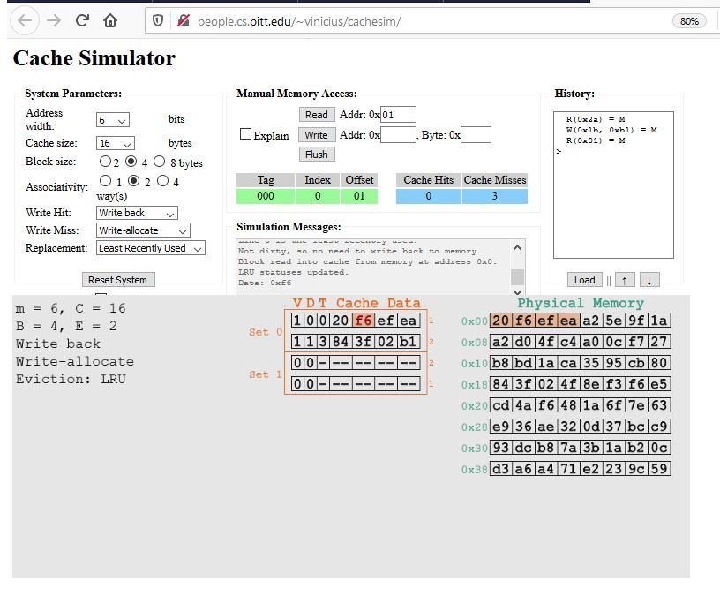
Cache tutorial page 4
To the left: view of simulator after reading from 0x01.
How do we make the predictions for (e)?
0x1C = 011100
Tag = 011, set = 1
There are empty lines, so, no conflict.

Slide 26
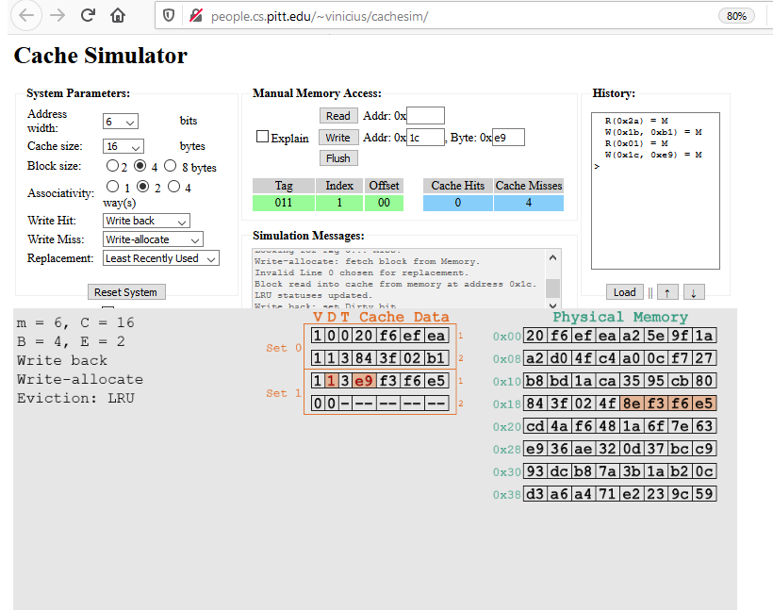
Cache tutorial page 4
To the left: view of simulator after writing to 0x1c.

Slide 27
Cache tutorial page 5
Verifying these predictions follows the same process as shown on the previous slides – just pull out the set and tag bits and determine if the data are present in the cache.

Slide 28
Cache tutorial page 5

Slide 29
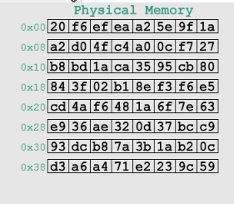
Cache tutorial page 5
We have performed a write to 0x03 that has not yet been written to memory (0xff vs. 0xea) and writes to 0x1c and 0x1d (e9 vs 8e and 00 vs f3). Note the dirty bit is on for both blocks. The write back/write allocate policies imply that writes will only occur upon eviction.

Slide 30
Questions?

