Slide 1
CS449 Lab 7/21/20 and 7/23/20
These slides will be available online:
https://github.com/kc13/CS449
Agenda for today
Overview of the Malloc Lab
Relevant material from the lecture slides
Lab handout
Please see Github for some additional slides from the professor – these might be covered in the future if time permits.

Slide 2
Memory allocation
The memory returned to malloc calls comes from the heap region of the virtual memory space. The heap is bounded from above by the memory address indicated by brk (which can be moved).

Slide 3
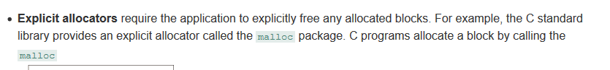
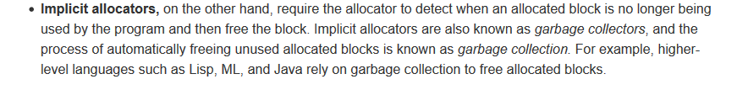
Memory allocation
Summary: Memory is allocated in units of blocks. See book comments on explicit/implicit difference:

Slide 4
Memory allocation
Reminders: (1) Malloc will return NULL if it cannot return a block of >= the requested size that is aligned on a 16-byte boundary (i.e, least 4 bits / 1 hex value should be 0). (2) sbrk is a function that can be used to adjust brk.

Slide 5
Memory allocation
Example reviewing malloc/free use…

Slide 6
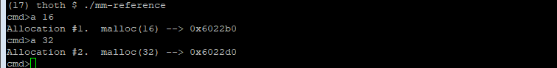
Memory allocation
Lab handout refers to this
Your lab will require a heap that can be resized
Makes use of an implicit free list; you will use an explicit free list (see later slides).
Same as stdlib implementation described on earlier slide – 16 byte alignment, last hex digit zero for the start address for the allocated region

Slide 7
Memory allocation

Slide 8
Memory allocation (skipping slides 11-16)
These are good examples of issues that may come up in your implementation for this lab.

Slide 9
Memory allocation
Free just takes a pointer, not a size. To keep track of how much was allocated, you can use the word in the heap directly preceding the address you returned with malloc, and save within that word the number of bytes allocated. You can also make similar use of the first word in each unallocated block of words, and the same word can also be used to store info about whether the memory region is free or not (shown on later slides)

Slide 10
Memory allocation – jumping to slide 49
← Used by mm-reference.c
← You must implement this
In the lab, you will use an explicit free list: Each free block will contain a pointer to the next free block and also the preceding free block (that is, the pointers form a doubly-linked list…back pointers do not appear to be depicted in this slide). Also note that next/previous should be thought of as part of a logical sequence here; the memory addresses need not be sequential (see later slide).

Slide 11
Memory allocation
This slide shows how the region of the free blocks that follows the initial size/usage information can be used to store the pointers to the next and the preceding free blocks. This illustration also depicts a “boundary/footer tag”: the replication of the size/usage info at a word following the allocatable block. (Although it is shown to be optional, it is recommended that you use footer tags for this lab.)

Slide 12
Memory allocation
Summary: You can choose whether you want the path of pointers to “loop around” the ends, or whether to just use NULL pointers at the end.
The “fit” terms refer to methods for finding a free block to allocate (see slides 26-27 in lecture).

Slide 13
Memory allocation
Recapping the point about logical vs. physical order.

Slide 14
Memory allocation
Depiction of free list after splitting off a part of a block to be allocated, and then later allocating the other chunk of that.

Slide 15
Memory allocation
You will use LIFO for the lab.

Slide 16
Memory allocation – slides 56-60 summary
Review these slides for a reminder of how coalescing is implemented when an explicit free list + LIFO is used.
Coalescing = joining together contiguous free blocks into a single free block
Requires a lot of pointer manipulation (and sizes will need to be updated).

Slide 17
Malloc lab
Utilization: Maximizing the ratio of allocated/total memory -- degraded through fragmentation.
Throughput: speed of processing memory requests

Slide 18
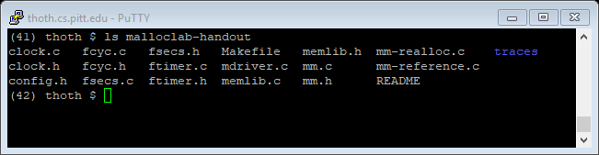
Malloc lab

Slide 19
Malloc lab
Repeating from before: There is a reference implementation that uses implicit free lists; you should use an explicit free list + LIFO.
You will complete functions in the mm.c file.

Slide 20
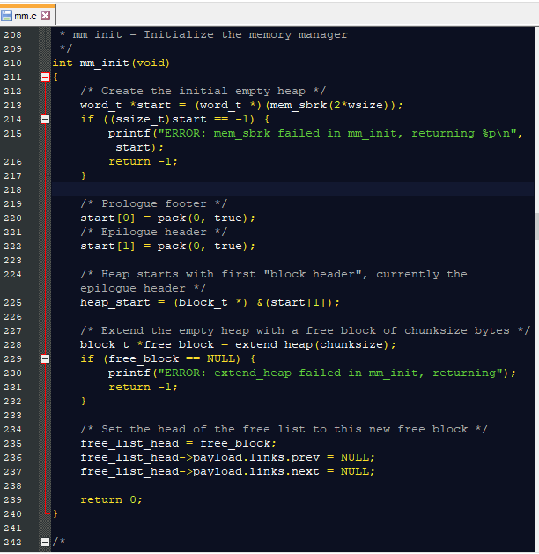
Malloc lab
Initial allocation is to a region of 2* the word size (defined on lines 90-93).
Note that by default this is being set up with linear pointers (no loop around).

Slide 21
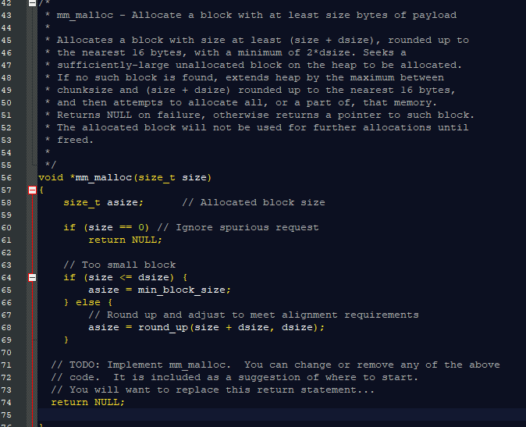
Malloc lab
Allocated region should also be aligned along 8-byte intervals (so, last 3 bits of memory address should be 0 – see later page).
Note that this function is partially completed, but you need to finish it.

Slide 22
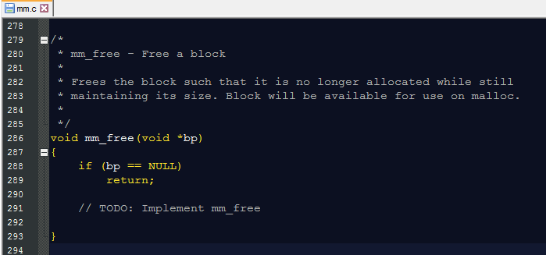
Malloc lab
The majority of this has yet to be implemented. The behavior shares a lot in common with the free function from stdlib.c.

Slide 23
Malloc lab
More on the performance evaluation in a later section.
Note this paragraph was updated on 7/20 (it previously said you needed to do 16-byte alignment, but later pages refer to 8-byte alignment).

Slide 24
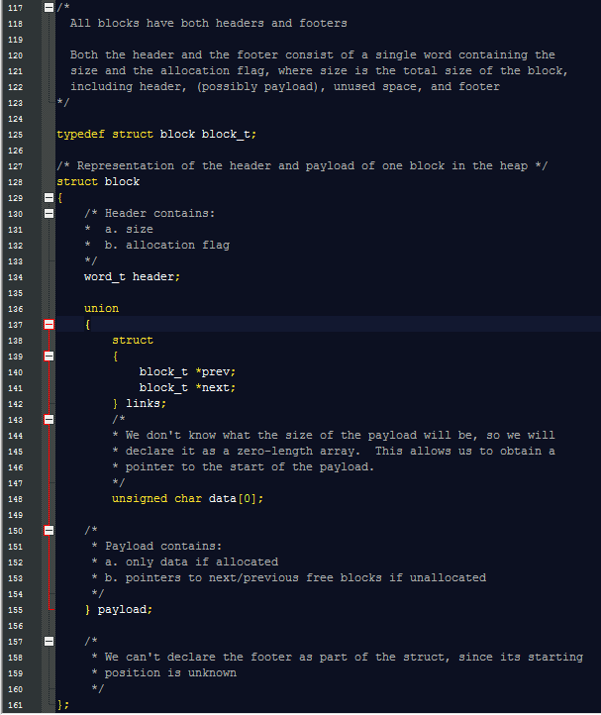
Malloc lab
← Note the block_t struct does not include the footer.

Slide 25
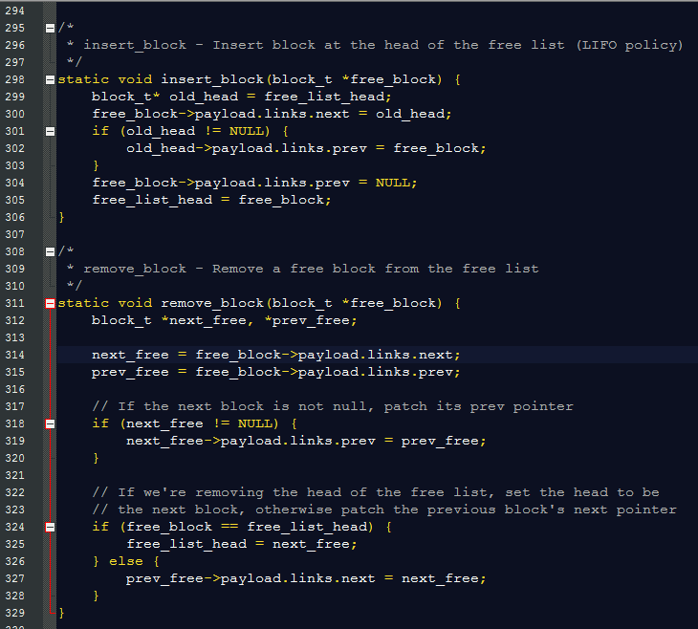
Malloc lab

Slide 26
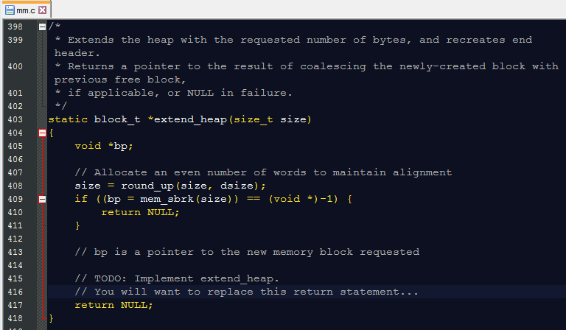
Malloc lab
mm_init might be a useful reference for this. Note the epilogue header is a reserved word that marks the end of the memory allocator’s available heap region (see also diagram on lines 34-40).

Slide 27
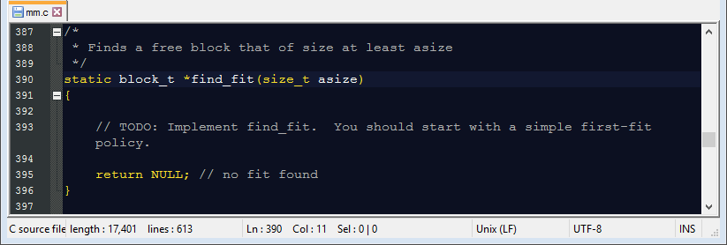
Malloc lab

Slide 28
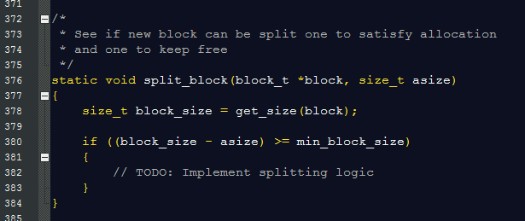
Malloc lab
Instructions/comments seem to imply that this not only checks if the block can be split, but does perform the split, with appropriate modifications to the free list.

Slide 29
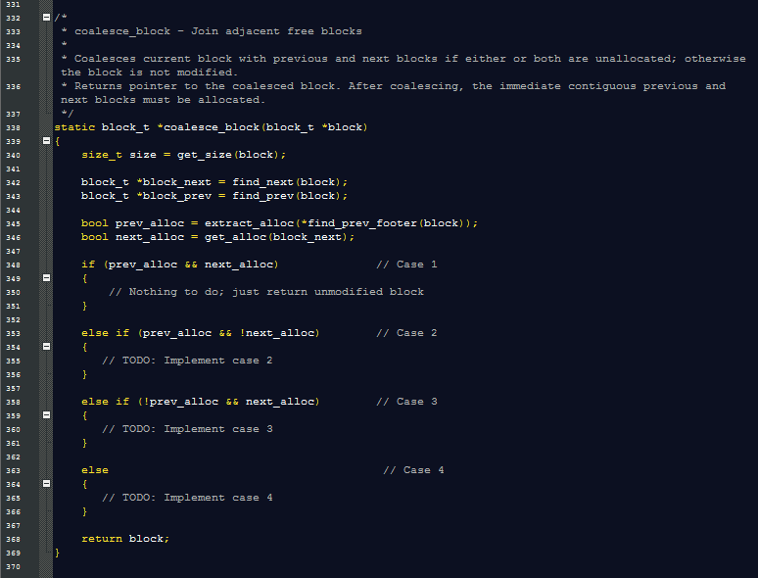
Malloc lab

Slide 30
Malloc lab
Summary: (1) Some suggestions are given for optional ways to break apart the larger task of building this full assignment, (2) you are provided with helper functions, including one function that will display the heap’s contents (for debugging).

Slide 31
Malloc lab
See example of mem_sbrk usage in mm_init..

Slide 32
Malloc lab
Note: In the traces directory, type wc * to get information about the size of each trace file (first column is # of lines). The shortest files might be the most useful for initial testing.

Slide 33
Malloc lab
Driver program options…

Slide 34
Malloc lab

Slide 35
Malloc lab

Slide 36
Malloc lab

Slide 37
Malloc lab (skipping sections 11-12)
Also note the comments at the top of mm.c
You might also consider creating your own trace files…

Slide 38
Malloc lab
See the final section for an extra credit opportunity.
Questions?

