Slide 1
CS449 Lab 6/23/20 and 6/25/20
These slides will be available online:
https://github.com/kc13/CS449
Agenda for today
Overview of the Attack Lab

Slide 2
Attack Lab

Slide 3
Attack Lab

Slide 4
Attack Lab

Slide 5
Attack Lab – review of buffer overflow slides from lecture (3-20)

Slide 6
Attack Lab

Slide 7
Attack Lab
→ Input string is short enough; stack contents are not disrupted – program returns as expected.

Slide 8
Attack Lab

Slide 9
Attack Lab
Remember little endian flips the bytes within each 32-bit word.

Slide 10
Attack Lab

Slide 11
Attack Lab
In other words, you want to try to modify the return address.

Slide 12
Attack Lab

Slide 13
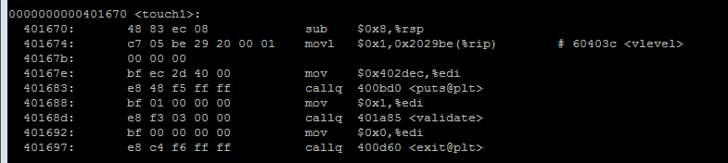
Attack Lab
Instruction address to target

Slide 14
Attack Lab

Slide 15
Attack Lab
You might also find the unix program ‘od’ helpful (with -h flag)

Slide 16
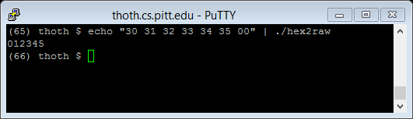
Attack Lab
hex2raw will take a series of space-delimited bytes and convert it to the corresponding string representation, assuming ASCII formatting

Slide 17
Attack Lab
All the different options for using hex2raw along with ctarget…

Slide 18
Attack Lab - tools for generating machine code

Slide 19
Attack Lab - tools for generating machine code

