Slide 1
CS449 Lab 5/19/20 and 5/21/20
These slides will be available online:
https://github.com/kc13/CS449
Agenda for today
Administrative updates
Review of Data Representation worksheet
Overview of Lab #1

Slide 2
Office hours
Zoom URL:
https://pitt.zoom.us/my/kmc51
Meeting ID # 8361144966
This is the same as what is used for the recitations.
These will be used for both general questions and “check-off” meetings (see course website: https://sites.google.com/view/cs449su20/home)
I will send out an email in the next 24 hours with information on times and how to reserve time slots. If you’d like to complete the Doodle poll please do so ASAP: https://doodle.com/poll/za9d9akdem9w9qsm

Slide 3
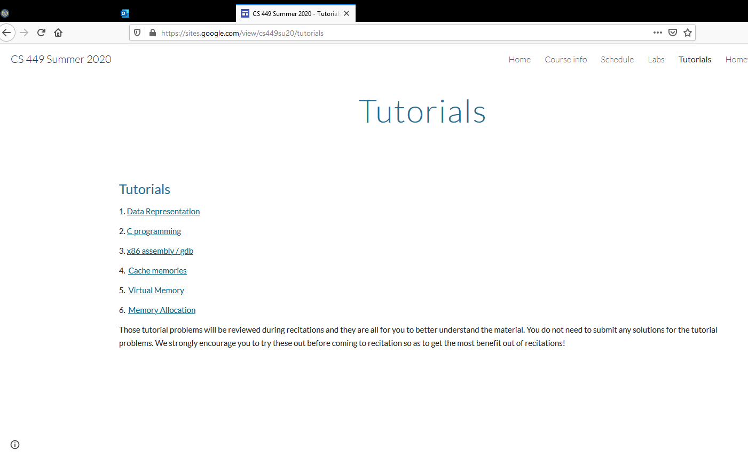
Review of Data Representation worksheet

Slide 4
Review of Data Representation worksheet
It can be very helpful to memorize this info, and also to memorize the powers of 2 up to at least 2⁸ (=256).

Slide 5
Review of Data Representation worksheet: base conversion
Note: We can assume that these are unsigned ints, or that they are signed ints and all bits that are not shown (to fill in sizeof() number of bytes for the datatype) are 0s.

Slide 6
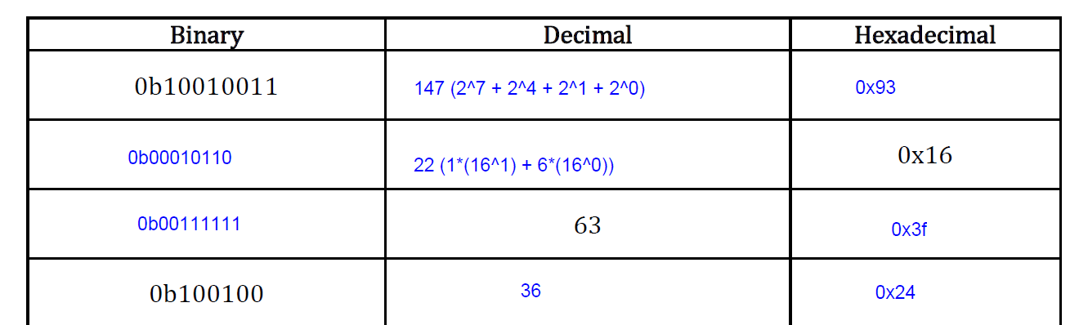
Review of Data Representation worksheet: first 4 rows
Note: You can check your work using online calculators and/or software (e.g., Matlab).

Slide 7
Review of Data Representation worksheet: final 4 rows

Slide 8
C bitwise operators

Slide 9
C bitwise operators

Slide 10
Practice with bitwise operators

Slide 11
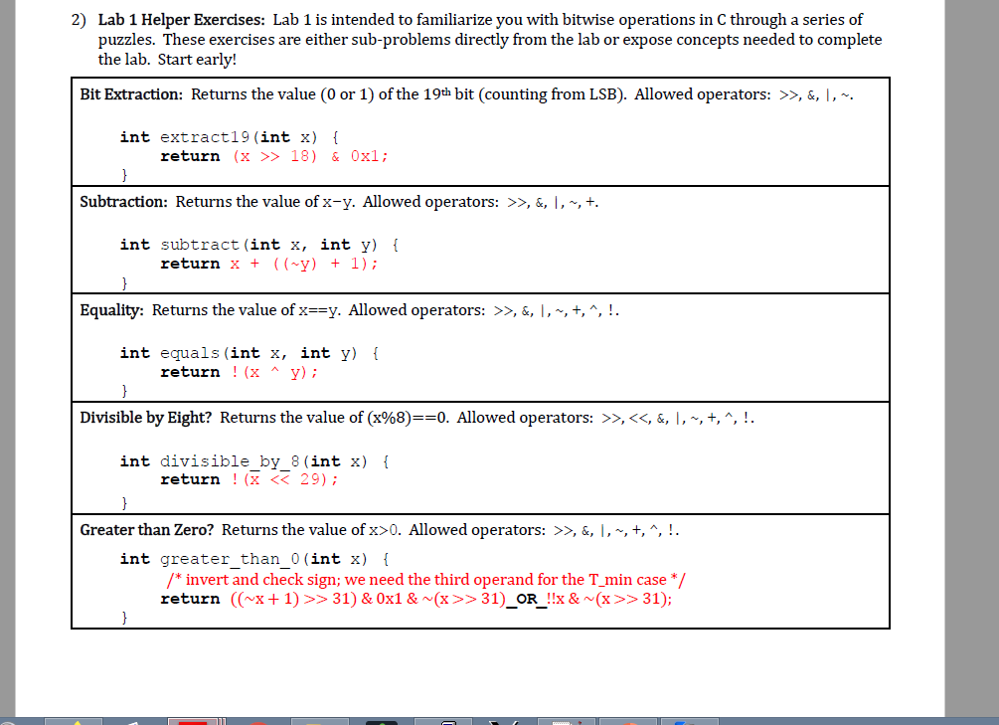
Practice with bitwise operators (other answers might work also)
Note: I made a mistake in the 5/19 video in saying !! was a typo.

Slide 12
Practice with pointers

Slide 13
Practice with pointers

Slide 14
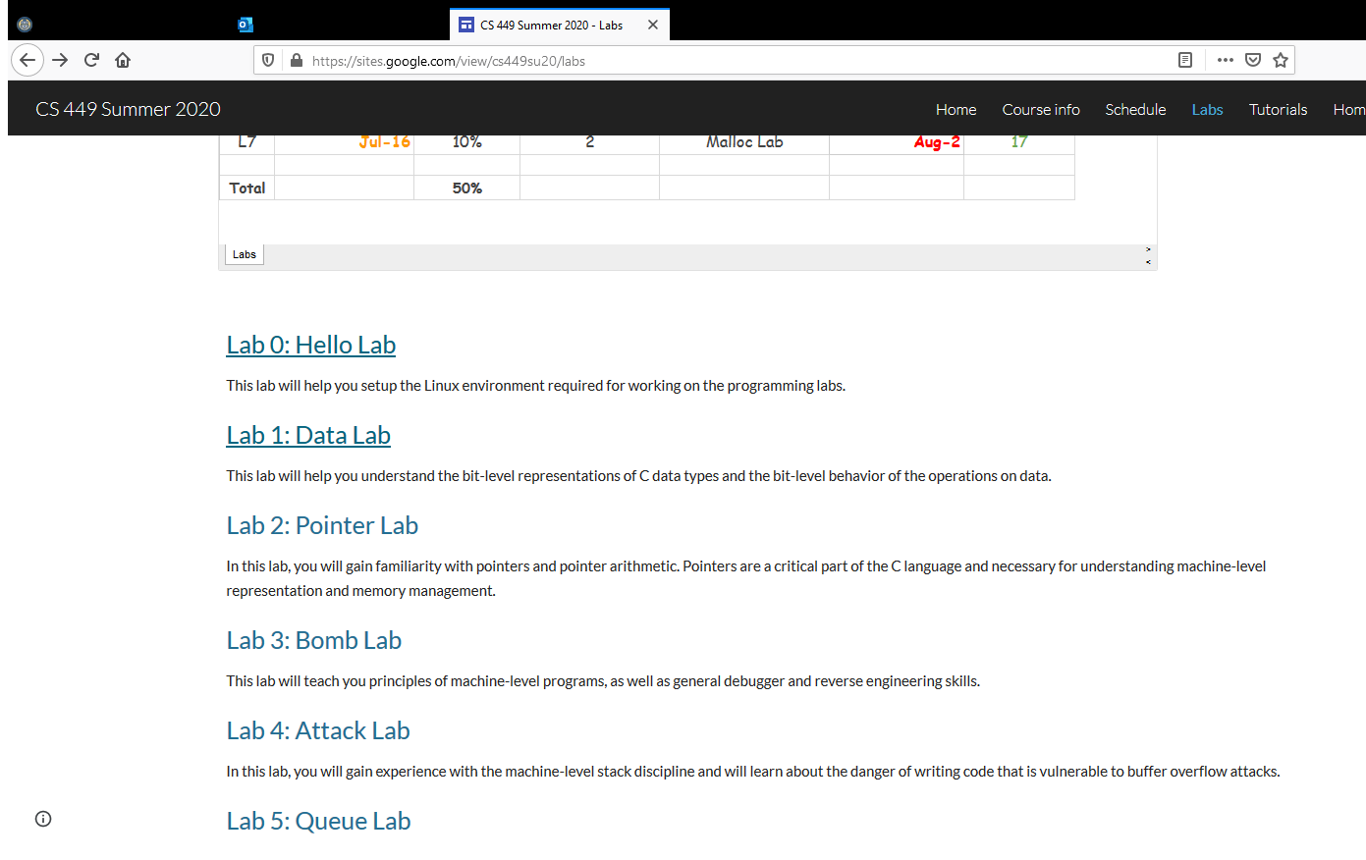
Lab #1

Slide 15
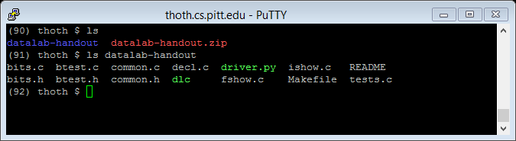
Lab #1 (be sure to also review comments in code)

Slide 16
Lab #1 page 2
Some of these rules do not apply to floats (see next page).

Slide 17
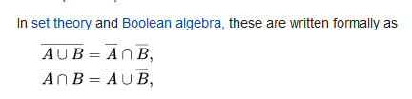
Lab #1 page 2
Reminder of DeMorgan’s law, from Wikipedia:

Slide 18
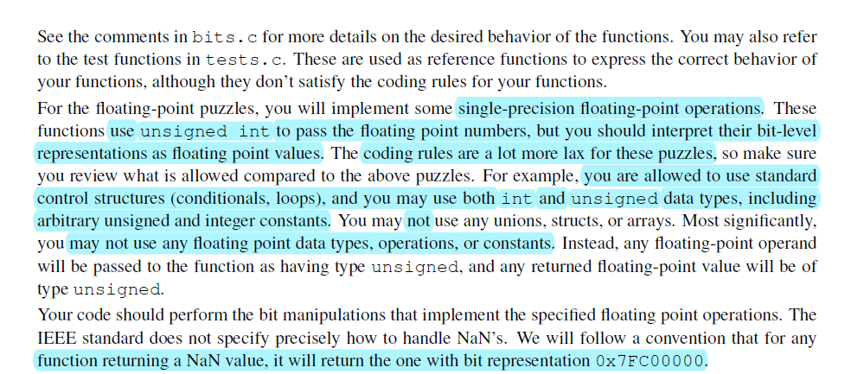
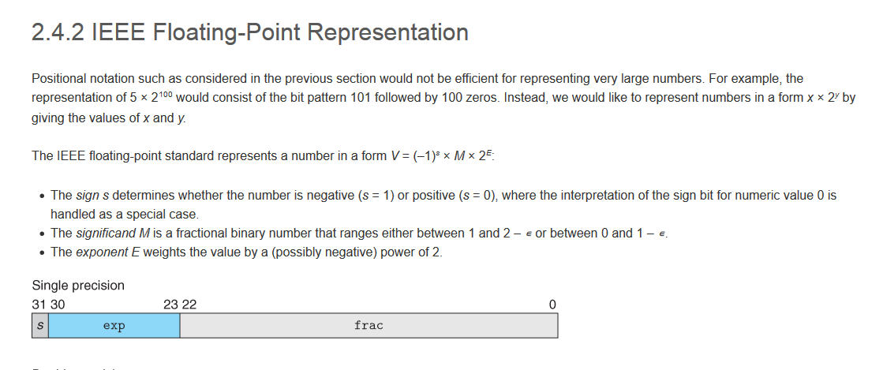
Lab #1 page 3
From the textbook:

Slide 19
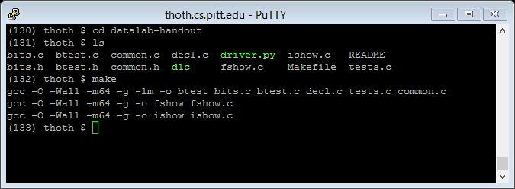
Lab #1 page 3

Slide 20
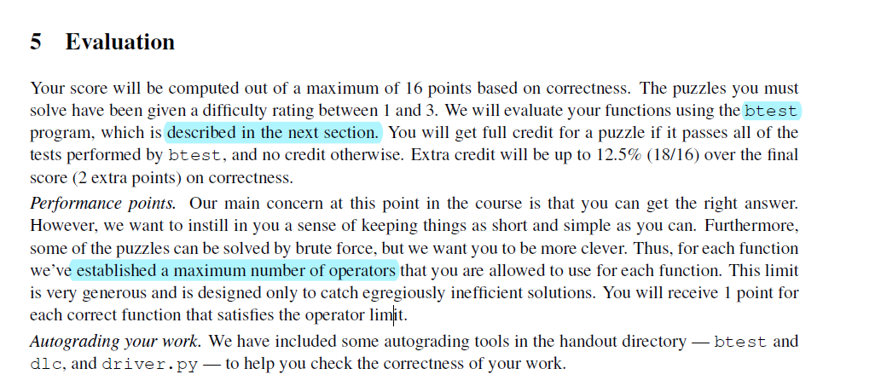
Lab #1 page 4

Slide 21
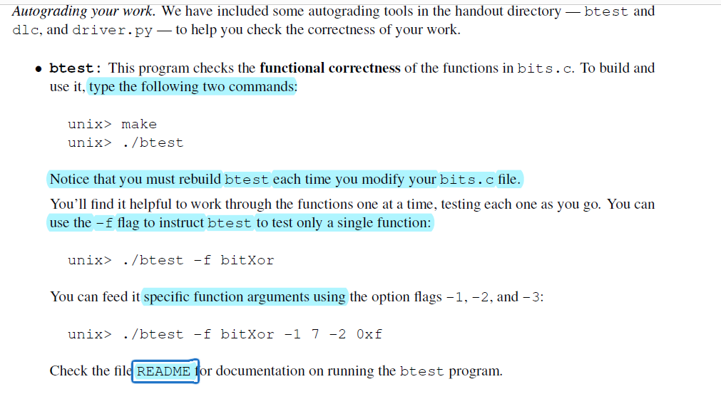
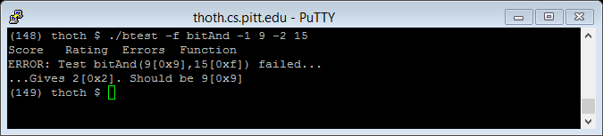
Lab #1
Above: another example of running btest

Slide 22
Lab #1

Slide 23
Lab #1

Slide 24
Lab #1

Slide 25
Lab #1
In short, within {}, declare your *all* your variables before making use of them, to get dlc to accept the code.

Slide 26
Lab #1
Section 7 talks about how GDB might be helpful as you work through this.

Slide 27
Lab #1

Slide 28
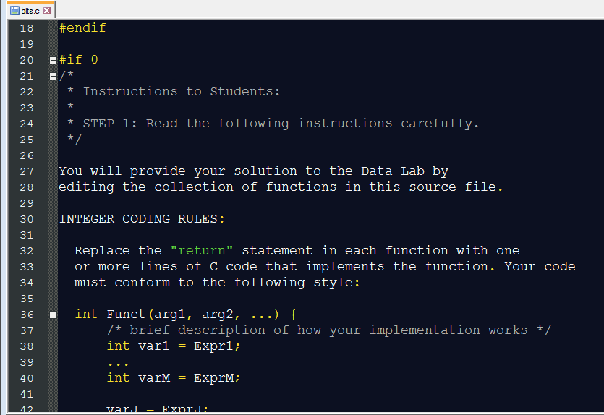
A brief initial look at bits.c
Be sure to read the instructions starting on line 22!

Slide 29
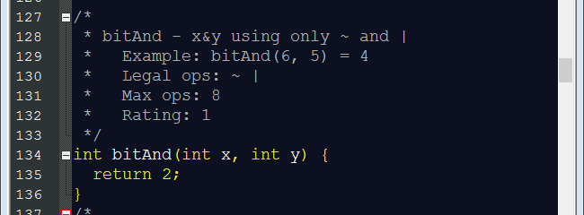
A brief initial look at bits.c
Also make note of the instructions above each function, and the placeholder return value (which will obviously need to be replaced…)
Also be sure to read the README file!

Slide 30
Questions?

