Slide 1
CS449 Lab 6/16/20 and 6/18/20
These slides will be available online:
https://github.com/kc13/CS449
Agenda for today
Continued discussion of bomb lab (phase 1 specifically)

Slide 2
Side note: Some midterm topics:
•Data Representation –Bit-wise operations, 2’s complement, Floating point, Endianness •C Programming –Pointers, Arrays, Strings, Memory Management •Machine-level Representation (x86-64) –Assembly Basics, Control Flow, Calling Conventions, Buffer Overflow •Executables –Compilers, Assemblers, Linkers, Loaders

Slide 3
Bomb lab revisited: A more detailed look at phase 1.
A few comments:
Some hints along these lines were already provided on pages 5-6 of the bomb lab instructions.
These slides will illustrate the process of reasoning through phase 1 in more detail. They also may (hopefully) provide a little more information about x86 in general.
Note that this is simply an illustration with one example bomb – no guarantees may be made regarding how things will work with the bomb you download!

Slide 4
A few general tips:
Taking notes as you work through this may indeed be very, very helpful. It may also help to paste or otherwise output different snippets of assembly code into text files.
As stressed in last week’s slides, it is a good precautionary measure to set a breakpoint at explode_bomb (‘break explode_bomb’). Also note that:
The breakpoint just ensures that gdb will pause at the top of the explode_bomb function. If you continue stepping past this breakpoint, the bomb will explode and this will be registered in the scoreboard (even though you’re running in gdb).
If you end up at explode_bomb, you have various options (restarting execution with ‘run’ or ‘start’, quitting gdb with ‘quit’, etc…).

Slide 5
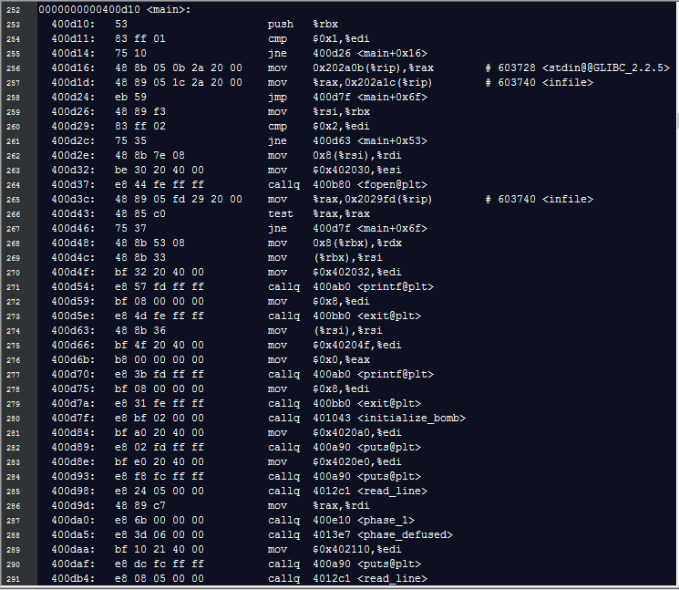
Taking a look at the main method in the objdump -d output
Note call to phase_1, preceded by call to read_line and placement of a return value in $rdi (first argument register). This is going to be a pointer to the user’s string.

Slide 6
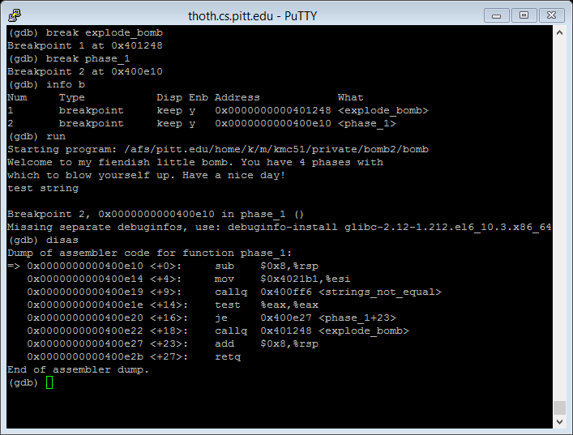
Going into gdb + setting some breakpoints + inspecting contents of phase_1 function
Note call to strings_not_equal, preceded by placement of another string pointer into $esi (second argument register).
Tip: You can use ctrl-L to clear the screen in gdb.

Slide 7
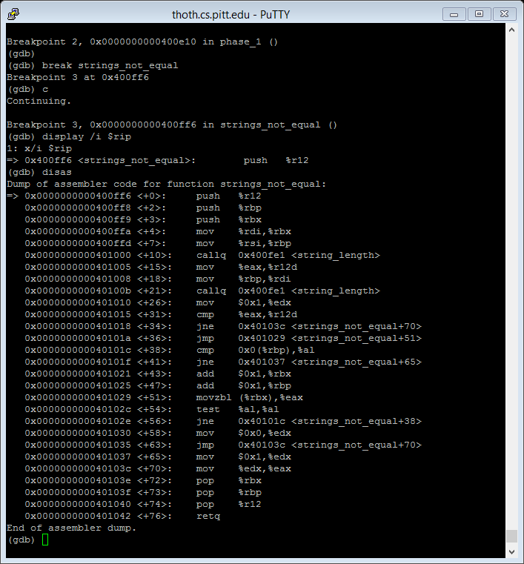
Further exploration of strings_not_equal
This starts with backing up some values on the stack (remember calling convention) and making some copies between registers, followed by some calls to string_length.

Slide 8
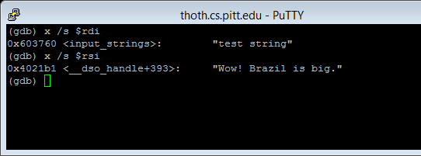
Further exploration of strings_not_equal
Repeat from last week: We can inspect the contents of the argument registers $rdi and $rsi. The /s argument will treat their contents as string pointers when formatting the output.
We see the input string, and another string which looks like it might be a candidate for the key to defuse phase_1.

Slide 9
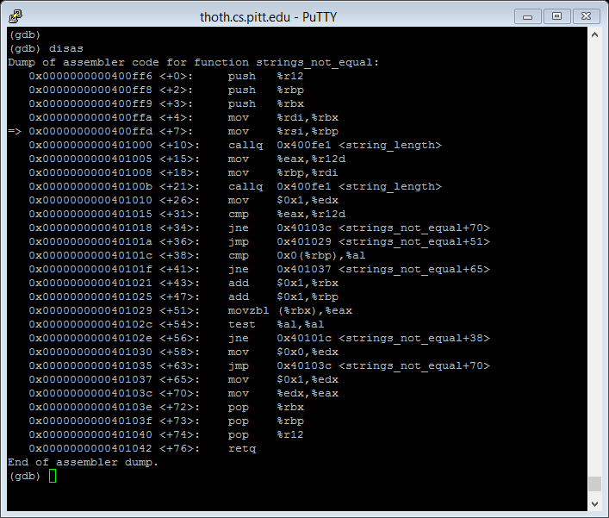
Further exploration of strings_not_equal
Returning to our instructions for strings_not_equal: We might hypothesize that string_length computes the number of characters in whatever is passed through it in $rdi (first argument register).

Slide 10
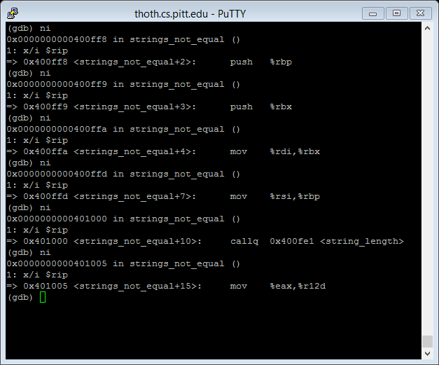
Further exploration of strings_not_equal
Alternative to using breakpoints: We can check this out by using ni to step through the instructions *without* going into the individual string_length instructions (use si if you do want to step through individual instructions of called functions also…)

Slide 11
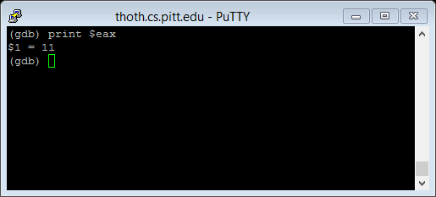
Further exploration of strings_not_equal
Now let’s take a look at what is in $eax (remember $rdi contained “test string”). This is the return value, which will be copied to $r12d.
This does indeed look like the # of characters in the string passed in through $rdi.

Slide 12
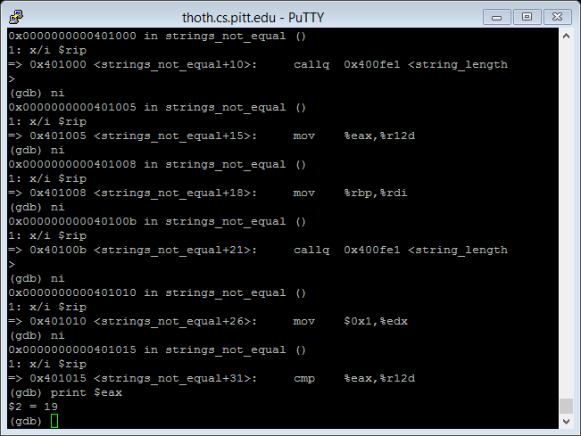
Further exploration of strings_not_equal
We can repeat the process with the next call to string_length. Note now the “Wow! Brazil is big.” string is the one passed through $rdi. 19 is what we would expect.
The mov $0x1, $edx line will take on more significance later.

Slide 13
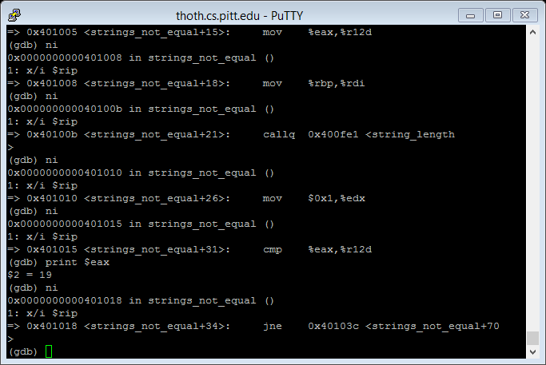
Further exploration of strings_not_equal
The cmp instruction will compare the values in $eax (19) and in $r12d (11). If the values are equal, then the zero flag (ZF) will be set to 1, otherwise it will be set to 0.

Slide 14
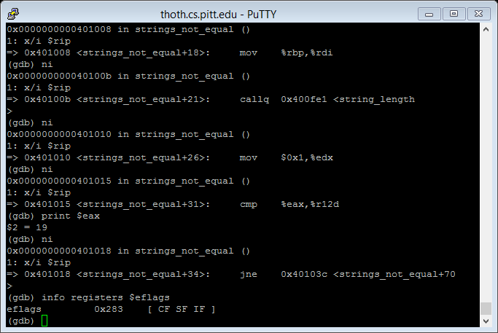
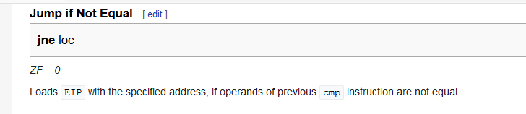
Further exploration of strings_not_equal
We can confirm that the zero flag is not set (!= 1) by typing ‘info registers $eflags’. If it were set, we would see a ‘ZF’ in this list.
The jne line will branch to the indicated instruction address (ref: https://en.wikibooks.org/wiki/X86_Assembly/Control_Flow#Jump_if_Not_Equal)

Slide 15
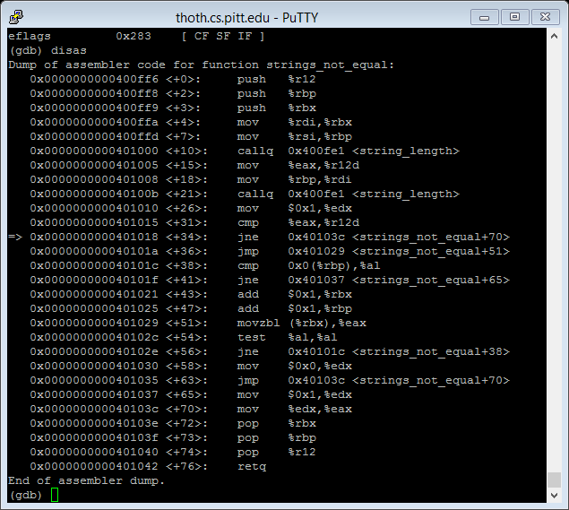
Further exploration of strings_not_equal
The branch to the +70 line is bad news – it means this function will return with an $eax value of 1 (see later slides…this triggers an explosion).
If the values *had* been equal, then they would have progressed to the unconditional jump (jmp) to +51.

Slide 16
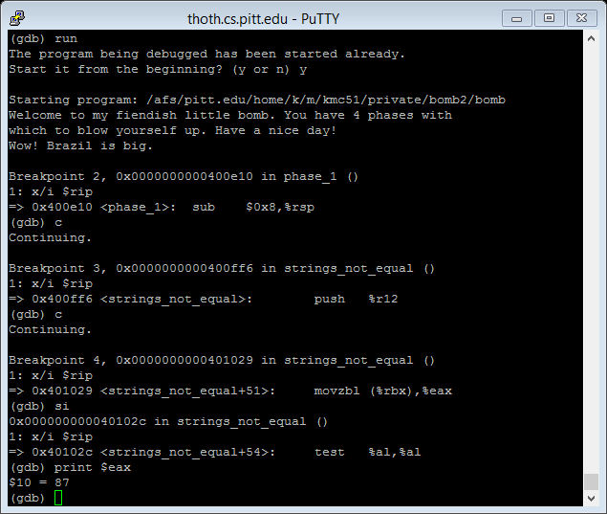
Further exploration of strings_not_equal
What happens at +51? Here’s a look at what happens if we run again with the input string “Wow! Brazil is big.” and set a breakpoint at that line (Breakpoint 4 at 0x401029, type ‘break *0x401029’).
Note 87 is the ascii value for “W”. What has been accomplished through movzbl is the placement of the first character of the user’s input string in $eax.
The test line confirms that this isn’t the null terminating character.

Slide 17
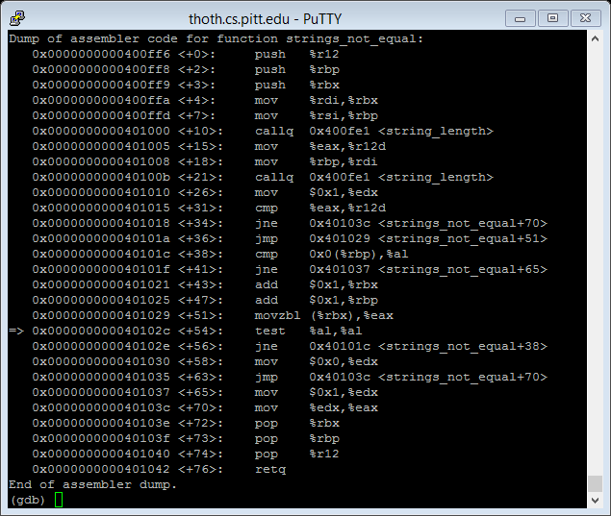
Further exploration of strings_not_equal
Long story short: The green box outlines the region that is looping over the characters of the two strings, byte by byte.
If they ever mismatch, this will trigger a jump to +65, which will again result in the function exiting with a return value of 1.
For info on movzbl, see https://cs61.seas.harvard.edu/wiki/images/3/3f/Scribe12-l08-benzguo-hysun-jonathanmiller.pdf, slide 4

Slide 18
Further exploration of strings_not_equal
However, if they never mismatch, then eventually we’ll hit the null terminator.
This means the code will advance to +58, which puts a 0 in $edx…then there is a jump to +70, which puts that 0 in $eax…so the return value will be 0.

Slide 19
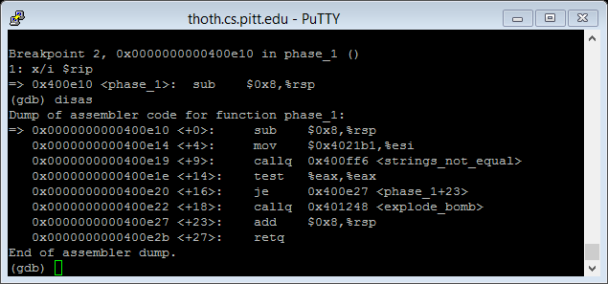
Returning to phase 1.
Returning to phase_1…je will jump when ZF == 1. $ZF =1 when the output of test is 0 (test will perform bitwise and on $eax). So when $eax is 0, je will jump to +23, past the call to explode_bomb.

Slide 20
Final comments
Some similar strategies may be useful for the other phases, but be aware the solutions are likely much more complicated.
Remember to check out the gdb tutorial on the course website.
Questions?

