Slide 1
CS449 Lab 7/7/20 and 7/9/20
These slides will be available online:
https://github.com/kc13/CS449
Agenda for today
Overview of Cache Lab (released 7/2)

Slide 2
Cache lab
Summary: You will complete some already started code for a simulator that reads in info about memory accesses, and prints out when cache hits/misses/etc should occur, given a set of cache parameters.

Slide 3
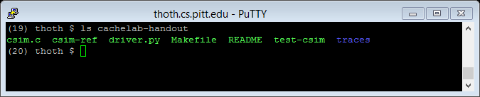
Cache lab

Slide 4
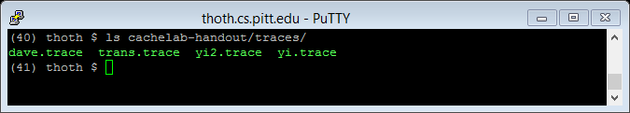
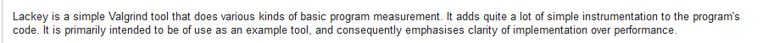
Cache lab – Input trace files
Valgrind (briefly discussed in an earlier lab) provides tools that can examine memory management and other issues in linux programs.
--log-fd=1 tells valgrind to write to stdout
--tool=lackey says to use the Lackey tool (below from https://www.valgrind.org/docs/manual/lk-manual.html):
More on next slide…

Slide 5
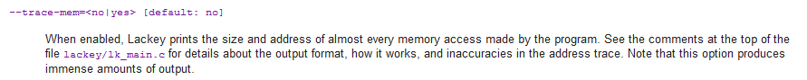
Cache lab – Input trace files
-v = verbose (display lots of info)
--trace=mem (from https://www.valgrind.org/docs/manual/lk-manual.html):
ls -l tells valgrind to inspect the memory addresses when running ls with the l flag (so, just list the directory contents with detailed info)
If you try this example command line, it will indeed produce an immense amount of output. The trace files you will process for this lab are more manageable (ranging in size from 5-596 lines).

Slide 6
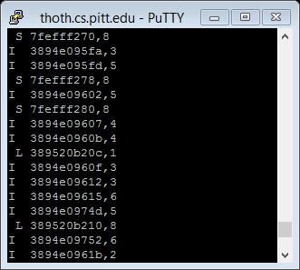
Cache lab – Input trace files
Another example: subset of the output when trying the ls -l example from the previous slide:
For this lab, you will be disregarding the ‘I’ lines from the trace files you are given.

Slide 7
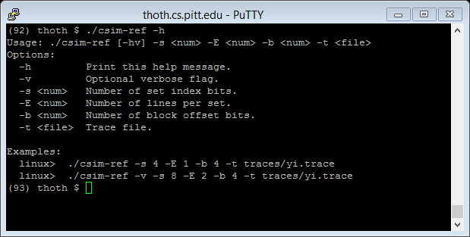
Cache lab
Lines per set determines associativity.
# of sets (2^{s}) x lines per set x bytes per block (2^{b}) determine cache size.

Slide 8
Cache lab – reminder of cache organization
See also: Recitation slides from last week (with answers to cache tutorial).

Slide 9
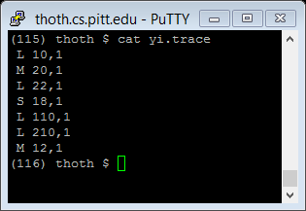
Cache lab –
Simulator
Contents of yi.trace:
(16 sets, direct-mapped, 16 bytes per block)
Cold misses
Reminder of format:
Same blocks as pulled in earlier, different bytes

Slide 10
Cache lab – creating your own simulator in csim.c
(into tag/set/offset fields)
(you design the structure)
(you design the structure)
(when you have to evict a line, discard the least recently accessed one)
While you’re working on this, it might also be helpful to reference the web-based simulator from http://www.cs.pitt.edu/~vinicius/cachesim/ (see cache tutorial), for a visualization of how a cache with a given set of parameters should look and behave.
In general, you’ll need to think about how to keep track of the current tag (if any) associated with each line within each set, and the relative recency of each of those tags.

Slide 11
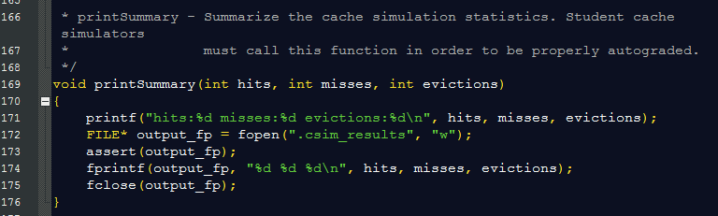
Cache lab – creating your own simulator in csim.c
…and free any memory you’re done using
printSummary is already completed for you:

Slide 12
Cache lab – creating your own simulator in csim.c
Final column of each trace can be safely ignored – once you have identified the block associated with the memory address, that should be all you need to determine the information needed to determine hit/miss status (whereas in a situation with accesses that could cross block boundaries, you might need to determine whether multiple different blocks are present in the cache).

Slide 13
Cache lab – evaluation

Slide 14
Cache lab – evaluation

Slide 15
Cache lab – section 7 hints
5 lines, L and S ops
Below: example from page 4 of -v use:

Slide 16
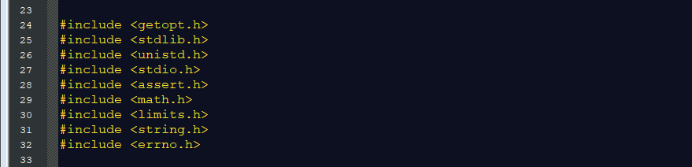
Cache lab – section 7 hints
The appropriate header files for these library functions have already been included for you in the starter code for csim.c. (stdlib.h will also be needed for the use of malloc/free)

Slide 17
Cache lab – section 7 hints
You may have seen examples of of sscanf during the bomb lab.
The lines in the trace files appear to take a form like “ %c %x,%d”
(This hasn’t yet been tested, but see reference here: https://en.wikipedia.org/wiki/Scanf_format_string).
Correction- the string to use is %c %llx, %u

Slide 18
Cache lab – section 7 hints / section 8
Same example from before:

Slide 19
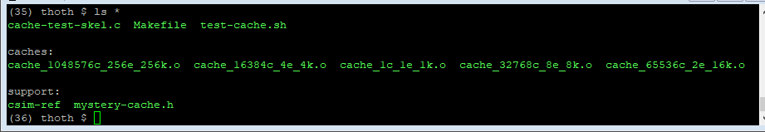
Cache lab – extra credit

Slide 20
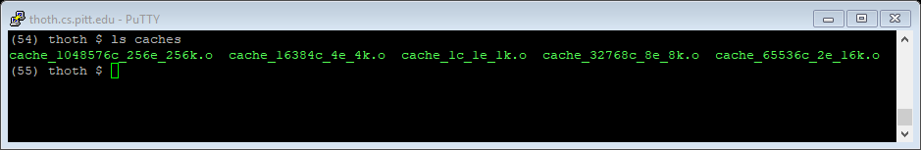
Cache lab – extra credit
The ‘caches’ are compiled programs; mystery-cache.h can be found in the ‘support’ directory’.
These functions and typedefs will be useful in your code, also.

Slide 21
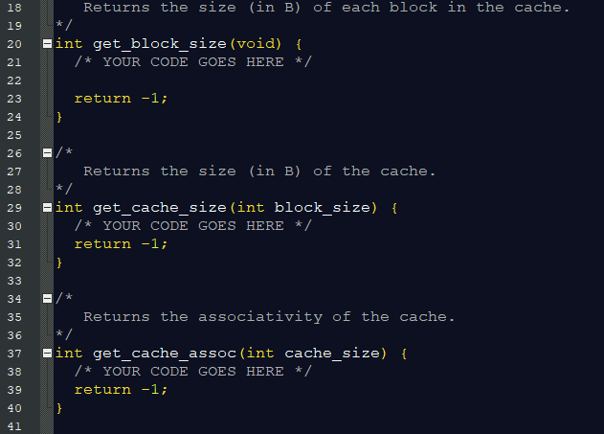
Cache lab – extra credit
In other words: You’ll need to infer the # of sets, # of lines/set, and # bytes/block based on what you observe when trying out different memory accesses. Functions to complete are here:

Slide 22
Cache lab – extra credit

Slide 23
Cache lab – extra credit
Methods for testing with either just one cache or with all caches.

Slide 24
Cache lab – extra credit

Slide 25
Cache lab – questions?

