Slide 1
Malloc Lab

Slide 2
Outline
Concept
How to choose blocks
Metadata
Debugging / GDB Exercise

Slide 3
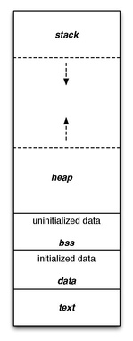
What is malloc?
A function to allocate memory during runtime (dynamic memory allocation)
More useful when the size or number of allocations is unknown until runtime (e.g. data structures)
The heap is a segment of memory addresses reserved almost exclusively for malloc to use
Your code directly manipulates the bytes of memory in this section.

Slide 4
Malloc Internals
The heap consists of blocks of memory
(heap)
free
free
malloc’d
malloc’d
free
malloc’d
malloc’d

Slide 5
Concept
Overall, malloc does three things:
Organizes all blocks and stores information about them in a structured way
Uses the structure made to choose an appropriate location to allocate new memory
Updates the structure when the user frees a block of memory

Slide 6
Concept (Implicit list)
Organizes all blocks and stores information about them in a structured way
(heap)
free (size = 25)
free (size = 8)
malloc’d (size = 7)
m(3)
f(3)
m(5)
m(4)

Slide 7
Concept (Implicit list)
Uses the structure made to choose an appropriate location to allocate new memory
(heap)
free (size = 25)
free (size = 8)
malloc’d (size = 7)
malloc(8)
m(3)
f(3)
m(5)
m(4)
(heap)
free (size = 25)
malloc’d (size = 8)
malloc’d (size = 7)
m(3)
f(3)
m(5)
m(4)

Slide 8
Concept (Implicit list)
Updates the structure when the user frees a block of memory
(heap)
free (size = 25)
free(that block)
malloc’d (size = 8)
malloc’d (size = 7)
m(3)
f(3)
m(5)
m(4)
(heap)
free (size = 25)
malloc’d (size = 8)
malloc’d (size = 7)
m(3)
free (size = 8)
m(4)

Slide 9
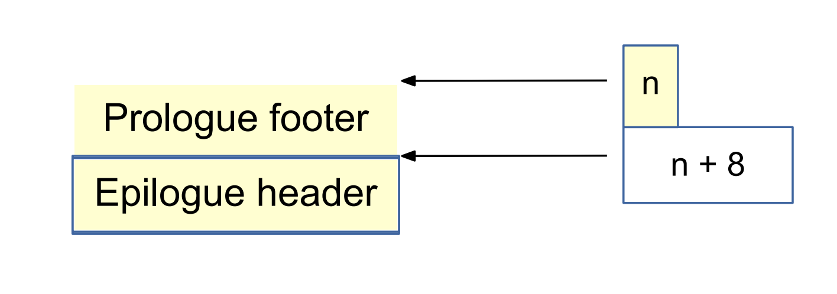
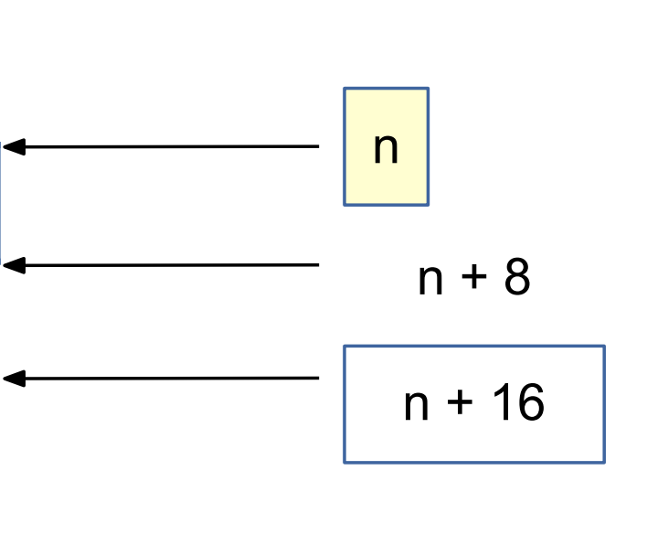
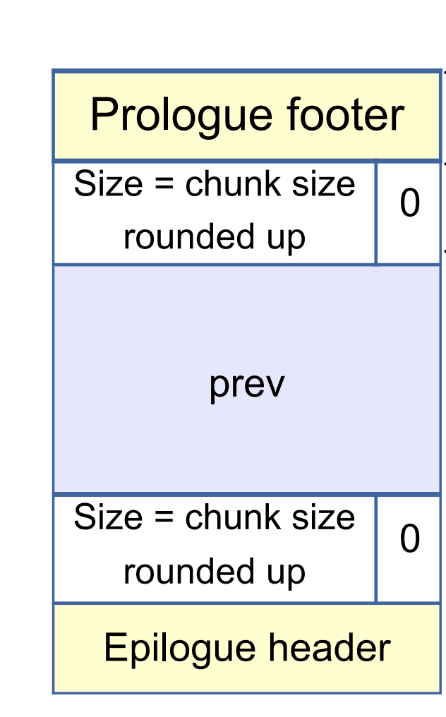
mm_init
Why prologue footer and epilogue header?
Payload must be 16-byte aligned
But, the size of payload doesn’t have to be a multiple of 16 - just the block does!
Things malloc’d must be within the prologue and epilogue

Slide 10
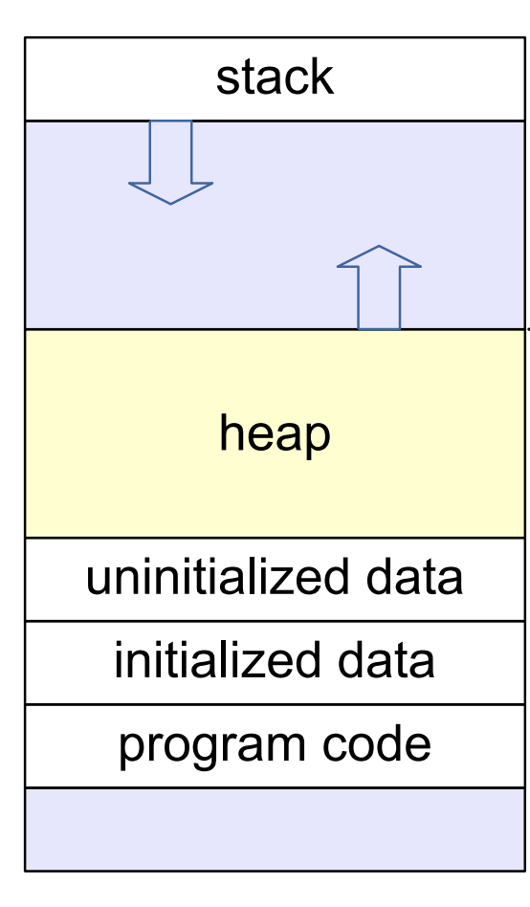
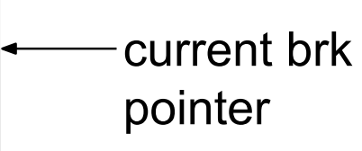
If We Can't Find a Usable Free Block
Assume an implicit list implementation
Need to extend the heap
mem_sbrk()
sbrk(num_bytes) allocates space and returns pointer to start
sbrk(0) returns a pointer to the end of the current heap
For speed, extend the heap by a little more than you need immediately
use what you need out of the new space, add the rest as a free block
What are some tradeoffs you can make?

Slide 11
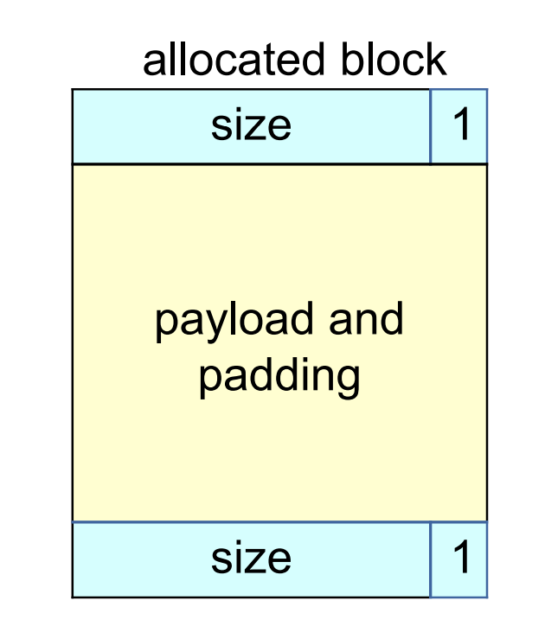
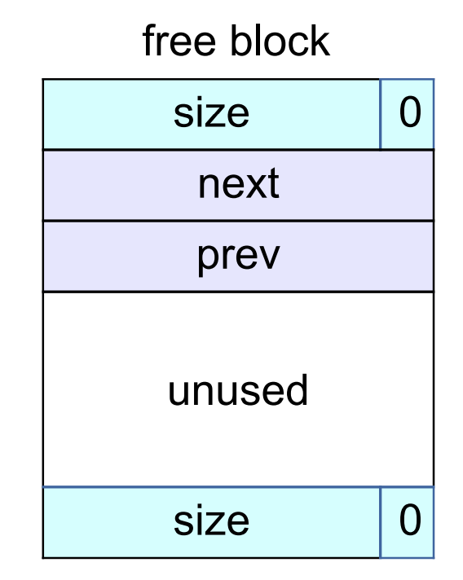
Tracking Blocks: Explicit List
Maintain a list of free blocks instead of all blocks
means we need to store forward/backward pointers, not just sizes
we only track free blocks, so we can store the pointers in the payload area!
need to store size at end of block too, for coalescing

Slide 12
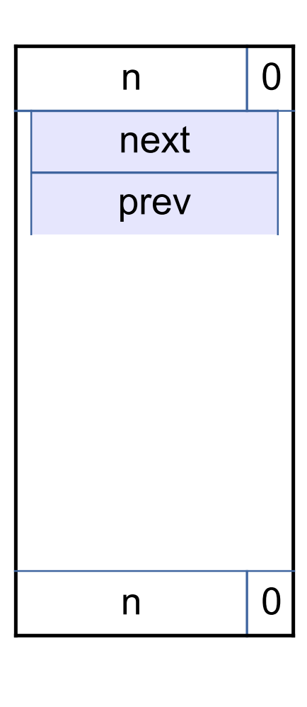
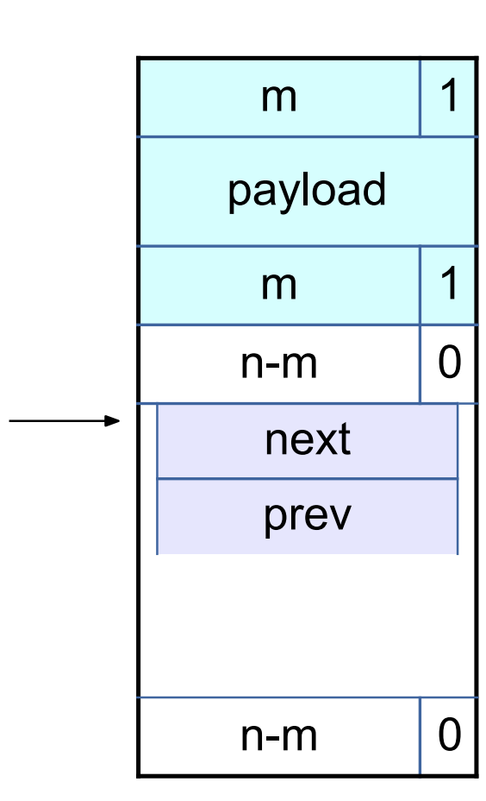
Splitting a Block
If the block we find is larger than we need
Split it
Leave the remainder for a future allocation
Explicit lists: correct previous and next pointers
When would we not split a block?

Slide 13
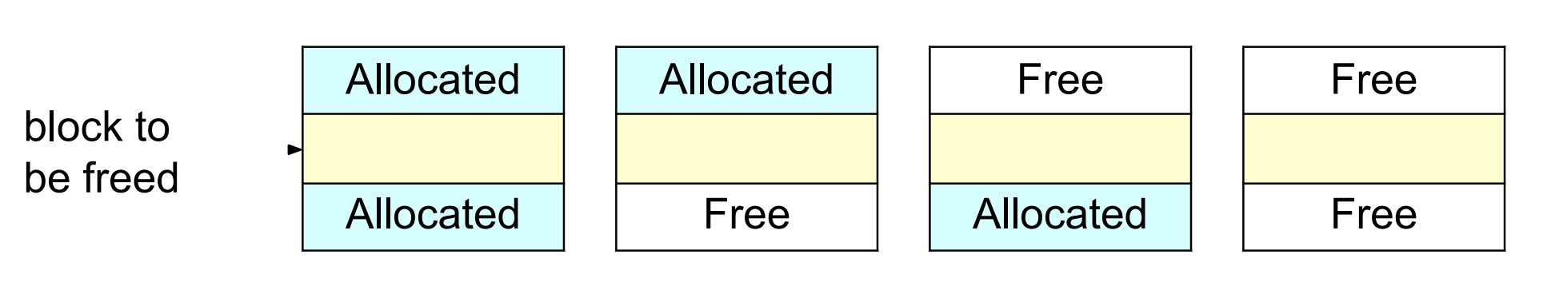
Coalescing Memory
Combine adjacent blocks if both are free
Explicit lists: look forward and backward in the heap, using block sizes, not next/prev pointers
Four cases

Slide 14
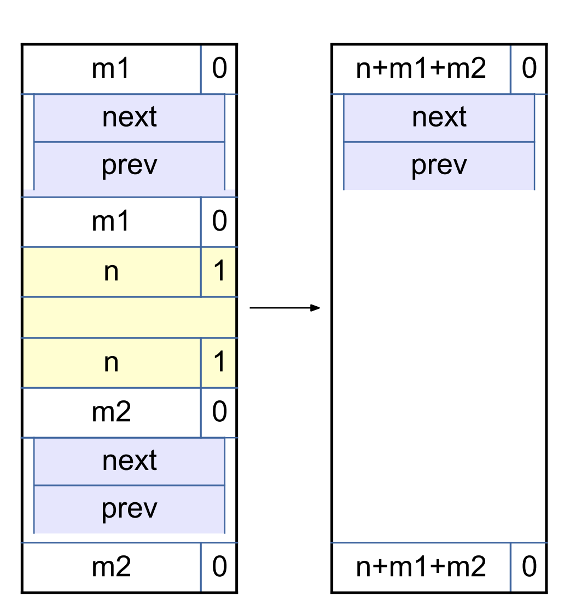
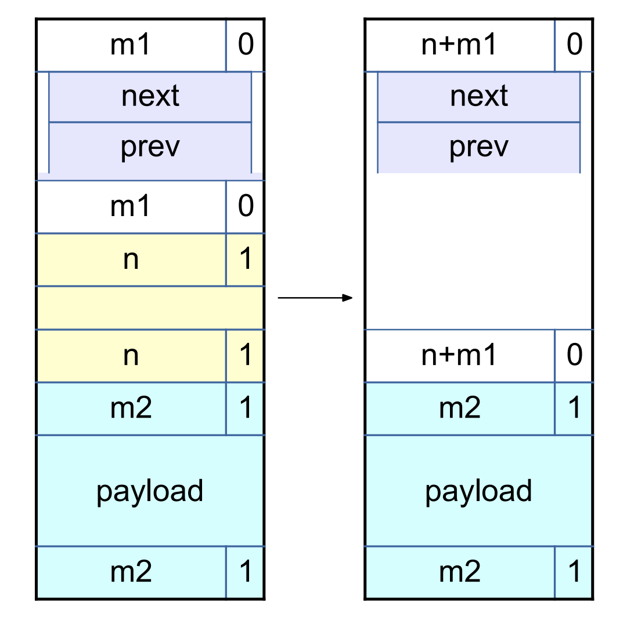
Coalescing Memory: Examples

Slide 15
Goals of your Memory Allocator
Run as fast as possible
Waste as little memory as possible
Seemingly conflicting goals, but with effort you can do well in both areas!
The simplest implementation is the implicit list
mm-reference (provided) uses this method
Unfortunately…

Slide 16
$ ./mdriver -V
Using default tracefiles in traces/
Measuring performance with gettimeofday().
Testing mm malloc
Reading tracefile: amptjp-bal.rep
Checking mm_malloc for correctness, efficiency, and performance.
Reading tracefile: cccp-bal.rep
Checking mm_malloc for correctness, efficiency, and performance.
Reading tracefile: cp-decl-bal.rep
Checking mm_malloc for correctness, efficiency, and performance.
Reading tracefile: expr-bal.rep
Checking mm_malloc for correctness, efficiency, and performance.
Reading tracefile: coalescing-bal.rep
Checking mm_malloc for correctness, efficiency, and performance.
Reading tracefile: random-bal.rep
Checking mm_malloc for correctness, efficiency, and performance.
Reading tracefile: random2-bal.rep
Checking mm_malloc for correctness, efficiency, and performance.
Reading tracefile: binary-bal.rep
Checking mm_malloc for correctness, efficiency, and performance.
Reading tracefile: binary2-bal.rep
Checking mm_malloc for correctness, efficiency, and performance.
Results for mm malloc:
trace valid util ops secs Kops
0 yes 98% 5694 0.025191 226
1 yes 99% 5848 0.023583 248
2 yes 99% 6648 0.036894 180
3 yes 99% 5380 0.028275 190
4 yes 66% 14400 0.001330 10828
5 yes 92% 4800 0.018685 257
6 yes 91% 4800 0.018738 256
7 yes 54% 12000 0.296136 41
8 yes 47% 24000 1.172669 20
Total 83% 83570 1.621501 52
Perf index = 50 (util) + 1 (thru) = 51/100
This is pretty slow!!

Slide 17
Allocation methods in a nutshell
Implicit list: a list is implicitly formed by jumping between blocks, using knowledge about their sizes.
Explicit list: Free blocks explicitly point to other blocks, like in a linked list.
Understanding explicit lists requires understanding implicit lists
Allocated | Free | Allocated | Free | Allocated
 | Free |  | Free

Slide 18
Choices
What kind of implementation to use?
Implicit list, explicit list, segregated lists, binary tree methods, etc.
You can use specialized strategies depending on the size of allocations
Don’t directly test for which trace file is running!
What fit algorithm to use?
First fit / next fit: search linearly starting from some location and pick the first block that fits.
Best fit: choose the smallest block that is big enough to fit the requested allocation size
Which is faster? Which uses less memory?
“Good enough” fit: a blend between the two
Losing memory because of the way you choose your free blocks is called external fragmentation.

Slide 19
Metadata
All blocks need to store some data about themselves for malloc to keep track of them (e.g. headers)
This takes memory too…
Losing memory for this reason is called internal fragmentation
What data might a block need?
Does it depend on the malloc implementation you use?
Is it different between free and allocated blocks?
Can we use the extra space in free blocks?
Or do we have to leave the space alone?
How can we overlap two different types of data at the same location?
Notes:
Yes, yes, yes (can use the space)
Unions! (See textbook)

Slide 20
In an ideal world…
Setting up the blocks, metadata, lists… etc
+ Finding and allocating the right blocks
+ Updating your heap structure when you free =
$ ./mdriver -V
Using default tracefiles in traces/
Measuring performance with gettimeofday().
...
Testing mm malloc
Results for mm malloc:
trace valid util ops secs Kops
0 yes 88% 5694 0.000724 7866
1 yes 91% 5848 0.000637 9182
2 yes 94% 6648 0.001377 4829
3 yes 96% 5380 0.000904 5949
4 yes 66% 14400 0.001445 9965
5 yes 86% 4800 0.001183 4056
6 yes 85% 4800 0.001090 4404
7 yes 54% 12000 0.005541 2166
8 yes 47% 24000 0.004757 5045
Total 79% 83570 0.017658 4733
Perf index = 47 (util) + 40 (thru) = 87/100
That is much better!

Slide 21
In reality…
Setting up the blocks, metadata, lists… etc
+ Finding and allocating the right blocks
+ Updating your heap structure when you free
+ One bug, somewhere lost =
$ ./mdriver -V
Using default tracefiles in traces/
Measuring performance with gettimeofday().
Testing mm malloc
Reading tracefile: amptjp-bal.rep
Segmentation fault (core dumped)

Slide 23
Common errors you might see
Garbled bytes
Problem: overwriting data in an allocated block
Solution: finding where you’re overwriting by stepping through with gdb
Overlapping payloads
Problem: having unique blocks whose payloads overlap in memory
Solution: finding where you’re overlapping by stepping through with gdb
Segmentation fault
Problem: accessing invalid memory
Solution: finding where you’re accessing invalid memory by stepping through with gdb

Slide 24
What’s better than printf? Using GDB
Use GDB to determine where segfaults happen!
Using GDB well in malloclab can save you debugging time
Login to Thoth Machine
wget https://bit.ly/2CUCAsR -O malloclab-buggy.zip
unzip malloclab-buggy.zip
cd malloclab-buggy
make
Let’s use GDB to investigate a buggy mdriver

Slide 25
Debugging mdriver
$ ./mdriver -V
…
Reading tracefile: binary-bal.rep
Segmentation fault (core dumped)
$ gdb --args ./mdriver -f traces/binary-bal.rep
(gdb) run
(gdb) backtrace
(gdb) list
1) What function is listed on the top of backtrace?
2) What line of code crashed?
3) How did that line cause the crash?

Slide 26
Debugging mdriver
(gdb) x /10gx block
Shows the memory contents within the block
In particular, look for the header.
Remember the output from (gdb) bt?
(gdb) frame 1
Jumps to the function one level down the call stack (aka the function that called write_footer)
Type “list” again if you want to see the code
What was the caller function? What is its purpose?
Was it writing to block or block_next when it crashed?

Slide 27
Thought process while debugging
write_footer crashed because it got the wrong address for the footer…
The address was wrong because the header of the block was some garbage value
Since write_footer uses get_size(block) after all
But why in the world does the header contain garbage??
The crash happened in place, which basically splits a free block into two and uses the first one to store things.
Hm, block_next would be the new block created after the split? The one on the right?
The header would be in the middle of the original free block actually. Wait, but I wrote a new header before I wrote the footer!
Right? …Oh, I didn’t. Darn.

Slide 28
Segfault
To resolve a segfault, it is necessary to find the earliest time things went wrong
One way to do this is to print the whole heap before/after relevant functions
Scroll up from the point of segfault and find the earliest operation that makes the heap look wrong
Sometimes this gives too much information, not all of which are useful
The heap checker can make this easier
Checks violation of invariants (corruption of the heap)

Slide 29
Heap Checker (implement this!)
Once you’ve settled on a design, write the heap checker that checks all the invariants of the particular design
The checking should be detailed enough that the heap check passes if and only if the heap is truly well-formed
Call the heap checker before/after the major operations whenever the heap should be well-formed

Slide 30
Invariants (non-exhaustive)
Block level: What should always be true of every block in the heap?
Header and footer match
Payload area is aligned, size is valid
No contiguous free blocks in memory (unless you defer coalescing)
List level: What should always be true of every element of a free list?
Next/prev pointers in consecutive free blocks are consistent
Free list contains no allocated blocks
All free blocks are in the free list
Heap level: What should be true of the heap as a whole?
Prologue/Epilogue blocks are at specific locations (e.g. heap boundaries) and have special size/alloc fields
All blocks stay in between the heap boundaries
And your own invariants (e.g. address order)

Slide 31
Summary: GDB Usage
backtrace: Shows the call stack
frame: Lets you go to one of the levels in the call stack
list: Shows source code
print <expression>:
Runs any valid C command, even something with side effects like mm_malloc(10)
watch <expression>:
Breaks when the value of the expression changes
break <function / line> if <expression>:
Only stops execution when the expression holds true

