Slide 1
CS449 Lab 6/2/20 and 6/4/20
These slides will be available online:
https://github.com/kc13/CS449
Agenda for today
Reminders
Overview of Lab #3

Slide 2
Reminders
You now have 10 days post-deadline to complete checkoffs (see Canvas announcements)
If you haven’t already done a checkoff meeting for the data lab, you should do so. Next up will be the checkoff for the pointer lab.

Slide 3
Lab #3- Queue Lab

Slide 4
Lab #3- Queue Lab
Deadline currently specified as 6/11 on Website/Gradescope

Slide 5
Lab #3- Queue Lab
also available as e-book through library
(in addition to other C e-books)

Slide 6
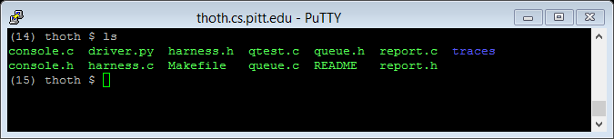
Lab #3- Queue Lab – part 4

Slide 7
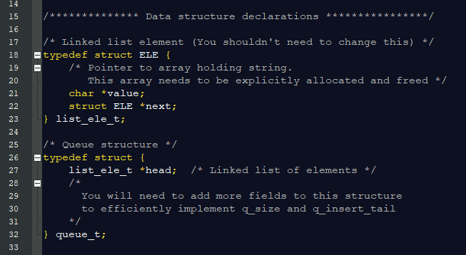
Lab #3- Queue Lab – part 5
We can refer to each of these two-field boxes as nodes.
Each node corresponds to one instance of the struct which we have labeled list_ele_t (using a typedef).
Each node will include one pointer to an array of ASCII characters (“value”) and one pointer to another node (“next”). See the blue arrows in the diagram.

Slide 8
Lab #3- Queue Lab – part 5
queue_t will refer to a struct that contains a pointer to a node but not necessarily to a char array (so it can be useful to serve as the head node of a queue)
You will also add fields to queue_t (see later slides…)

Slide 9
Lab #3- Queue Lab – part 5

Slide 10
Lab #3- Queue Lab – part 5

Slide 11
Lab #3- Queue Lab – part 5
Null?
Null?
Null case: Declared a pointer only
Empty queue: Pointer points to a memory address, but nothing assigned to head field pointer yet.

Slide 12
Lab #3- Queue Lab – part 6
Very minimal code started in queue.h/queue.c (declarations in queue.h, headers/return statements and some lines of some functions in queue.c)

Slide 13
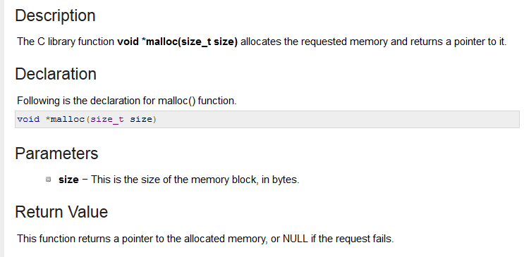
Lab #3- Queue Lab – part 6
Info that might be helpful here:
For string length: strlen (from <string.h>), does not include null char at end
https://www.tutorialspoint.com/c_standard_library/c_function_strlen.htm
malloc is in <stdlib.h>
General function call format:
https://www.tutorialspoint.com/c_standard_library/c_function_malloc.htm
Remember you need space for the string and the null terminator character. You’ll also need space for the new node in the linked list.

Slide 14
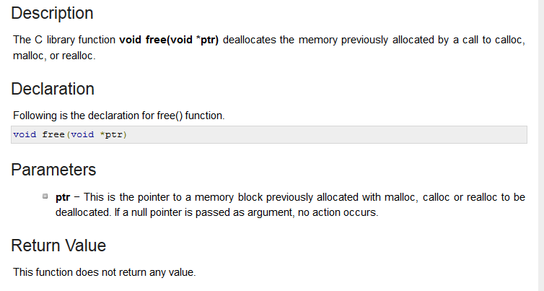
Lab #3- Queue Lab – part 6
Free is also in <stdlib.h>
General function call format:

Slide 15
Lab #3- Queue Lab – part 6
Summary: The run time (proportional to number of operations) for q_insert_tail and q_size should be independent of the number of nodes currently in the queue.
Since you are allowed to add fields to queue_t, you may consider adding a field to track the number of nodes currently in the queue (and update this field as needed) and perhaps also the “next” pointer for the final node in the queue.
Many linked list operations require iterating over the nodes currently in the queue, so use a loop for that, as opposed to recursion.

Slide 16
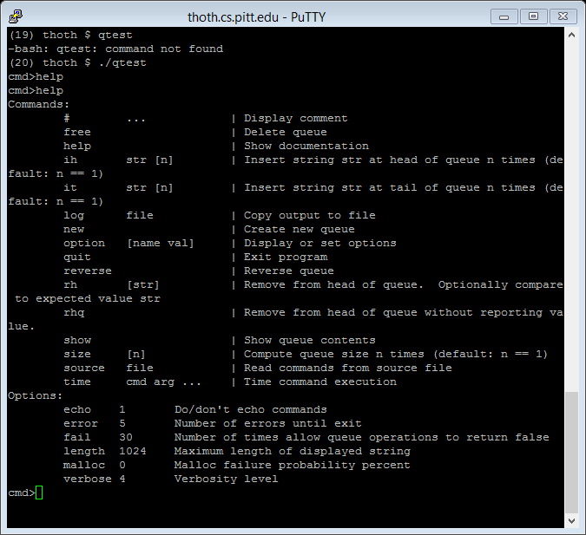
Lab #3- Queue Lab – part 7

Slide 17
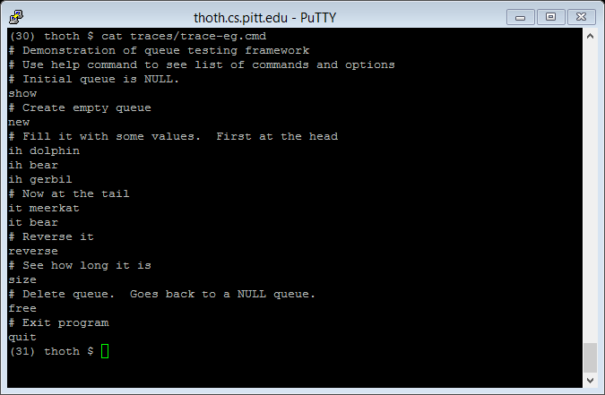
Lab #3- Queue Lab – part 7
ih <string> / it <string> to insert words at the head/tail of the linked list

Slide 18
Lab #3- Queue Lab – part 7
Using the starter code alone, you’ll see lots of issues (segmentation faults, etc…)

Slide 19
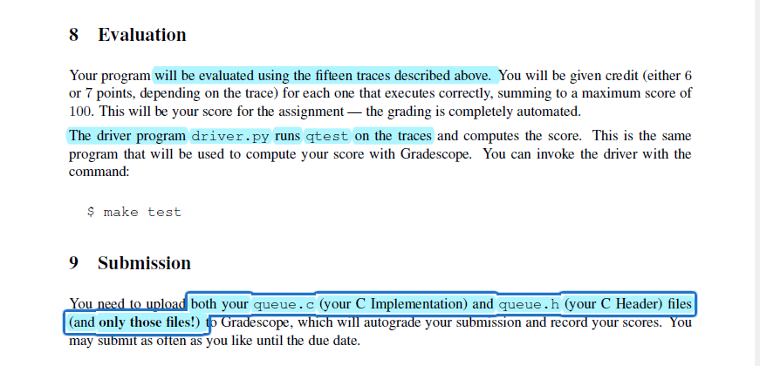
Lab #3- Queue Lab – parts 8,9

Slide 20
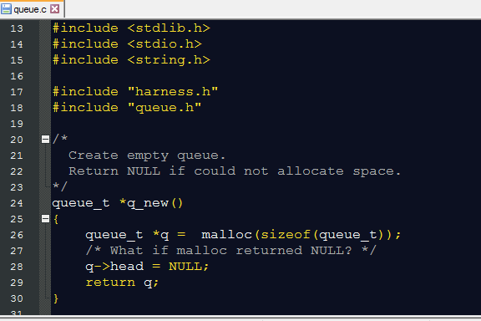
Lab #3- Queue Lab – reviewing queue.c (but also remember to modify queue.h!)
q_new : partly completed; make sure to take care of edge case

Slide 21
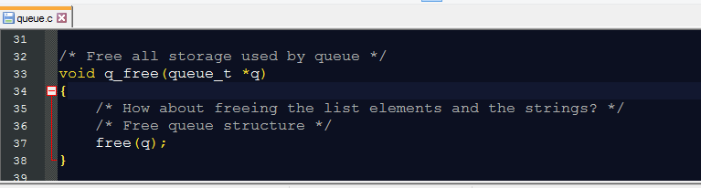
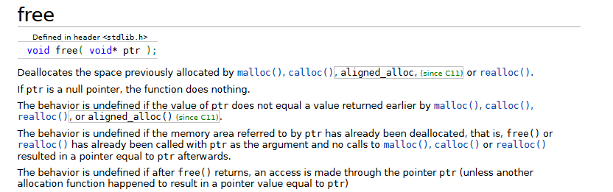
Lab #3 – reviewing queue.c
q_free: you’ll need to free the memory used by all the individual nodes
The instructions/comments don’t really speak to any edge cases, but here’s a reference, just in case (from https://en.cppreference.com/w/c/memory/free):

Slide 22
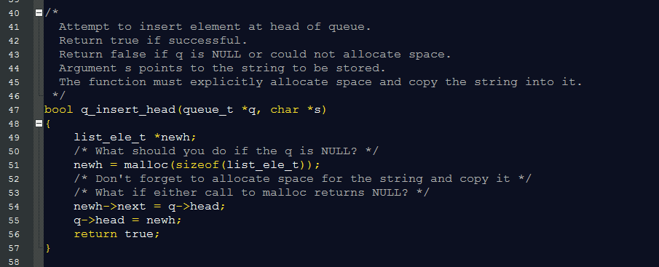
Lab #3 – reviewing queue.c
Completed for you: Space for a new node, plus update of the pointer at the queue’s head (the queue_t struct) to point to the new node, and update of the new node’s pointer to point to whatever was formerly the target of the queue head’s pointer.
To complete: Handling of edge cases, and you need to allocate space for the character array (with the “value” char pointer pointing to it), and you need to copy the characters into the array (don’t forget the null character).

Slide 23
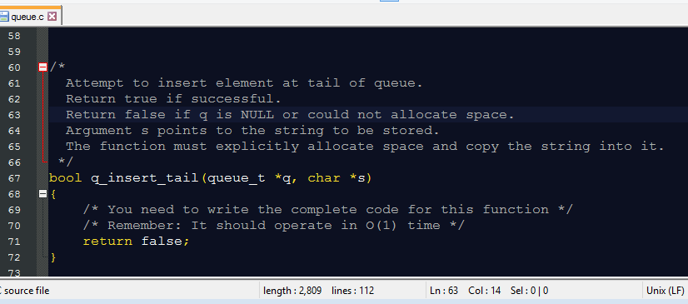
Lab #3 – reviewing queue.c
To complete:
Allocate space for a new node (q_insert_head is a good reference for how to do this)
The ‘next’ pointer of the final node in the existing list should point to this new node (so it may be helpful to store relevant info about this as a field in queue_t, to meet the run time requirement)
Repeat the same steps you completed for q_insert_head (allocate space for and copy string, and deal with edge cases).

Slide 24
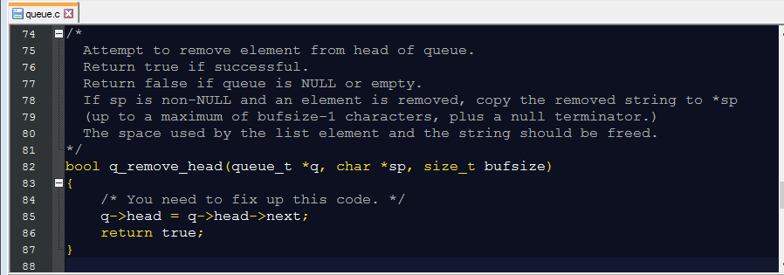
Lab #3 – reviewing queue.c
Already completed: The pointer in the queue_t struct is updated to point to the current 2nd item in the linked list, reflecting the eventual removal of the 1st item.
To complete:
The space associated with the removed node (struct and the char array) will need to be freed.
Assuming the character pointer sp is not NULL, the contents of the character array – for the node that is being removed – should be copied so that sp points to the first character. Also, you should only copy the first bufsize-1 non-null characters, and the final null character.
Handle the edge cases as described in the comments.

Slide 25
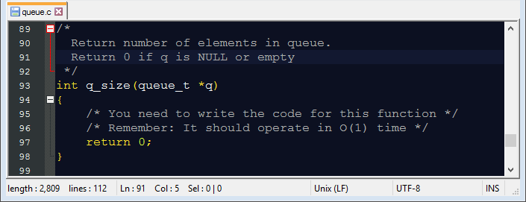
Lab #3 – reviewing queue.c
This should be straightforward if you’re updating a size field in the queue_t struct.

Slide 26
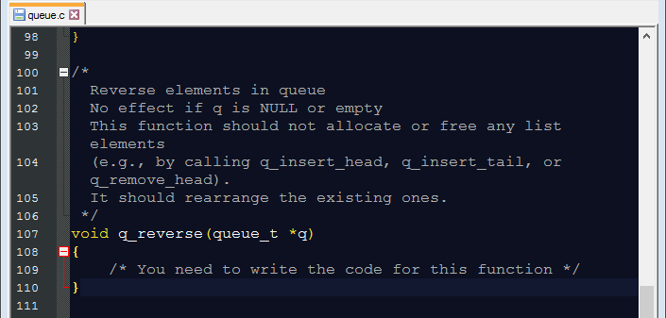
Lab #3 – reviewing queue.c
This function needs to be completed in its entirety.
Handle null/empty edge cases
You can’t use the other insertion/removal functions, so you’ll have to figure out how to swap around the pointers so the linked list sequence is reversed.

Slide 27
Lab #3 – questions?

