Slide 1
CS449 Lab 6/9/20 and 6/11/20
These slides will be available online:
https://github.com/kc13/CS449
Agenda for today
Overview of Lab #4 (bomb lab)
See also the tutorial on x86/gdb here:
https://sites.google.com/view/cs449su20/tutorials

Slide 2
Lab 4 – the Bomb Lab
Also an option to submit strings listed in a text file

Slide 3
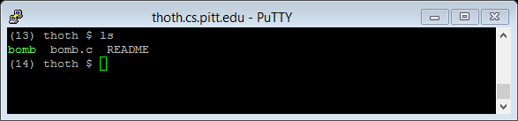
Lab 4 – the Bomb Lab
If multiple bombs are downloaded, the last submission/bomb ID used is what will count for the grade

Slide 4
Lab 4 – the Bomb Lab

Slide 5
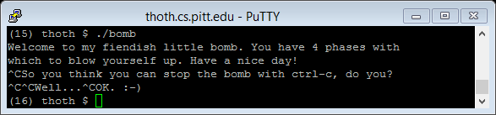
Lab 4 – the Bomb Lab
Also note you can terminate early using ctrl-C without penalty (though the program will make you type it multiple times):

Slide 6
Lab 4 – the Bomb Lab
gdb can be used for the steps/breakpoints

Slide 7
Lab 4 – the Bomb Lab
Note the bomb may not show up on the webpage until at least one phase has been defused or an explosion has occurred.

Slide 8
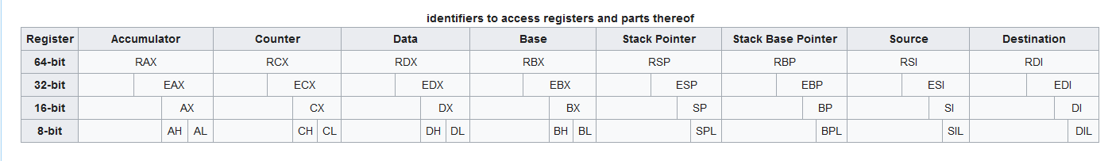
Lab 4 – the Bomb Lab
The “r” may sometimes be replaced with an “e” to refer to the register’s 32 least significant bits (image from https://en.wikibooks.org/wiki/X86_Assembly/X86_Architecture):
See also: Intel’s x86 manual (very long but potentially helpful): https://software.intel.com/content/www/us/en/develop/download/intel-64-and-ia-32-architectures-sdm-combined-volumes-1-2a-2b-2c-2d-3a-3b-3c-3d-and-4.html

Slide 9
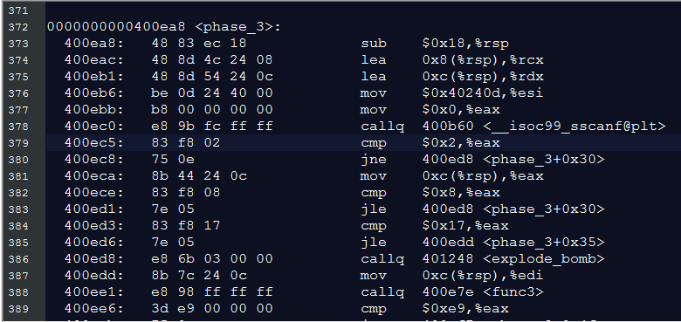
Lab 4 – the Bomb Lab
Example of sscanf call in assembly for phase 3 (obtained with objdump)

Slide 10
Lab 4 – the Bomb Lab
In summary:
Trial and error will likely not work well.
Be careful not to make assumptions about string length or content

Slide 11
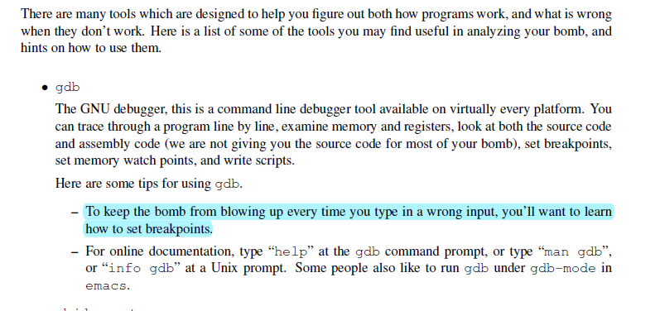
Lab 4 – the Bomb Lab
Useful breakpoint to set: A break before explode_bomb(), see next slide

Slide 12
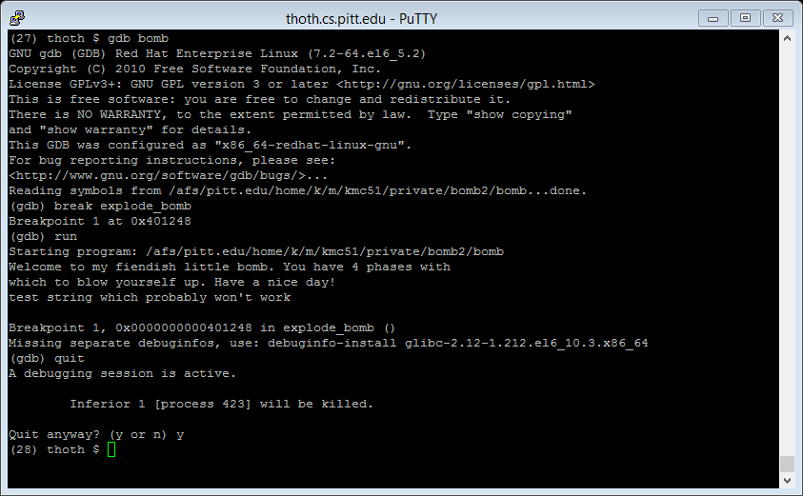
Lab 4 – the Bomb Lab

Slide 13
Lab 4 – the Bomb Lab
Use redirection to send the output to a text file, or | grep… to search for a string pattern in the output (see next slide).

Slide 14
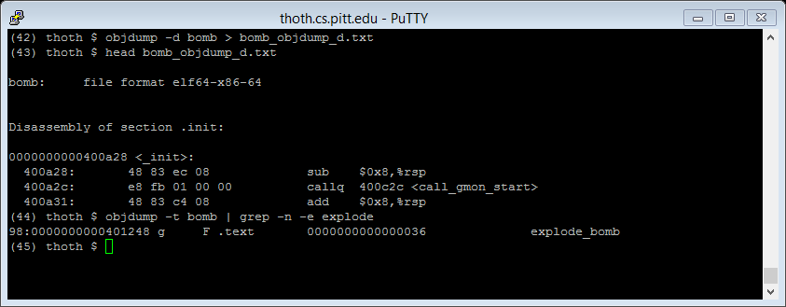
Lab 4 – the Bomb Lab

Slide 15
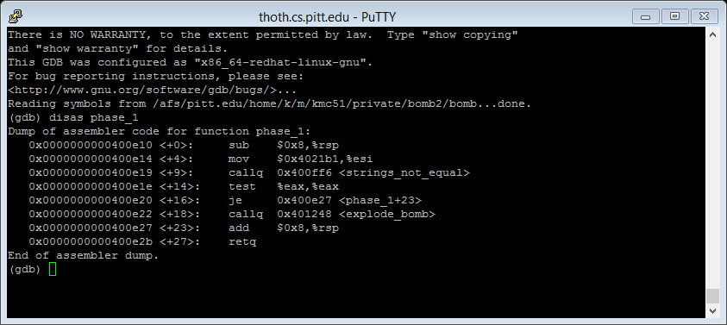
Lab 4 – the Bomb Lab
This will print out the assembly instructions for Phase 1. Note that between the call to strings_not_equal and the call to explode bomb you have a jump (je) that is conditionalized on the result of an earlier comparison.

Slide 16
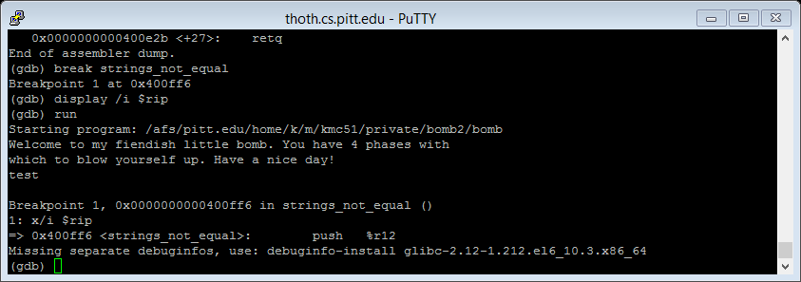
Lab 4 – the Bomb Lab
So we now see the first instruction in strings_not_equal (not surprisingly, it involves placing something on the stack).

Slide 17
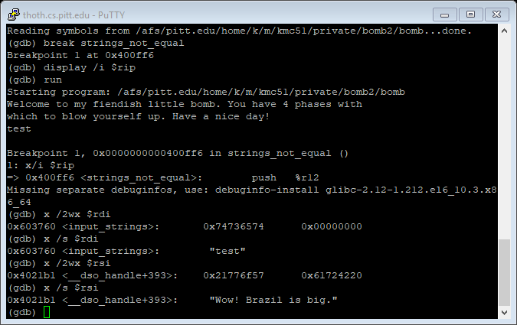
Lab 4 – the Bomb Lab

Slide 18
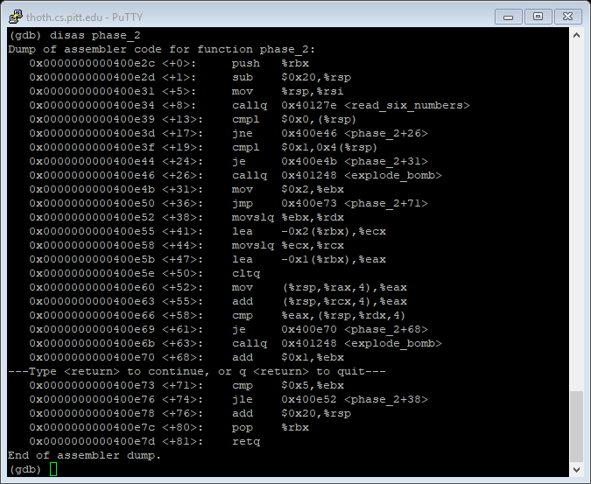
Lab 4 – the Bomb Lab

Slide 19
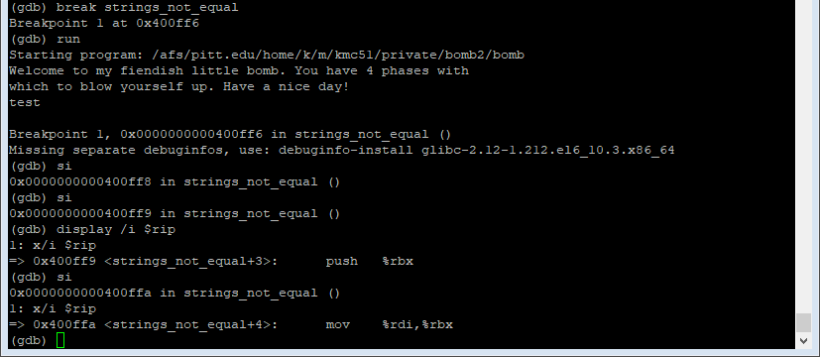
Lab 4 – the Bomb Lab
Remember to use display /i $rip, otherwise just the address will be shown

Slide 20
Questions?

