Slide 1
CS449 Lab 5/26/20 and 5/28/20
These slides will be available online:
https://github.com/kc13/CS449
Agenda for today
Overview of Lab #2

Slide 2
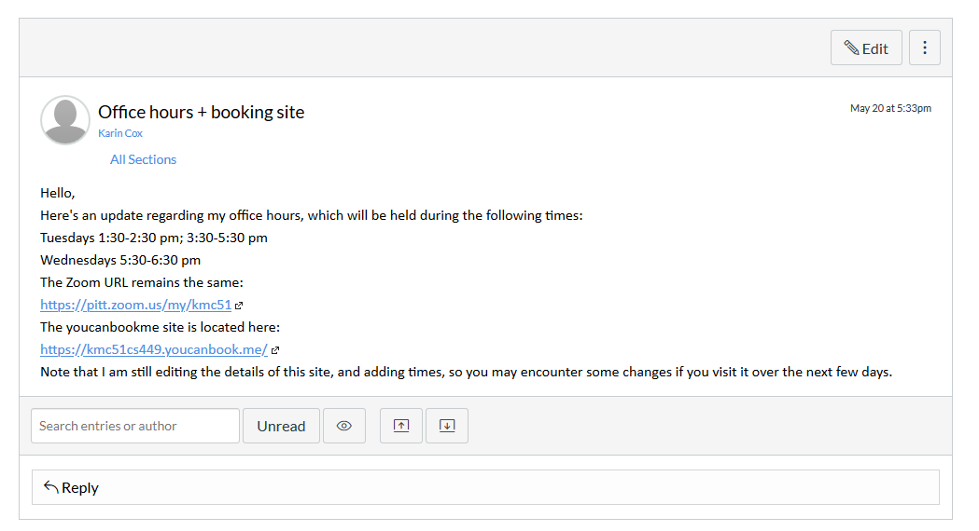
Office hours reminder
See Canvas announcement (below).
Please sign up through youcanbookme.
You can use these for checkoff meetings or general questions.
You can also schedule checkoff meetings during the professor’s office hours (the website still needs to be updated to indicate this).
See https://sites.google.com/view/cs449su20/course-info for more info on the checkoff meetings.

Slide 3
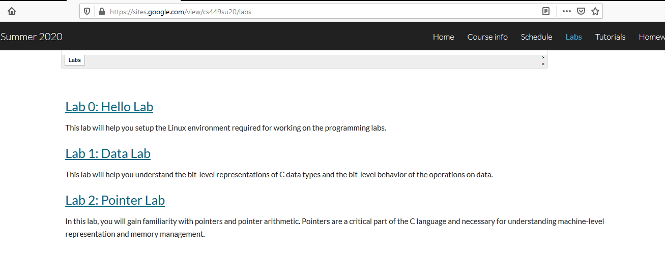
Lab #2: Pointer Lab
This lab shares many similarities with Lab 1, but be careful to notice various subtle differences in the rules/testing procedures/etc.

Slide 4
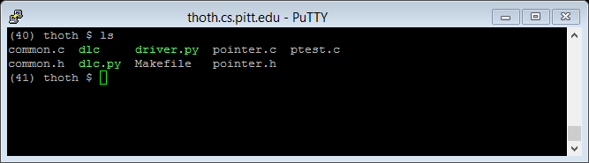
Lab #2 (be sure to also review comments in code)
Note: See slides from last week for answers to the pointers section in the Data Representation tutorial; this may be helpful review
FYI: The lab handout says that dlc.py should be used (nothing is said about dlc).

Slide 5
Lab #2
Note regarding data types: If you convert a pointer from an int * (or double *, or whatever) to an unsigned long (or a long, or a long long), you can perform regular arithmetic on it, as opposed to pointer arithmetic. This can be very helpful to keep in mind, though be aware that the current version of the dlc checker appears to complain about some kinds of casts, and also that the sign bit might be used in the memory addresses.

Slide 6
Lab #2
Functions: intSize(), doubleSize(), pointerSize()
-- The comment from the previous slide may be useful here.
-- It may not be strictly necessary to make use of arrays at all.

Slide 7
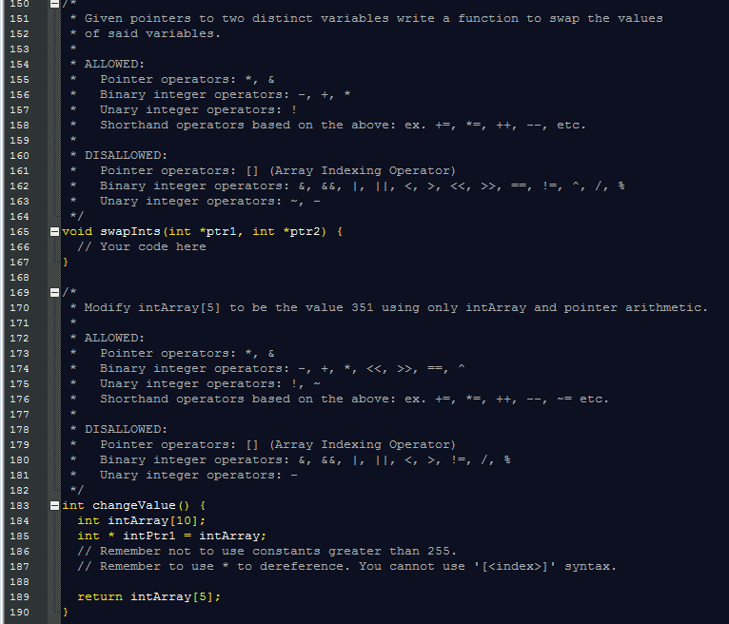
Lab #2

Slide 8
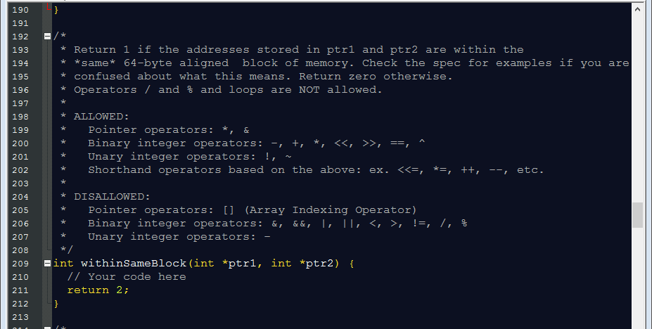
Lab #2

Slide 9
Lab #2
0,63 → OK
0,64 → not OK (note 64-byte boundaries fall on multiples of 0x40 = 64)
63,64 → not OK
974, 1007 (960 and 1024 are nearest alignment boundaries)
0x404 = 1024

Slide 10
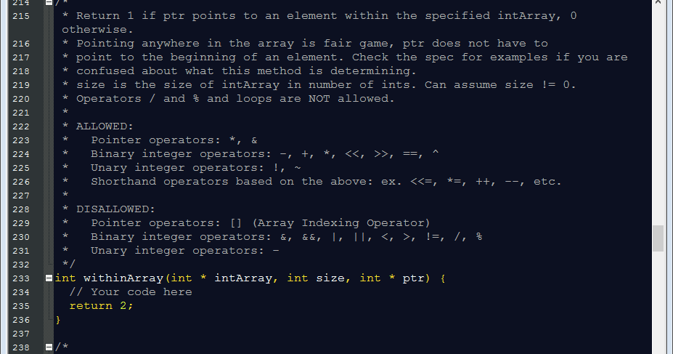
Lab #2

Slide 11
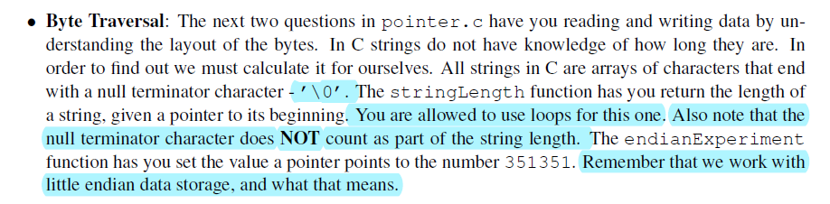
Lab #2

Slide 12
Lab #2
https://algs4.cs.princeton.edu/21elementary/
Another good reference on selection sort (and other sorts.)

Slide 13
Lab #2

Slide 14
Lab #2

