Slide 1

DQE: Distributed Randomness Beacons (DRBs)
Kevin Choi
Fall 2021
New York University

Slide 2
What is a randomness beacon?
First formalized by Rabin in 1983 to describe an ideal service that emits fresh random numbers at regular intervals
Centralized beacons
NIST, random.org
Can we trust NY State Lottery?
Public implicit beacons
Stock market data, Bitcoin
Issue: high-frequency traders, miners

Slide 3
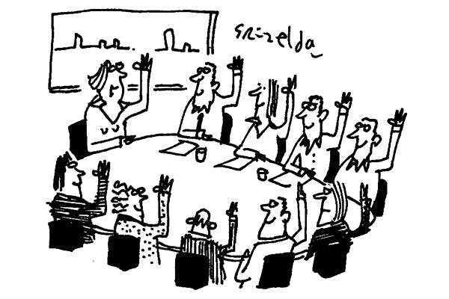
Distributed Randomness
Natural progression: distribution of trust
DRB (distributed randomness beacon): beacon realized via distributed randomness protocol capable of handling a Byzantine network

Slide 4
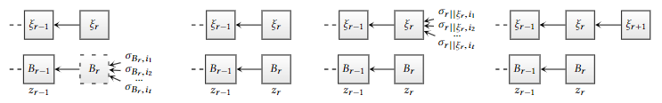
DRB Use Cases
Gambling and lotteries
Sampling ballots for election audits
Risk-limiting audit, Bayesian audit
Selecting parameters for cryptographic protocols
Random twist-secure elliptic curves
Leader election in BFT consensus & blockchains
Dfinity
Blockchain sharding (e.g. OmniLedger and Chainspace)

Slide 5
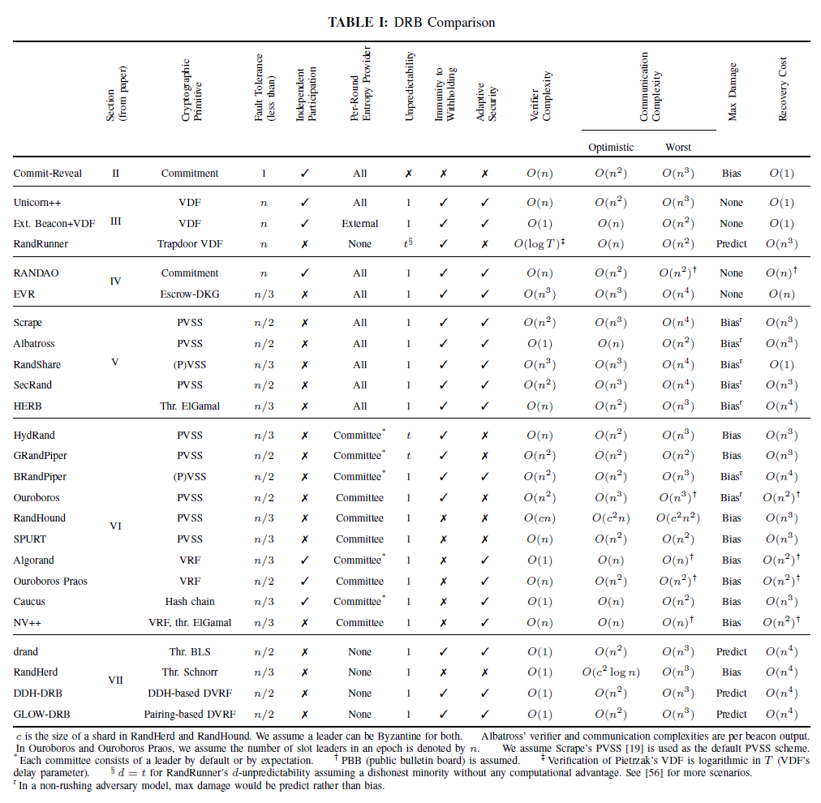
My Contribution & Plans
Worked on systematizing the landscape of DRBs
Submitted to IEEE S&P

Slide 6
My Contribution & Plans
Identified two key components of DRB design
Selection of entropy providers
Beacon output generation
Characterized typical attack vectors (grinding, withholding, adaptive) and countermeasures that can be employed by DRBs
Suggested optimizations to existing DRBs
Advice for practitioners

Slide 7
My Contribution & Plans
Plans (more on this later)
Currently working on a DRB protocol enabling permissionless, ad hoc participation using timed commitments
Research related building blocks
DKG (distributed key generation)
BFT consensus
Asynchrony
VDFs (verifiable delay functions)
Various (non-interactive zero knowledge) proof techniques

Slide 8
DRB System Model
Participants (also called nodes): {P₁, ..., P_{n}} or {1, ..., n}
t-limited adversary: up to t out of n nodes are Byzantine
Fail-stop / withholding
Return incorrect result
Send different results to different nodes
By default, assume:
PKI (public key infrastructure)
Point-to-point authenticated channels
Synchronous network (message delay bound Δ)
PPT (probabilistic polynomial time) adversary
Static adversary (vs adaptive)

Slide 9
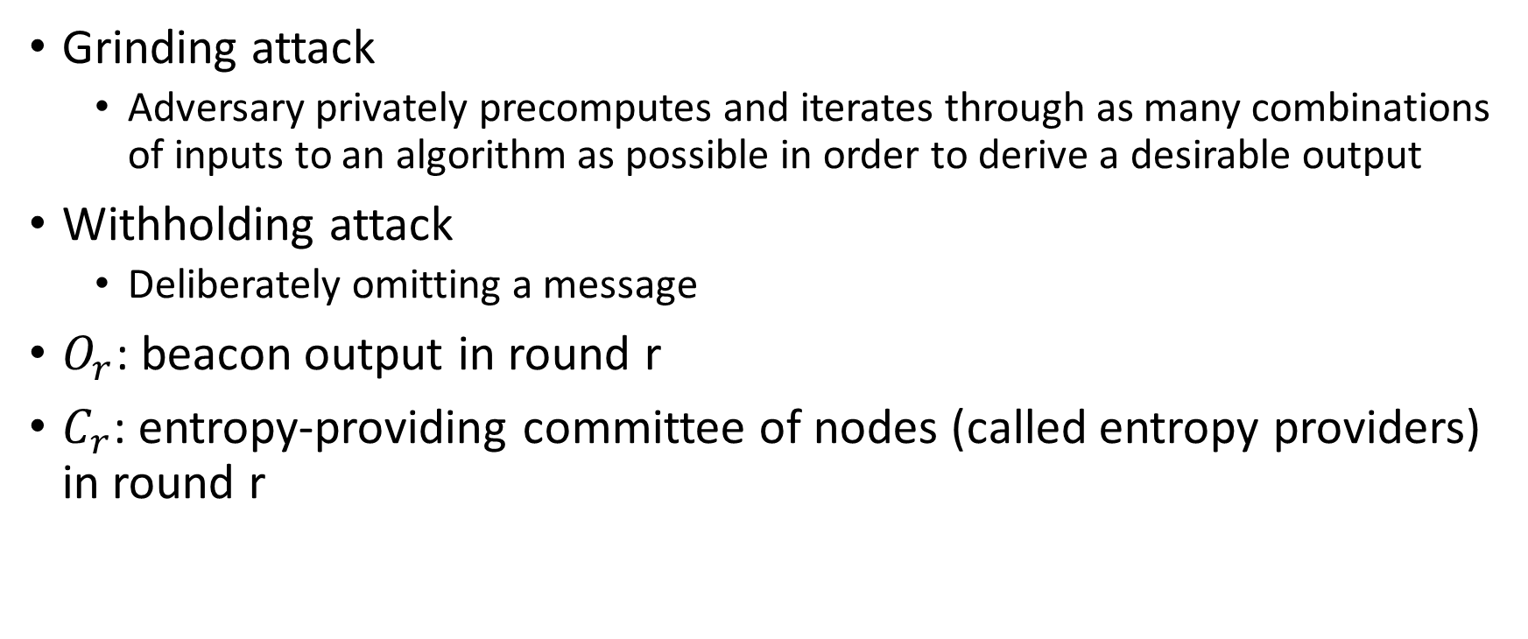
DRB System Model
Grinding attack
Adversary privately precomputes and iterates through as many combinations of inputs to an algorithm as possible in order to derive a desirable output
Withholding attack
Deliberately omitting a message
$O_{r}$: beacon output in round r
$C_{r}$: entropy-providing committee of nodes (called entropy providers) in round r

Slide 10
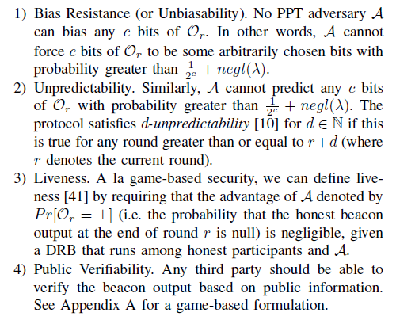
DRB Security Properties
Unbiasability
Unpredictability
Liveness
Public Verifiability

Slide 11

Strawman & Commit-Reveal
Strawman: Rock-Paper-Scissors
Assuming perfect synchrony (Δ = 0)
Commit-Reveal
Commit: publish not e_{i} (entropy contribution), but Com(e_{i}, r_{i})
Reveal: open the commitment by revealing (e_{i}, r_{i})
Main problem: last-revealer attack

Slide 12
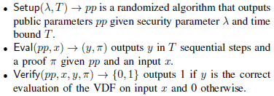
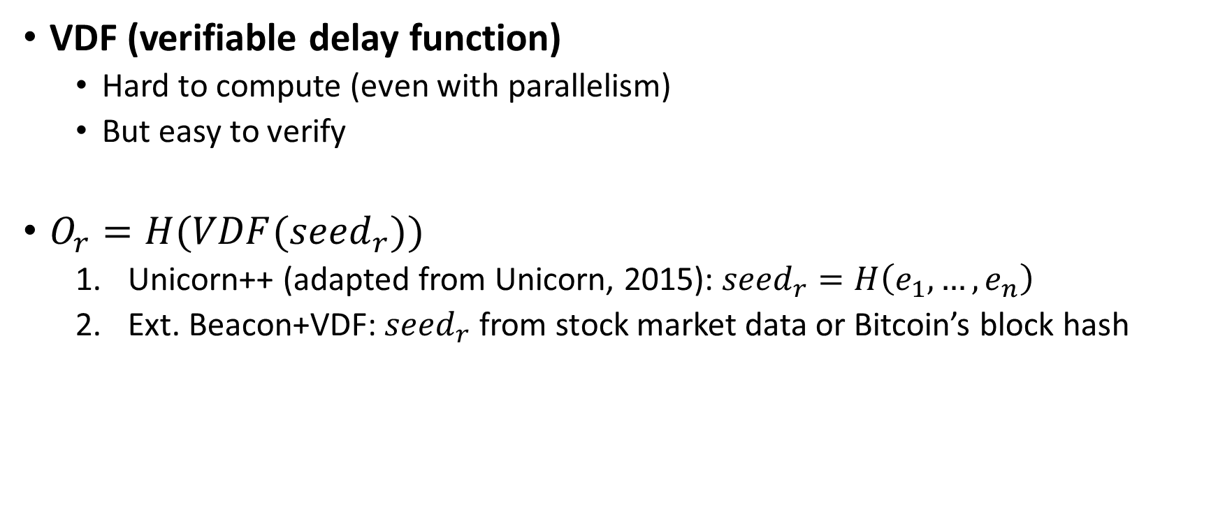
Solution I: Delay-based
VDF (verifiable delay function)
Hard to compute (even with parallelism)
But easy to verify
$O_{r}=H(VDF({seed}_{r}))$
Unicorn++ (adapted from Unicorn, 2015): ${seed}_{r}=H\left(e_{1}, …,e_{n}\right)$
Ext. Beacon+VDF: ${seed}_{r}$ from stock market data or Bitcoin’s block hash

Slide 13
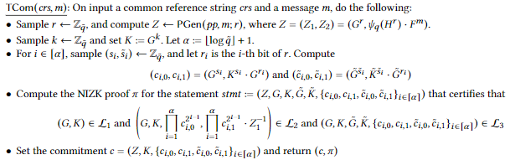
Solution I: Delay-based
Timed commitment (TC)
Commit phase
Open phase
Forced-open phase: similar to computing a VDF (e.g. sequential steps in a group of unknown order)
TC-based DRB (2021)
Optimistic case: no need to wait as in VDF
Worst case: can leverage homomorphic TC to force-open one aggregate TC => scalability

Slide 14
Solution II: Commit-Reveal-Punish
Assumes: financial punishment, escrow (e.g. smart contract on Ethereum), rational participants
RANDAO: punish if no reveal
EVR (Economically Viable Randomness, 2020): realized via DKG used as “threshold” commit-reveal
Common disadvantage: financial assumptions & requirements

Slide 15
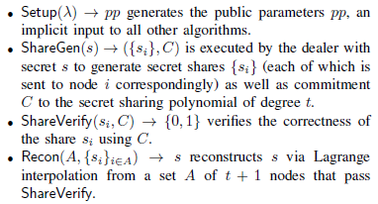
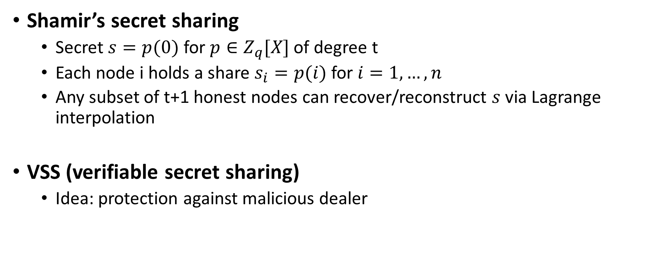
Shamir’s secret sharing, VSS, PVSS, DKG
Shamir’s secret sharing
Secret $s=p(0)$ for $p∈Z_{q}[X]$ of degree t
Each node i holds a share $s_{i}=p(i)$ for $i=1, …, n$
Any subset of t+1 honest nodes can recover/reconstruct $s$ via Lagrange interpolation
VSS (verifiable secret sharing)
Idea: protection against malicious dealer

Slide 16
Shamir’s secret sharing, VSS, PVSS, DKG
PVSS (publicly verifiable secret sharing)
Idea: adds public verifiability (e.g. via non-interactive zero knowledge proofs) to VSS
DKG (distributed key generation)
Idea: group of nodes ends up with a shared “implied” group secret key sk, group public key pk, and individual key pairs (sk_{i}, pk_{i})
t+1 nodes out of n can use sk
Construction: n parallel runs of VSS

Slide 17
Solution III: Commit-Reveal-Recover
∃recovery/reconstruction process in case the last revealer withholds
PVSS-based (Scrape, 2017)
Threshold encryption-based (HERB, 2019)

Slide 18
Solution III: Commit-Reveal-Recover (Scrape)
Commit: commit-reveal’s commit + PVSS sharing
Reveal: commit-reveal’s reveal
Recover: PVSS recovery for withheld secrets (entropy contributions)
Albatross (2020)
Extension of Scrape
O(n²) = O(n) * O(n) beacon outputs per round
O(n) from “packed Shamir’s secret sharing”
O(n) from linear t-resilient functions

Slide 19
Solution III: Commit-Reveal-Recover (HERB)
Threshold encryption-based
Idea: DKG → t+1 honest nodes (rather than all n) can decrypt using the group secret key
DKG vs PVSS
No need for PKI vs needs PKI
Costly setup & reconfiguration (change in set of nodes) vs more flexible setup

Slide 20
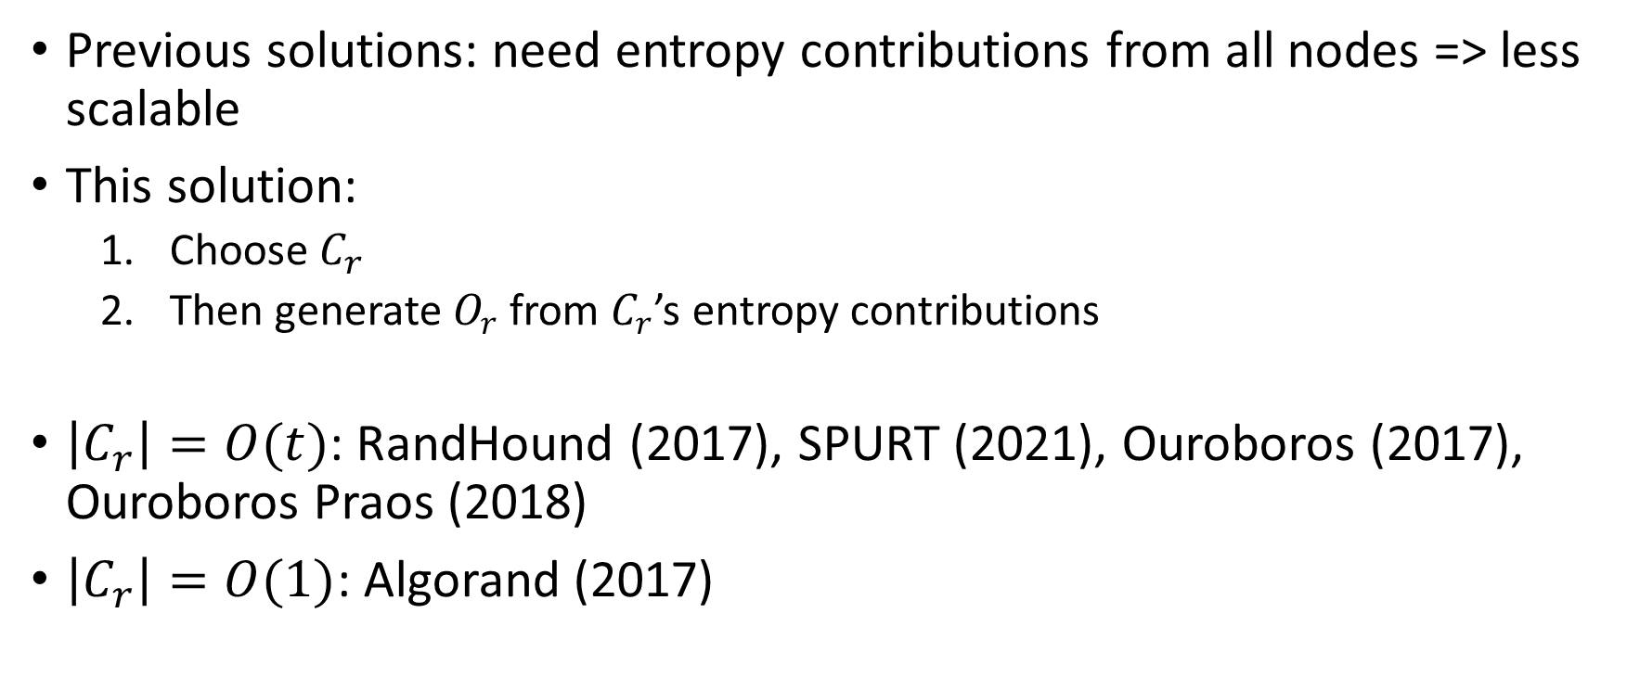
Solution IV: Committee-based DRB
Previous solutions: need entropy contributions from all nodes => less scalable
This solution:
Choose $C_{r}$
Then generate $O_{r}$ from $C_{r}$’s entropy contributions
$\left|C_{r}\right|=O(t)$: RandHound (2017), SPURT (2021), Ouroboros (2017), Ouroboros Praos (2018)
$\left|C_{r}\right|=O(1)$: Algorand (2017)

Slide 21
Solution IV’s Step 1: Committee Selection
Public selection
Round-robin
Random selection
Leader-based selection
Private selection (private lottery)
VRF (verifiable random function), hash chain, mining

Slide 22

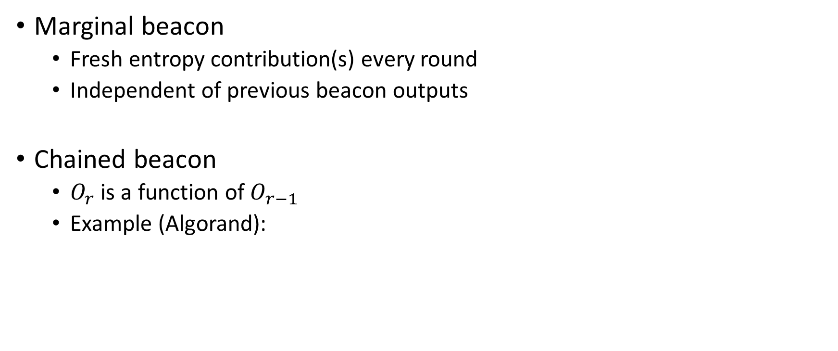
Solution IV’s Step 2: Output Generation
Marginal beacon
Fresh entropy contribution(s) every round
Independent of previous beacon outputs
Chained beacon
$O_{r}$ is a function of $O_{r−1}$
Example (Algorand):

Slide 23
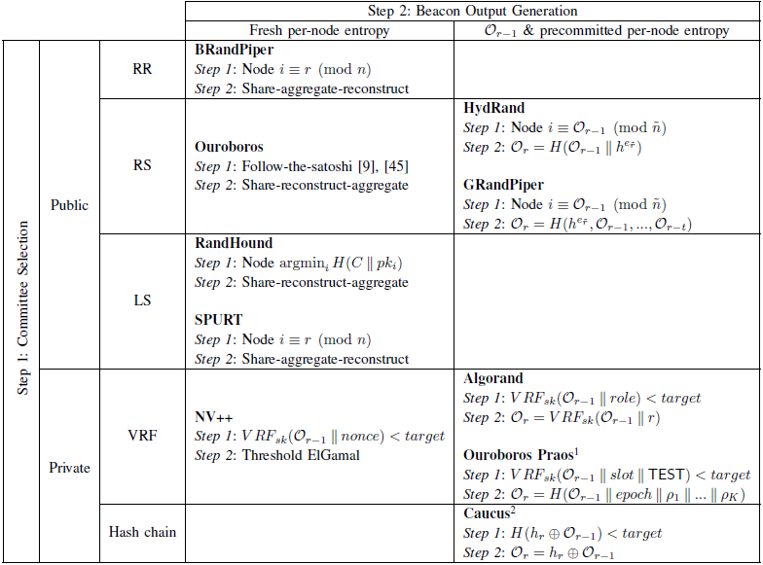

Slide 24

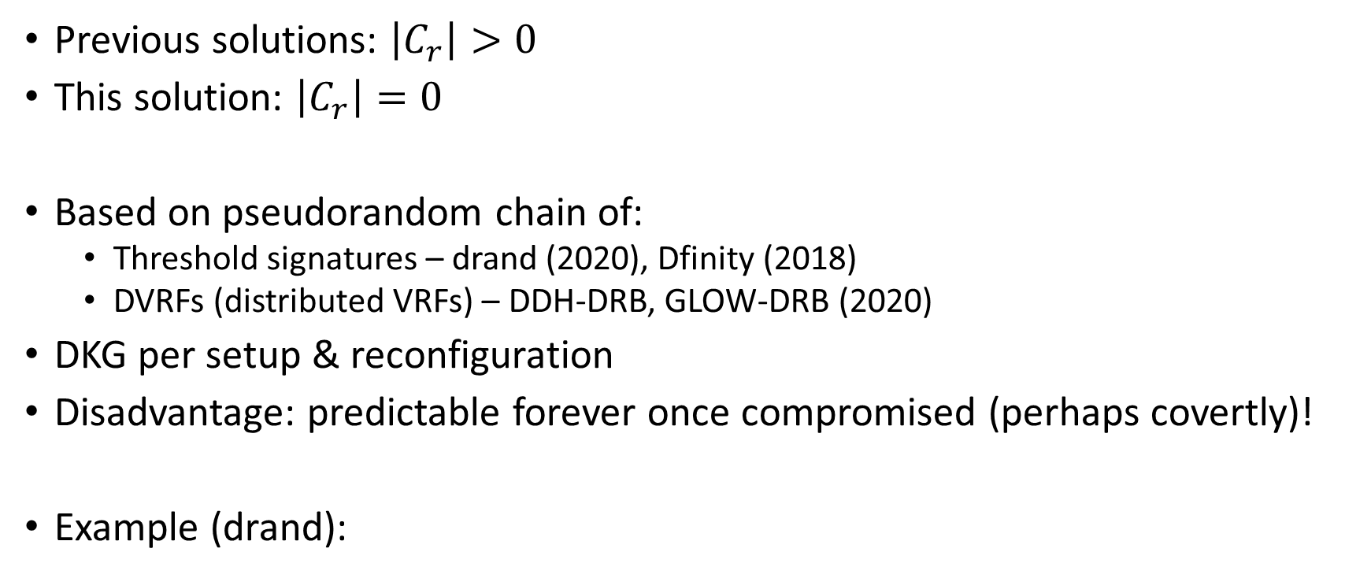

Solution V: $\left|C_{r}\right|=0$
Previous solutions: $\left|C_{r}\right|>0$
This solution: $\left|C_{r}\right|=0$
Based on pseudorandom chain of:
Threshold signatures – drand (2020), Dfinity (2018)
DVRFs (distributed VRFs) – DDH-DRB, GLOW-DRB (2020)
DKG per setup & reconfiguration
Disadvantage: predictable forever once compromised (perhaps covertly)!
Example (drand):

Slide 25
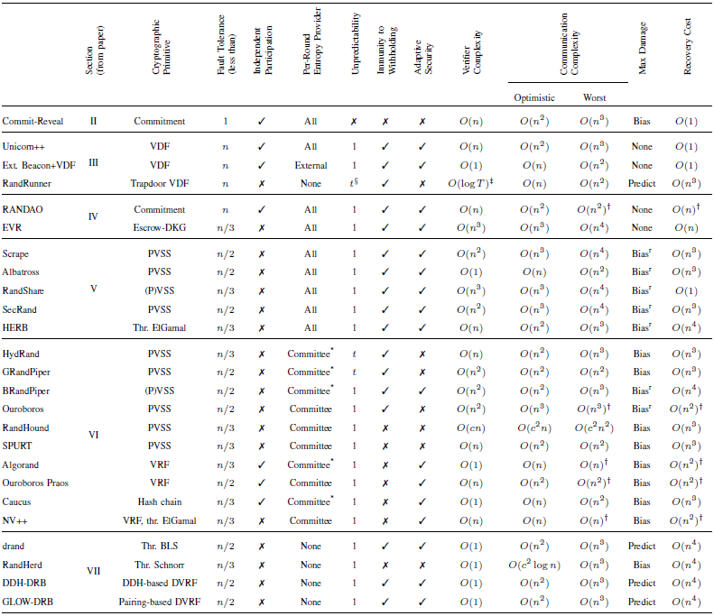

Slide 26
Advice for Practitioners
Four practical considerations
Scalability (in n)
Flexibility (reconfiguration & independent participation)
Robustness (fault tolerance & max damage)
Randomness quality (“true” randomness vs pseudorandomness)

Slide 27
Advice for Practitioners
Delay-based protocols (Solution I) seem best
For non-delay-based, need to think about: size of the set of participants & reconfiguration frequency
Small/static: DKG-based (from Solutions III & V)
Small/dynamic: PVSS-based (from Solution III)
Large/dynamic: PVSS- & committee-based (from Solution IV) or private lottery-based (from Solution IV)
Solution II: for financially-motivated applications (e.g. lotteries)

Slide 28
Plans/WIP
BFT consensus as building block
PBFT (1999)
Tendermint (2016)
SBFT (2019)
HotStuff (2019)
Quick story of IBFT (Istanbul BFT)
https://github.com/ConsenSys/quorum/issues/305
JP Morgan’s Quorum: inspired by PBFT and Tendermint
Issue: possibility of deadlock?
SPURT’s first version used IBFT, the recent version uses HotStuff
DKG as building block
Practical ADKG (asynchronous DKG, 2021)
AVSS (async. verifiable secret sharing) → ACSS (async. complete secret sharing)
Can DKG be reconfiguration-friendly?

Slide 29
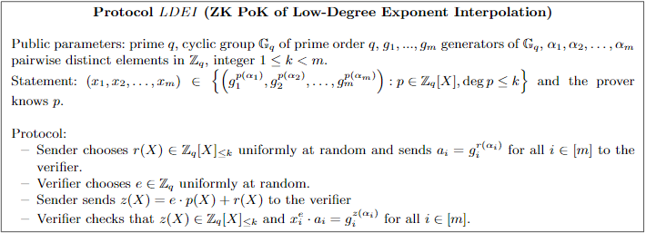
Plans/WIP
Proof techniques as building block
Chaum-Pedersen’s DLEQ → LDEI (low degree exponent interpolation)

Slide 30
Plans/WIP
Proof techniques as building block
Chaum-Pedersen’s DLEQ → LDEI (low degree exponent interpolation)
How about DLEQ across different groups?
Aggregation: MuSig (2018) → MuSig2 (2020)
Plain public key model
Key aggregation
Prenonces to replace precommitment
WIP: TC-based DRB to complement VDF-based approaches
Borrowing concepts from MuSig and MuSig2
Class group implementations (on smart contracts?)

Slide 31
Thank You!

