Slide 1





PIZZA STORE ANALYSIS
-USING SQL
BY - KARTIKAY CHAUDHARY
2K21/EE/158

Slide 2


COMPLETE ANALYSIS OF A PIZZA STORE

Slide 3

INTRODUCTION
The pizza industry is highly competitive, with customers expecting high-quality products, fast service, and a seamless ordering experience. In such a dynamic market, pizza stores need to continually assess their performance to maintain and grow their customer base. This project aims to analyze various aspects of a pizza store's operations, including sales patterns, customer preferences, and operational efficiency, to identify opportunities for improvement and strategic growth.
The analysis will focus on key performance indicators such as sales trends, popular menu items, and customer demographics.
To conduct this analysis, we will utilize data analytics tools and techniques, including sales data analysis, customer details and pizza types. The findings from this analysis will provide actionable recommendations for optimizing the pizza store's operations and enhancing customer satisfaction.

Slide 4


DATASETS AVAILABLE
orders
order_details
pizza_types
pizzas

Slide 5
QUESTIONS/STAKEHOLDERS DEMAND
  Retrieve the total number of orders placed.
  Calculate the total revenue generated from pizza sales.
  Identify the highest-priced pizza.
  Identify the most common pizza size ordered.
  List the top 5 most ordered pizza types along with their quantities.
  Join the necessary tables to find the total quantity of each pizza category ordered.
  Determine the distribution of orders by hour of the day.
  Join relevant tables to find the category-wise distribution of pizzas.
  Group the orders by date and calculate the average number of pizzas ordered per day.
  Determine the top 3 most ordered pizza types based on revenue.
  Calculate the percentage contribution of each pizza type to total revenue.
  Analyze the cumulative revenue generated over time.
  Determine the top 3 most ordered pizza types based on revenue for each pizza category.

Slide 6


1) Retrieve the total number of orders placed.
QUERY -
RESULT -

Slide 7
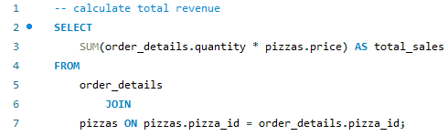

2) Calculate the total revenue generated from pizza sales.
QUERY -
RESULT -

Slide 8
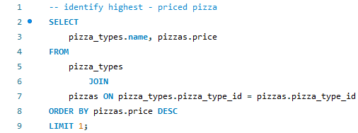

3) Identify the highest-priced pizza.
QUERY -
RESULT -

Slide 9
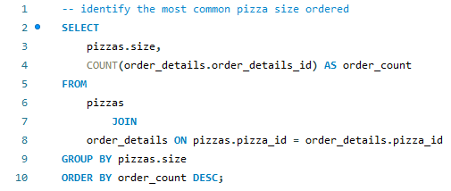
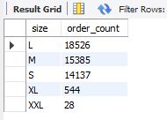
4) Identify the most common pizza size ordered.
QUERY -
RESULT -

Slide 10

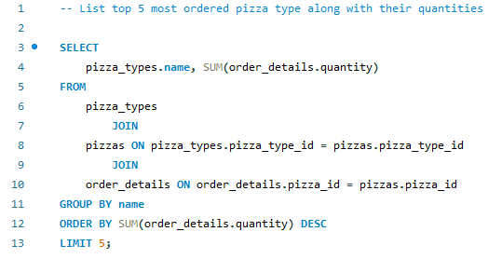
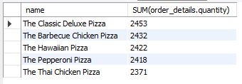
5) List the top 5 most ordered pizza types along with their quantities.
QUERY -
RESULT -

Slide 11
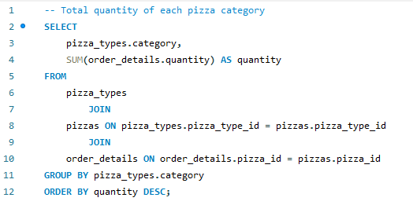
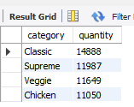
6) Join the necessary tables to find the total quantity of each pizza category ordered.
QUERY -
RESULT -

Slide 12
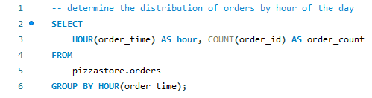
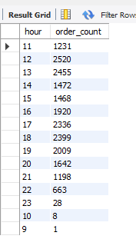
7) Determine the distribution of orders by hour of the day.
QUERY -
RESULT -

Slide 13
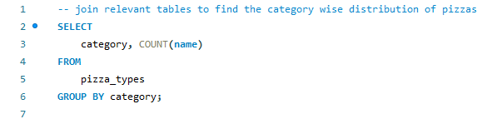
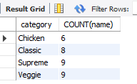
8) Join relevant tables to find the category-wise distribution of pizzas.
QUERY -
RESULT -

Slide 14
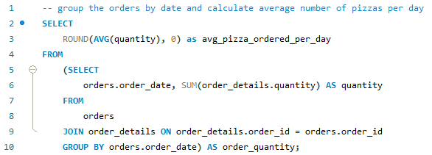

9) Group the orders by date and calculate the average number of pizzas ordered per day.
QUERY -
RESULT -

Slide 15

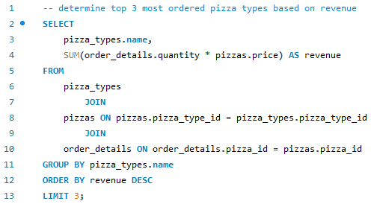
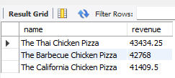
10) Determine the top 3 most ordered pizza types based on revenue.
QUERY -
RESULT -

Slide 16
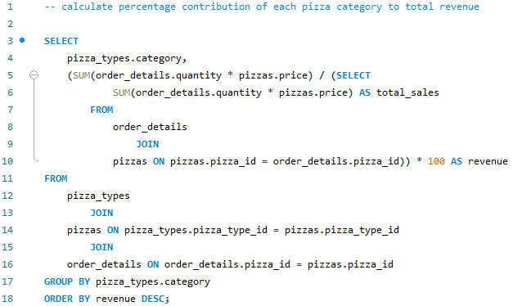
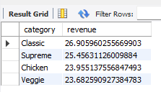
11) Calculate the percentage contribution of each pizza type to total revenue.
QUERY -
RESULT -

Slide 17
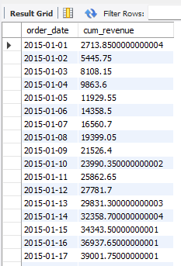
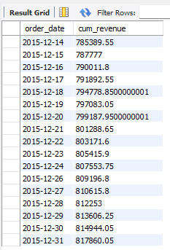
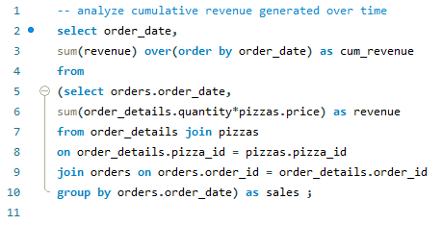
12) Analyze the cumulative revenue generated over time.
RESULT -
QUERY -

Slide 18
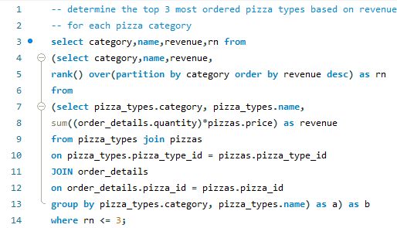
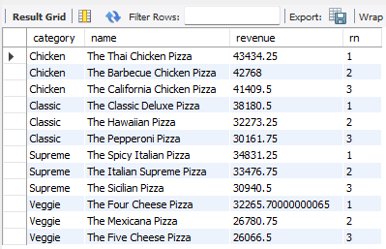
13) Determine the top 3 most ordered pizza types based on revenue for each pizza category.
QUERY -
RESULT -

Slide 19
Thank You
BY - KARTIKAY CHAUDHARY
2K21/EE/158

