Slide 1
SmartCheck: UI Design & Frontend Implementation
Where Presence Meets Precision
PRESENTED BY GROUP12

Slide 2

SmartCheck - App Identity
Introducing SmartCheck
"Where Presence Meets Precision"
Core UI/UX Goals:
Intuitive & Accessible
Clear & Professional Visuals
Seamless Navigation

Slide 3


Visual Design Language
SmartCheck's Look & Feel
Color Palette:
- Primary -> 007EFC,
- Secondary -> 003366,
- Background -> 000000(Black), FFFFFF(White)
Typography: Nunito and italliano
Layout: Clean, user-centric, clear hierarchy.

Slide 4
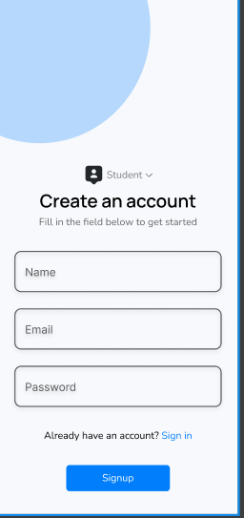
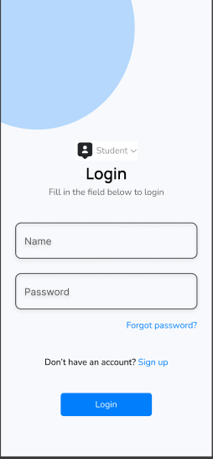
Frontend: Login & Signup UI
SmartCheck: Authentication Screens
Key Implementation: Built with React Native, Client-side Validation.

Slide 5
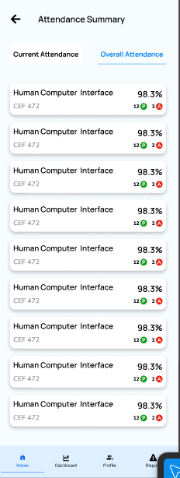
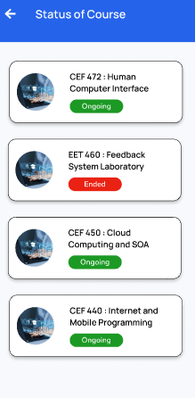
Frontend: Student Dashboard UI
SmartCheck: Student Course Status
Implementation: Core layout, navigation, component structure

Slide 6
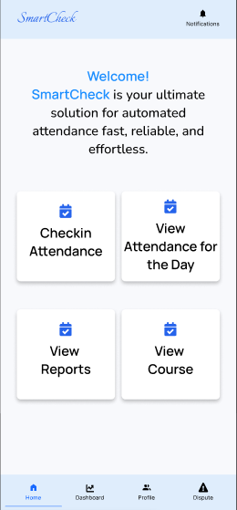
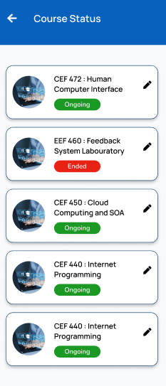
Frontend: Lecturer Dashboard UI
SmartCheck: Lecturer Homepage
Implementation: Role-specific view, foundational UI elements.

Slide 7
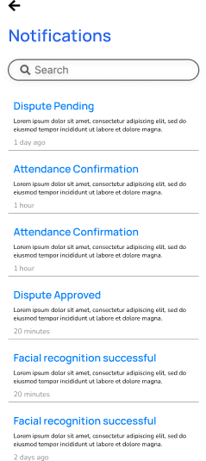
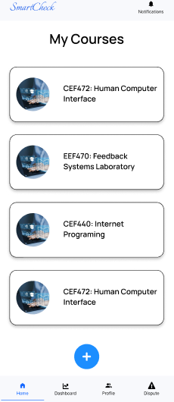
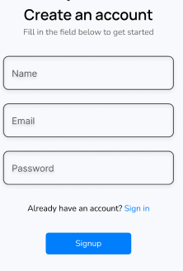
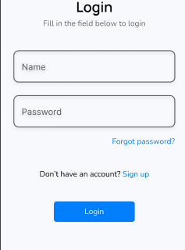
Frontend: Common UI Components
SmartCheck: Consistent UI Elements
Implementation: Reusable components for consistency.
Notification
Courses
Forms

Slide 8
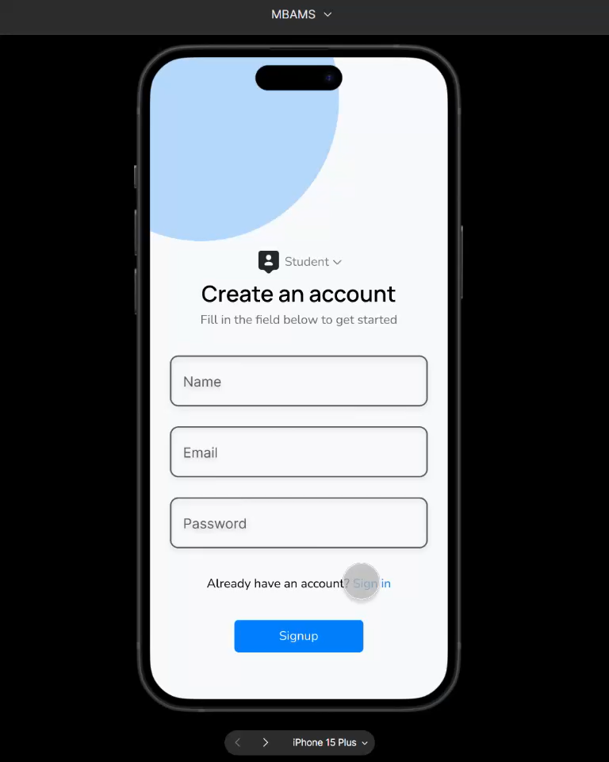
UI Prototype Demo

Slide 9



Frontend Technology Stack
Building SmartCheck: Our Frontend Tech

Slide 10
Implementation Status & Next Steps
SmartCheck: Frontend Progress
Implemented:
App Identity & Visual Design Defined
Core UI Screens (Login, Signup, etc)
General UI Components & Navigation
Next Steps (Frontend):
Dashboard interactivity
Connect to mock APIs
Initial Attendance Marking UI

Slide 11
Thank You!

