Slide 1

SmartCheck: Database Design & Backend Implementation
Building the Foundation for "Where Presence Meets Precision"
PRESENTED BY GROUP12

Slide 2
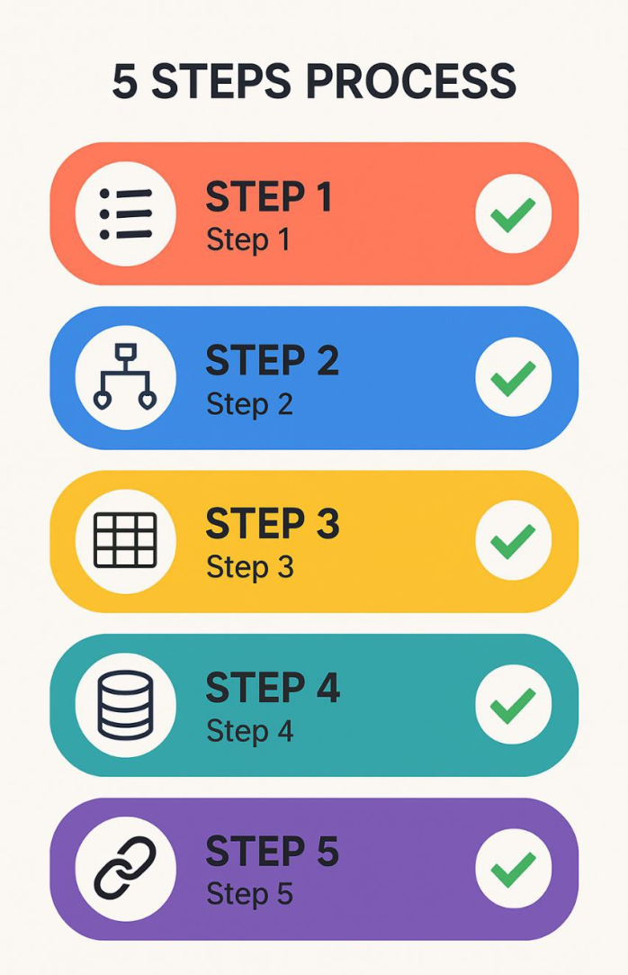
Task Overview - Database Journey
Objective: To design and implement a robust, scalable, and normalized database for SmartCheck.
Key Stages Covered:
Data Element Identification
Conceptual Design (ER Diagram)
Logical Design (Relational Schema)
Database Implementation (SQL DDL)
Backend & Database Connection (Initial Steps)

Slide 3
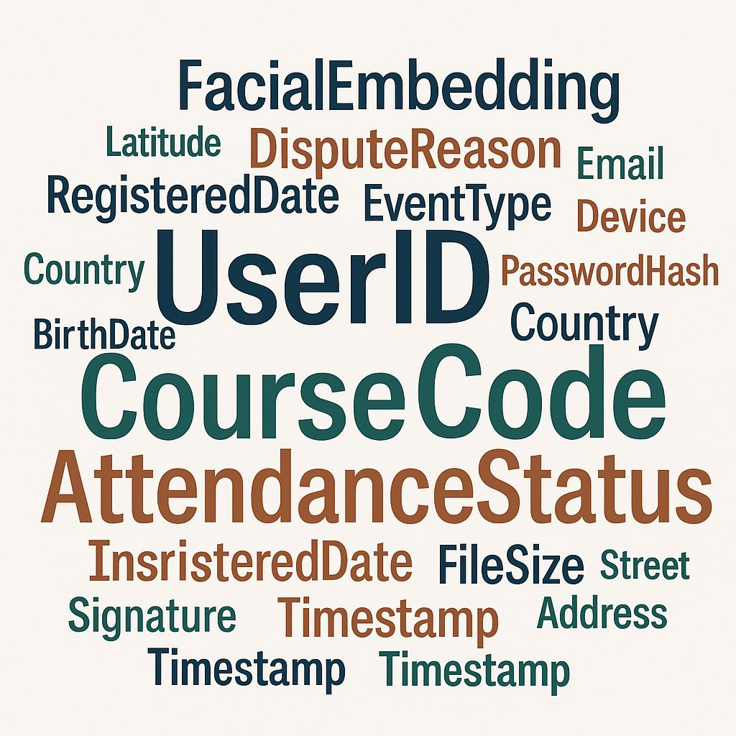
Step 1: Identifying Data Elements
Process:
Analyzed system requirements (SRS, Class Diagram) to list all necessary data points for SmartCheck.
Examples of Data Categories Identified:
User Information (Common, Student, Lecturer, Admin)
Course & Session Details
Attendance Records
Facial Recognition Data
Geofencing Parameters
Disputes & Leave Requests
System Logs & Settings

Slide 4
Step 2: Conceptual Design - The ER Diagram
Purpose of ERD: To create a high-level model showing our system's main entities and how they relate to each other.
Key Entities Highlighted:
User (Student, Lecturer, Admin)
Course, CourseSession, AttendanceRecord
FacialData, GeofenceLocation, Dispute

Slide 5
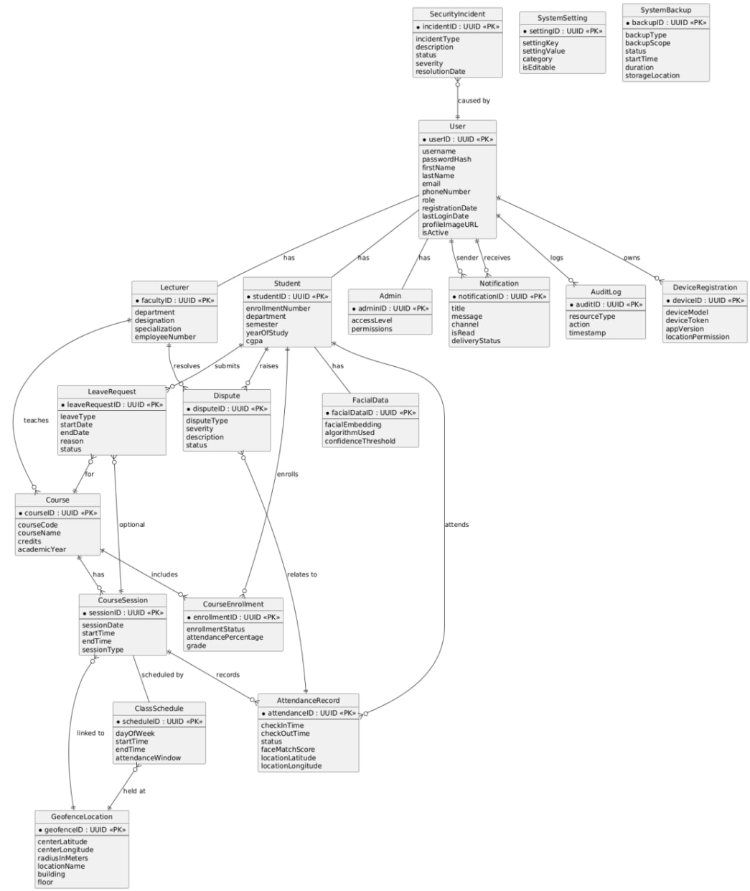

Slide 6
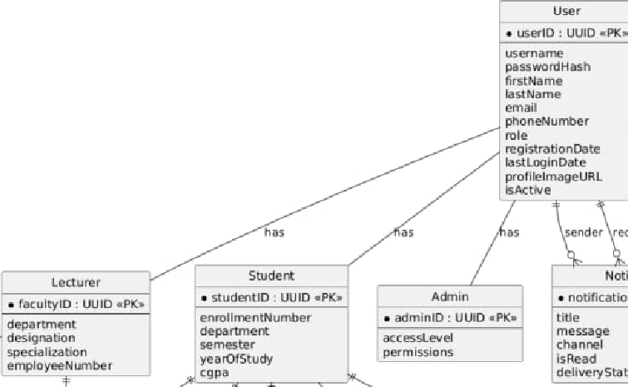
ER Diagram - Core Relationships Example
User Specialization (1:1):
User <--> Student
User <--> Lecturer
Each Student/Lecturer IS A User, inheriting common attributes. Course Enrollment (M:N resolved):
Student <--- CourseEnrollment ---> Course
Students and Courses have a many-to-many relationship, managed by the CourseEnrollment table.

Slide 7
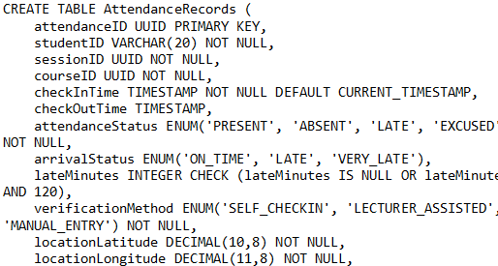
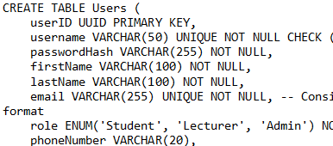
Step 3: Logical Design - Database Schema
Process:
Translated the ERD into a detailed relational schema.
Defined tables, columns, data types, and constraints (PK, FK, NOT NULL, UNIQUE).
Focused on normalization (primarily 3NF) to ensure data integrity and reduce redundancy.
Example Table Structure (Show 1-2 key tables):

Slide 8
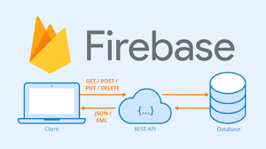
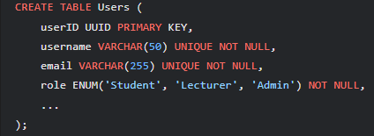
Step 4: Database Implementation - SQL DDL
Process:
We wrote SQL Data Definition Language (DDL) statements (CREATE TABLE) based on the schema.
Implemented primary keys, foreign keys, data types, and constraints.
We chose Firebase for implementation.
DDL Snippet (Illustrative):

Slide 9
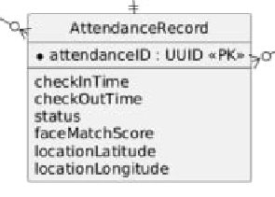
Key Table Example: AttendanceRecords
Purpose: This crucial table stores every attendance instance, linking students, sessions, and verification data.
Key Columns & FKs:
attendanceID (PK)
studentID (FK to Students)
sessionID (FK to CourseSessions)
courseID (FK to Courses)
checkInTime, attendanceStatus, verificationMethod
locationLatitude, locationLongitude, faceMatchScore

Slide 10
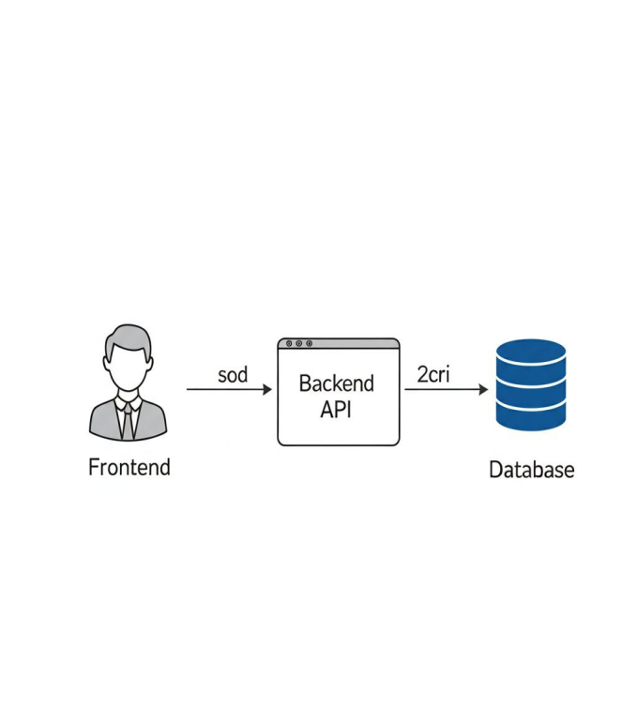
Step 5 & 6: Backend & Database Connection (Initial Stages)
Backend Implementation (Overview):
Started backend development using Node.js/Express.
Defining API endpoints for core functionalities (e.g., user auth, course data).
Business logic will interact with the database via these APIs.
Database Connection:
Established initial connection between the backend application and the SmartCheck database.
Using [ORM/Driver, e.g., Sequelize, SQLAlchemy, JDBC/ODBC driver] for database interaction.

Slide 11
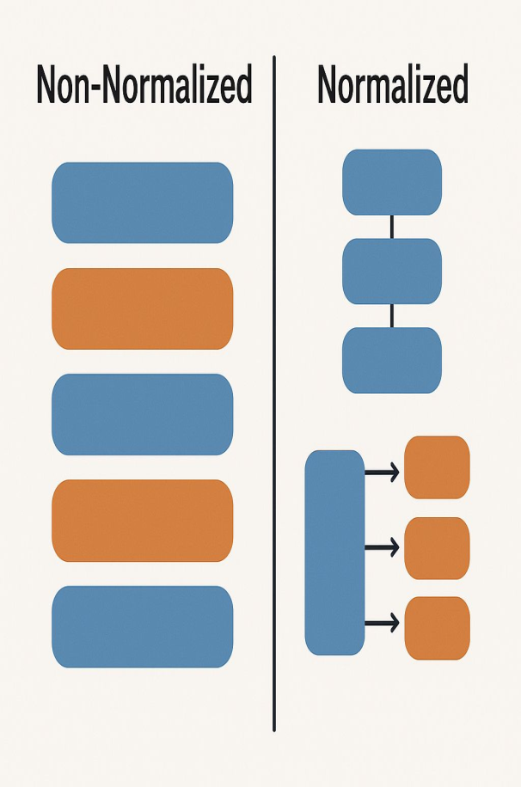
Normalization & Data Integrity
Normalization:
Schema designed to 3rd Normal Form (3NF).
Benefits: Reduced data redundancy, minimized update anomalies, improved data consistency.
Data Integrity Mechanisms:
Primary Keys: Ensure unique record identification.
Foreign Keys: Maintain referential integrity between tables.
NOT NULL, UNIQUE, CHECK Constraints: Enforce data rules at the database level.

Slide 12
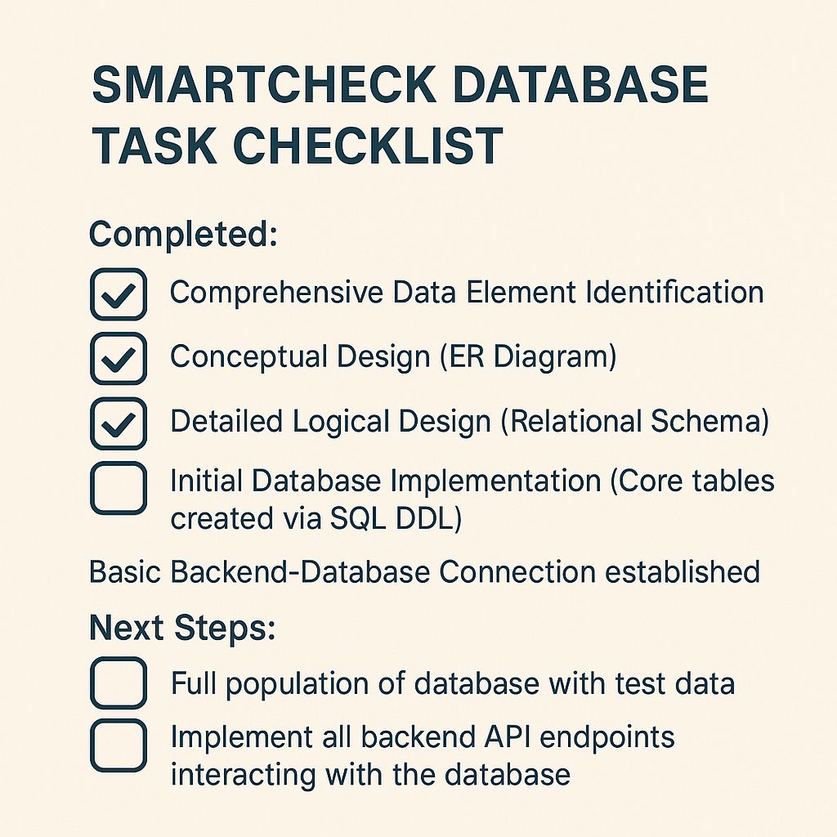
Current Status & Next Steps
Completed for Task 6:
Comprehensive Data Element Identification.
Conceptual Design (ER Diagram).
Next Steps:
Refine indexes based on query performance testing.
Develop stored procedures/triggers if needed for complex logic/auditing

Slide 13
THANK YOU

