Slide 1
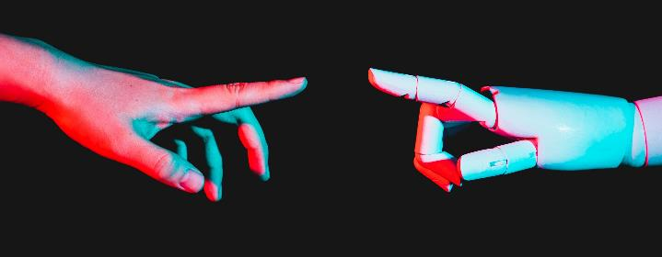
GROUP 12
Mobile based Attendance management system based on geofencing and facial recognition
TASK 4: SYSTEM MODELLING AND DESIGN

Slide 2
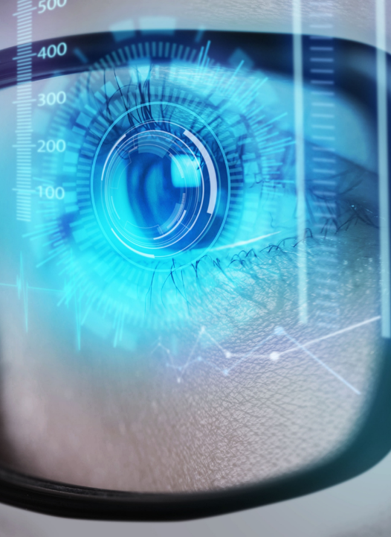
AGENDA
The essence of UML diagrams in the development life cycle
Use case diagram
Class diagram
Context diagram
Data flow diagram
Sequence diagram
Deployment diagram

Slide 3
THE ESSENCE OF UML DIAGRAMS
Use Case Diagram: Shows user interactions like marking and viewing attendance.
Class Diagram: Defines system data entities and their relationships.
Sequence Diagram: Illustrates step-by-step processes (example: marking attendance).
Deployment Diagram: Displays physical system setup : mobile devices, servers, and databases.
Context Diagram: Outlines the system boundary and external interactions.
Data Flow Diagram (DFD): Visualizes how data moves between processes, data stores, and users.

Slide 4
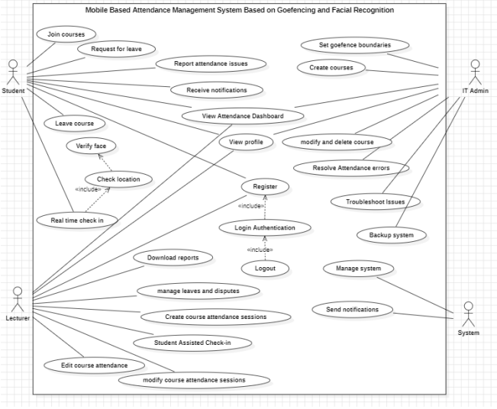
USECASEDIAGRAM
Primary actors: Students and Lecturers
Secondary actors: IT Admin and System
Students: Join courses, mark attendance, verify identity, request leave,report attendance issues,view attendance dashboard and profile
Lecturers: Manage attendance sessions, handle disputes, download reports
IT Admin: Manage configurations, courses, and system maintenance
System: Handle notifications, logins, and background operations

Slide 5
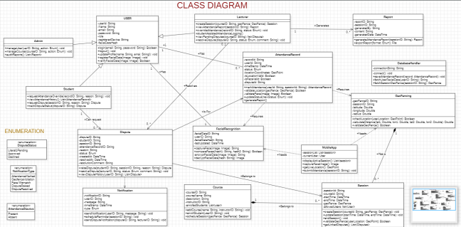
CLASS DIAGRAM
Key Classes: User, Student, Lecturer, Admin, Course, Attendance, Notification
User class: Superclass with attributes like userId, name, email, password, role.
Student, Lecturer,Admin: Inherit from User
Course: Contains courseId, courseName, lecturerId, description
Attendance: Records attendanceId, studentId, courseId, date, status
Notification: Includes notificationId, title, message, timestamp Relationships:User linked to multiple Attendance records. Course associated with multiple Students and a Lecturer. Notifications sent to Users

Slide 6
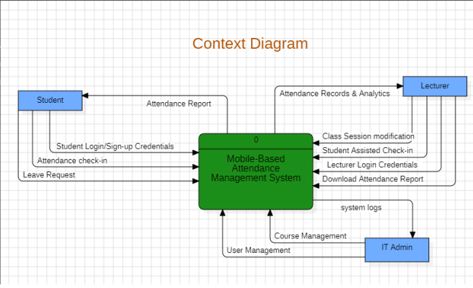
Contex diagram
External Entities: Student, Lecturer, IT Admin
System: Mobile-Based Attendance Management System
Student sends: Login credentials, check-ins, leave requests
Student receives: Attendance reports
Lecturer sends: Class session updates, assisted check-ins, login credentials Lecturer receives: Attendance records, analytics, reports
IT Admin sends: User and course management data and IT Admin receives: System logs

Slide 7
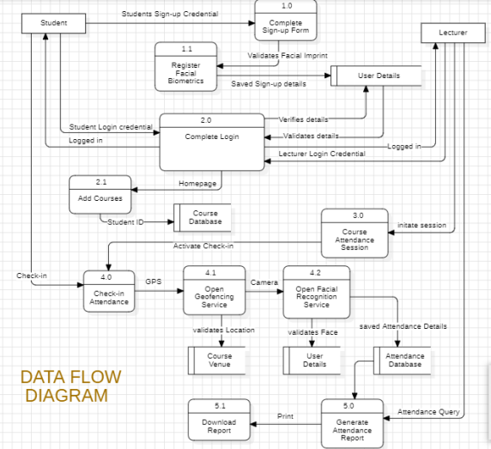
DATADLOW DIAGRAM
User Registration & Login Students sign up using a form and facial biometrics. Lecturers log in with their credentials. The system verifies all credentials.
Course Management Students add their courses to the system using their Student ID. Course data is stored in the course database.
Attendance Session Initiation Lecturers start an attendance session from their dashboard, which activates check-in.
Student Check-In Process Students check in by validating their GPS location and face using geofencing and facial recognition services. Validated attendance is stored.
Report Generation Lecturers can generate and download attendance reports based on stored data.

Slide 8
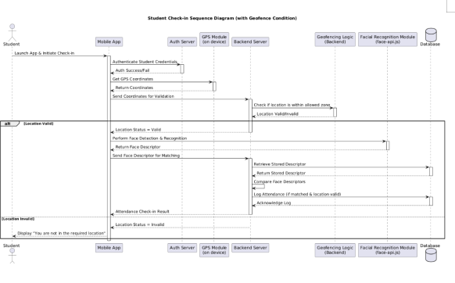
SEQUENCE DIAGRAM
Student opens the app and starts the check-in process.
Mobile app authenticates the student and retrieves GPS coordinates.
Location is verified via geofencing logic on the backend.
If location is valid:
The app captures the student’s face.
Face is matched with stored data using facial recognition.
If both match, attendance is logged successfully.
If location is invalid:App notifies the student they’re not at the required location.

Slide 9
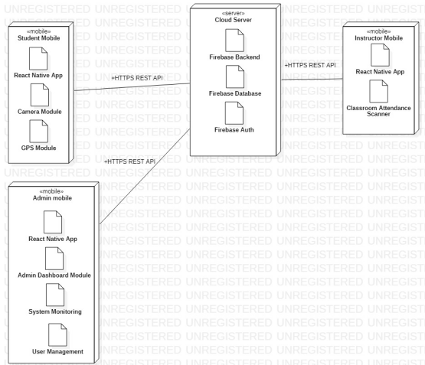
Deployment diagram
Student Mobile AppBuilt with React Native, includes camera and GPS modules for check-in.
Instructor Mobile App Uses React Native and a classroom attendance scanner to monitor student presence.
Admin Mobile App Built in React Native, includes modules for dashboard access, system monitoring, and user management.
Cloud Server Central backend using Firebase (Auth, Database, and Logic), communicates with all apps via secure HTTPS REST APIs.

Slide 10
conclusion
The diagrams provide a clear overview of the system’s structure and processes, including secure check-in using GPS and facial recognition, and interactions between mobile apps and backend services. They lay a strong foundation for the next step: UI design and implementation, helping ensure a smooth, efficient transition to building a functional and user-friendly system.

Slide 11
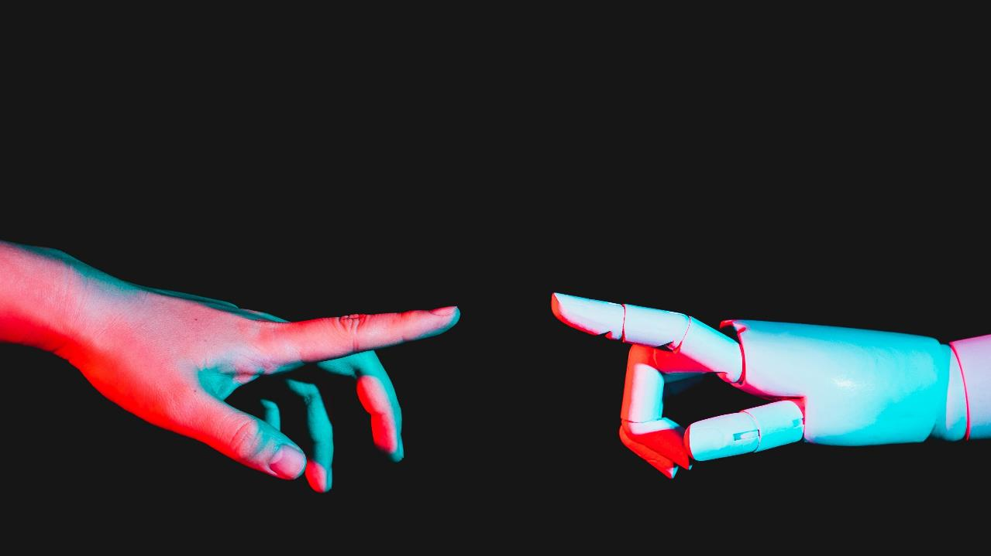
Thank you

