Slide 1
Carving Robot Arm Control
263C Control of Robotics Systems
Team #2
Andy Choi
Dooseop Song

Slide 2
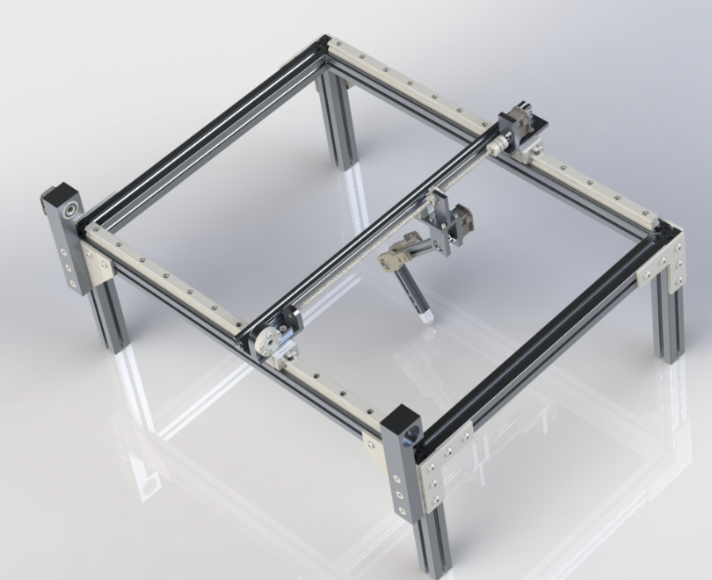
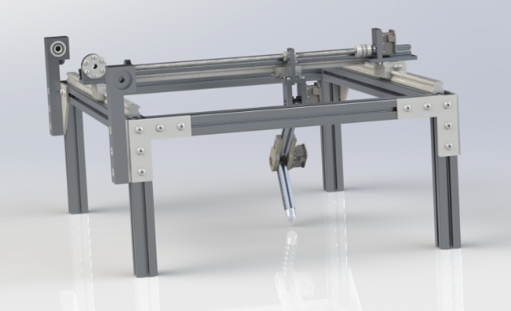
Design of the robot

Slide 3
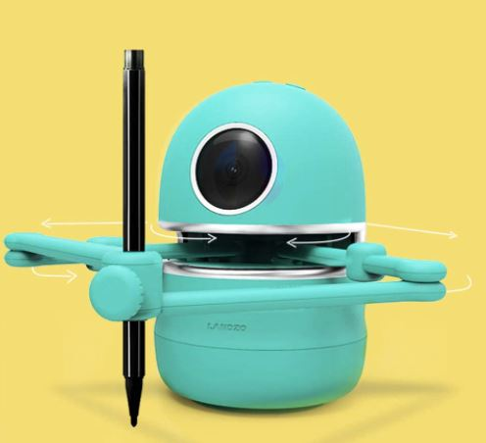
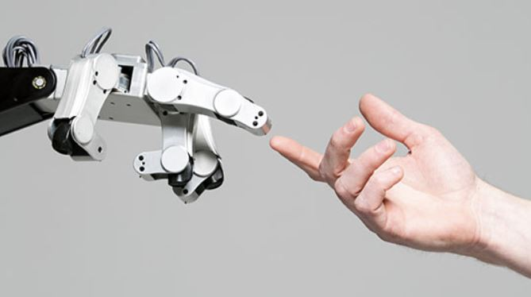
Overview of the project
How can we make robot more close to our life?
Sensitive interaction between
robot and human is necessary
https://www.amazon.com/BOOBI-Educational-Painting-Mathematical-Calculation/dp/B085XFYKHP
https://asegrad.tufts.edu/academics/explore-graduate-programs/human-robot-interaction

Slide 4

Objectives of controller design
Purpose : Carving cube to make wooden signs using two different control methods
Free motion: Joint Space Inverse Dynamics Control
To move in the z-direction of 10cm
Force and motion: Hybrid Force/Motion Control
To carve wood by 1 cm deep in z- direction
Move along the trajectory line of 20 cm or 15 cm along the y-direction
https://www.customlogosigns.com/custom-wood-signs.html

Slide 5
Stiffness Calculation
Cedar, northern white wood
Y = Young’s Modulus = 4400MPa = 440000 N/cm²
A = 0.01cm², L = 2cm
k = Y*A/L
k = 2200 N/cm = 220000 N/m
https://amesweb.info/Materials/Youngs-Modulus-of-Wood.aspx

Slide 6
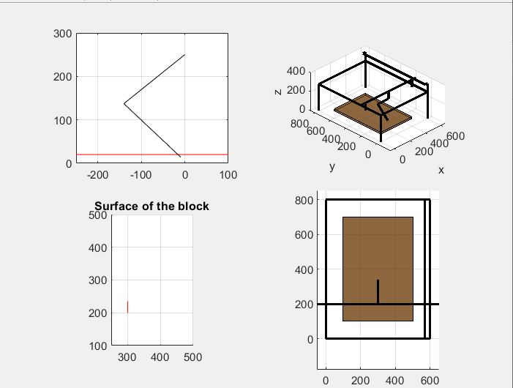
Assumptions
Frictionless Y-direction
Robot’s initial point
Rotating cube
Robot’s and motor’s parameters
The stiffness of the material
Trapezoidal velocity profile

Slide 7
Flow Diagram
No
Start
Move Down
Carve
Carve
Move Up / End?
End
Yes
Hybrid Force/Motion Control
Joint Space Inverse Dynamics Controller

Slide 8
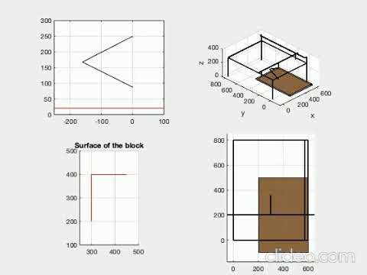
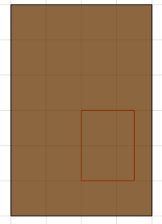
Results of the Project
Simulation
https://www.youtube.com/watch?v=nihArZl8k4I

Slide 9
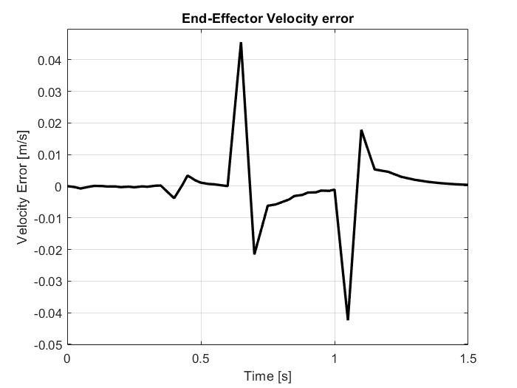
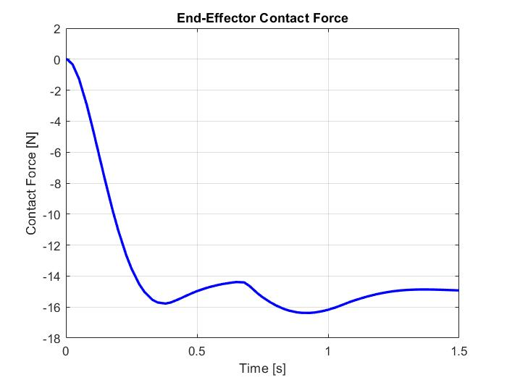
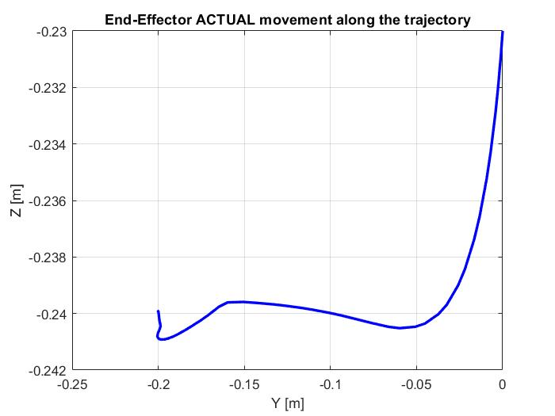

Hybrid Force / Motion Controller Results
Stiffness | K = 1500 (Stiffness of the cube material)
Gains | KP_lamda | KD_lamda | KP_nu | KI_nu
 | 60 | 10 | 10 | 80
1cm deep along z
20cm move along y
https://creativemarket.com/Drum-magic/1384614-Smile-Icon

Slide 10
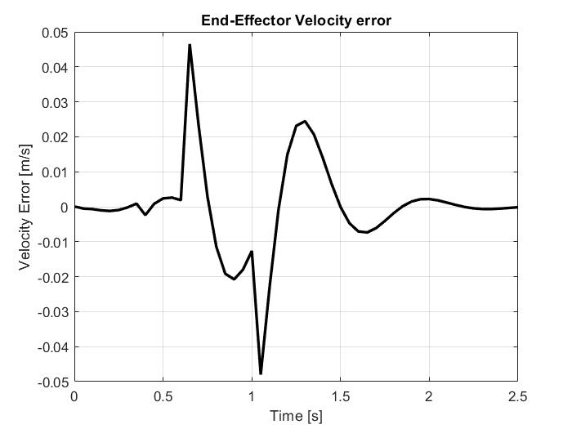
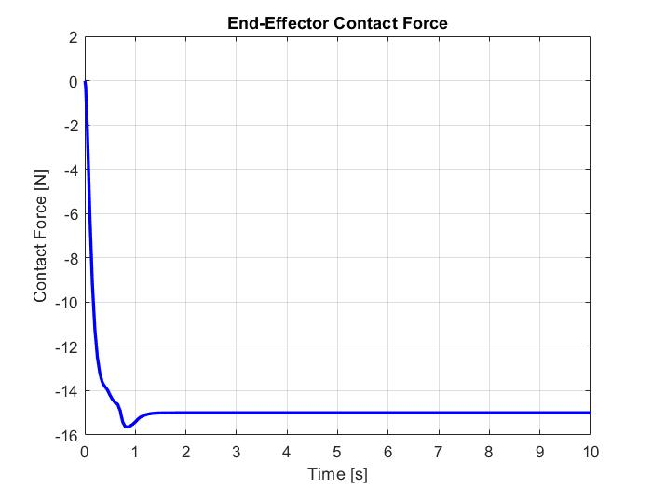
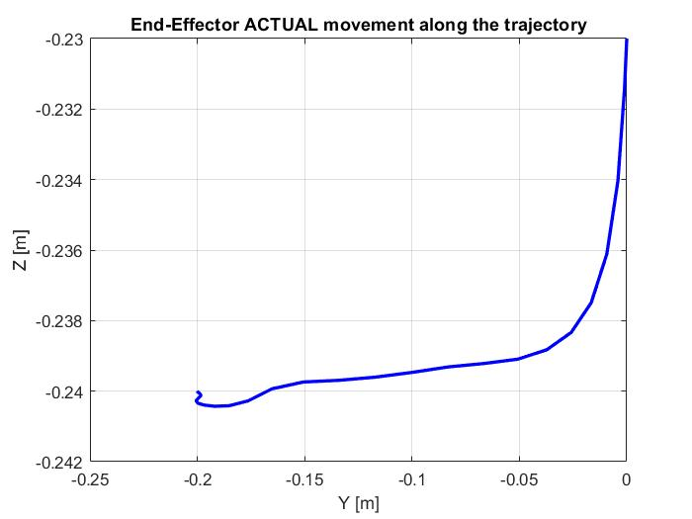

Hybrid Force / Motion Controller Results
Stiffness | K = 1500 (Stiffness of the cube material)
Gains | KP_lamda | KD_lamda | KP_nu | KI_nu
 | 100 | 20 | 10 | 80
https://creativemarket.com/Drum-magic/1384614-Smile-Icon

Slide 11
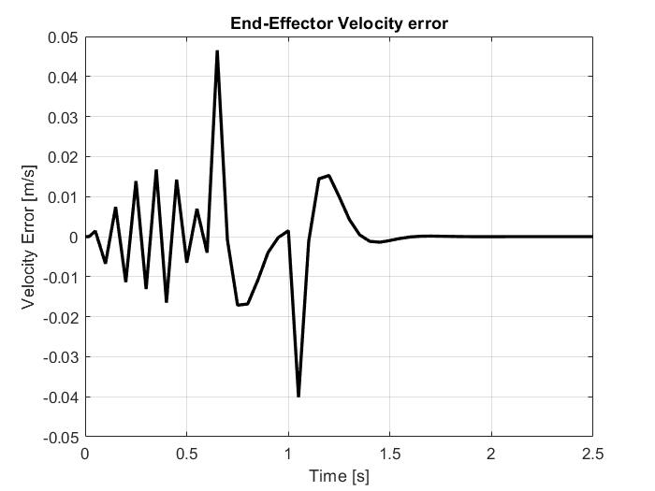
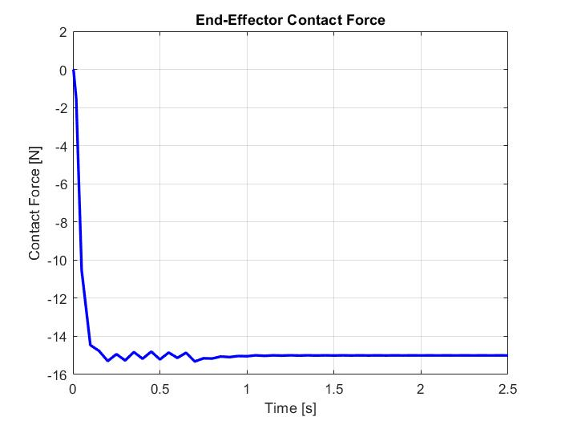
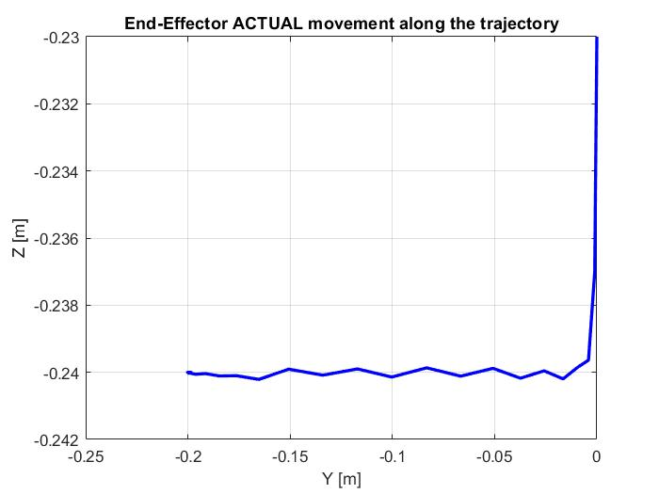

Hybrid Force / Motion Controller Results
Stiffness | K = 1500 (Stiffness of the cube material)
Gains | KP_lamda | KD_lamda | KP_nu | KI_nu
 | 500 | 40 | 20 | 100
https://creativemarket.com/Drum-magic/1384614-Smile-Icon

Slide 12
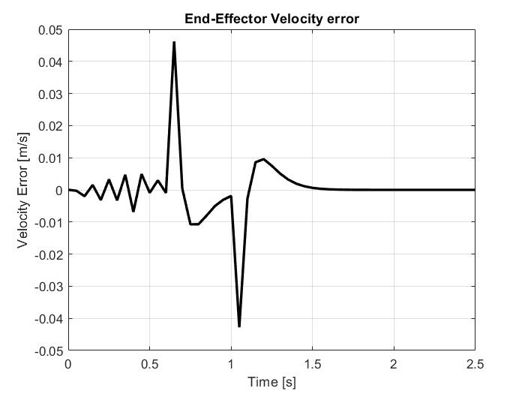
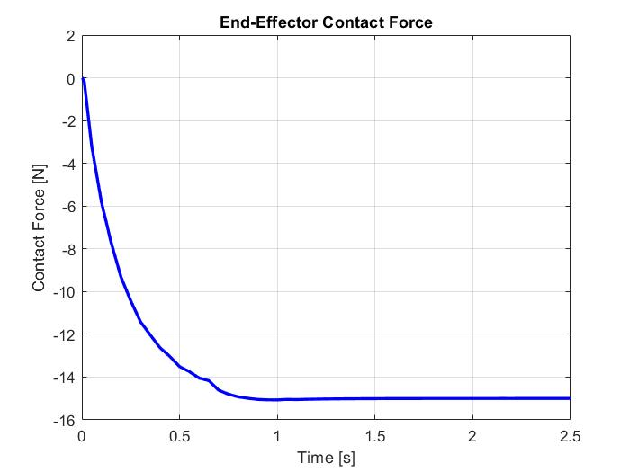
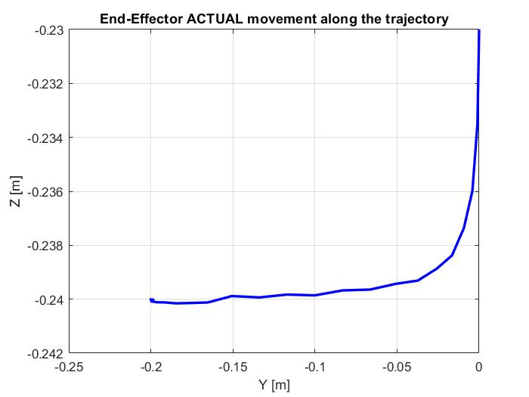

Hybrid Force / Motion Controller Results
Stiffness | K = 1500 (Stiffness of the cube material)
Gains | KP_lamda | KD_lamda | KP_nu | KI_nu
 | 240 | 40 | 20 | 100
https://creativemarket.com/Drum-magic/1384614-Smile-Icon

Slide 13
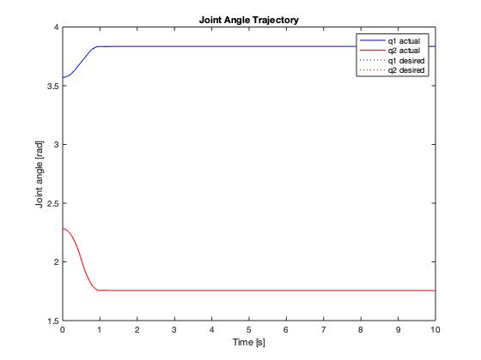
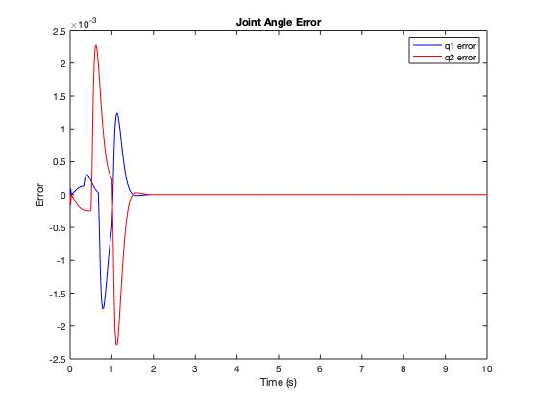
Joint Space Inverse Dynamics Controller
Kp = 100, Kd = 16, from ω_{n} = 10 rad/s, 𝛇 = 0.8

Slide 14
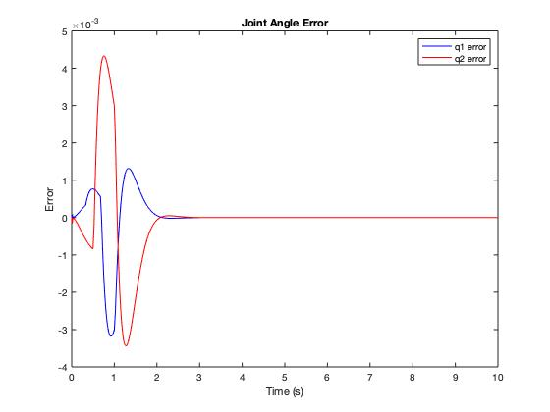
Joint Space Inverse Dynamics Controller
Kp = 25, Kd = 8, ω_{n} = 5 rad/s, 𝛇 = 0.8

Slide 15
Discussion
Capabilities
Joint Space Inverse Dynamics Control
Able to move down in almost a straight path
Hybrid Force/Motion Control
Carve the surface in a 1 cm deep with clear cut of both left and right ends
Apply consistent 15 N/m force on the cube
Limitations
Joint Space Inverse Dynamics Control
Inverse Kinematics
Hybrid Force/Motion Control
Gain tuning issue : Waterbed effect
Methods to improve the performance except gain values

Slide 16
Challenges
Change in group members
Controller choices
Mistakes in robot design at beginning of the project

Slide 17
Future work
Prismatic joint control
Control in both force and motion along the same direction
Stiffness of the block

Slide 18
THANK YOU

