Slide 1
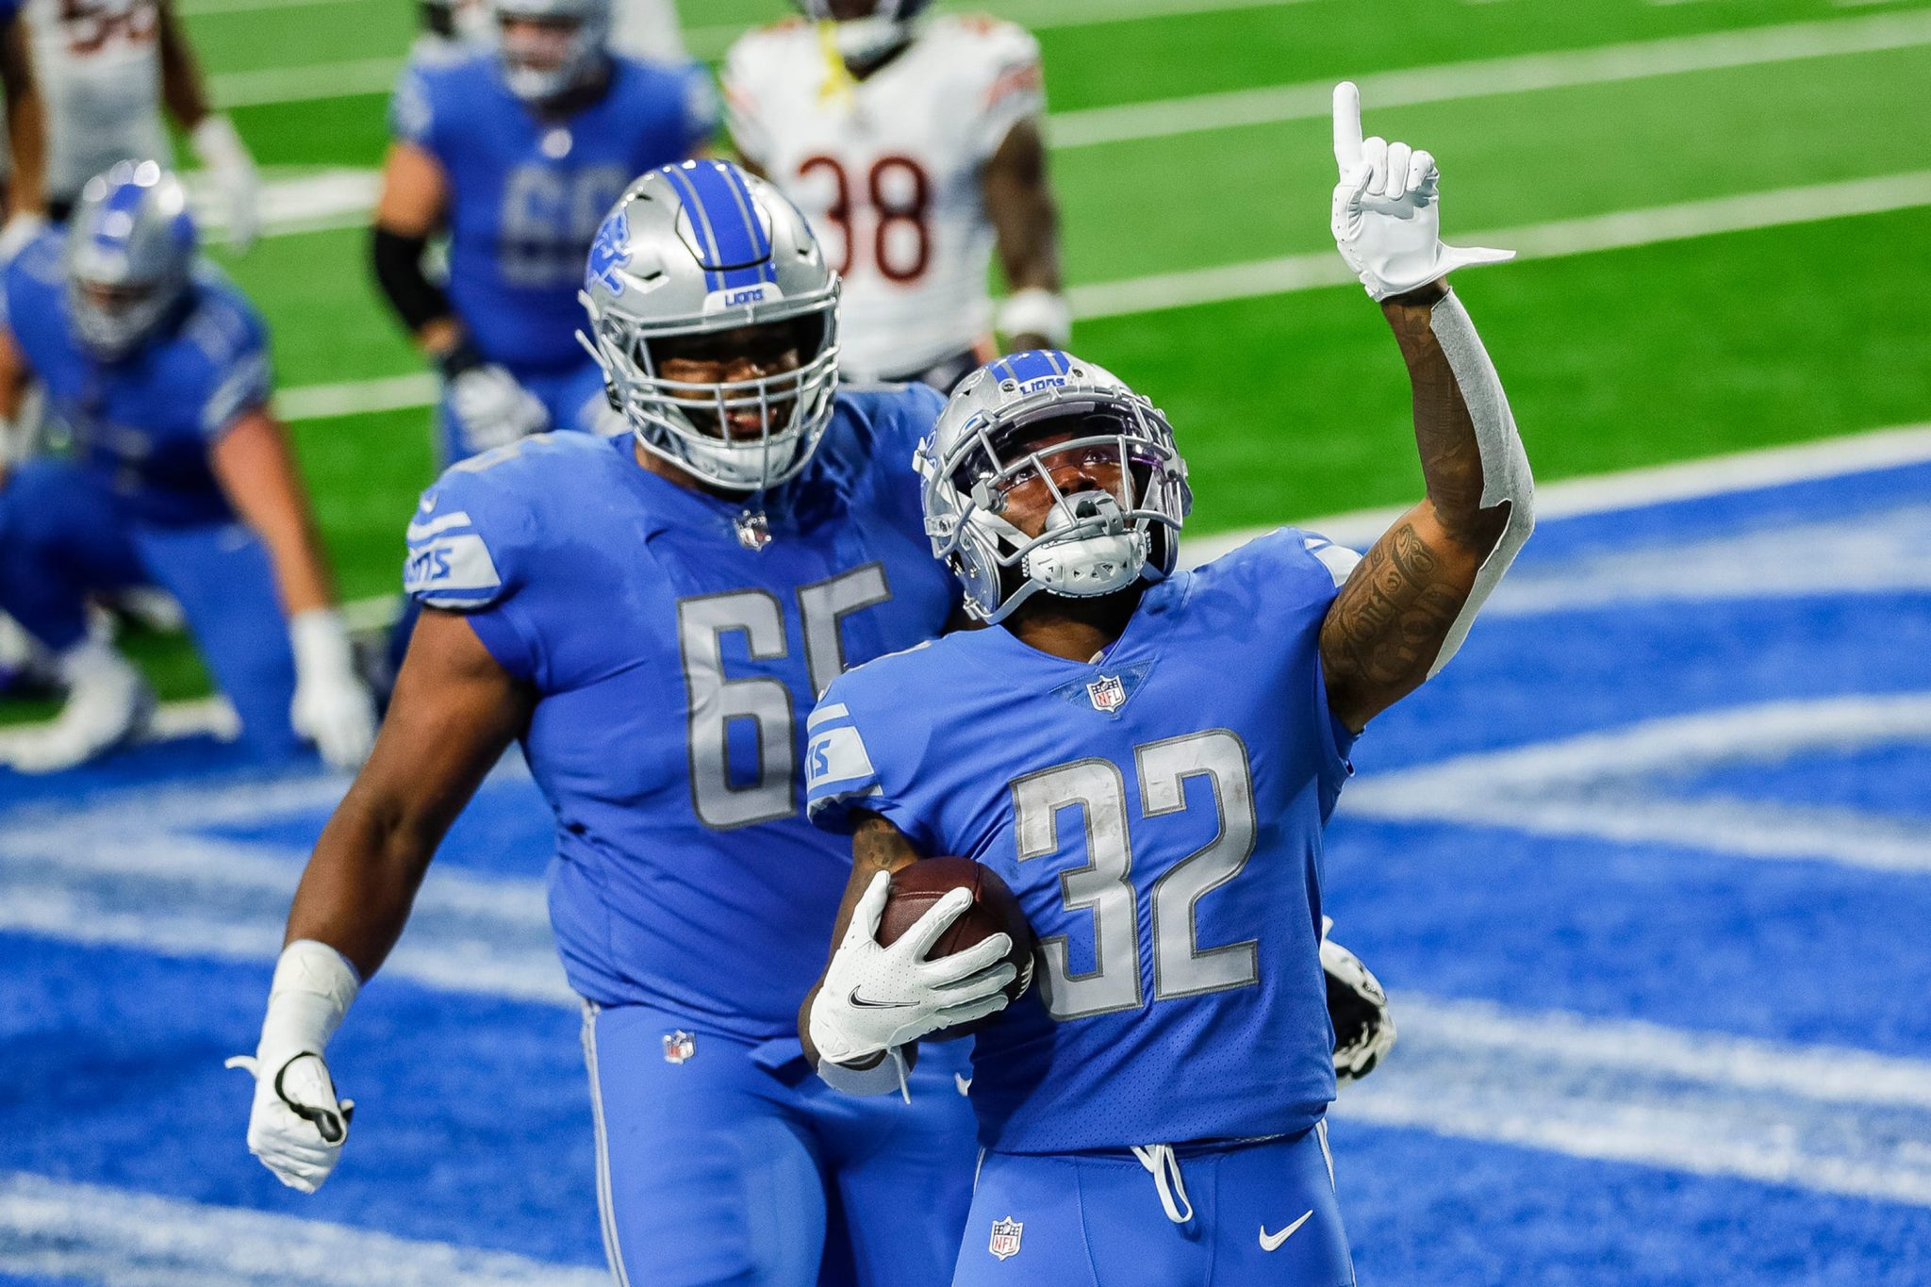
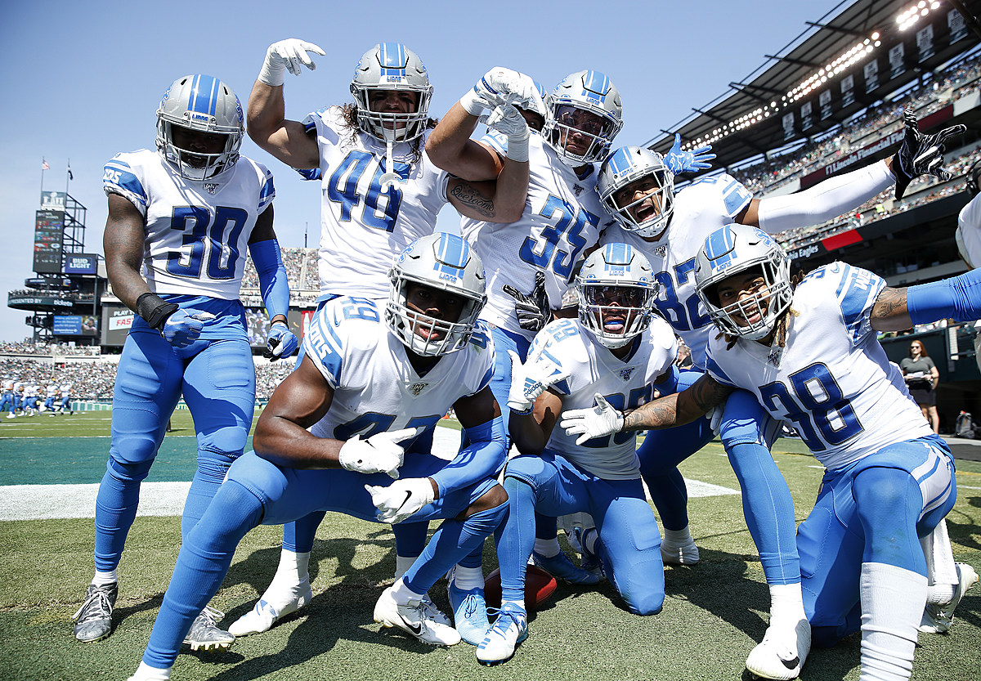
Lions Plotting CSC 302- Data Visualization Midterm Presentation
Ken Sebastian
Keith Frambro
Austin Warren

Slide 2
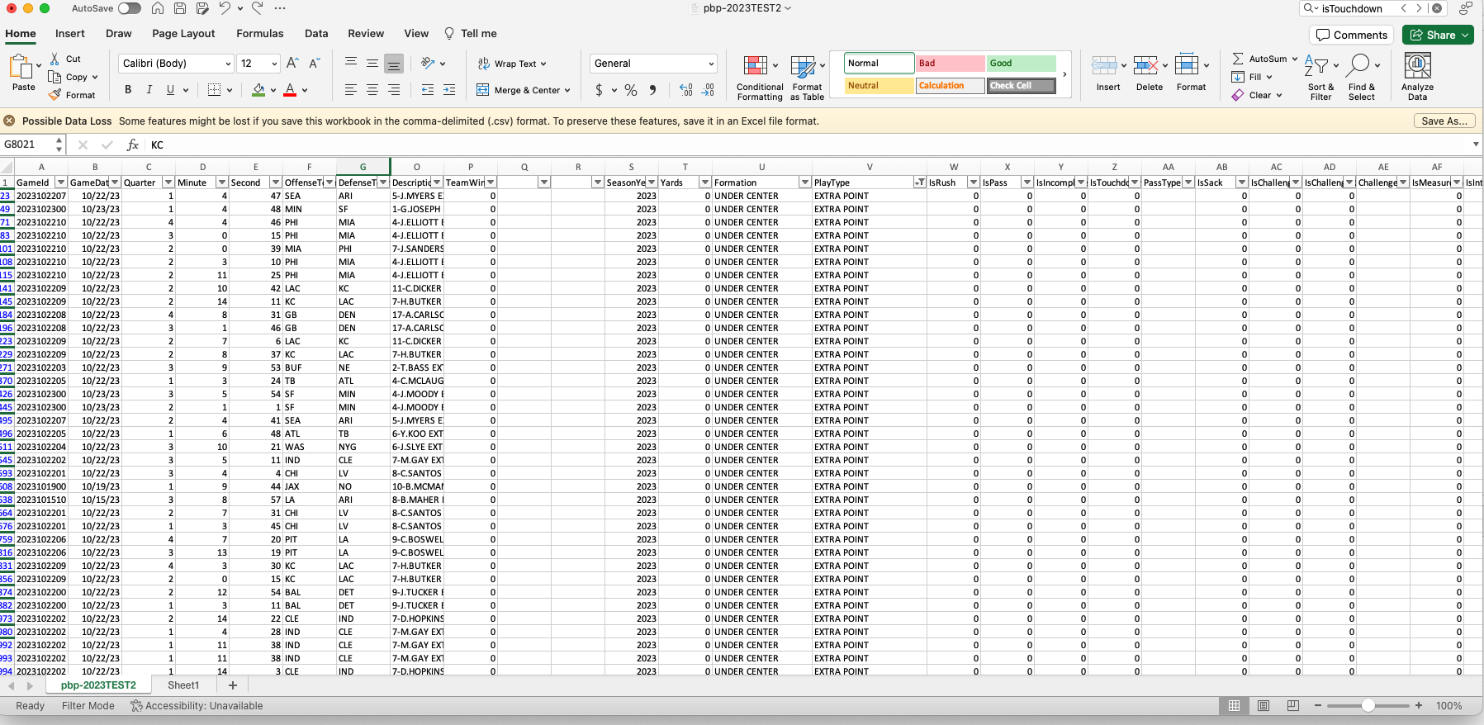
Our Data
Lions Dataset
GameId
GameDate
Quarter
Minute
Second
OffenseTeam
DefenseTeam
Down
ToGo
YardLine
Unnamed: 10
SeriesFirstDown
Unnamed: 12
NextScore
Description
TeamWin
SeasonYear
Yards
Formation
PlayType
IsRush
Lions Dataset
IsChallenge
IsChallengeReversed
Challenger
IsMeasurement
IsInterception
IsFumble
IsPenalty
IsTwoPointConversion
IsTwoPointConversionSuccessful
RushDirection
YardLineFixed
YardLineDirection
IsPenaltyAccepted
PenaltyTeam
IsNoPlay
PenaltyType
PenaltyYards
IsPass
IsIncomplete
IsTouchdown
PassType
IsSack

Slide 3
What are we asking
Q1: Do games the Lions win have higher passing and running yards totals than their opponents?
Inference: We expect the teams with higher offensive total yards passing and running to win the games.
Q2: Keith
Inference: Keith
Q1: Austin
Inference: Austin

Slide 4
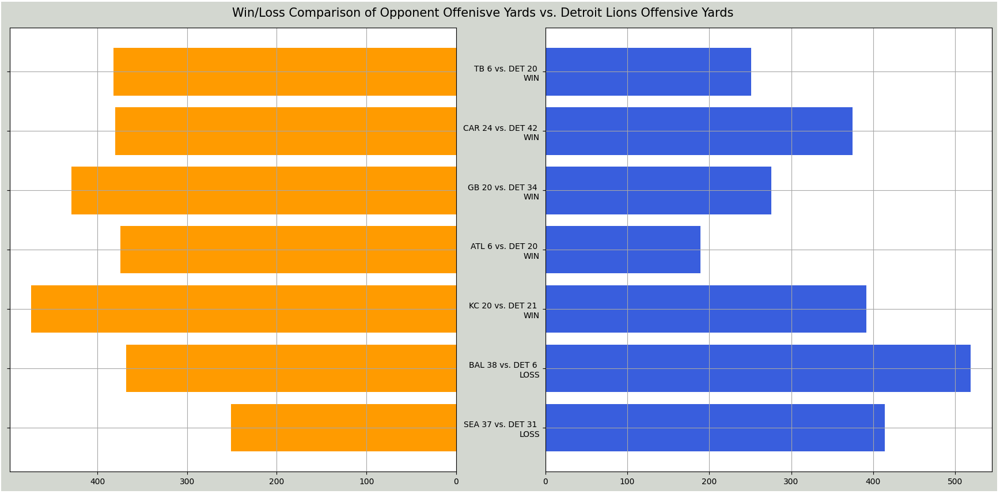
Q1 Visualization
Games that the Lions won the total yards were higher.
Games that the Lions lost the opponents total yards were higher.
Conclusion: The total offensive yards look to be related to wins/losses.

Slide 5

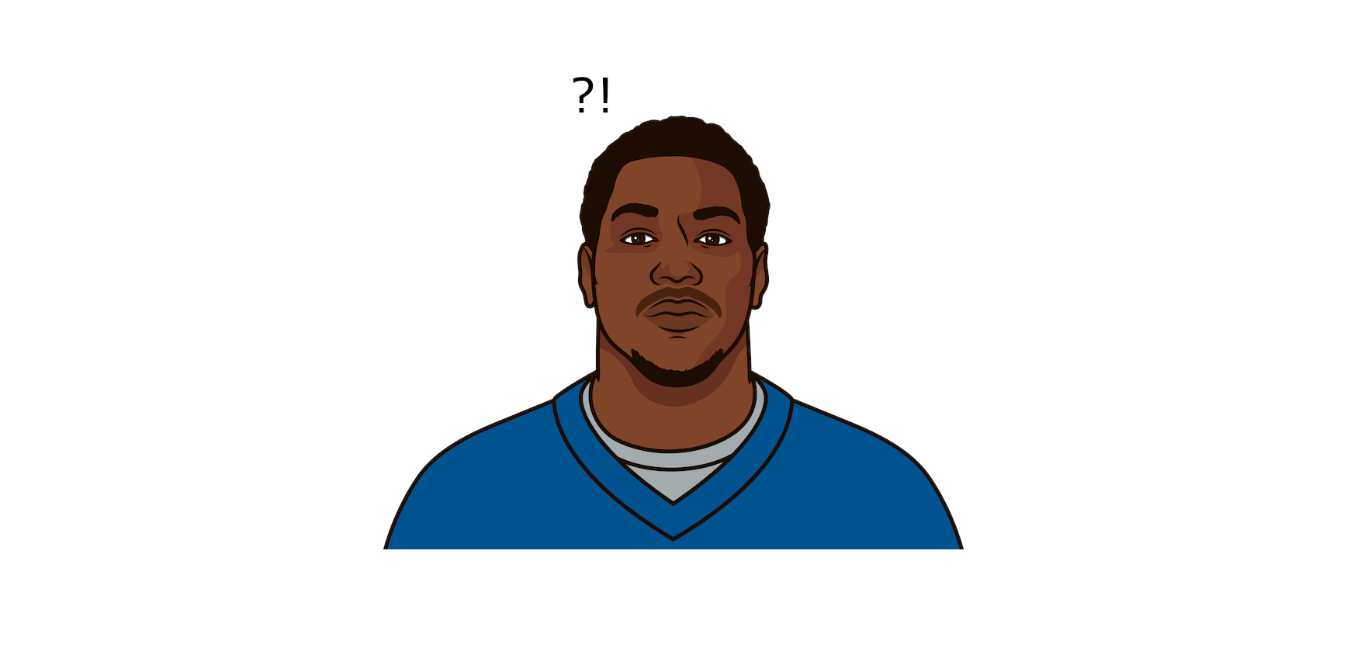
Q/A
Questions

