Slide 1
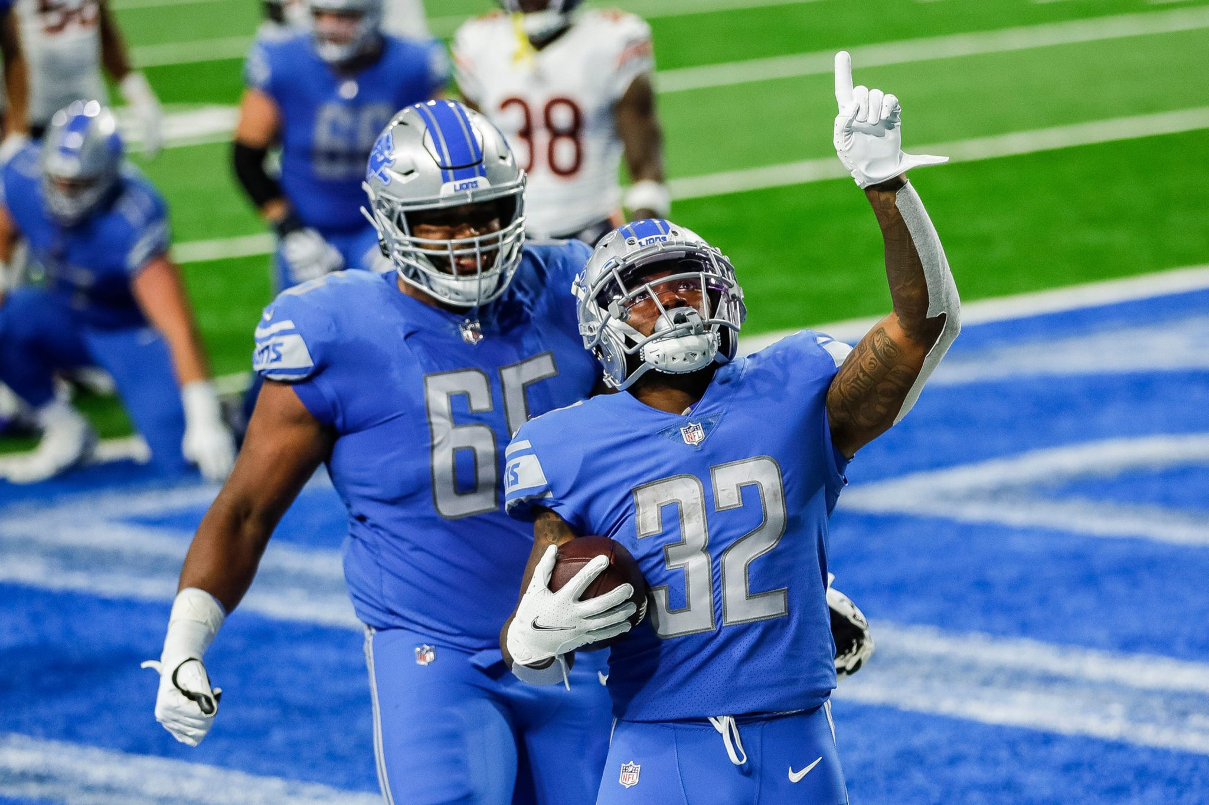
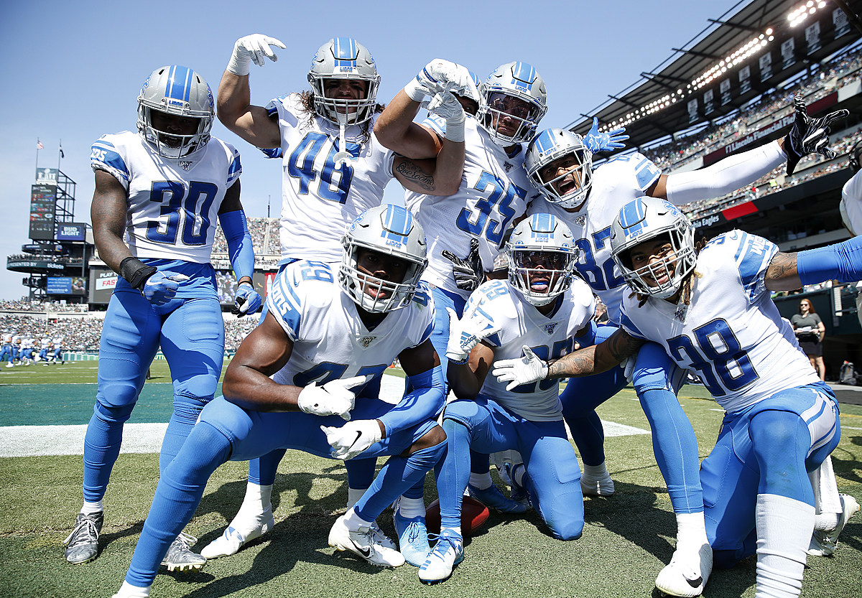
Lions Plotting CSC 302- Data Visualization Midterm Presentation
Ken Sebastian
Keith Frambro
Austin Warren

Slide 2
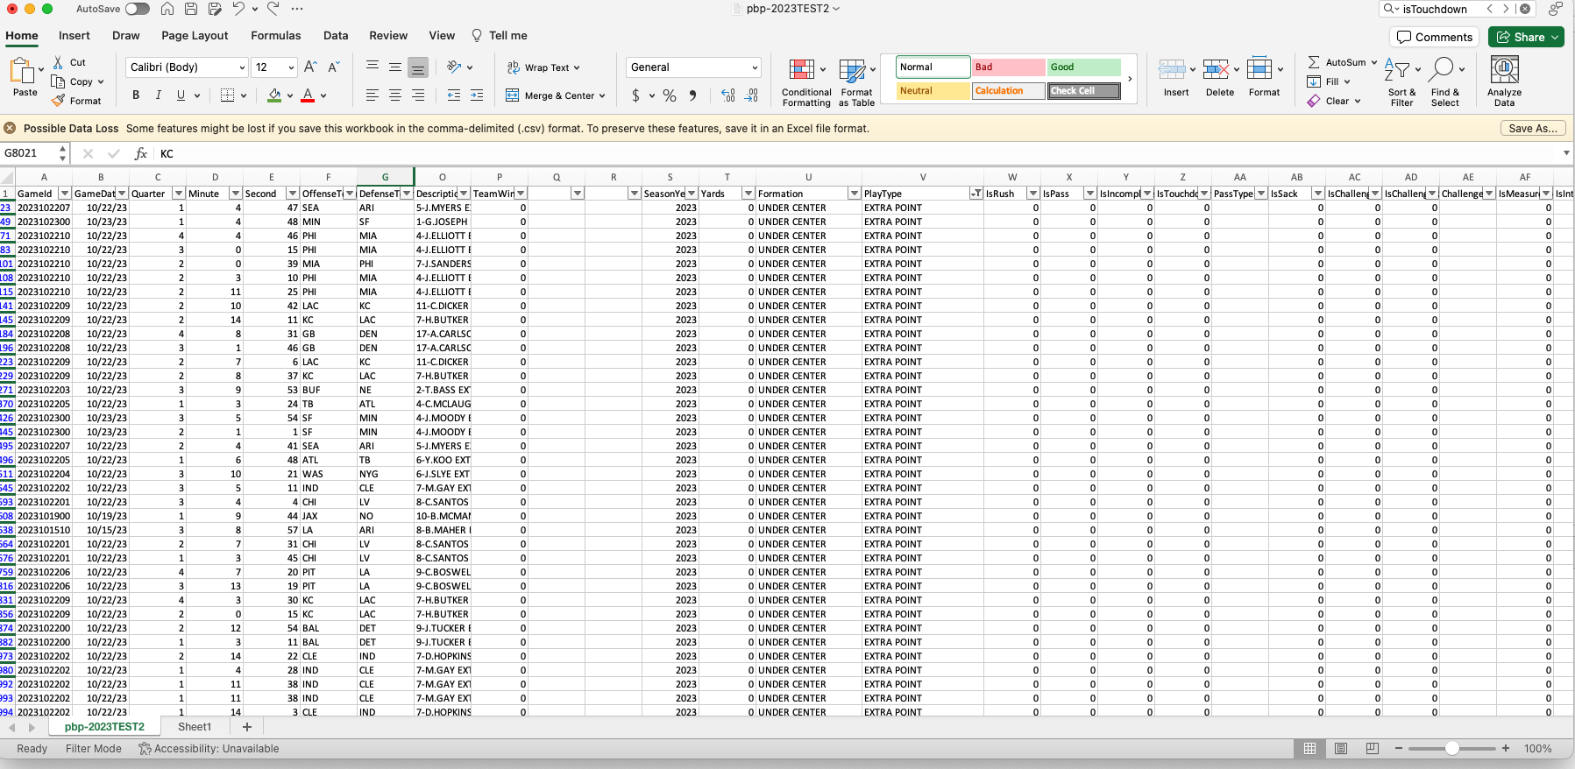
Our Data
Lions Dataset
GameId
GameDate
Quarter
Minute
Second
OffenseTeam
DefenseTeam
Down
ToGo
YardLine
Unnamed: 10
SeriesFirstDown
Unnamed: 12
NextScore
Description
TeamWin
SeasonYear
Yards
Formation
PlayType
IsRush
Lions Dataset
IsChallenge
IsChallengeReversed
Challenger
IsMeasurement
IsInterception
IsFumble
IsPenalty
IsTwoPointConversion
IsTwoPointConversionSuccessful
RushDirection
YardLineFixed
YardLineDirection
IsPenaltyAccepted
PenaltyTeam
IsNoPlay
PenaltyType
PenaltyYards
IsPass
IsIncomplete
IsTouchdown
PassType
IsSack

Slide 3

What are we asking
Q1: Do games the Lions win have higher passing and running yards totals than their opponents?
Inference: We expect the teams with higher offensive total yards passing and running to win the games.
Q2: Do the Lions score more points when playing in colder weather?
Inference: We expect the Lions, who as based in a cold weather state, to score more points when playing games in cold weather.
Q3: Do games the Lions lose have more penalties than the
opponents?
Inference: Penalties would cost the Lions game wins.
Q4: Austin
Inference: Austin

Slide 4
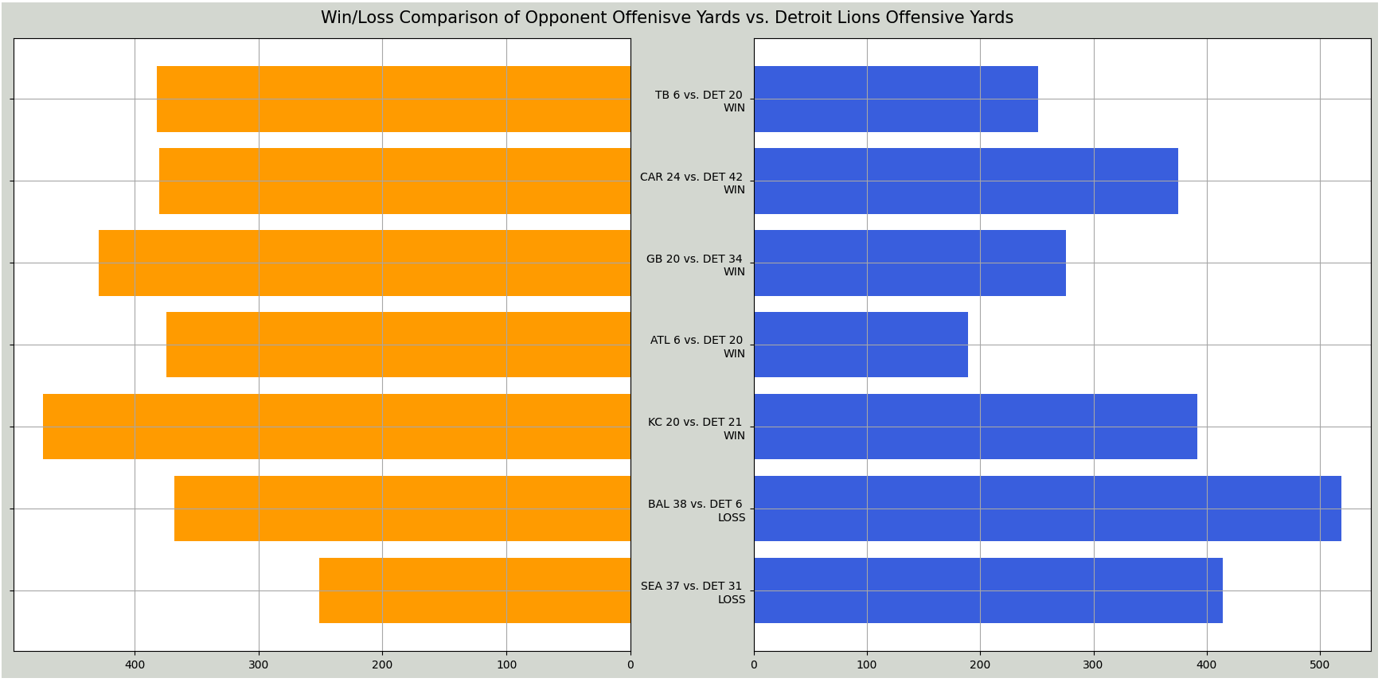
Q1 Visualization
Games that the Lions won the total yards were higher.
Games that the Lions lost the opponents total yards were higher.
Conclusion: The total offensive yards look to be related to wins/losses.

Slide 5
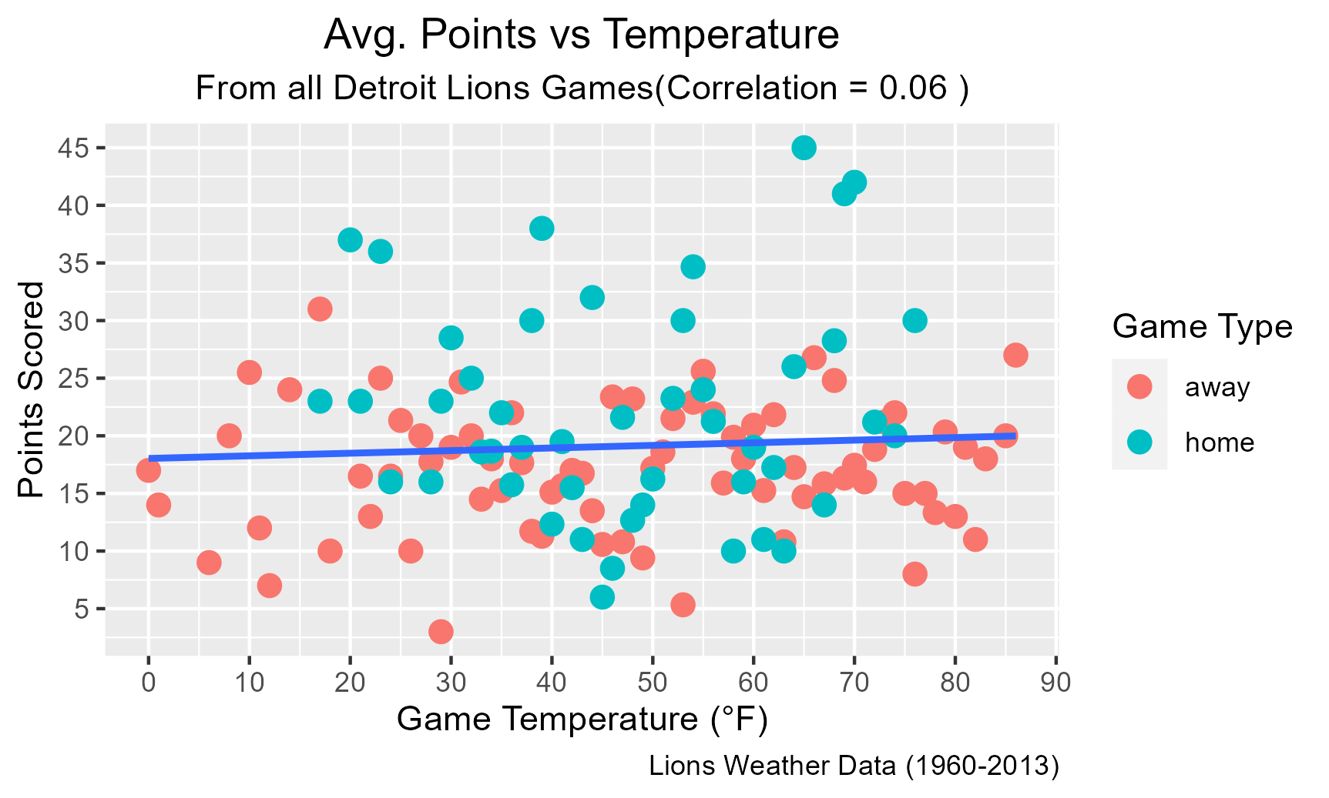
Q2 Visualization
Home games that the Lions played showed no correlation between game temperature and points scored by the team.
Away games that the Lions played showed no correlation between game temperature and points scored by the team.
Conclusion: There is no correlation (0.06) between game temperature and points scored by Lions
Unrelated Conclusion: Lions tend to score more points in home games

Slide 6
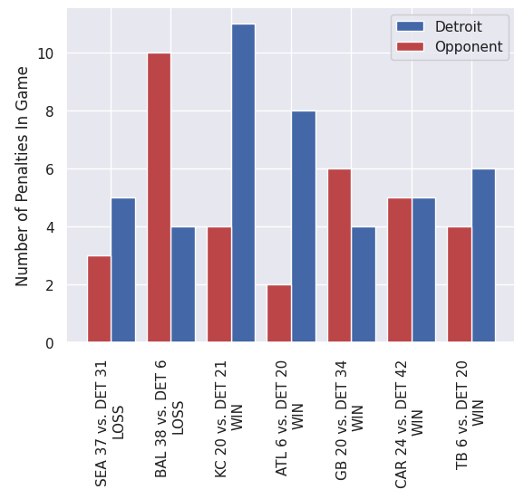
Q3 Visualization
Q3: Do games the Lions lose have more penalties than the
opponents?
Inference: Penalties would cost the Lions game wins.
Games the Lions had more penalties than the opposition
Were won and the games that were lost one had more penalties
And the other had less penalties. There seems to be no correlation
Between penalties and wins/losses.

Slide 7

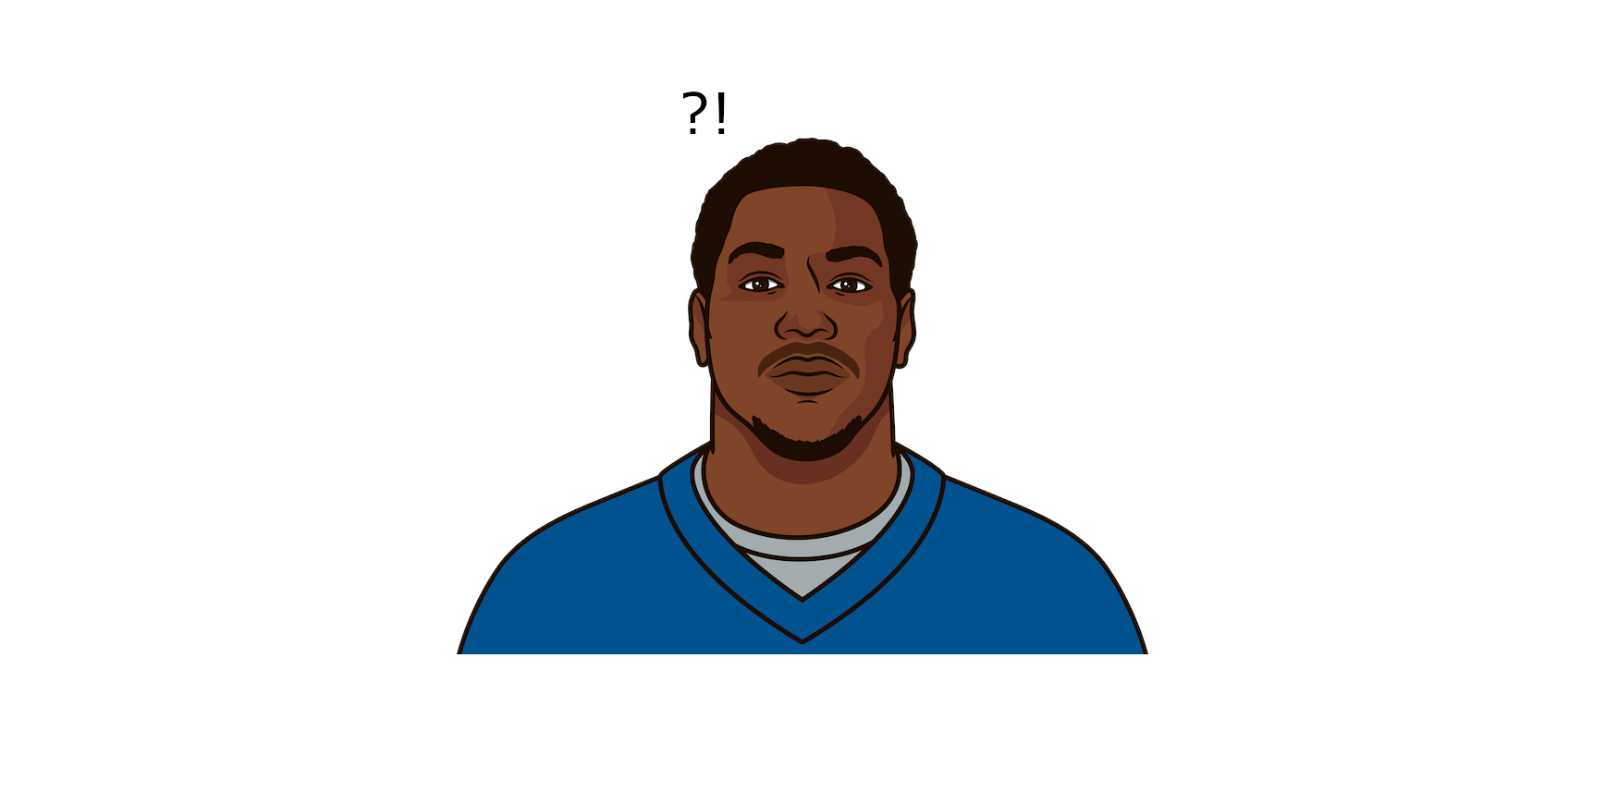
Q/A
Questions

