Slide 1
NAFLD Progression
Deep Patel

Slide 2
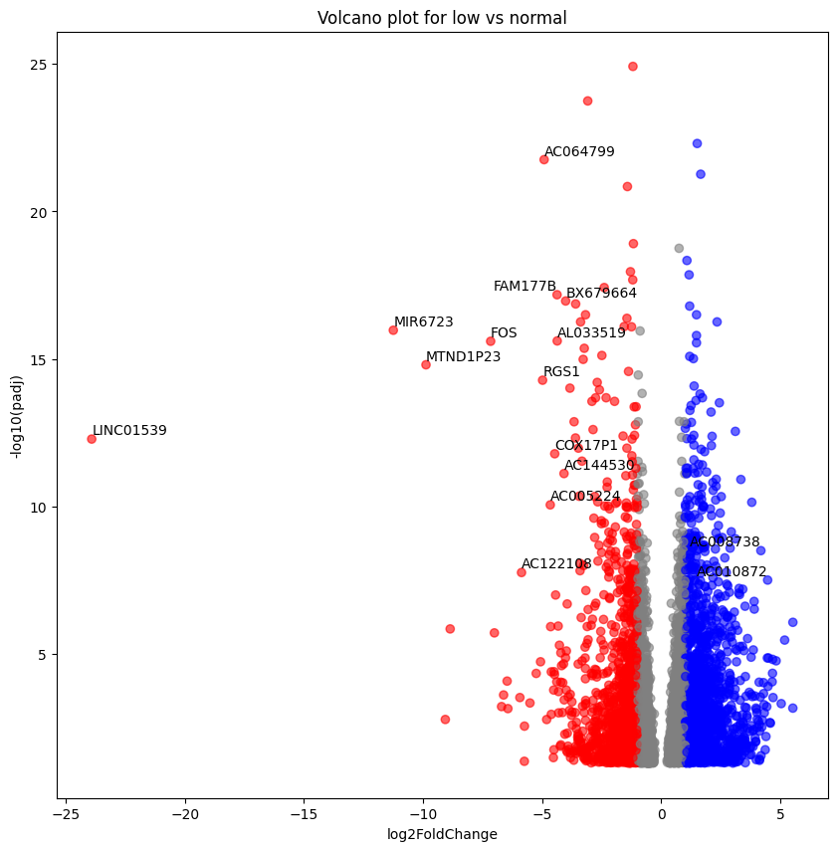
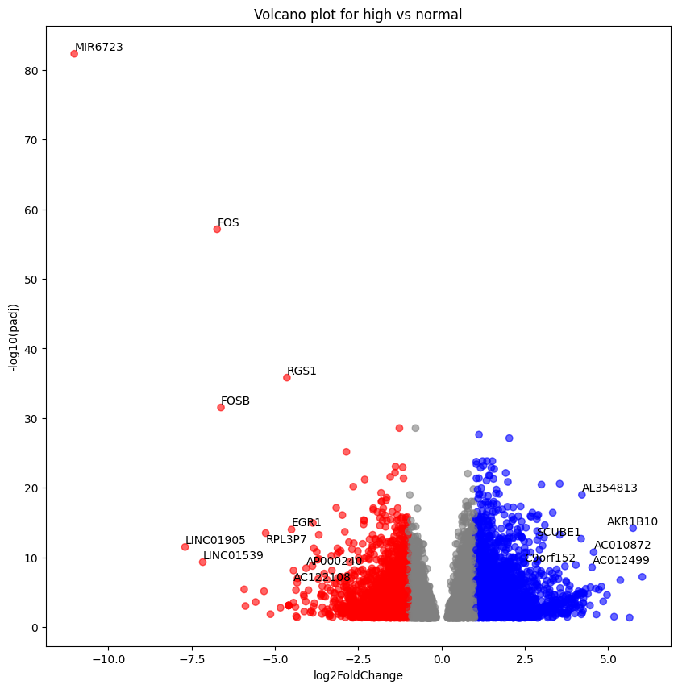
Volcano Plot

Slide 3
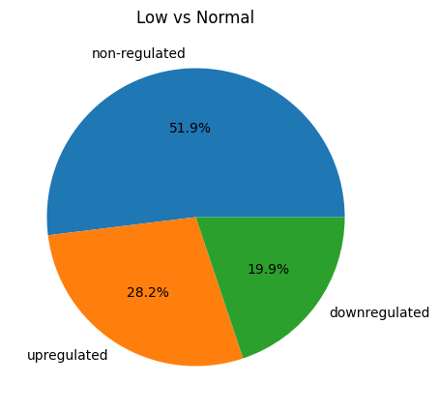
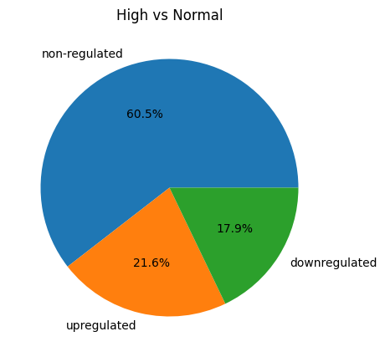
Gene Regulation Distribution

Slide 4
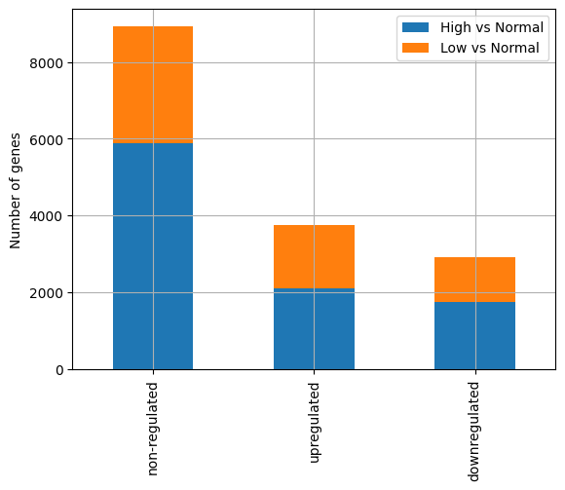
Gene Regulation Distribution

Slide 5
Gene Regulation Distribution

Slide 6
Gene ontology

