Slide 1
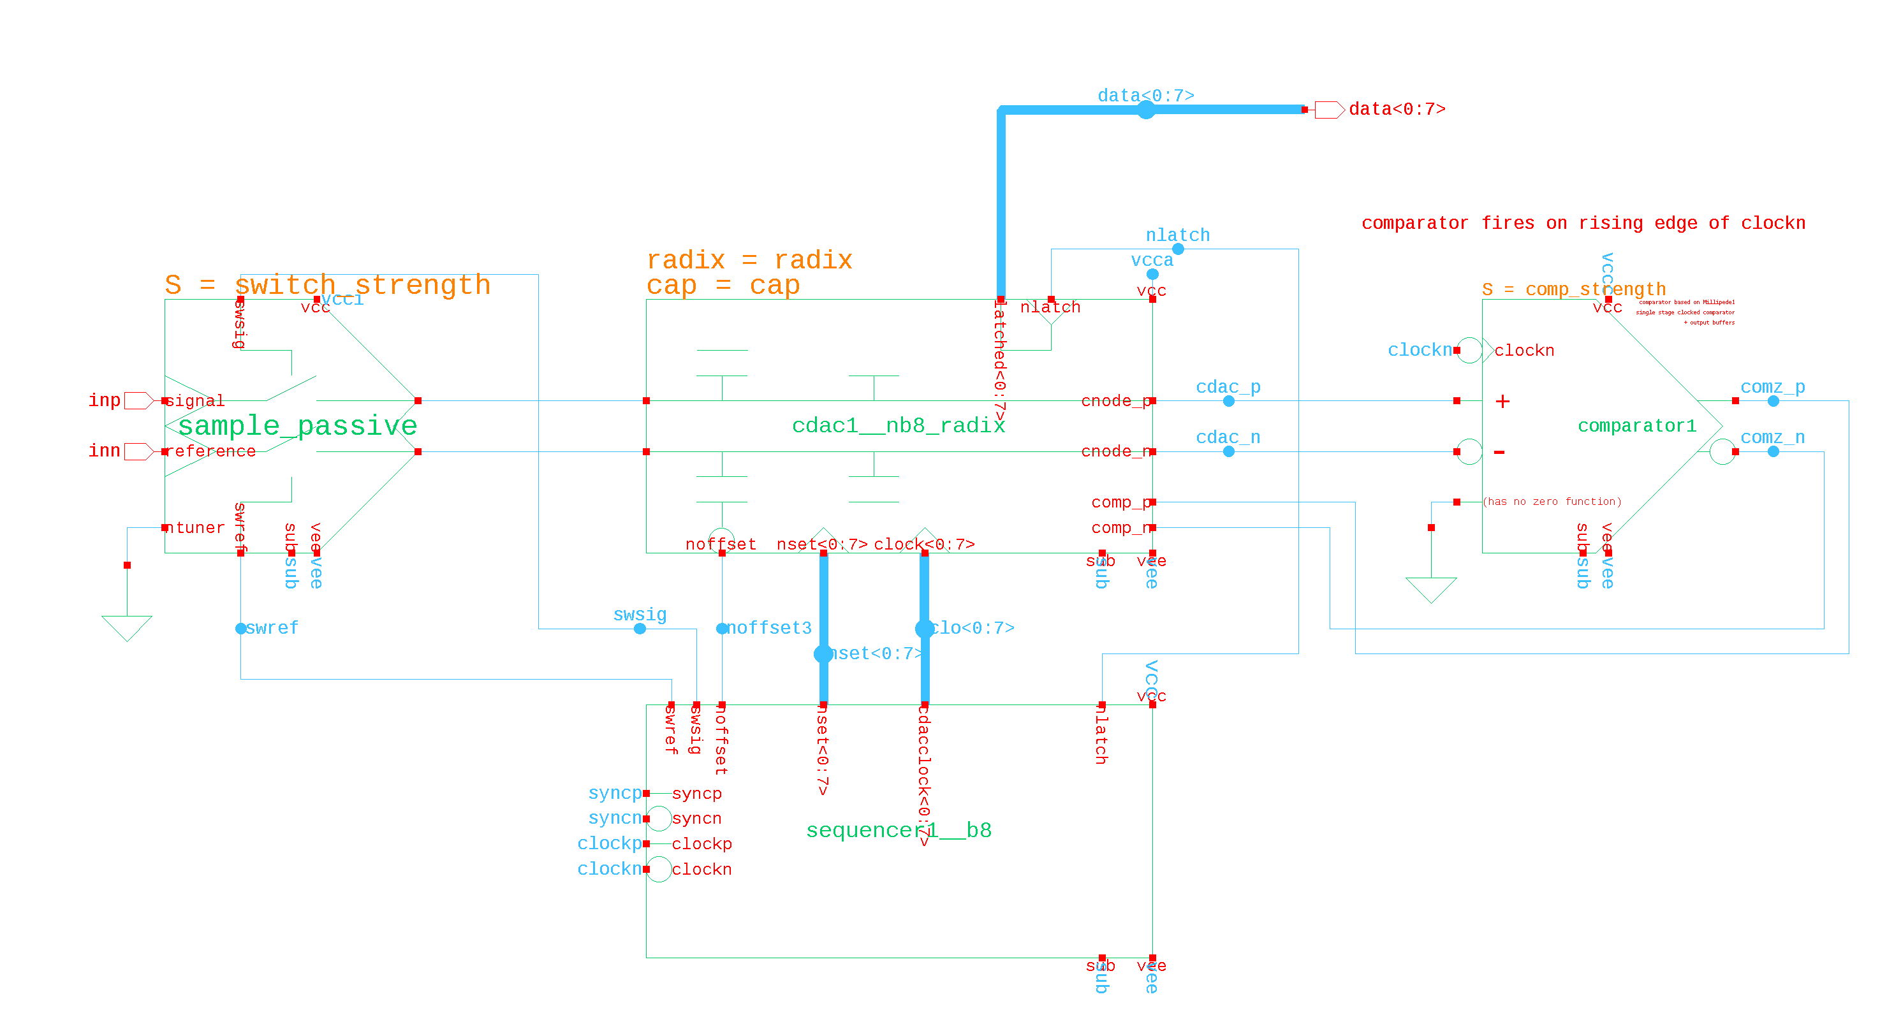
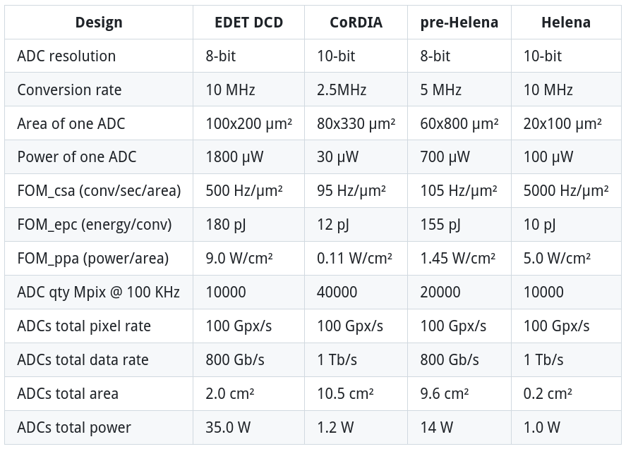
What’s the goal?
What should we try tuning?
✅ capacitor array radix ratio & repetitions
✅ capacitor array unit & repetitions total values
✅ capacitor array switching scheme? (monotonic is simple)
✅ comparator architecture and strength
✅ total ADC nominal resolution
✅ total comparisons & time per comparison
SPICE @ 100 samples per bin:
8-bit ADC: ~15 hours
10-bit ADC: ~2.5 days

Slide 2
Schematic setup: Principles
RDAC omitted for now, for simplicity
Output code interpretation done in Python
Several parameters are be passed to each block, from Python testbench
Parameters which mandate different topologies (e.g. bus widths) are resolved by different schematics. Hopefully less than ~20 configurations
Hierarchy switch list used to enable Verilog-A ideal versions of blocks
(currently just have comparator)

Slide 3
Model parameters
params = {
"ADC": {
"bit_size": 8, # nominal resolution of the ADC (switching between netlists)
"sampling_frequency": 10.0e6, # sampling rate in Hz, used to driver clock sources
"jitter": 0.0e-12, # aperture jitter in seconds (TBD)
"device_noise": False, # enables basic gaussian noise in behavioral, and tran noise in SPICE
},
"TESTBENCH": {
"positive_input_voltages": [0.2, 1.2, 20e-6], # start, end (incl.), and step voltage
"negative_input_voltages": [1.2, 0.2, 20e-6],
"use_calibration": False, # account for cap error when calculating Dout (re-analog)
"pdk_file": "\"~/helena/tech/tsmc65/default_testbench_header_55ulp_linux.lib\" tt",
"spicedir": None, # Use this to write netlist from template
"rawdir": None, # Use this to set SPICE output dir, and to read for parsing
},
"SWITCH": {
"offset_voltage": 0.0e-3, # offset voltage in Volts
"common_mode_dependent_offset_gain": 0.0, # common mode voltage gain
"threshold_voltage_noise": True,
"type": "passive", # supports active, passive, or ideal
"strength": 4,
},
"COMP": {
"offset_voltage": 0.0e-3, # offset voltage in Volts
"common_mode_dependent_offset_gain": 0.0, # common mode voltage gain
"threshold_voltage_noise": True,
"strength": 4, # used to size some active devices (SPICE only)
},
"CDAC": {
"positive_reference_voltage": 1.2, # reference voltage in Volts
"negative_reference_voltage": 0.0, # reference voltage in Volts
"reference_voltage_noise": 0.0e-3, # reference voltage noise in Volts (CDAC)
"switching_strat": "monotonic", # {monotonic, bss} used to determined initial starting voltages
"unit_capacitance": 1e-15, # unit capacitance
"target_capacitance": None, # Used for alternative
"array_size": 8, # number of capacitor stages
"array_N_M_expansion": False, # Sizing strategy where
"multiple_conversions": None, # List bit positions in C array, with number of repetitions at each
"use_rdac": False, # Set bit position which should
"use_offset_cap": False, # set to 0 farads, if disabled
"use_split_cap": True, # set to 0 farads, if disabled
"parasitic_capacitance": 5.00e-14, # estimate of capacitance at output (added to SPICE and ideal)
"settling_time": 0.0e-9, # individual settling errors per capacitor?
},
}
❗Work in progress ❗
Notes:
\textrm{cycles} = 1,2,3,4,5,6,7,8,9
\textrm{weights} = w_i = w_7, w_6, w_5, w_4, w_3, w_2, w_1, w_0
\textrm{SA register} = r_i = r_7, r_6, r_5, r_4, r_3, r_2, r_1, r_0
R^{'}=\sum_{i=1}^{N_{CDAC}} b_i \cdot w_{i-1}
\textrm{data out} = b_i = b_7, b_6, b_5, b_4, b_3, b_2, b_1, b_0

Slide 4
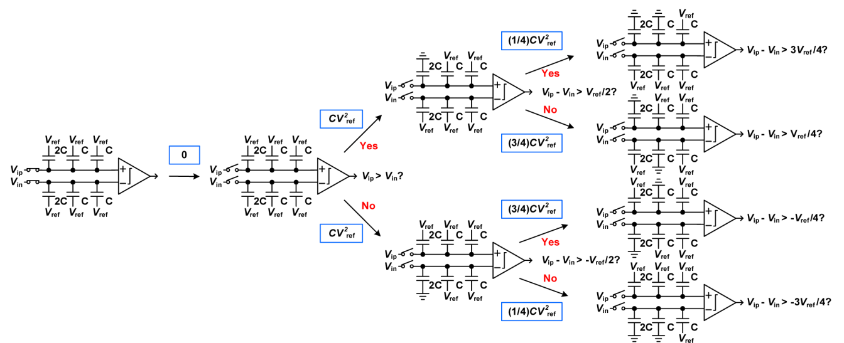
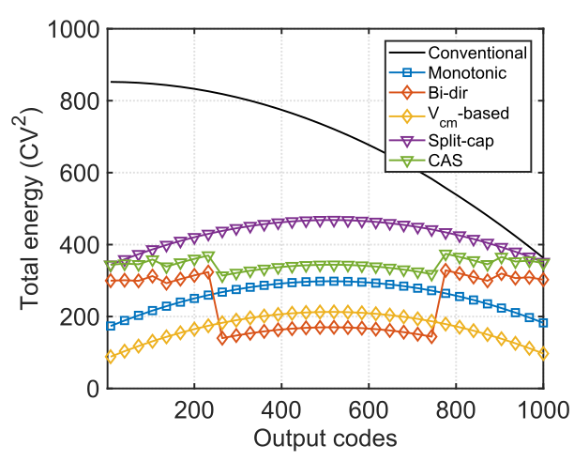
CDAC model parameters: Switching scheme
Initial values of bottom-plate voltages differentiate ‘Monotonic’ vs ‘BSS’ switching
[C.C. Liu JSSC 2010]
Other schemes require different topology but we already have good energy savings
[X. Tang IEEE TCAS 2022]

Slide 5


CDAC model parameters: Capacitor calculation
number of capacitor stages (on both N and P plate)
radix: 2.0, 1.85, 1.8, etc
Approach #1:
thinking in terms of LSB capacitor size
Approach #2: If we care about total capacitance
typically ~1 fF
typically ~ 100 fF
weights
capacitor values
capacitor values
weights
>>> w_radix1p8 = [2.0**i for i in range(8)]
[1.0, 2.0, 4.0, 8.0, 16.0, 32.0, 64.0, 128.0]
>>> w_radix2 = [1.8**i for i in range(8)]
[1.0, 1.8, 3.24, 5.83, 10.5, 18.9, 34.01, 61.22]
Approach #3: If we care about allowable input signal swing, account for split offset and parasitic caps
Notes:
w_7, w_6, w_5, w_4, w_3, w_2, w_1, w_0\,\,
C_{unit}\,\,
N_{CDAC}\,\,
\textrm{radix}\,\,
w_i = \beta^i \; \textrm{where} \; i = 0, 1, 2, \; ... \; , \; (N_{CDAC}-1)
C_i = C_{unit} \cdot w_i \;
\textrm{where} \; i = 0, 1, 2, \; ... \; , \; (N_{CDAC}-1) \;
\textrm{where} \; i = (N_{CDAC}-1), (N_{CDAC}-2), (N_{CDAC}-3), \; ... \; , \; 2,1,0 \;
w_i = \frac{C_i}{C_0} \;
C_i = \frac{C_{total}}{2 \cdot \beta^{(N_{CDAC}-1-i)}} \;

Slide 6
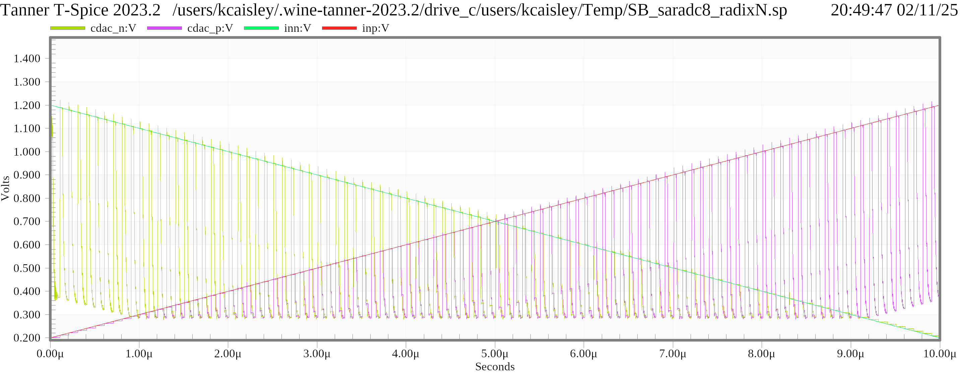

CDAC model parameters: Input voltage swings
❌ The differential input range is limited by the CDAC and additional + parasitic caps
In this 9-bit 1.2V ref case:
❌ Also note, non-ideal comparator has common-mode input limitation
Notes:
w_7, w_6, w_5, w_4, w_3, w_2, w_1, w_0\,\,
C_{unit}\,\,
N_{CDAC}\,\,
\textrm{radix}\,\,
w_i = \beta^i \; \textrm{where} \; i = 0, 1, 2, \; ... \; , \; (N_{CDAC}-1)
C_i = C_{unit} \cdot w_i \;
\textrm{where} \; i = 0, 1, 2, \; ... \; , \; (N_{CDAC}-1) \;
\textrm{where} \; i = (N_{CDAC}-1), (N_{CDAC}-2), (N_{CDAC}-3), \; ... \; , \; 2,1,0 \;
w_i = \frac{C_i}{C_0} \;
C_i = \frac{C_{total}}{2 \cdot \beta^{(N_{CDAC}-1-i)}} \;
\Delta V_p = \frac{C_{\text{dac}}}{C_{\text{total}}} \cdot V_{\text{ref}} = \frac{136}{61 + 136} \cdot 1.2 = 0.826
\Delta V_{in} \approx \frac{C_{\text{dac}}}{C_{\text{total}}} \cdot V_{\text{ref}} = \frac{136}{61 + 136} \cdot 1.2 = 0.826

Slide 7
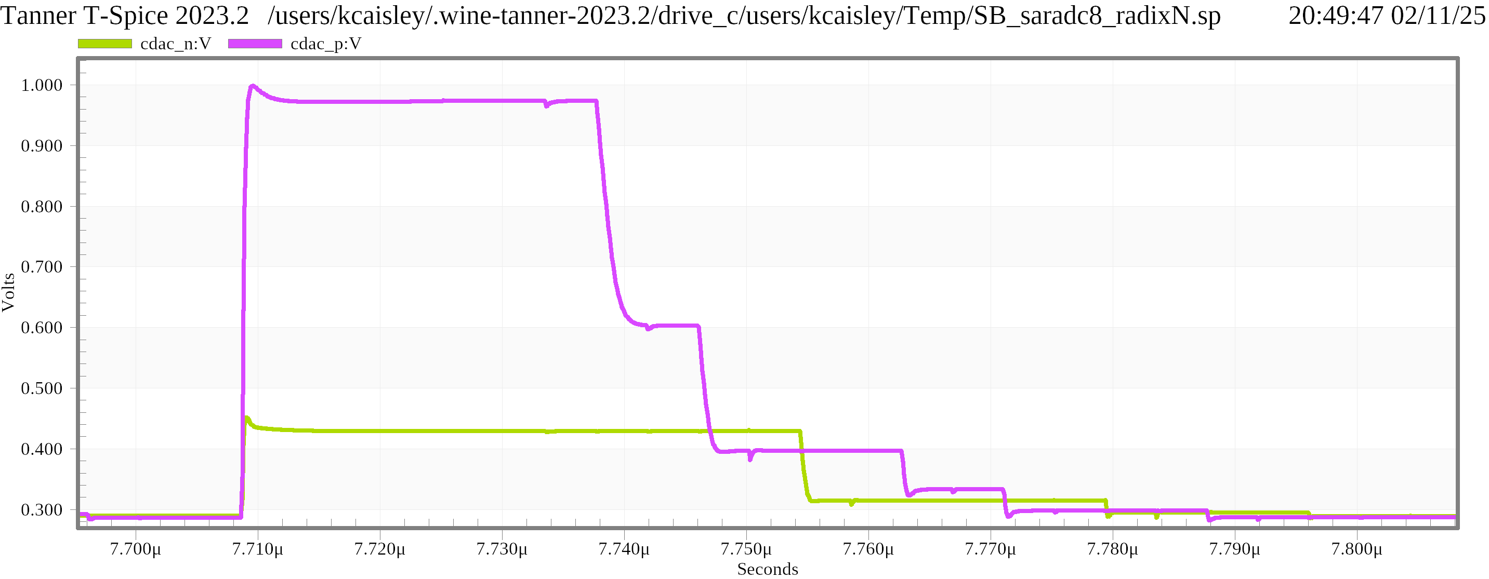
CDAC model parameters: Settling error
Monotonic switching ameliorates RC delay, but it will still manifest as voltage error when:
❌ Clock periods are short
❌ Differential input voltage is large
Should model this exponential
Notes:
w_7, w_6, w_5, w_4, w_3, w_2, w_1, w_0\,\,
C_{unit}\,\,
N_{CDAC}\,\,
\textrm{radix}\,\,
w_i = \beta^i \; \textrm{where} \; i = 0, 1, 2, \; ... \; , \; (N_{CDAC}-1)
C_i = C_{unit} \cdot w_i \;
\textrm{where} \; i = 0, 1, 2, \; ... \; , \; (N_{CDAC}-1) \;
\textrm{where} \; i = (N_{CDAC}-1), (N_{CDAC}-2), (N_{CDAC}-3), \; ... \; , \; 2,1,0 \;
w_i = \frac{C_i}{C_0} \;
C_i = \frac{C_{total}}{2 \cdot \beta^{(N_{CDAC}-1-i)}} \;
\text{settling\_time\_error} = e^{-\frac{1}{{\tau_s \cdot f_s \cdot (N + 1)}}}

Slide 8
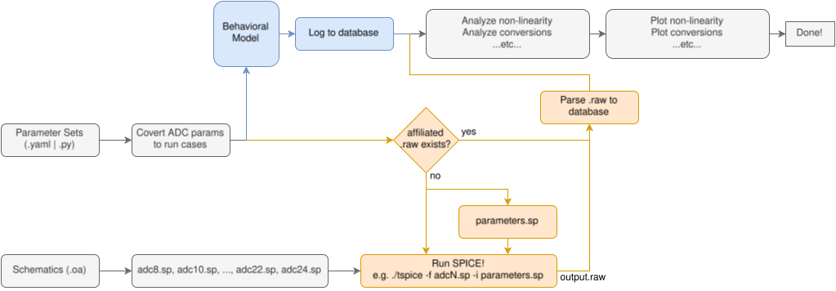
Workflow: SPICE & behavioral models use same params
Tried with Spectre/AFS but
.scs format is very different

Slide 9
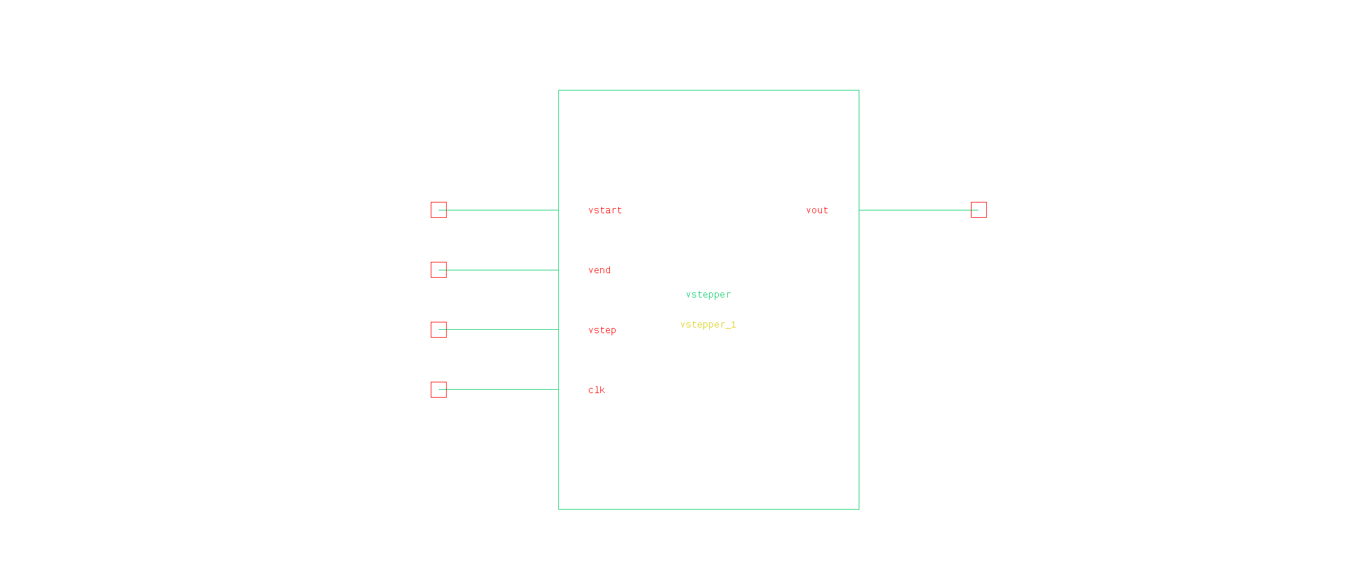
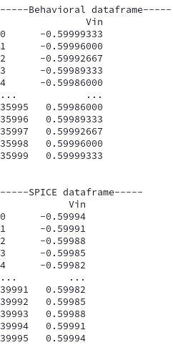
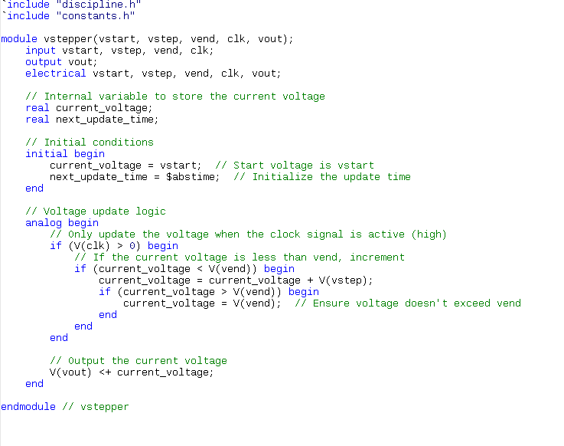
Testbench parameters: Syncing input voltages and clocks
Because we are trying to directly compare SPICE vs behavioral data, it’s best if the timing and voltage references are synced
We can correct this with Verilog-A models which are easier to handle than SPICE primitives

Slide 10
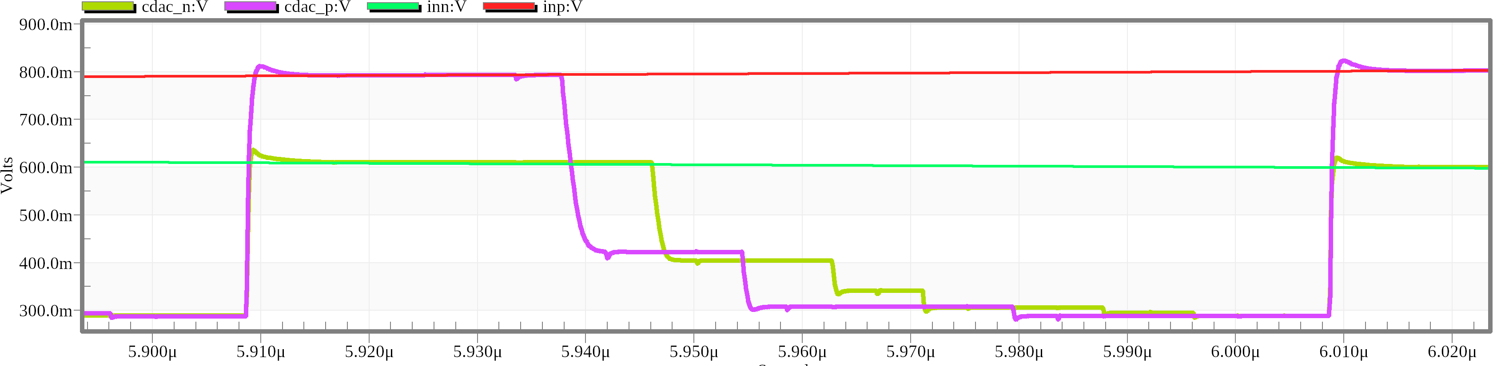
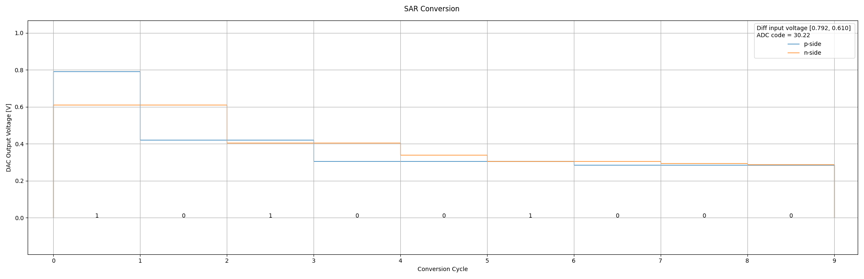
Does the behavioral model work?
792.1 mV
610.4 mV
1 0 1 0 0 1 0 0 0
✅ yep,
for (most) Vin values

Slide 11
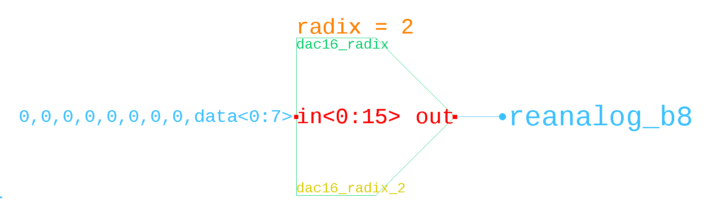

Testbench: Output value calculation (i.e. ‘re-analog’)
Equivalent expression
(except 0→1 range)
.subckt dac16_radix in<0> in<1> in<2> in<3> in<4> in<5>
+ in<6> in<7> in<8> in<9> in<10> in<11> in<12> in<13>
+ in<14> in<15> out radix=1.8
eout out gnd vol='
V(in<15>)/pow(radix, 0)+
V(in<14>)/pow(radix, 1)+
V(in<13>)/pow(radix, 2)+
V(in<12>)/pow(radix, 3)+
V(in<11>)/pow(radix, 4)+
V(in<10>)/ow(radix, 5)+
V(in<9>)/pow(radix, 6)+
V(in<8>)/pow(radix, 7)+
V(in<7>)/pow(radix, 8)+
V(in<6>)/pow(radix, 9)+
V(in<5>)/pow(radix, 10)+
V(in<4>)/pow(radix, 11)+
V(in<3>)/pow(radix, 12)+
V(in<2>)/pow(radix, 13)+
V(in<1>)/pow(radix, 14)+
V(in<0>)/pow(radix, 15)'
.ends
(default value)
8-capacitor
CDAC/ADC
>>> w_radix2 = [2.0**i for i in range(8)]
[1.0, 2.0, 4.0, 8.0, 16.0, 32.0, 64.0, 128.0]
>>> sum(w_radix2)
255.0
>>> w_radix1p8 = [1.8**i for i in range(8)]
[1.0, 1.8, 3.24, 5.83, 10.5, 18.9, 34.01, 61.22]
>>> sum(w_radix1p8)
136.4995072
Notes:
\textrm{cycles} = 1,2,3,4,5,6,7,8,9
\textrm{weights} = w_i = w_7, w_6, w_5, w_4, w_3, w_2, w_1, w_0
\textrm{SA register} = r_i = r_7, r_6, r_5, r_4, r_3, r_2, r_1, r_0
R^{'}=\sum_{i=1}^{N_{CDAC}} b_i \cdot w_{i-1}
\textrm{data out} = b_i = b_7, b_6, b_5, b_4, b_3, b_2, b_1, b_0

Slide 12

Testbench: Output value calculation (i.e. ‘re-analog’)
Can we use the trailing comparator output as an ADC bit?
8-capacitor
CDAC/ADC
8-cap CDAC
9-bit ADC
Notes:
\textrm{cycles} = 1,2,3,4,5,6,7,8,9
\textrm{weights} = w_i = w_7, w_6, w_5, w_4, w_3, w_2, w_1, w_0
\textrm{SA register} = r_i = r_7, r_6, r_5, r_4, r_3, r_2, r_1, r_0
R=\sum_{i=0}^{N_{CDAC}-1} b_i \cdot w_{i}
R=\sum_{i=1}^{N_{CDAC}} (2 \cdot b_i - 1) \cdot w_{i-1} + b_0 -1
\textrm{data out} = b_i = b_7, b_6, b_5, b_4, b_3, b_2, b_1, b_0

Slide 13
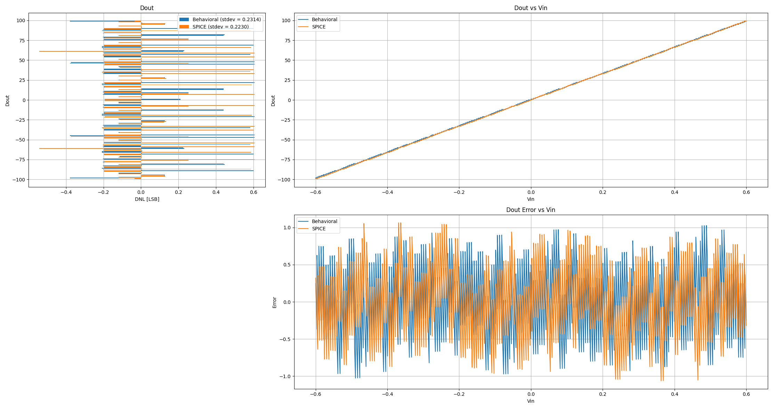
Behavioral vs SPICE: Linearity comparison
✅ DNL stddev is similar
9-bit ADC
1.8 radix
-99 to 98 range
❗Not exercising full range
✅ quantization error (RMS)
is identical @ 0.278 LSB
❓But ideal ADC would have
1/sqrt(12) = 0.289 LSB RMS.
I think I need to calibrate for Dout range of ~197.
❗ Worst-case INL

Slide 14
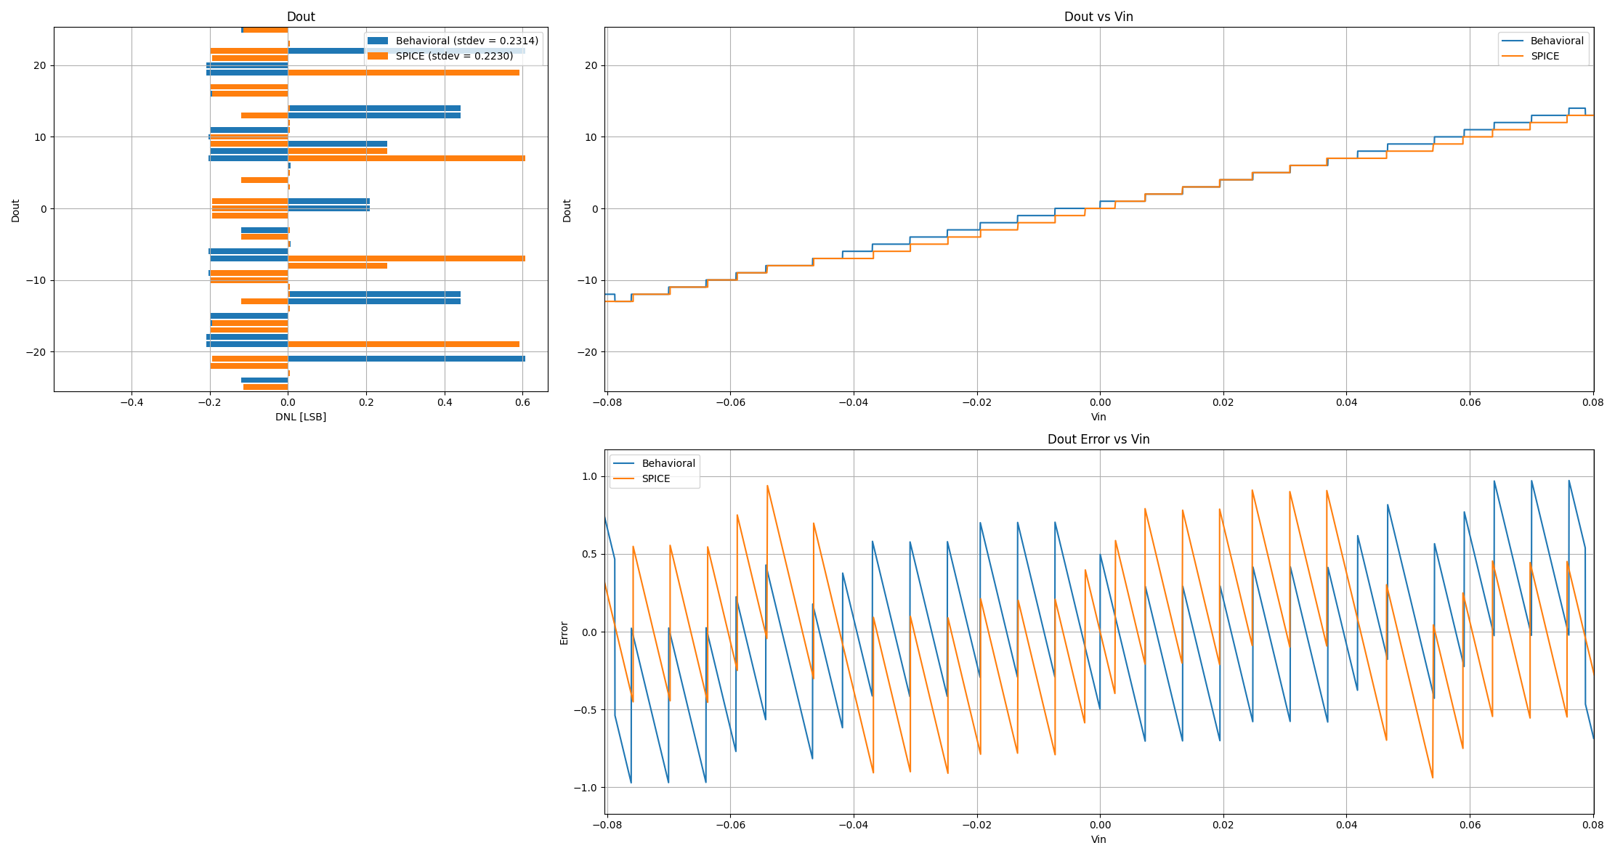
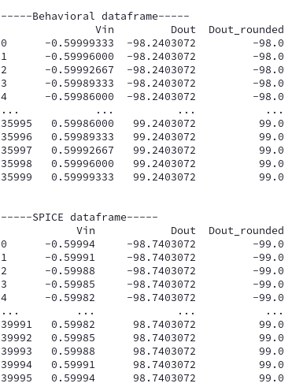
Behavioral vs SPICE: Linearity comparison
❌
❌
❌ 1 LSB errors exist
Is rounding applied at different stages?
Perhaps parasitic capacitance is throwing us off? I calculated ~50 fF for the parasitics plus

Slide 15
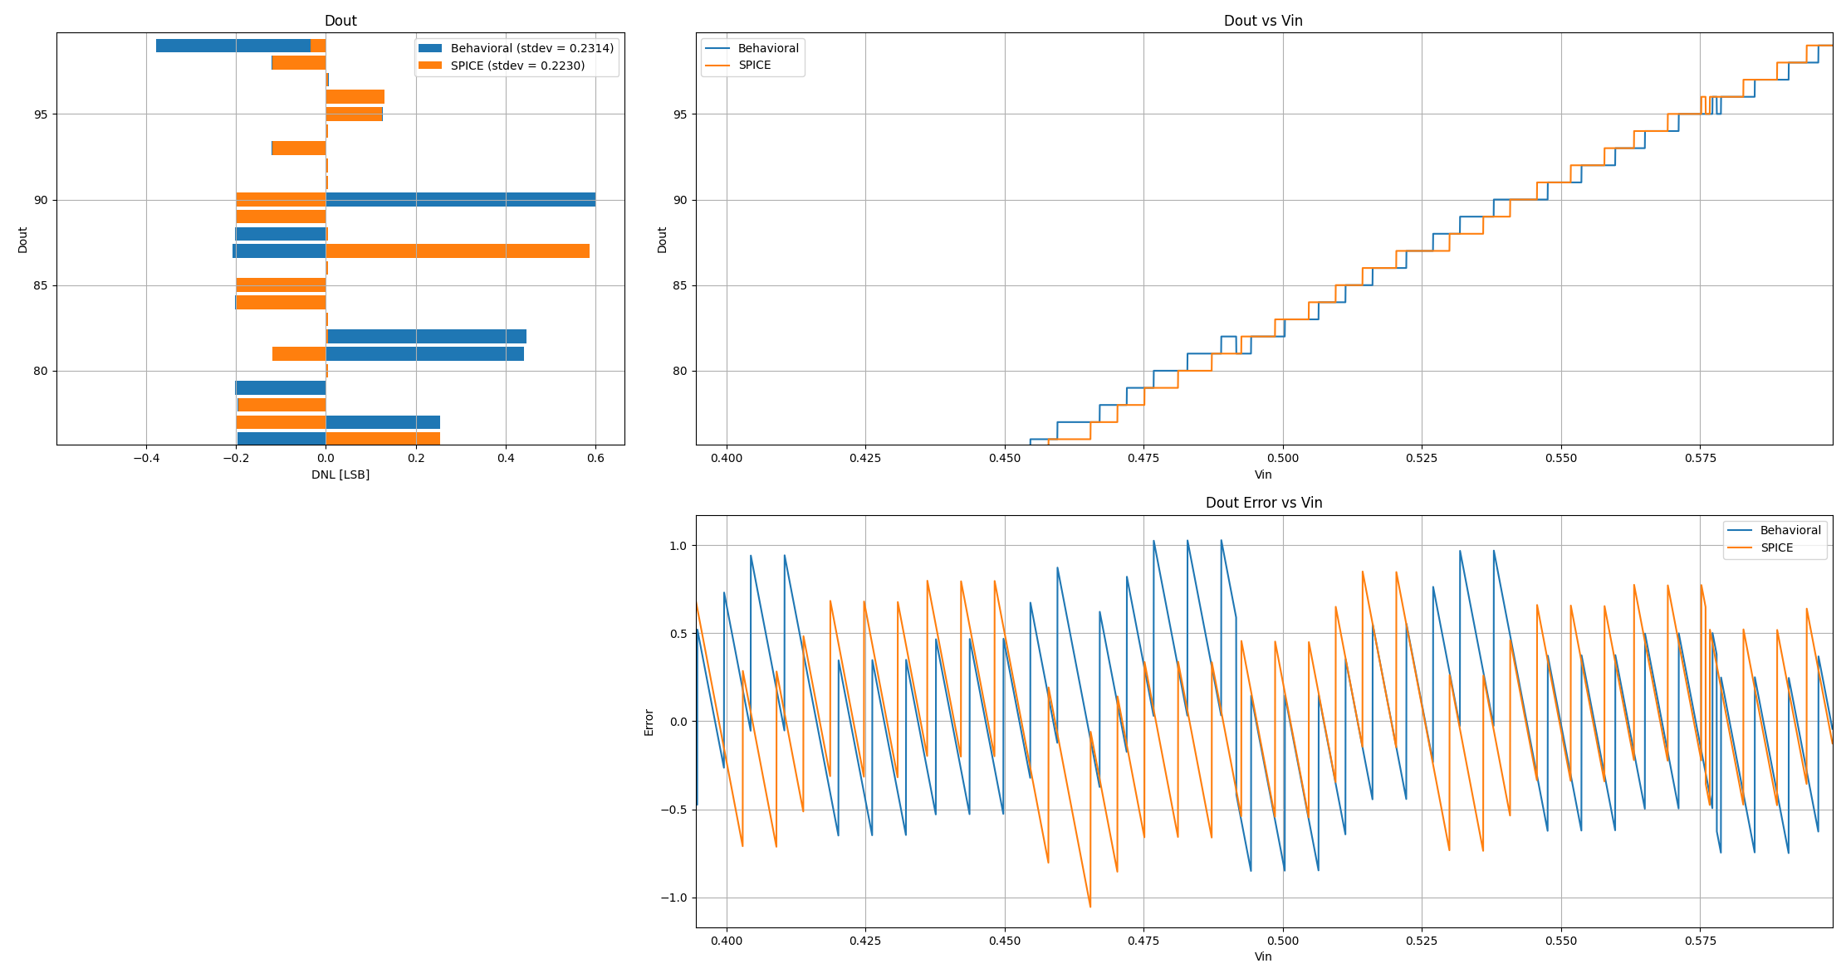

Behavioral vs SPICE: Linearity comparison
❓
❓Some codes are non-monotonic, in both SPICE and behavioral models?

Slide 16
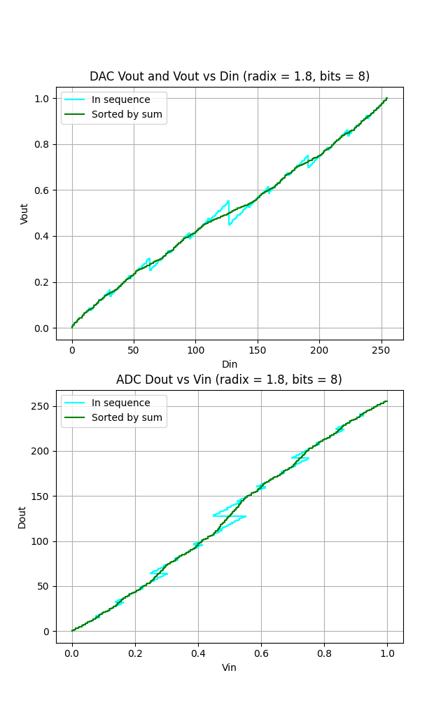
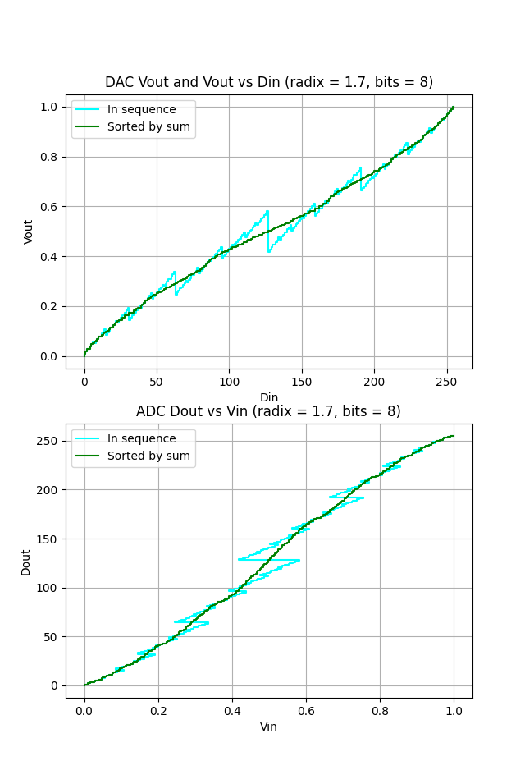
How are non-binary redundant codes distributed?

Slide 17
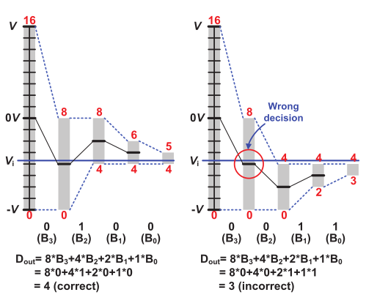
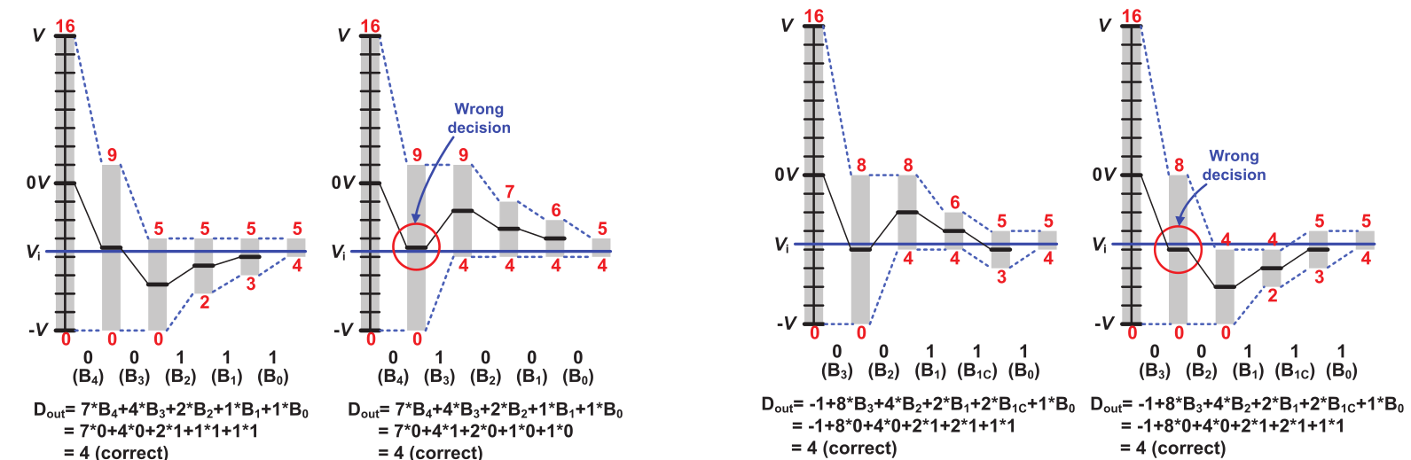
What about double conversions?
Side note: What type of adder hardware is ideal?
Non-binary
(integer rounded weights)
“Binary-scaled compensation/recombination”
Conventional binary
The repeated conversion steps need an offset of half their weight to account for the ‘bias’ they introduce
[C.C. Liu JSSC 2015]

Slide 18
Next steps?
params = {
"ADC": {
"bit_size": 8, # nominal resolution of the ADC (switching between netlists)
"sampling_frequency": 10.0e6, # sampling rate in Hz, used to driver clock sources
"jitter": 0.0e-12, # aperture jitter in seconds (TBD)
"device_noise": False, # enables basic gaussian noise in behavioral, and tran noise in SPICE
},
"TESTBENCH": {
"positive_input_voltages": [0.2, 1.2, 20e-6], # start, end (incl.), and step voltage
"negative_input_voltages": [1.2, 0.2, 20e-6],
"use_calibration": False, # account for cap error when calculating Dout (re-analog)
"pdk_file": "\"~/helena/tech/tsmc65/default_testbench_header_55ulp_linux.lib\" tt",
"spicedir": None, # Use this to write netlist from template
"rawdir": None, # Use this to set SPICE output dir, and to read for parsing
},
"SWITCH": {
"offset_voltage": 0.0e-3, # offset voltage in Volts
"common_mode_dependent_offset_gain": 0.0, # common mode voltage gain
"threshold_voltage_noise": True,
"type": "passive", # supports active, passive, or ideal
"strength": 4,
},
"COMP": {
"offset_voltage": 0.0e-3, # offset voltage in Volts
"common_mode_dependent_offset_gain": 0.0, # common mode voltage gain
"threshold_voltage_noise": True,
"strength": 4, # used to size some active devices (SPICE only)
},
"CDAC": {
"positive_reference_voltage": 1.2, # reference voltage in Volts
"negative_reference_voltage": 0.0, # reference voltage in Volts
"reference_voltage_noise": 0.0e-3, # reference voltage noise in Volts (CDAC)
"switching_strat": "monotonic", # {monotonic, bss} used to determined initial starting voltages
"unit_capacitance": 1e-15, # unit capacitance
"target_capacitance": None, # Used for alternative
"array_size": 8, # number of capacitor stages
"array_N_M_expansion": False, # Sizing strategy where
"multiple_conversions": None, # List bit positions in C array, with number of repetitions at each
"use_rdac": False, # Set bit position which should
"use_offset_cap": False, # set to 0 farads, if disabled
"use_split_cap": True, # set to 0 farads, if disabled
"parasitic_capacitance": 5.00e-14, # estimate of capacitance at output (added to SPICE and ideal)
"settling_time": 0.0e-9, # individual settling errors per capacitor?
},
}
Notes:
\textrm{cycles} = 1,2,3,4,5,6,7,8,9
\textrm{weights} = w_i = w_7, w_6, w_5, w_4, w_3, w_2, w_1, w_0
\textrm{SA register} = r_i = r_7, r_6, r_5, r_4, r_3, r_2, r_1, r_0
R^{'}=\sum_{i=1}^{N_{CDAC}} b_i \cdot w_{i-1}
\textrm{data out} = b_i = b_7, b_6, b_5, b_4, b_3, b_2, b_1, b_0

