Slide 1



Data converters for
high frame rate imaging detectors
Kennedy Caisley¹, Hans Krüger¹, Jochen Dingfelder¹, Bart Dierickx²
1. University of Bonn, DE
2. Caeleste, Mechelen, BE

Slide 2
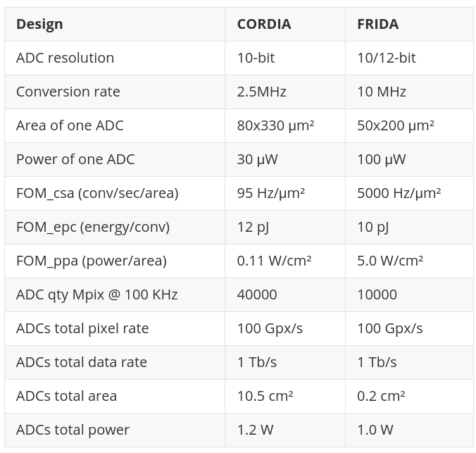
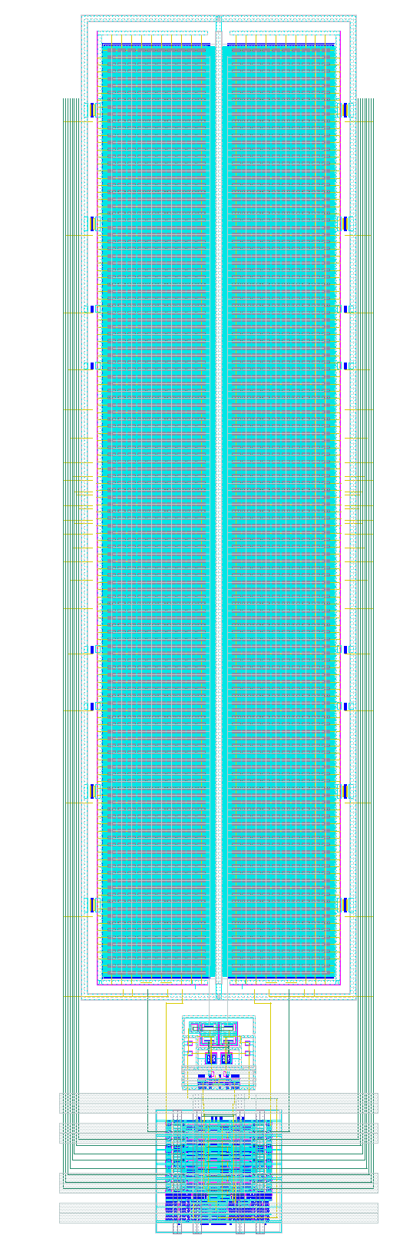
80
65nm → 28nm
50
200
330

