Slide 1

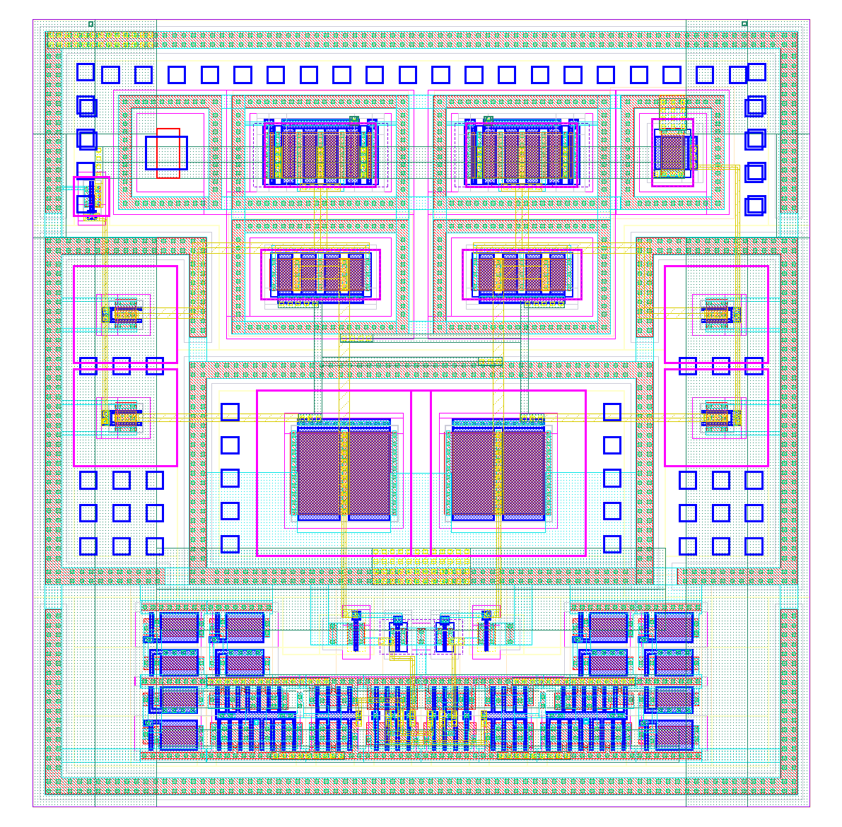
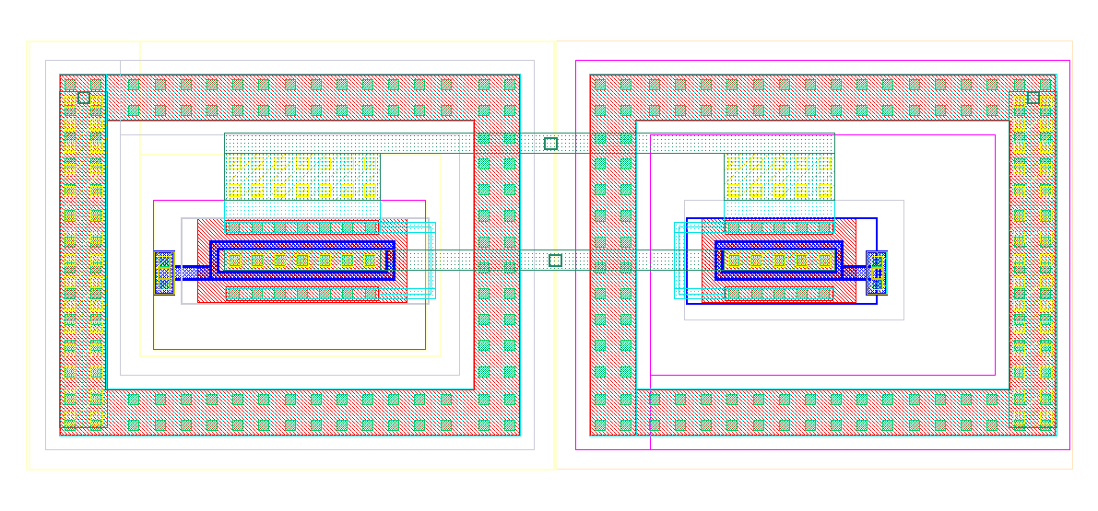
adc.v
- clkgate.v
- salogic.v
- sampdriver.v
(+) macros
top.v
- core.v
- spi_reg.v
- compmux.v
(+) adc.v
macro_placement.tcl
io_placement.tcl
pdn.tcl (UPF)
pads.tcl
macro_placement.tcl
io_placement.tcl
pdn.tcl (UPF)
caparray.py
Synthesis
Synthesis
caparray.cdl
caparray.gds
caparray.v
Abstract
Gen.
adc.cdl
top.cdl
caparray.lef
comp.lef
sampswitch.lef
FP + PG + MP
FP + PG + MP
adc.lef
pads.lef
comp.cdl
comp.gds
comp.v
G&D Placement
G&D Placement
constraint.sdc (SDC)
CTS
constraint.sdc
CTS
sampswitch.cdl
sampswitch.gds
sampswitch.v
G&D Routing
G&D Routing
adc.def
core.def
Finishing
Finishing
adc.gds
adc.lef
(adc.lib?)
core.gds
pads.gds

Slide 2
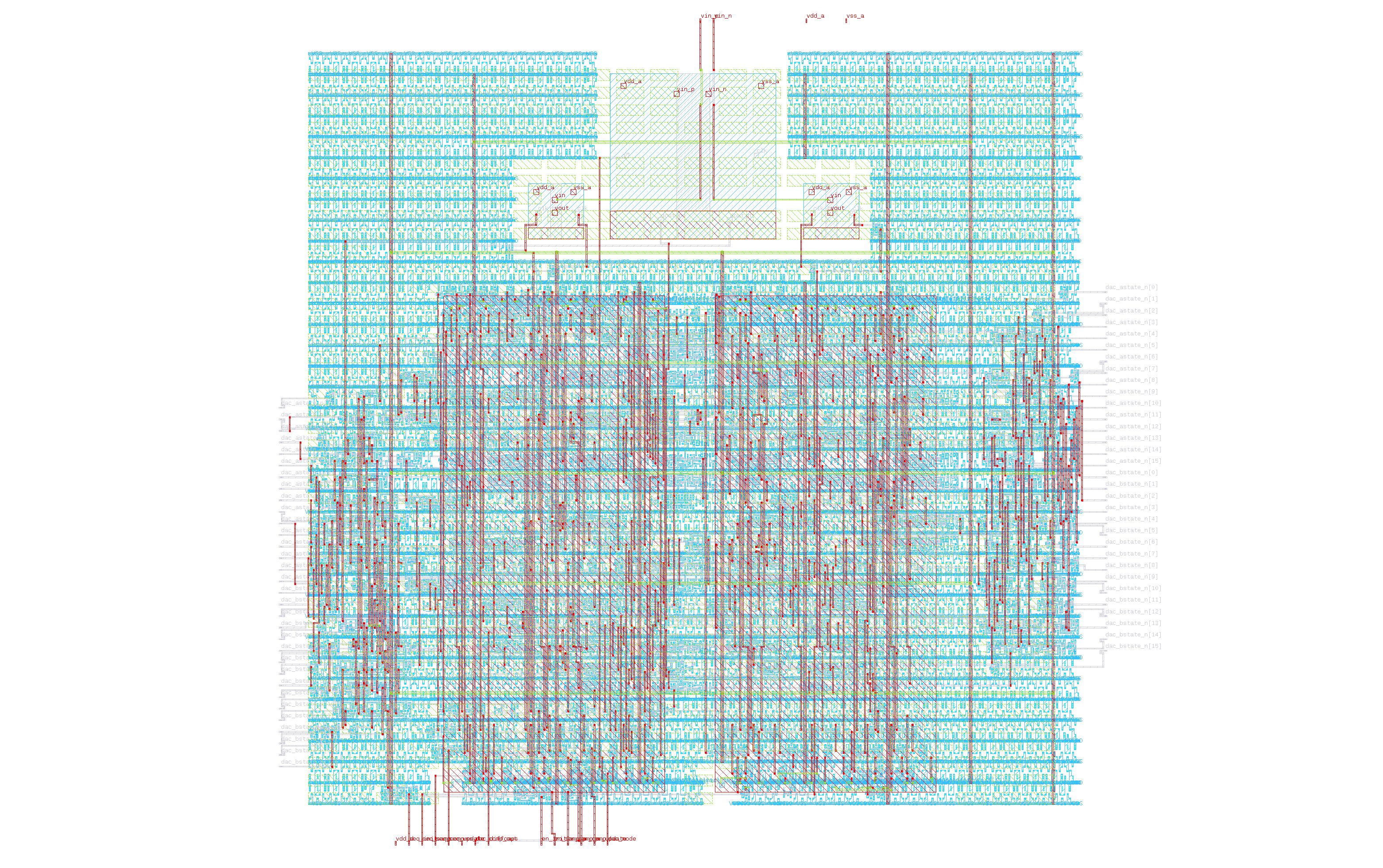

Slide 3
