Slide 1

MACS2
Alejandra López | Giulia Sansone | Kelly Cardona
BESE 394A

Slide 2
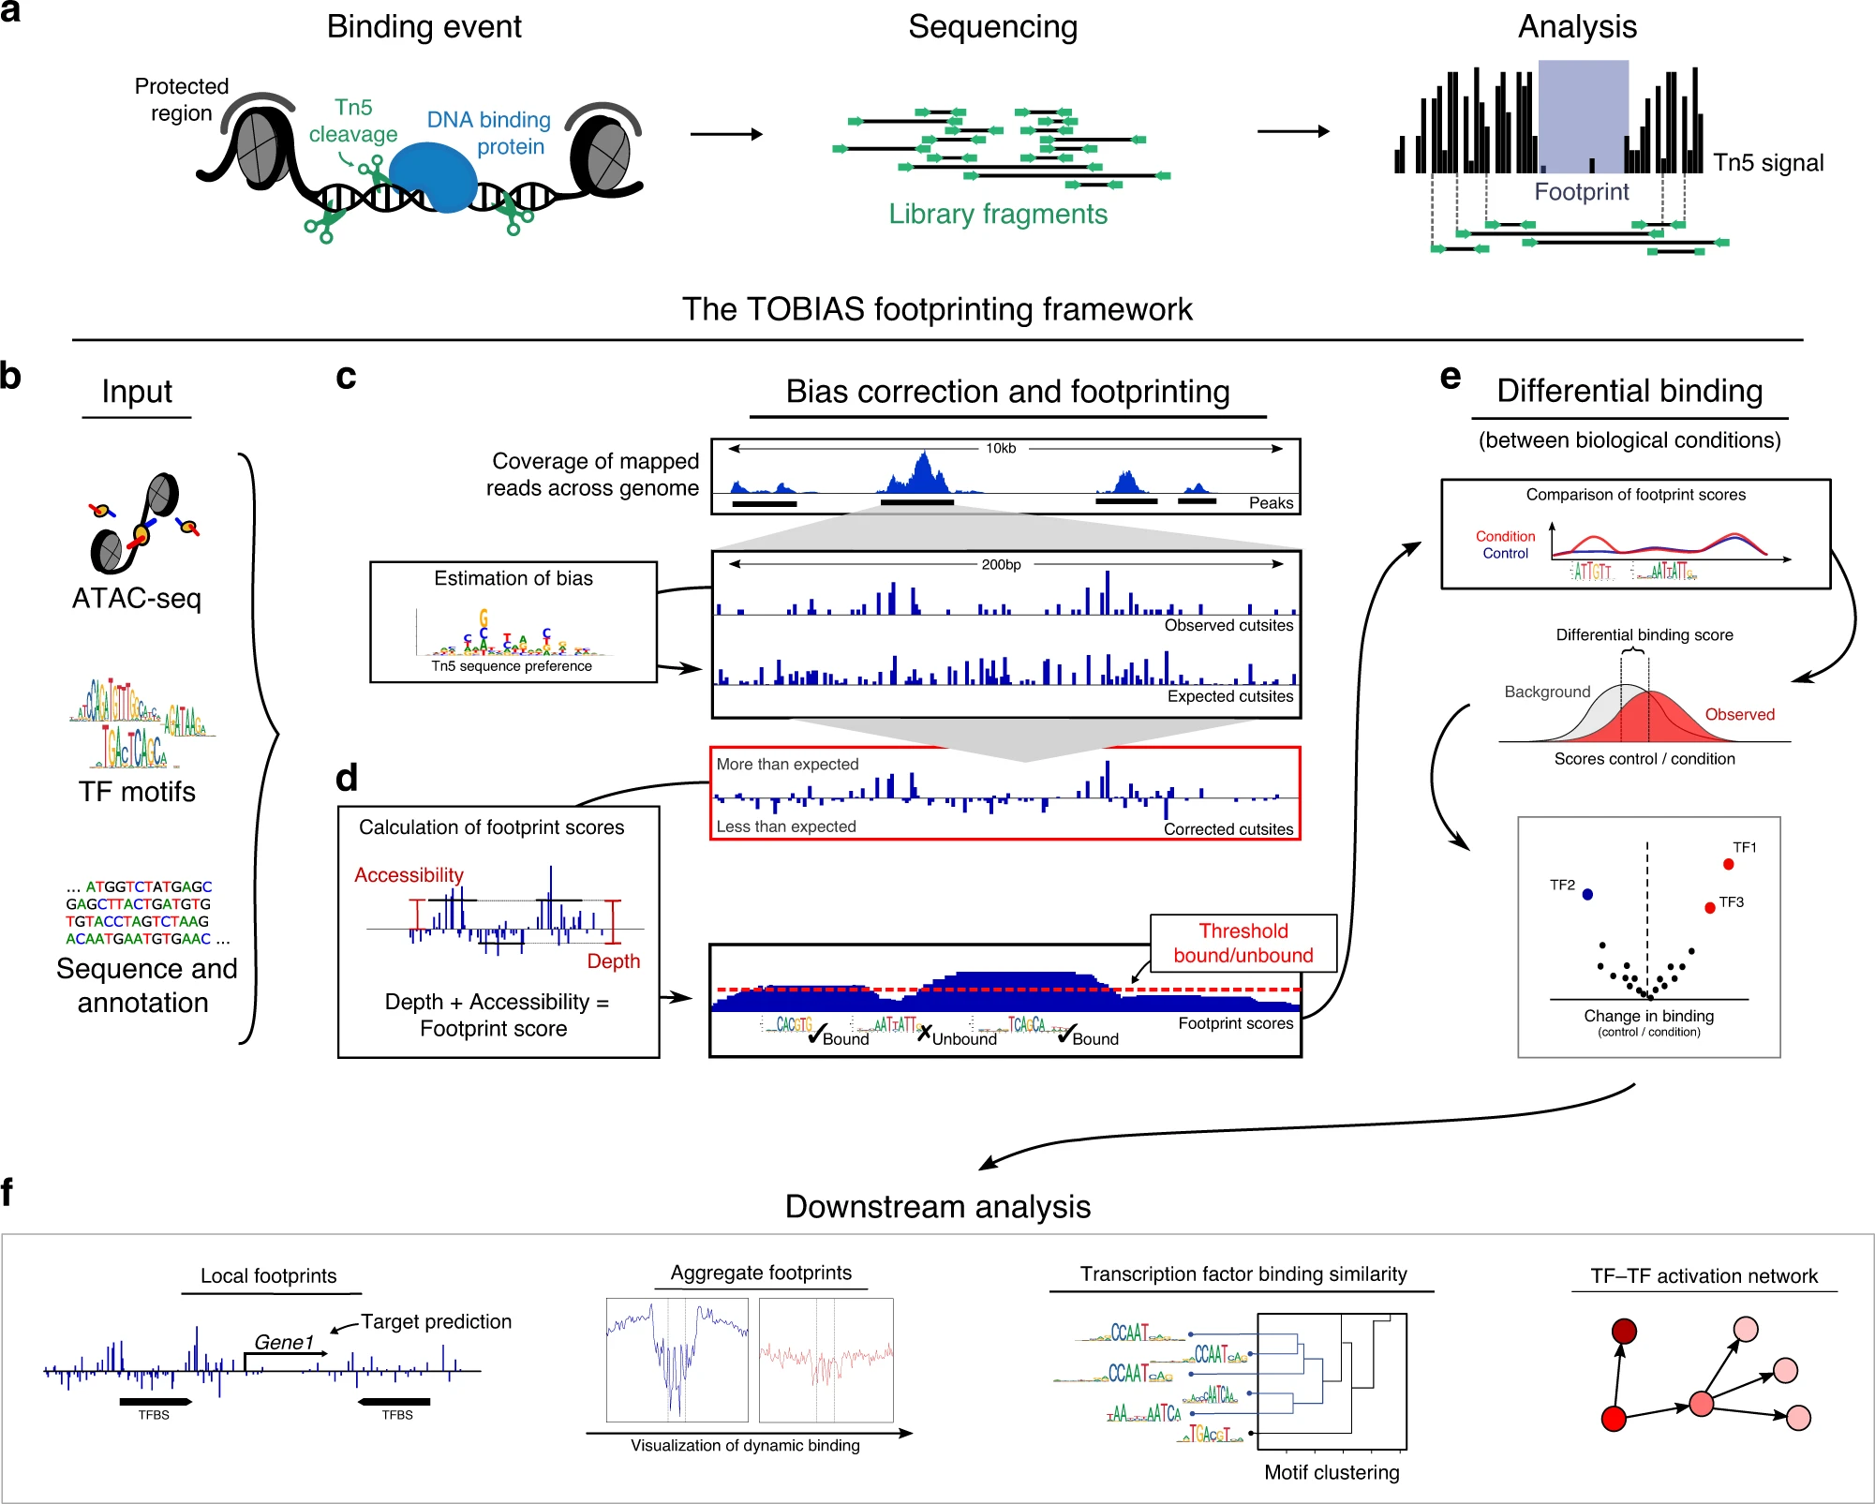
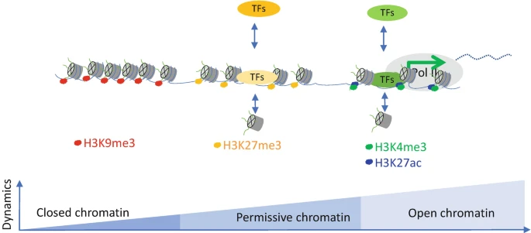
ATAC-Seq Experiment
Bentsen et al, 2020
ATAC-seq (Assay for Transposase Accessible Chromatin with high-throughput Sequencing) is a next-generation sequencing approach to assess the genome-wide chromatin accessibility.
Sahu et al, 2021

Slide 3
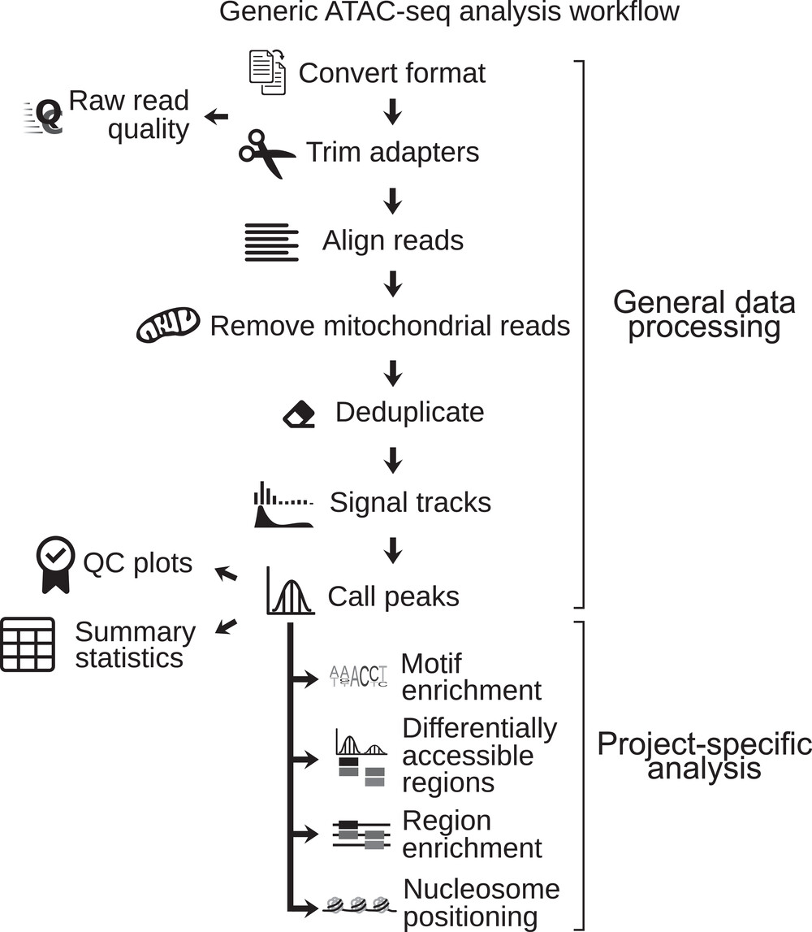
ATAC-Seq analysis General Workflow
MACS2
Smith & Sheffield, 2020

Slide 4
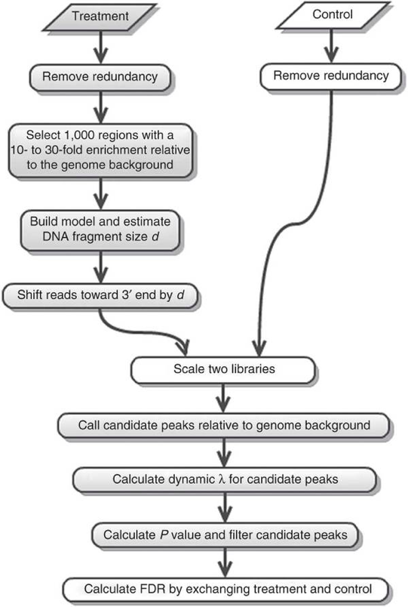
ATAC-Seq peak calling with MACS2
Notes:
Explanation of this workflow at: https://hbctraining.github.io/Intro-to-ChIPseq-flipped/lessons/06_peak_calling_macs.html
Remove duplicate reads.
Model a Poisson distribution for the background based on genome size and read count.
Detect candidate peaks based on p-value.
Model Poisson distributions for local regions of 1 kbp, 2 kbp, 5 kbp, and 10 kbp around each candidate peak. Take the max of these for each point.
Calculate the p-value with respect to these local regions for each candidate peaks to filter out false positives.

Slide 5
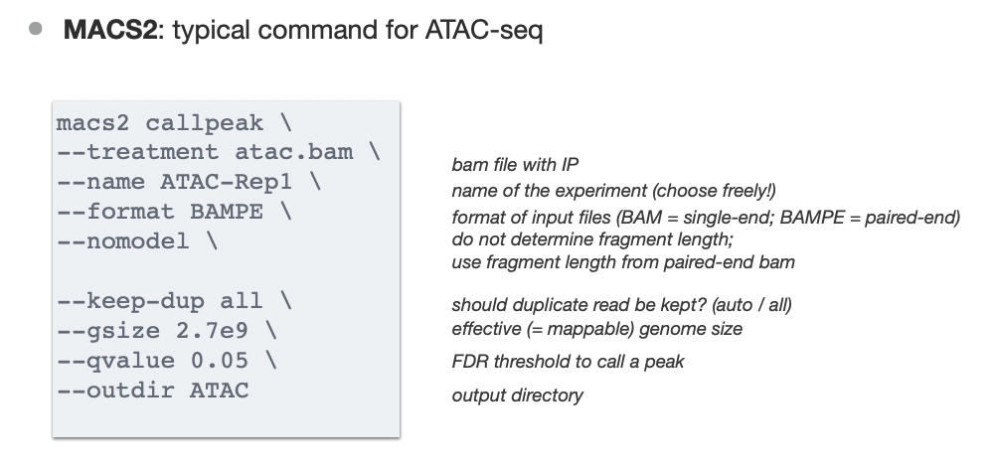
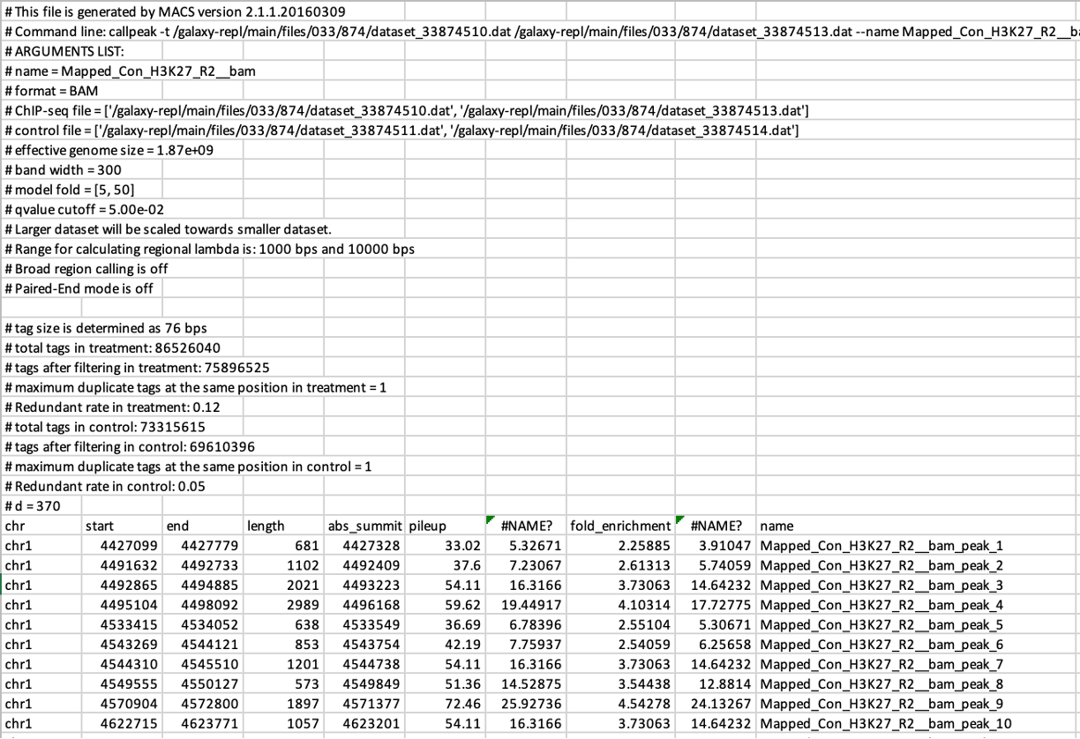
ATAC-Seq peak calling with MACS2
Input
Output
peaks.narrowPeak file (BED6+4)
peaks.xls file
summits.bed file
Health Data Science Unit - Medizinische Fakultät Heidelberg
Notes:
peaks.narrowPeak file: A BED6+4 format file which contains the peak locations together with peak summit, p-value, and q-value
peaks.xls file: A tabular file which contains information about called peaks. Additional information includes pileup and fold enrichment
summits.bed file: Peak summit locations for every peak

Slide 6
MACS3 vs. MACS2
MACS3 has more ATAC-seq oriented features than its predecessor, however, it is still in active development, so bugs may happen.
Main new features:
Call variants in peak regions directly from BAM files.
Implementation of HMMRATAC module. The basic idea behind HMMRATAC is to digest ATAC-seq data according to the fragment length of read pairs into four signal tracks: short fragments, mono-nucleosomal fragments, di-nucleosomal fragments and tri-nucleosomal fragments. Then integrate the four tracks again using Hidden Markov Model to consider three hidden states: open region, nucleosomal region, and background region.
Speed and memory optimization.
Notes:
More details: https://github.com/macs3-project/MACS/tree/master

Slide 7
References
Sahu, S.K., Basu, A., Tiwari, V.K. (2021). Measuring Chromatin Accessibility: ATAC-Seq . In: Borggrefe, T., Giaimo, B.D. (eds) Enhancers and Promoters. Methods in Molecular Biology, vol 2351. Humana, New York, NY. https://doi.org/10.1007/978-1-0716-1597-3_6
Bentsen, M., Goymann, P., Schultheis, H. et al. ATAC-seq footprinting unravels kinetics of transcription factor binding during zygotic genome activation. Nat Commun 11, 4267 (2020). https://doi.org/10.1038/s41467-020-18035-1
Smith JP, Sheffield NC. Analytical Approaches for ATAC-seq Data Analysis. Curr Protoc Hum Genet. 2020 Jun;106(1):e101. doi: 10.1002/cphg.101. PMID: 32543102; PMCID: PMC8191135.
Zhang, Y., Liu, T., Meyer, C.A. et al. Model-based Analysis of ChIP-Seq (MACS). Genome Biol 9, R137 (2008). https://doi.org/10.1186/gb-2008-9-9-r137
https://github.com/macs3-project/MACS/tree/master

Slide 8
Thank you!

