Slide 1
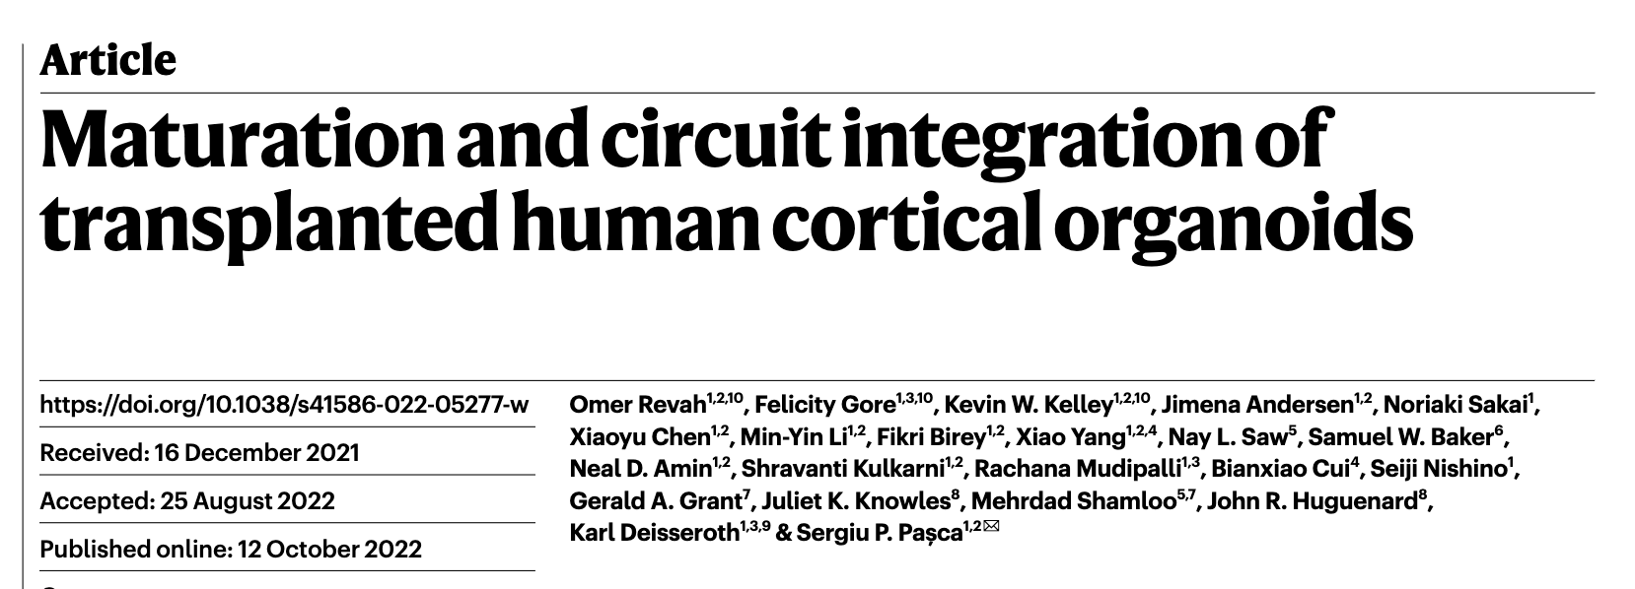
GROUP 2 | ALEJANDRA LOPEZ | KELLY CARDONA | GIULIA SANSONE

Slide 2
The manuscript in a nutshell:
Aim: To study the maturation and circuit integration of transplanted human cortical organoids into the somatosensory cortex of newborn rats.
The biological question: How these organoids develop mature cell types and integrate into sensory and motivation-related circuits in a host brain?
Rationale: In vitro organoid systems lack connectivity and behavioral integration.

Slide 3
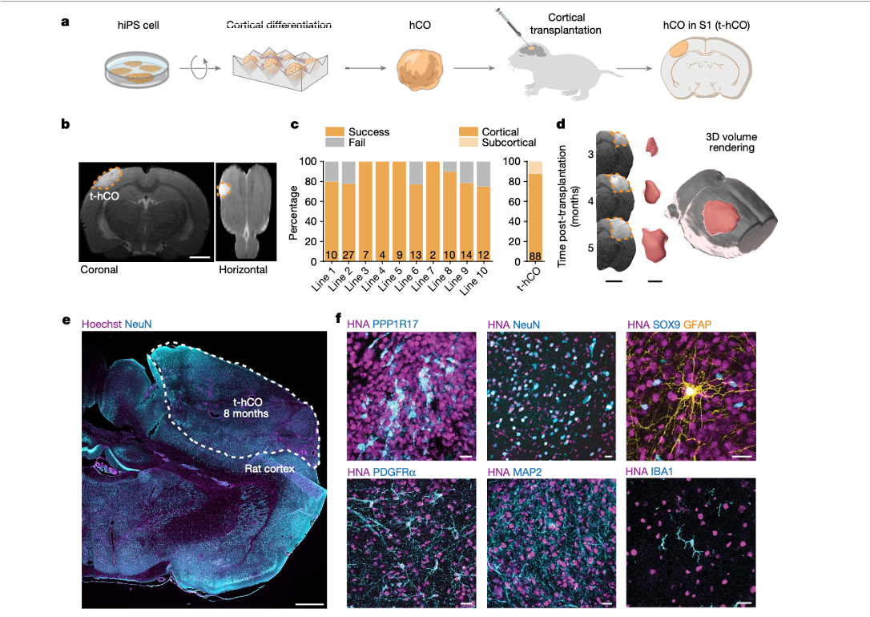
Transplantation of human organoid in rat brain
e developing rat cortex.

Slide 4
Single Cell Methods: Key steps
Data Integration & Visualization
Data Integration with Seurat
Clustering & visualization with UMAP
Markers for each cluster
Functional annotation
03
Single nuclei dissociation & Sequencing
Nuclei purification and Single cell 3′ chip for snRNA-seq library preparation using the 10x Genomics platform.
01
02
Single-nuclei Expression Analysis
Quantfication: 10x Genomics CellRanger software suite
Mapping: hybrid genome human + rat
Normalization and QC

Slide 5
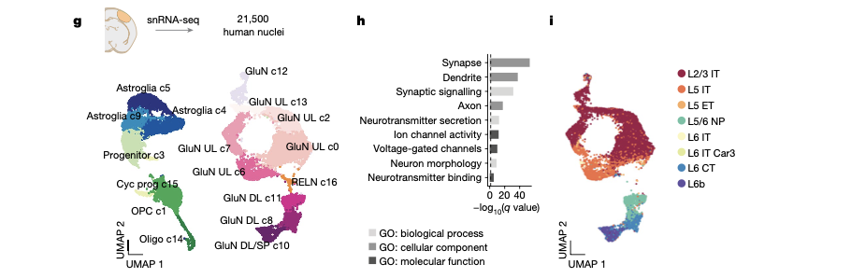
Transcriptomic characterization of human organoid cell types

Slide 6
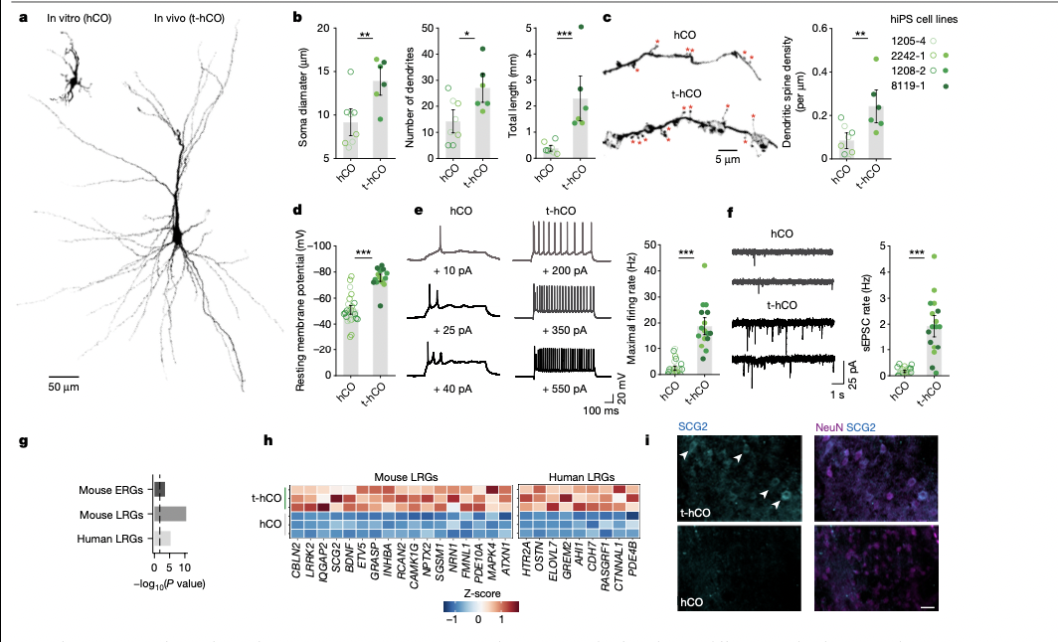
ERG and LRG expression comparison between htO and mouse brain
snRNA-seq revealed upregulation of activity-dependent gene transcripts in t-hCO compared with hCO in vitro
t-hCO glutamatergic neurons expressed higher levels of late-response activity-regulated genes (Fig. 2g,h) found in previous studies of mouse and human neurons
For example, BDNF18, SCG2 and OSTN, a primate-specific activity-regulated gene17, showed increased expression in t-hCO neurons compared with hCO neurons
Therefore, across transcriptional, morphological and functional analyses, t-hCO neurons displayed features of enhanced maturation compared with hCO neurons.

Slide 7
Relevance of single cell analysis in this study
Insights into the cellular diversity and maturation of individual neurons and glial cells in transplanted human cortical organoids
Identification and characterization of mature neuronal and glial subtypes that integrate into the host brain
Identification of developmental trajectories to understand how the hCO integrate into the host brain
Insights into functional integration (gene expression patterns) of human cells in the context of their new environment
Cell-type-specific insights into disease mechanisms and therapeutic responses

