Slide 1
Roadnet: XML to SVG road networks topology converter
Kevin Carmona-Murphy, 1059136

Slide 2
Getting Started
$ ruby parser.rb −f rd.xml
-f option specifies input xml file
Optional –o option specifies output html file containing svg graphics

Slide 3
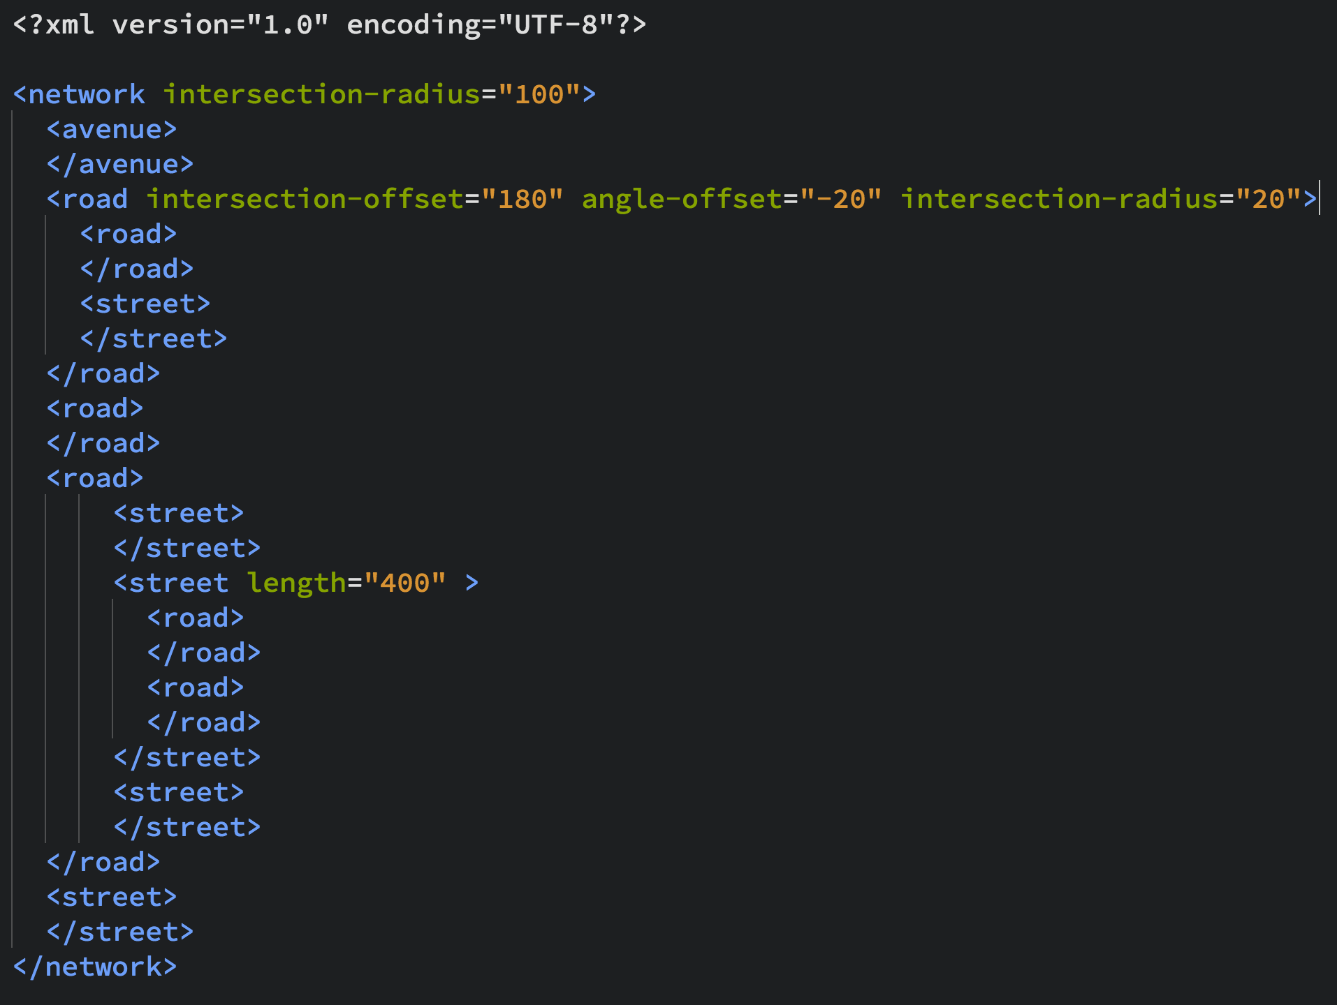
XML input
Nested hierarchies
Road, street, and avenue types
Specifiable attributes:
Intersection-radius
Angle-offset
Intersectino-offset
Length of link

Slide 4
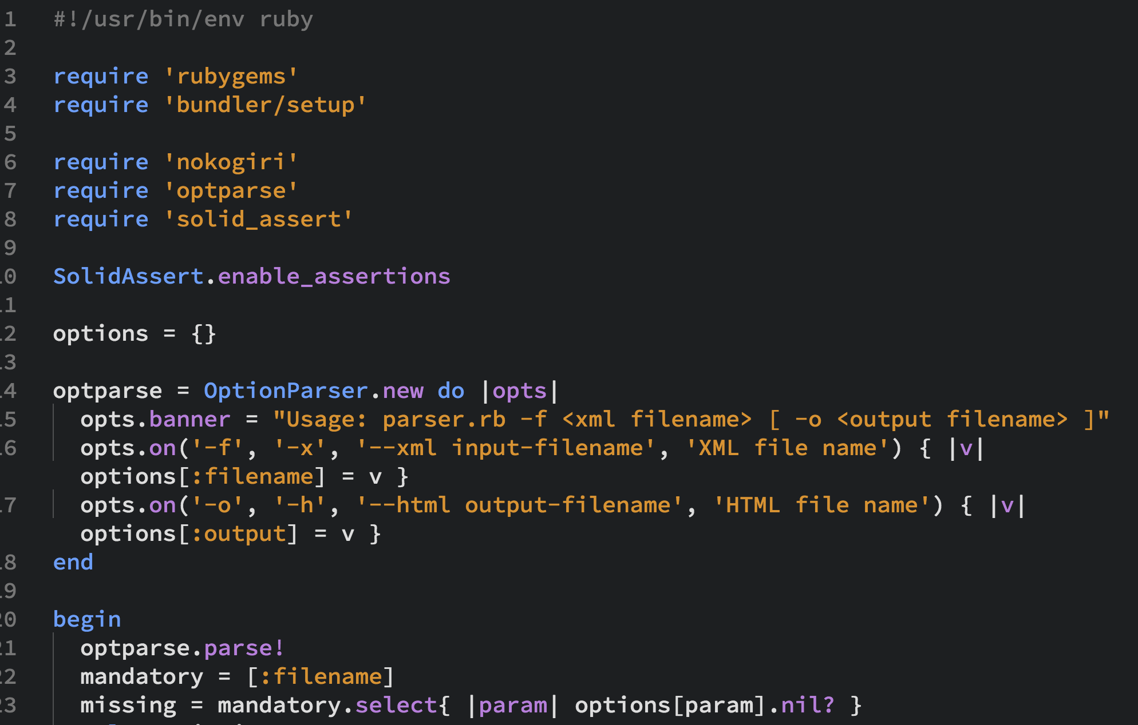
How it Works
Descends XML file recursively, drawing svg objects as it parses
Uses Nokogiri to parse XML and create final HTML file

Slide 5
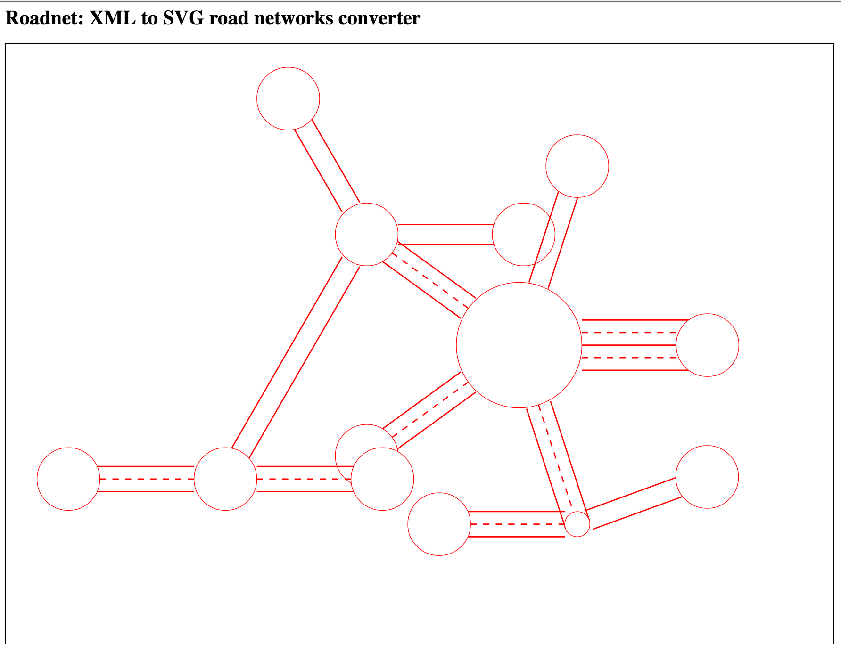
SVG Output

