Slide 1

Feedback, Dynamics, and Evolution in
Clusters of Galaxies
Ken Cavagnolo
Advisor: Megan Donahue
Thesis Proposal

Slide 2
Overview
Galaxy Clusters and Entropy Primer
Thesis Questions
Completed Work
Work In Progress
Future Goals and Timeline

Slide 3
Why study clusters of galaxies?
What is ICM entropy?

Slide 4
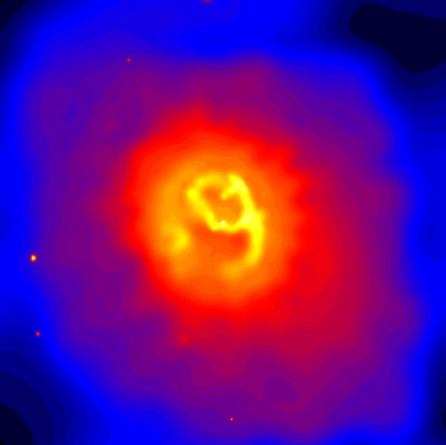
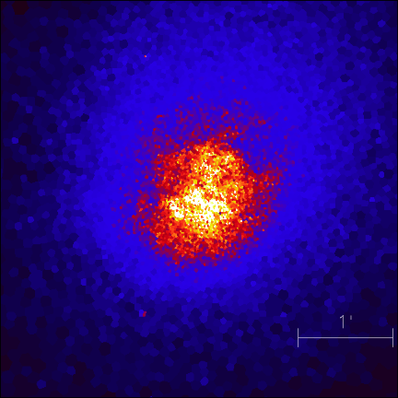
Galaxy Clusters and Entropy
Clusters of galaxies are the most recent objects to have formed in hierarchical structure formation.
Gas within the cluster is thermalized to >10⁶ K producing a hot plasma which is called the intra-cluster medium (ICM).
This plasma emits strongly in the X-ray band and can be observed with Chandra, XMM-Newton, ROSAT, etc.
The observed state of this gas is a combination of shock heating during accretion, radiative cooling, and thermal feedback triggered by cooling.
Notes:
Talk about:
Baryons trace the DM; tell about how gas becomes thermalized; thermalized means to lose energy by collisions and then reach a state that is well described by the Maxwell-Boltzmann distribution; ICM is the intracluster medium

Slide 5
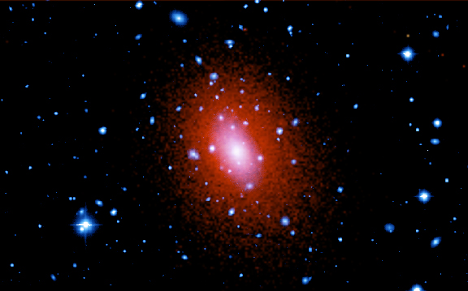
Galaxy Clusters and Entropy
Composite optical and X-ray image of the galaxy cluster Abell 2029
(Kitt Peak and Chandra)
Entropy is the quantity most affected by changes in thermal energy of the ICM (Voit 2005).
X-ray observations of the ICM enable study of gas entropy:
Κ = T/n_{elec}^{2/3} ; s = ln Κ^{3/2} + Κ₀
The distribution of entropy determines a cluster’s X-ray properties.
Gas density and temperature profiles are used to determine the entropy structure.
Thus, by studying the origin and evolution of ICM entropy we also are exploring how clusters form and evolve.

Slide 6
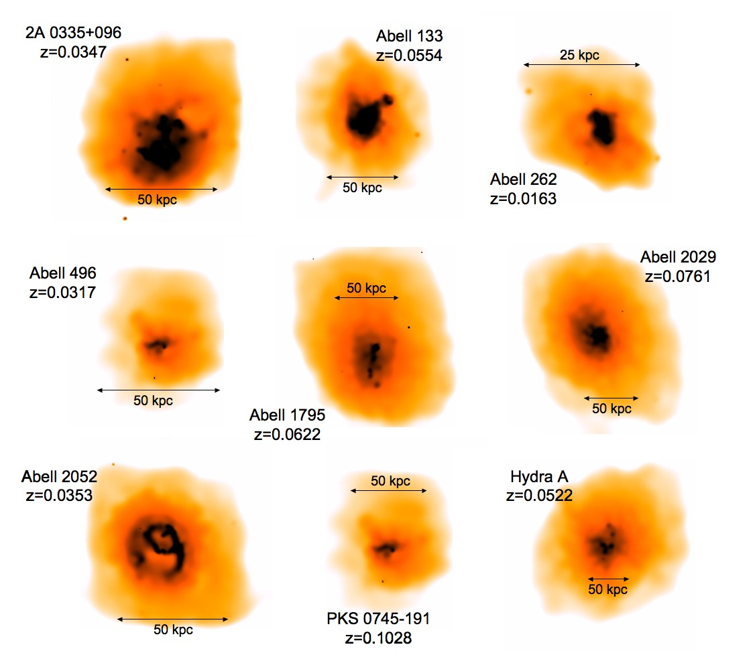
Galaxy Clusters and Entropy
Cluster entropy distributions are somewhat of a mystery because gravitational heating alone does not produce the observed X-ray properties.
Some source of heating must be coming from cluster members.
Candidates for this heating are supernovae, active galactic nuclei (AGN), and superburst star formation (Borgani 2004, Ponman 1999, Wu 1998).
To quantify how much feedback contributes to thermal state of gas, we look to entropy distributions of both real and simulated clusters.
Smoothed Chandra X-ray observations for initial sample of nine clusters.

Slide 7
Has this work been done before?

Slide 8
New, Unique Study
Study of entropy distribution is typically done for an individual cluster, or as an afterthought to calculating cluster mass or gas metallcity.
A survey-type study of entropy distributions has not been done before.
No such study has been performed for simulated cluster data.
Previous studies also used a generation of low spatial resolution X-ray telescopes, such as ROSAT, XMM-Newton, or Einstein.
We are concurrently investigating:
  Limitations of cluster observations
  Systematics of X-ray instruments
  How well simulations reproduce properties of real clusters
  Correlation of observables with simulated data

Slide 9
Where is the data?
Is there enough to sustain a thesis?

Slide 10
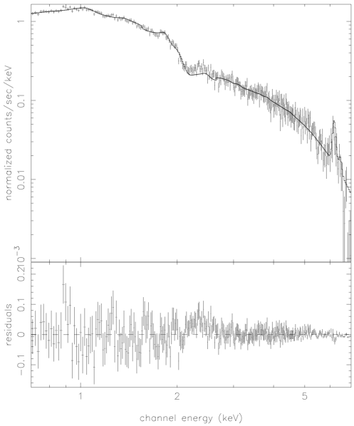
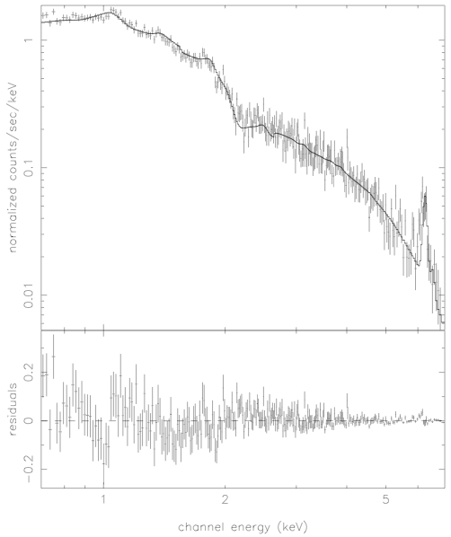
Observations and Data
X-ray data is taken from the Chandra Public Archive.
Of interest are cooling flow and non-cooling flow clusters of galaxies, there are many (over 200) observations in the Archive.
We will also utilize XMM-Newton as it offers a wider field of view and is a good consistency check at radii larger than is visible with Chandra.
This project is fully funded through two Chandra grants: SAO AR3-4017A and SAO AR5-6016X
Abell 1650
Abell 3112

Slide 11
Observations and Data
We will also be utilizing the Virtual Cluster Exploratory, a collection of public cluster simulations under development by Gus Evrard at the University of Michigan.
Of interest will be mock Chandra spectral images derived from the simulations, which will be geared toward studies of individual systems, deep sky images, and statistical samples.
The goal of using the VCE is to move toward a complete physical understanding of the ICM by merging observation with theory via application of observational techniques on simulated data.
T_{X}
Κ

Slide 12
Thesis Questions
Do non-cooling flow clusters fit into the framework of AGN regulated condensation of gas?
Is there a correlation between central entropy value and H-alpha emission or radio emission?
Can hierarchical structure formation be studied using the X-ray spectra of clusters of galaxies?
How does the projected appearance of a cluster relate to its virialized state?
Can we find observables that quantify a cluster’s position on the mass-temperature and mass-luminosity relations?
Is it possible to quantify the degree of virialization?
How well do deprojected quantities reflect the actual properties?
Does the assumption of symmetry in deprojection have a significant impact on our ability to accurately study clusters?

Slide 13
What has been completed thus far?

Slide 14
Completed Work
Entropy Profiles (Part I)
We’ve completed analysis on an initial sample of nine very luminous, nearby cooling flow clusters.
A data processing pipeline has been created to speed-up the reduction of Chandra data for much larger samples
Spectral fitting has been semi-automated to decrease time required for going from raw data to spectra ready for analysis.
Results for initial sample:
  The entropy profiles are similar despite a factor of two variation in global cluster temperature
  Entropy value at ~100kpc is similar for all clusters (~150-160 keV cm²)
  Core entropy values flatten to similar values within central 30-50kpc
This work resulted in two papers:
  Donahue M.E., Horner D.J., Cavagnolo, K.W., and Voit G.M., 2005, astro-ph/0511401
  Voit G.M., Donahue M.E., 2005, ApJ, 634, 955

Slide 15
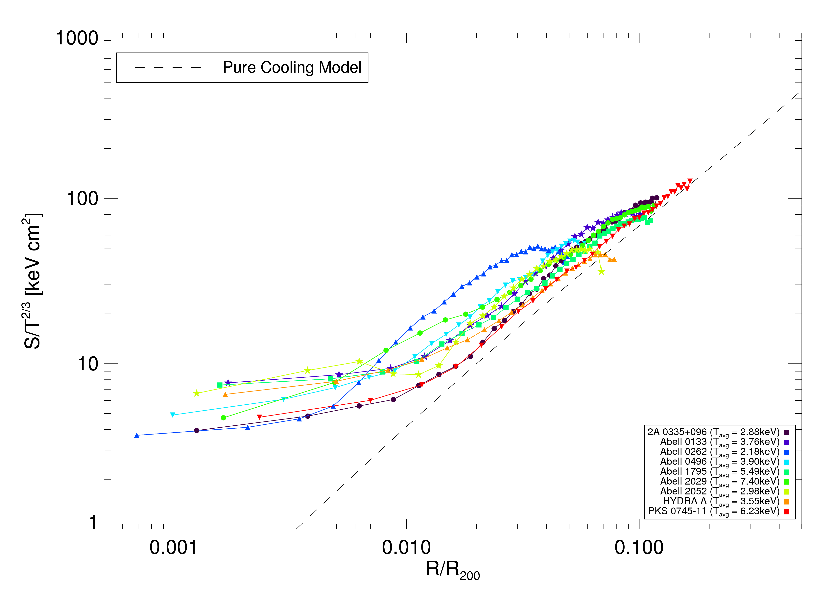
Completed Work
Entropy Profiles (Part I)
Entropy floor

Slide 16
Completed Work
Temperature Maps and Adaptive Binning (Part I)
We use a new adaptive binning technique from Diehl et al (Diehl 2006) that preserves flux in adaptively sized bins of a specified signal-to-noise ratio.
Adaptively binned images which reproduce or enhance cluster sub-structure can be used to investigate the 2D temperature, pressure, and entropy structure caused by AGN feedback or mergers.
A catalog of maps for Chandra X-Ray cluster data will serve as a fiducial for making comparisons with similar maps generated from simulated cluster data of the Virtual Cluster Exploratory.
The comparison between the models and these maps is to check how well simulations explain the correlation and range of global, radial, spectral, and imaging characteristics in an ensemble of real clusters.
I have developed a pipeline which combines the binning code and spectral fitting into a streamlined method for creating these maps.

Slide 17
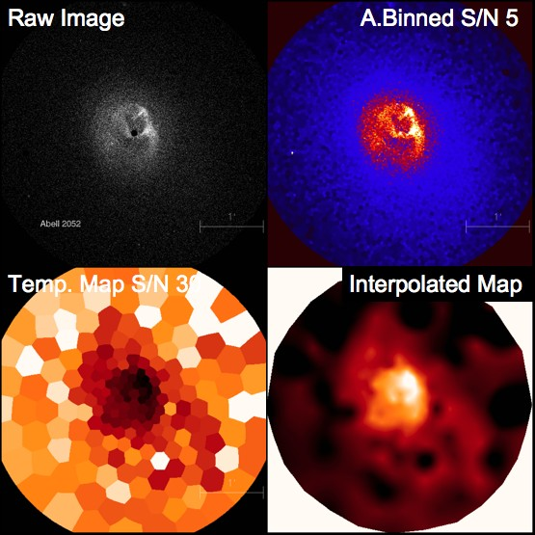
Completed Work
Temperature Maps and Adaptive Binning (Part I)

Slide 18
What work is in progress?

Slide 19
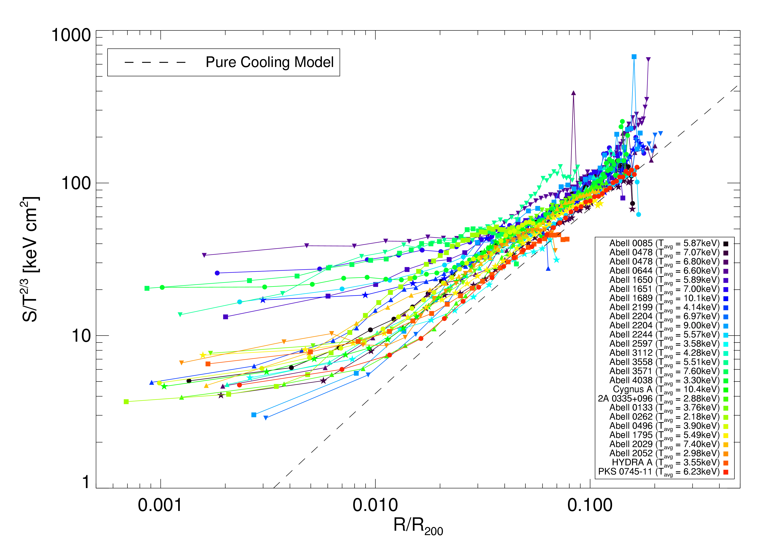
Work In Progress
Entropy Profiles (Part II)
The Chandra sample is being expanded to include more cooling flow clusters and to incorporate non-cooling flow clusters.
We are exploring how non-cooling flow clusters fit into our model of cooling flow regulation via AGN feedback.
H-alpha Luminous?
Radio-quiet?

Slide 20
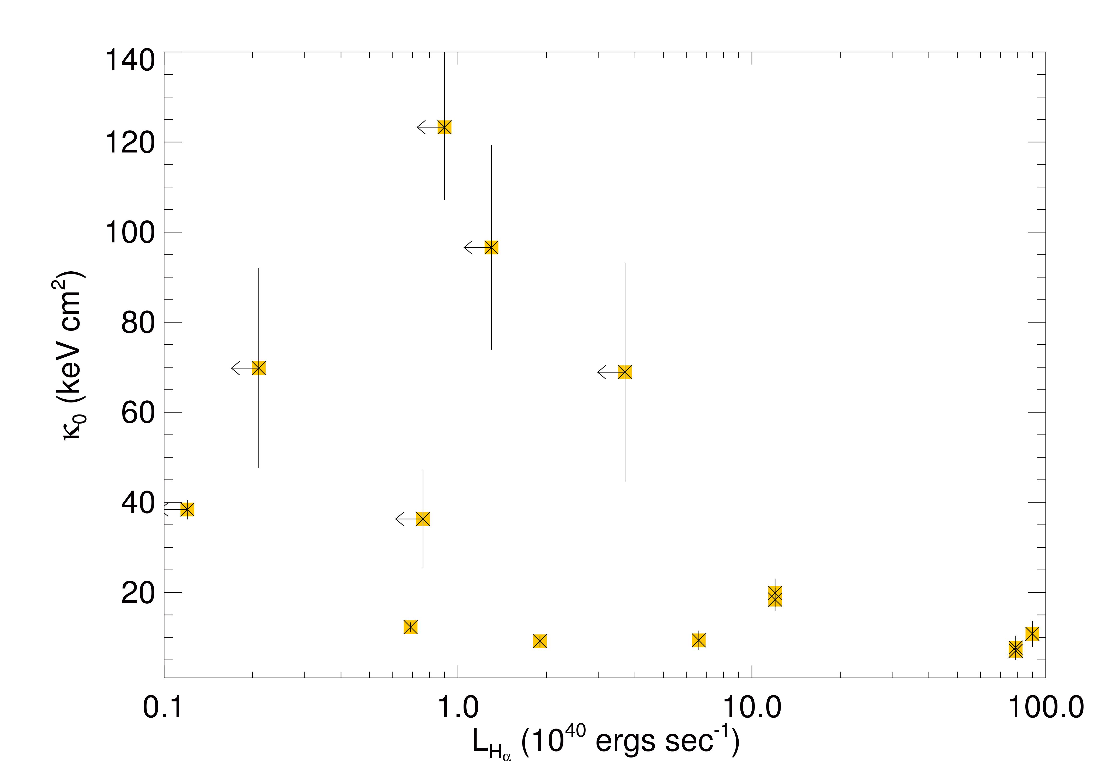
Work In Progress
H-alpha, Radio Emission, and Entropy Correlations
There is a trend such that the central entropy, for clusters with more luminous H-lpha regions at their center, tends to be low.
Do radio-quiet clusters have high central entropy values compared with radio-loud clusters?
A1650 and A2244 suggest AGN supply the feedback necessary to suppress condensation in cooling flow clusters.

Slide 21
Work In Progress
Hierarchical Structure Formation in X-ray Spectra
Do the spectra of X-ray loud clusters yields information about formation history of clusters of galaxies?
Spectrally resolved simulations of clusters by Mathiesen and Evrard (2001) predict a bandpass dependent deviation in the mass-weighted average temperature.
This effect may be indicative of cool gas accreting into clusters.
113 (z<0.85) clusters have been taken from the Chandra archive as the foundation for a volume-limited sample.
A sub-sample of clusters are being used to investigate the systematics of our analysis.
For short, we’ve named this the Mathiesen/Evrard Test.

Slide 22
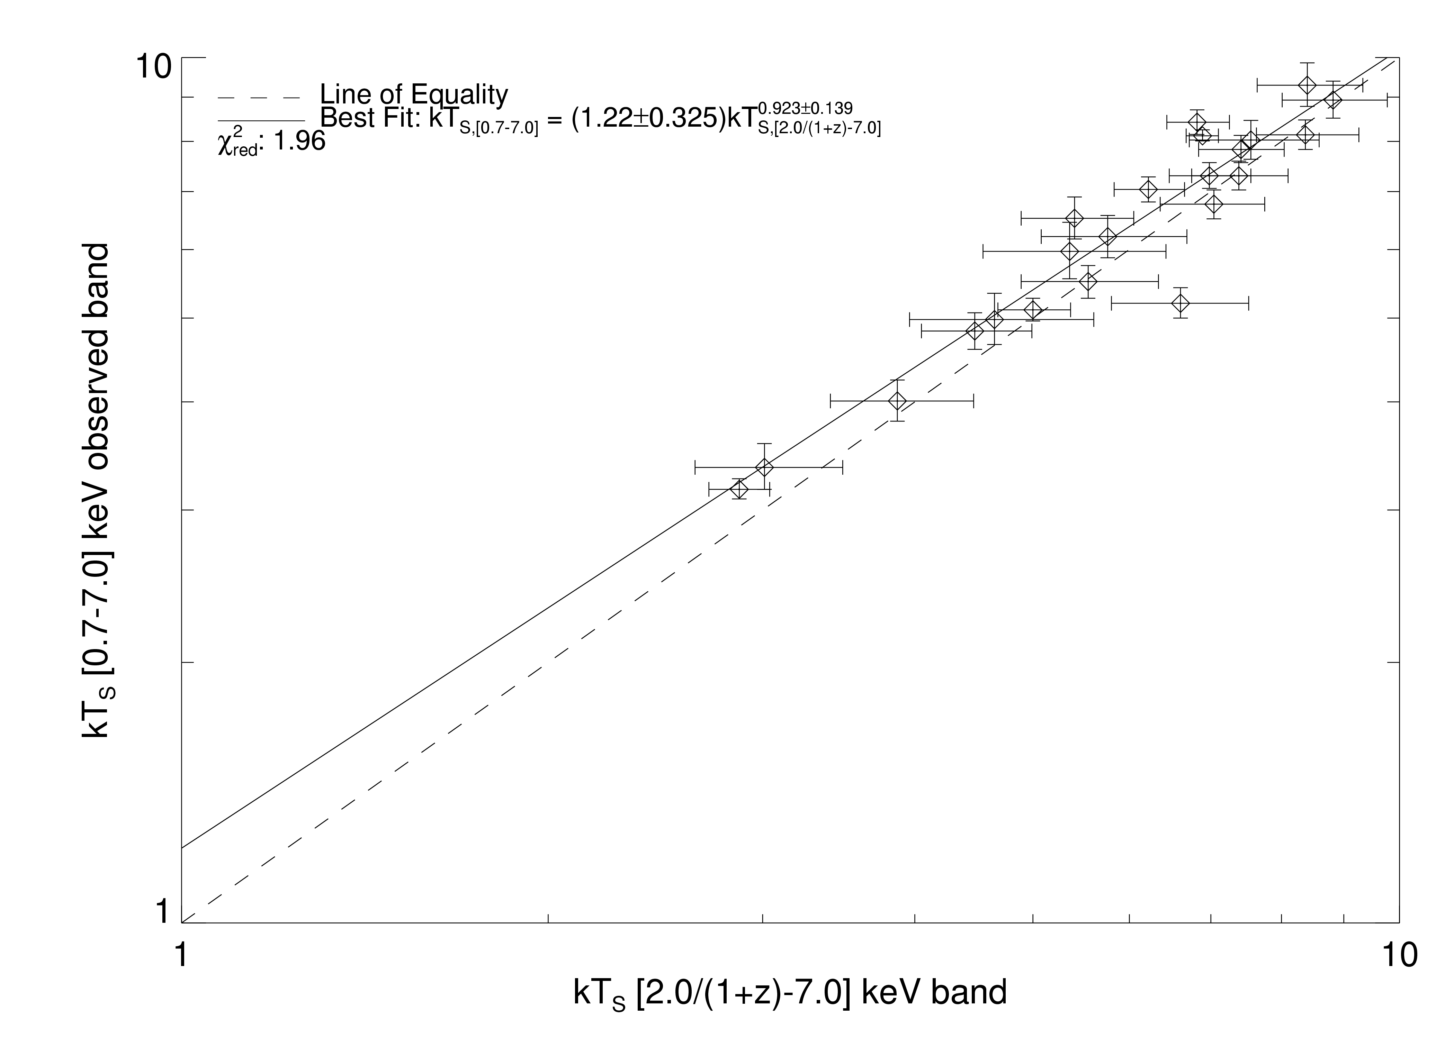
Work In Progress
Hierarchical Structure Formation in X-ray Spectra
Early results show a weak trend toward hotter temperatures in [2.0_{rest}-7.0]keV compared to [0.7-7.0]keV
However this likely is the result of either not properly fitting the hard-background or including too much background with apertures which are too large.
Notes:
Talk about:
The ACIS-S chipset has a layer of “stuff” building up; this build-up affects the soft emission detection of the chipset; we saw this effect in our data; CALDB 2.28 corrected most of this problem; the emission at this end accounts for a significant portion of the cluster emission;

Slide 23
What work lies ahead?

Slide 24
Future Work
Highlights
The addition of non-cooling flow clusters to the sample will round out the total picture of how entropy distribution correlates with AGN feedback.
Collecting H-alpha data for as many clusters as possible to check if lower central entropy correlates with luminous H-alpha regions.
Sort out the systematics of the sub-sample used in the Mathiesen/Evrard Test and then study the full sample for signs of hierarchical structure formation in the cluster spectra.
Utilize our observational tools on VCE data to explore:
  How the projected appearance of a cluster might relate to its virialized state
  If we can find observables that quantify a cluster’s position on the mass-temperature and mass-luminosity relations.
  If it is possible to quantify the degree of virialization.
  How well deprojected quantities reflect actual cluster properties.
  If the assumption of symmetry in deprojection has a significant impact on our ability to accurately study clusters.

Slide 25
Future Work
Timeline
Timeline 2006
Timeline 2007

Slide 26
Fin

