Slide 1


Band Dependence of X-ray Temperatures
Archival Chandra Sample
Data Analysis
Hard-band to Full-band Ratio (T_{HFR})
T_{HFR} Correlations:
  Cool Core and Non-cool Core
  Merger Systems

Slide 2
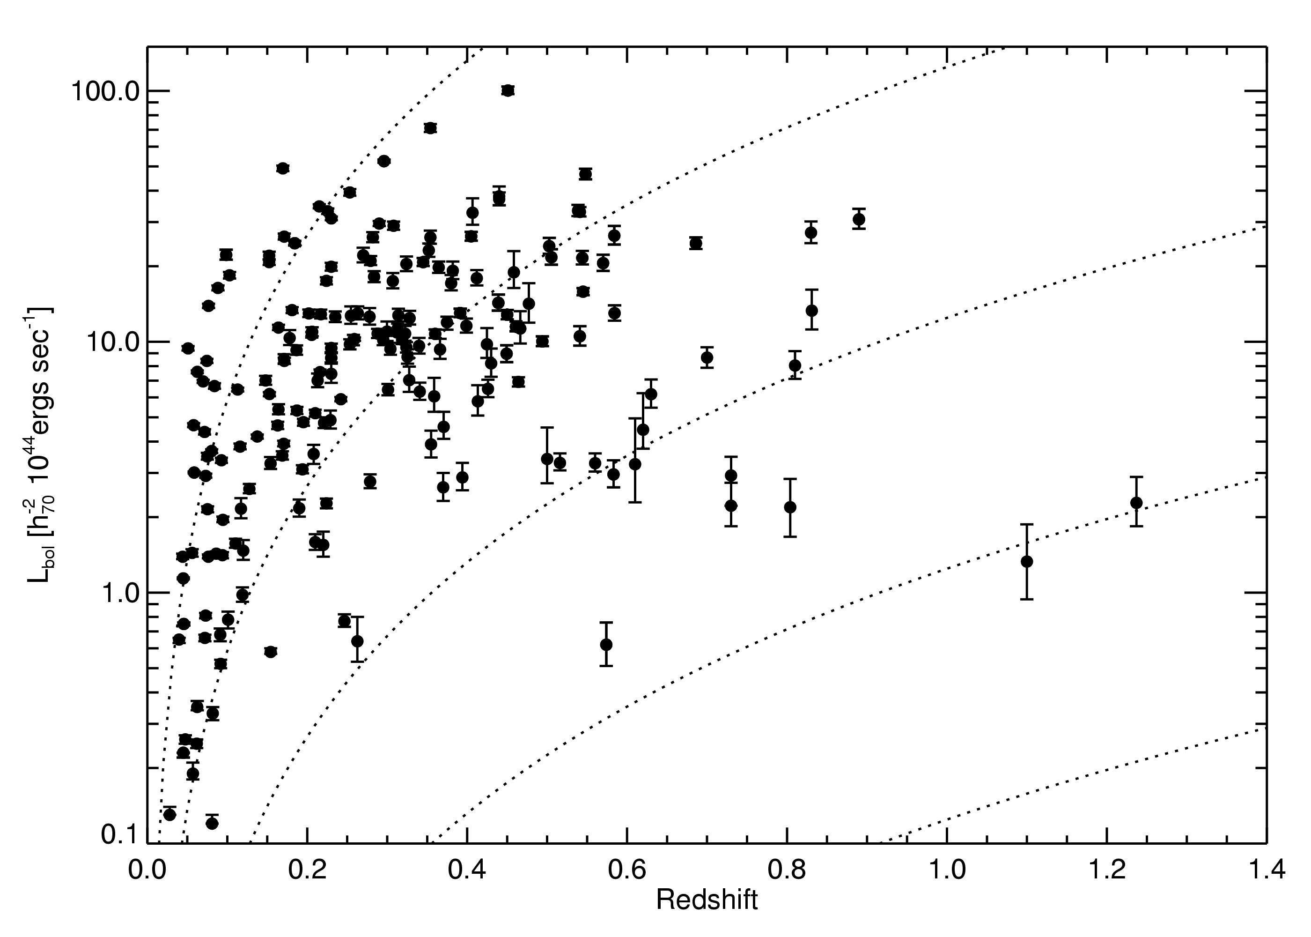

Cross-referenced multiple flux-limited surveys with CDA
Required minimum of R₅₀₀₀ in field
244 total observations for 193 clusters

Slide 3
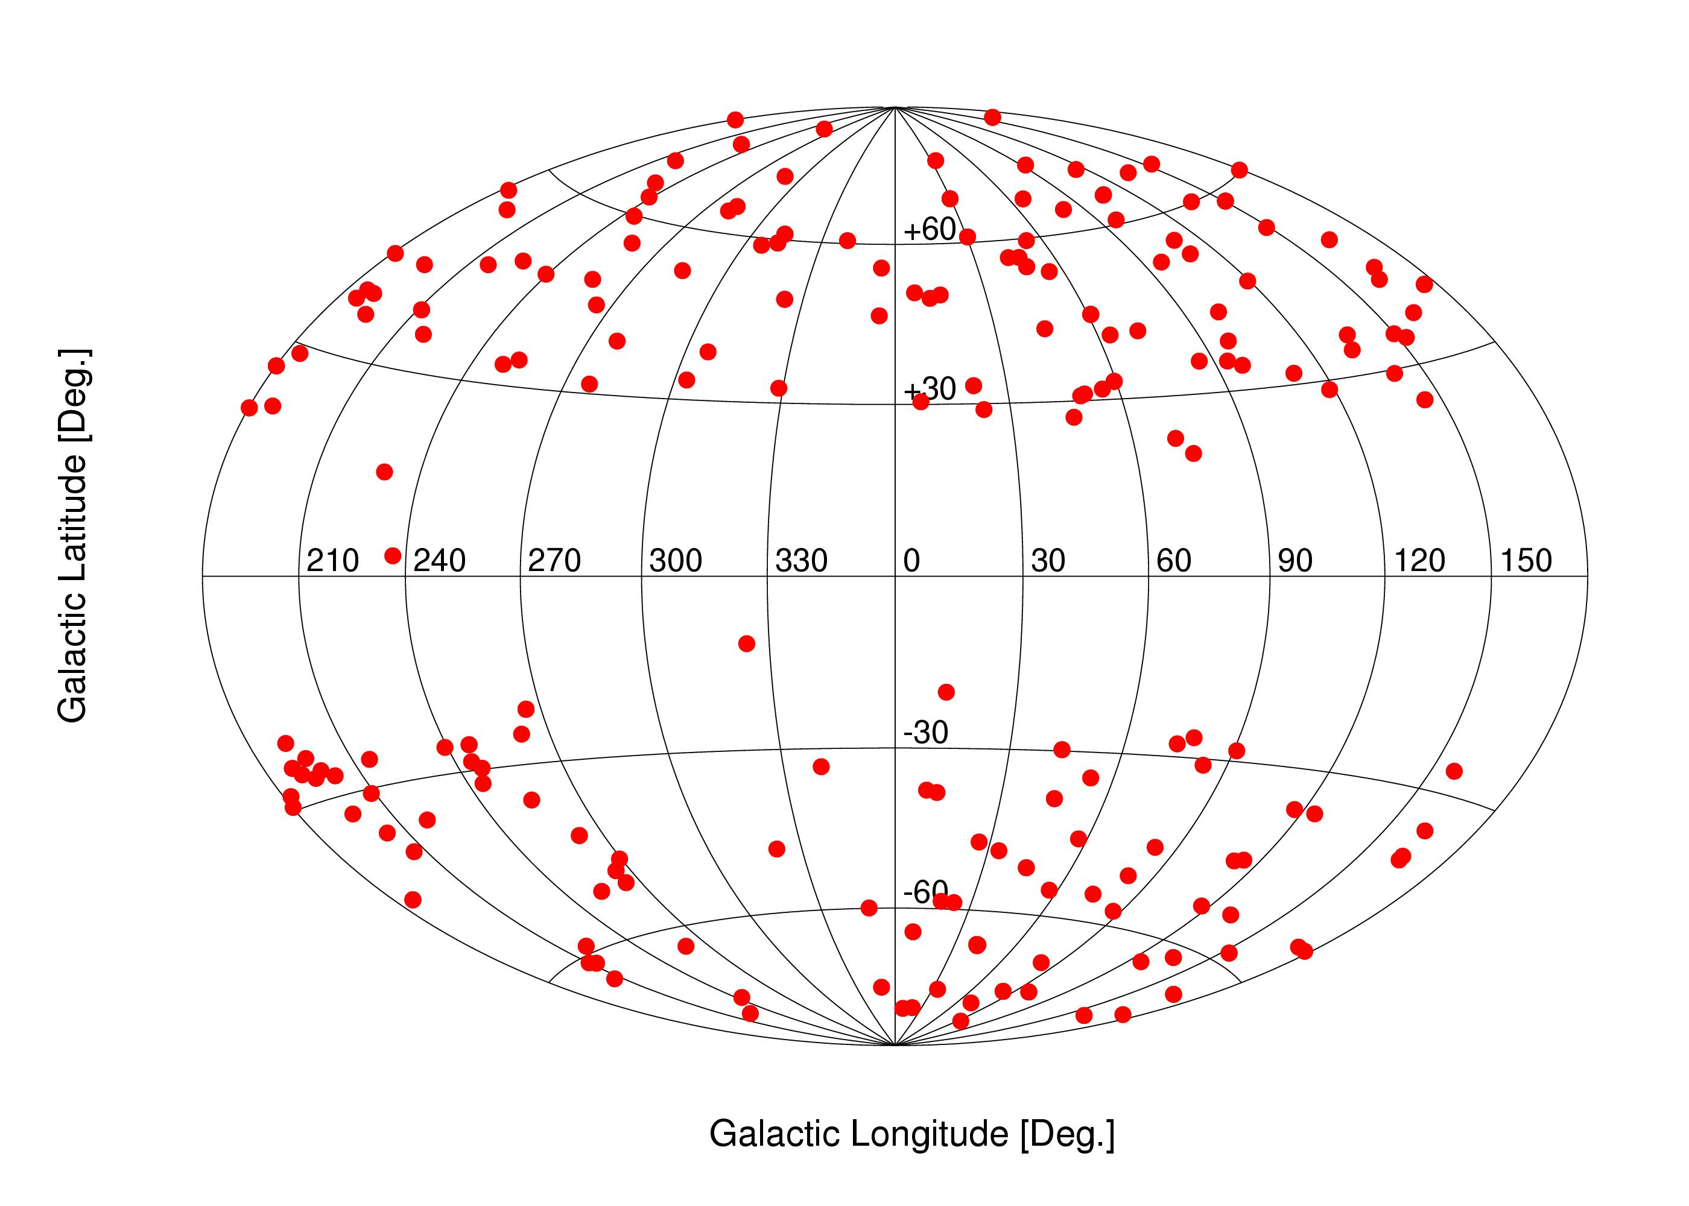
Cross-referenced multiple flux-limited surveys with CDA
Required minimum of R₅₀₀₀ in field
244 total observations for 193 clusters

Slide 4
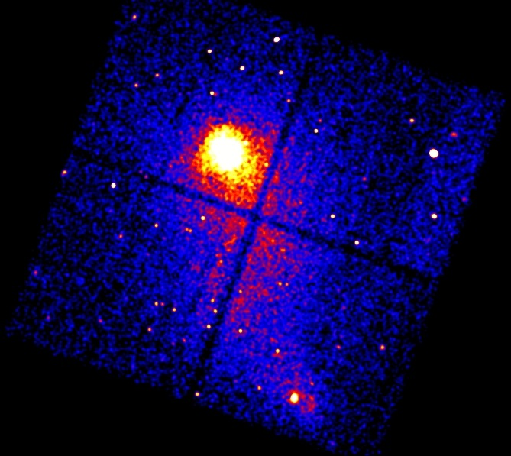
Data Analysis... in a hurry
Abell 2384
“Tadpole Cluster”

Slide 5
Data Analysis... in a hurry
Abell 2384
“Tadpole Cluster”
Must remove point sources

Slide 6
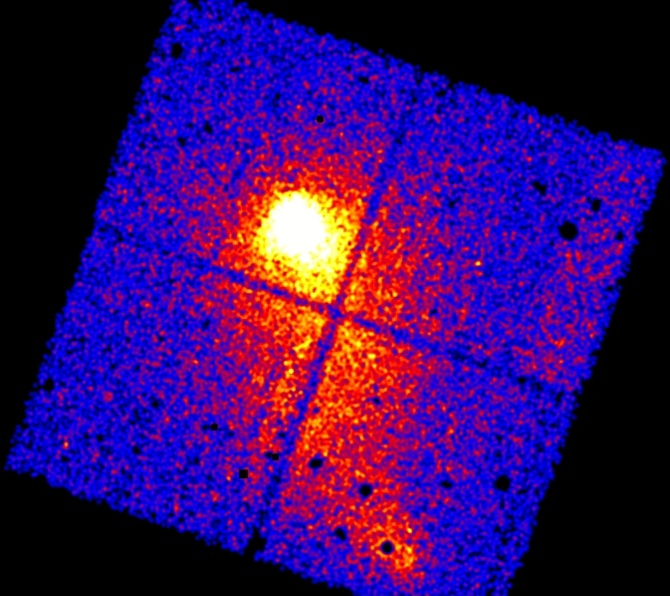
Data Analysis... in a hurry
Abell 2384
“Tadpole Cluster”

Slide 7
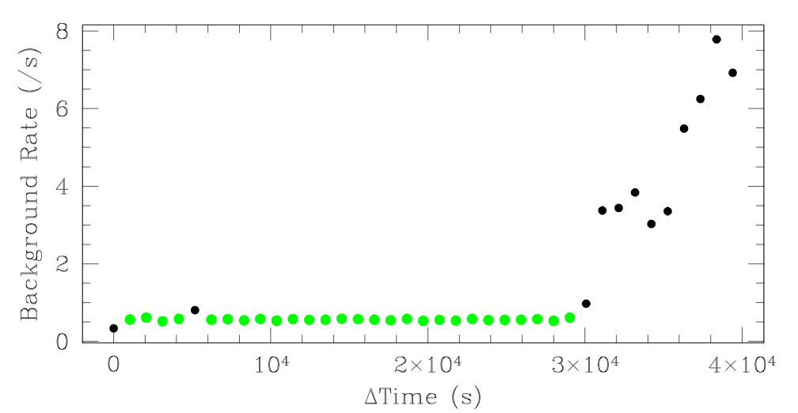
Data Analysis... in a hurry
Abell 2384
“Tadpole Cluster”
Remove background flares

Slide 8
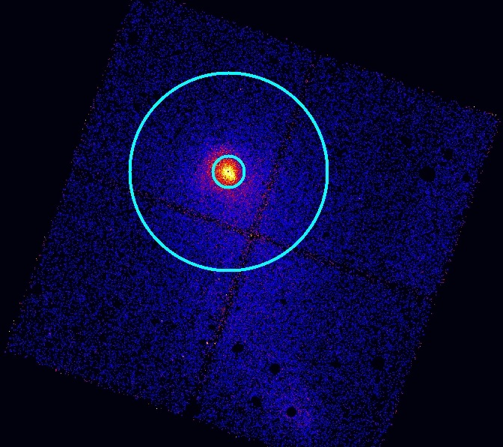
Data Analysis... in a hurry
Abell 2384
“Tadpole Cluster”
R₂₅₀₀
Core excluded!
Normalize
Centroid
Layout extraction regions
Adjust hard-particle background
Fit spatially varying soft background

Slide 9
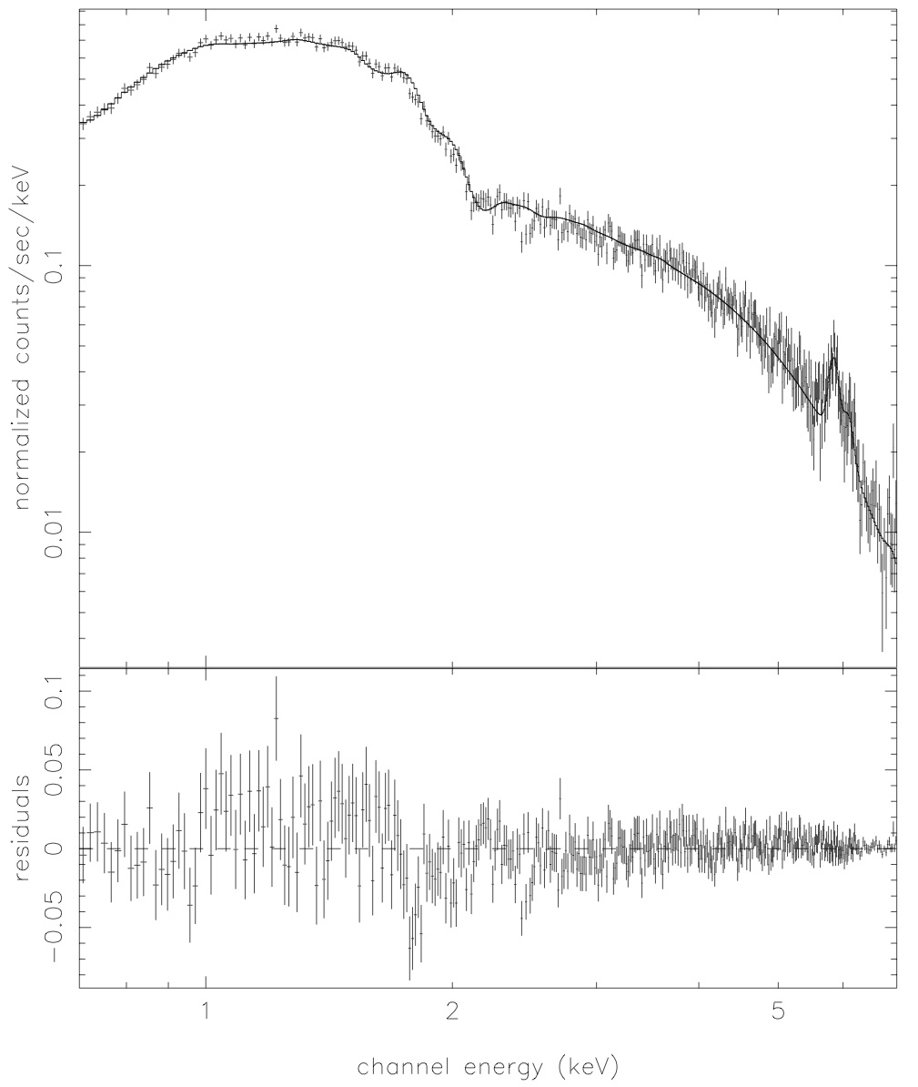
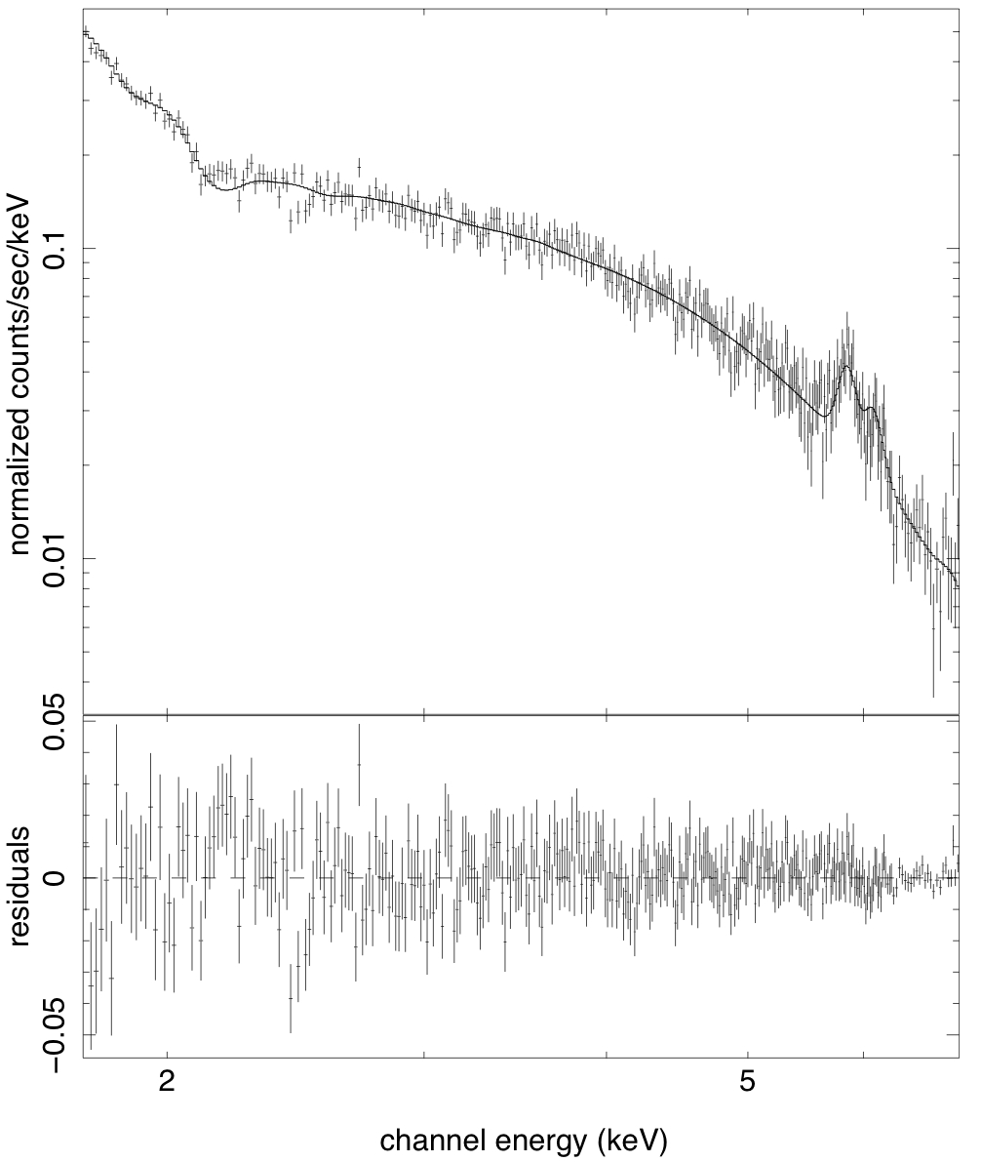

Inferring the gas temperature
Single-phase MeKaL plasma
N_{HI} fixed to Galactic
Metallicity is free parameter
Soft background fixed and error added
Full-band: 0.7-7.0 keV
Hard-band: 2.0'-7.0 keV
T_{X} = 7.41 ± 0.2 keV
T_{X} = 9.09 ± 0.5 keV

Slide 10
Inferring the gas temperature
Single-phase MeKaL plasma
N_{HI} fixed to Galactic
Metallicity is free parameter
Soft background fixed and error added
Do this 150+ times,
and you get...
Full-band: 0.7-7.0 keV
Hard-band: 2.0'-7.0 keV
T_{X} = 7.41 ± 0.2 keV
T_{X} = 9.09 ± 0.5 keV

Slide 11
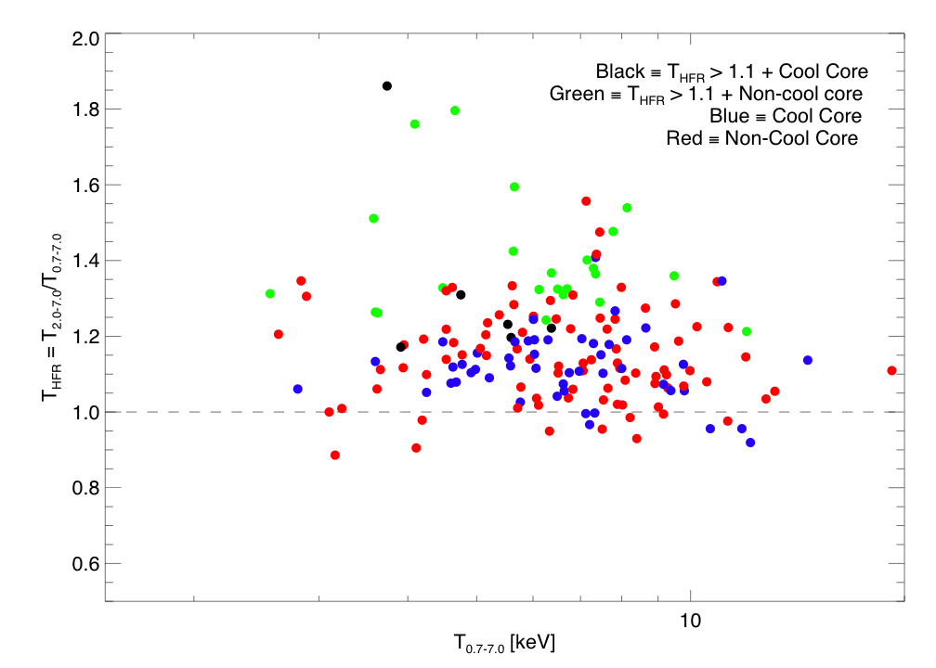
The Big Result
Weighted Average of T_{HFR} = 1.16 (SD 0.12 ; SDOM 0.01)

Slide 12
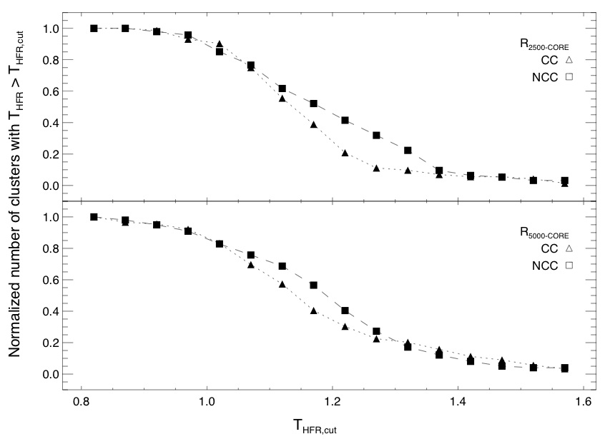
Culling out CCs using T_{HFR}
Increasing values of T_{HFR} “prefer” NCCs
Robust against choice of CC definition and bin scattering
Weighted Average of T_{HFR} = 1.16 (SD 0.12 ; SDOM 0.01)

Slide 13
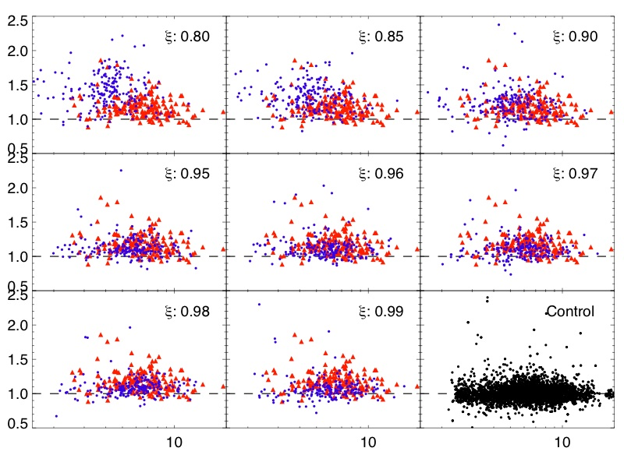
Gut check with simulated spectra from XSPEC
Repeat spectral analysis
Observe skewing in simulations but not in control sample
T_{HFR}
T_{0.7-7.0} keV

Slide 14
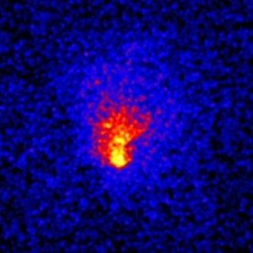
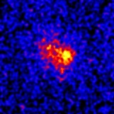
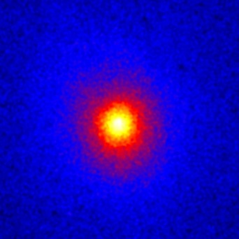
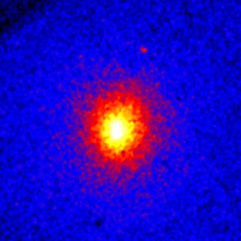
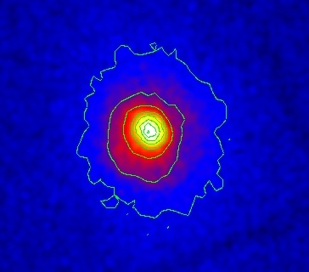
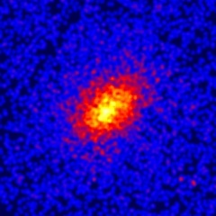
Putting It All Together
MS1008
THFR >> 1
NCC -- merger
RXJ1525
THFR >> 1
CC? -- merger?
A1689: odd “ball”?
A963
THFR ~ 1
CC – strong lenser
A68
THFR ~ 1
NCC – strong lenser
RXJ1720
THFR > 1
CC – cold front

Slide 15
Abell 1689: not so relaxed
Mlens = 2*MXray
Non-axisymmetric temperature structure
Optical observations find substructure and “non-uniform” galaxy redshift distribution
Low gas fraction: ~7% (XMM)
Morphological tests would never find this as a merger

