Slide 1

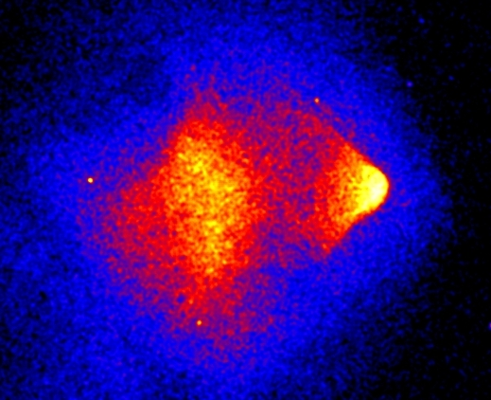
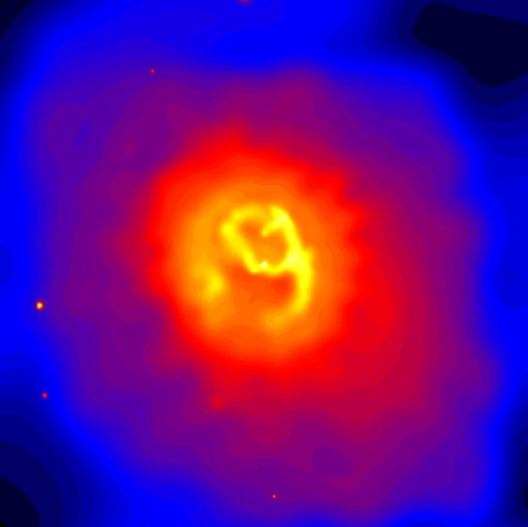
From Cosmology to Star Formation:
An Hour with Galaxy Clusters
Ken Cavagnolo
Michigan State University
Bullet Cluster
Abell 2052

Slide 2

From Cosmology to Star Formation:
An Hour with Galaxy Clusters
Ken Cavagnolo
Michigan State University
University of Waterloo*
Bullet Cluster
Abell 2052
* in September

Slide 3
Collaborators
Megan Donahue (Advisor)
G. Mark Voit (Co-advisor)
Ming Sun
David Ventimiglia
Brian McNamara

Slide 4
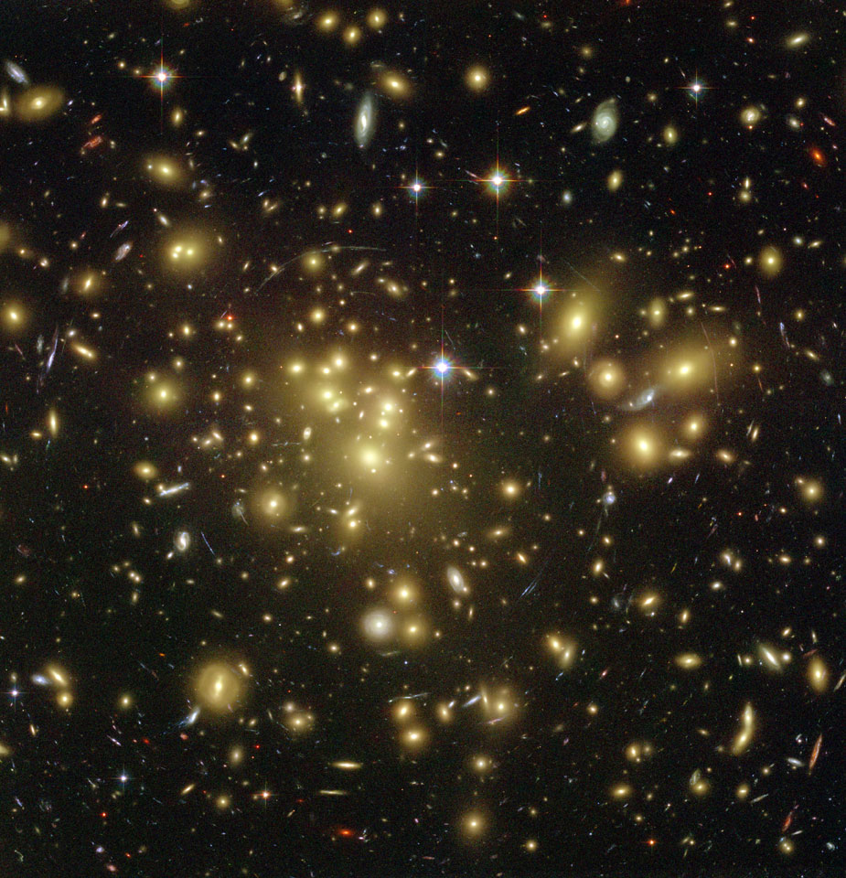
Galaxy Clusters Refresher
Abell 1689 in optical
100's to 1000's of galaxies
70-80% dark matter
30-20% baryons
Few Mpc in size
10¹³-10¹⁵ M☼
Stars and Galaxies aren't everything...
NASA / ACS Team / Benitez et al.

Slide 5
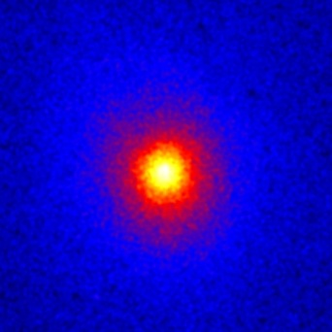
Galaxy Clusters Refresher
Abell 1689 in X-ray
Intracluster medium (ICM) is 60-90% of baryons
Hot: ≥ 10 million K
Diffuse: ≤ 10⁻¹ cm⁻³
Luminous: 10⁴²-10⁴⁵ ergs s⁻¹

Slide 6
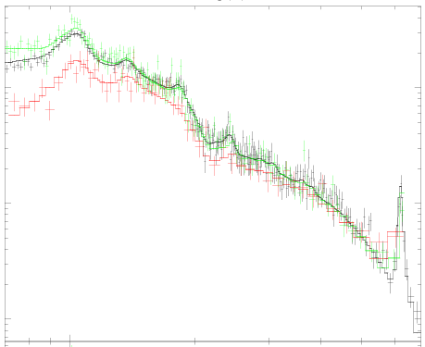
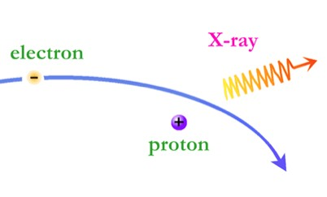
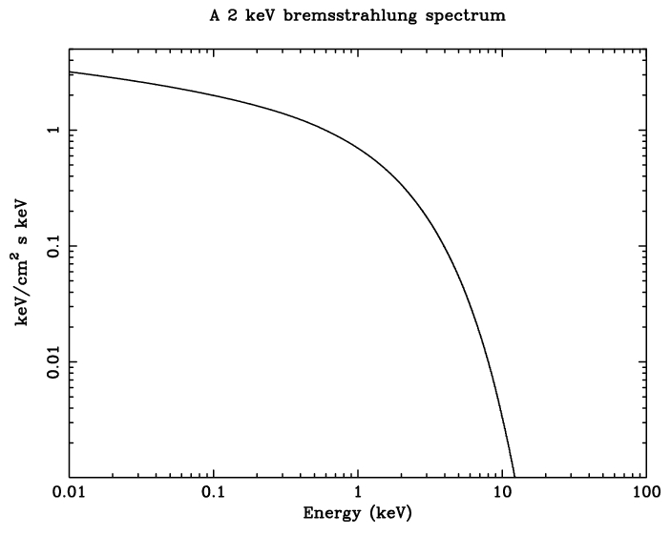
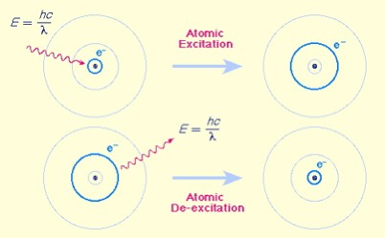
Galaxy Clusters Refresher
Dominant emission mechanism is thermal Bremsstrahlung
Chandra

Slide 7
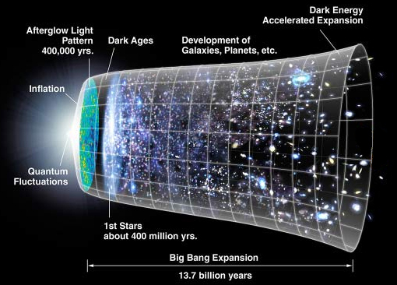
Why study galaxy clusters?
Cosmology
  Structure growth
  Need more precise masses
Galaxy Formation
  Explain Hubble Sequence
  Must understand feedback
NASA / JDEM

Slide 8
Why study galaxy clusters?
Cosmology
  Structure growth
  Need more precise masses
Galaxy Formation
  Explain Hubble Sequence
  Must understand feedback
NASA / JDEM

Slide 9
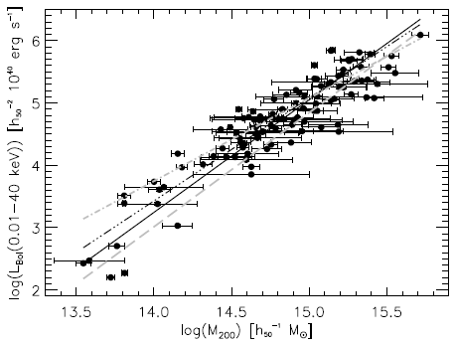
Cosmological Importance
of Relaxation
Clusters expected to be self-similar
Observables are mass surrogates, assuming equilibrium i.e. relaxation
Heating and cooling alter scaling relations
Precision cosmology requires knowledge of the scatter and how it evolves
Large dispersion
Large dispersion
Reiprich et al. 2001

Slide 10
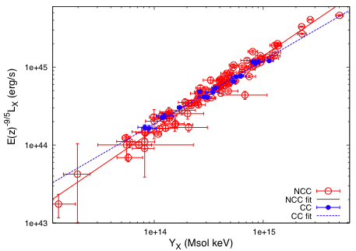
Cosmological Importance
of Relaxation
Is this problem tractable?
Quantify sub-structure through imaging analysis
What about an aspect independent measure?
Temperature skewing predicted by Mathiesen & Evrard 2001
Maughan 2007

Slide 11
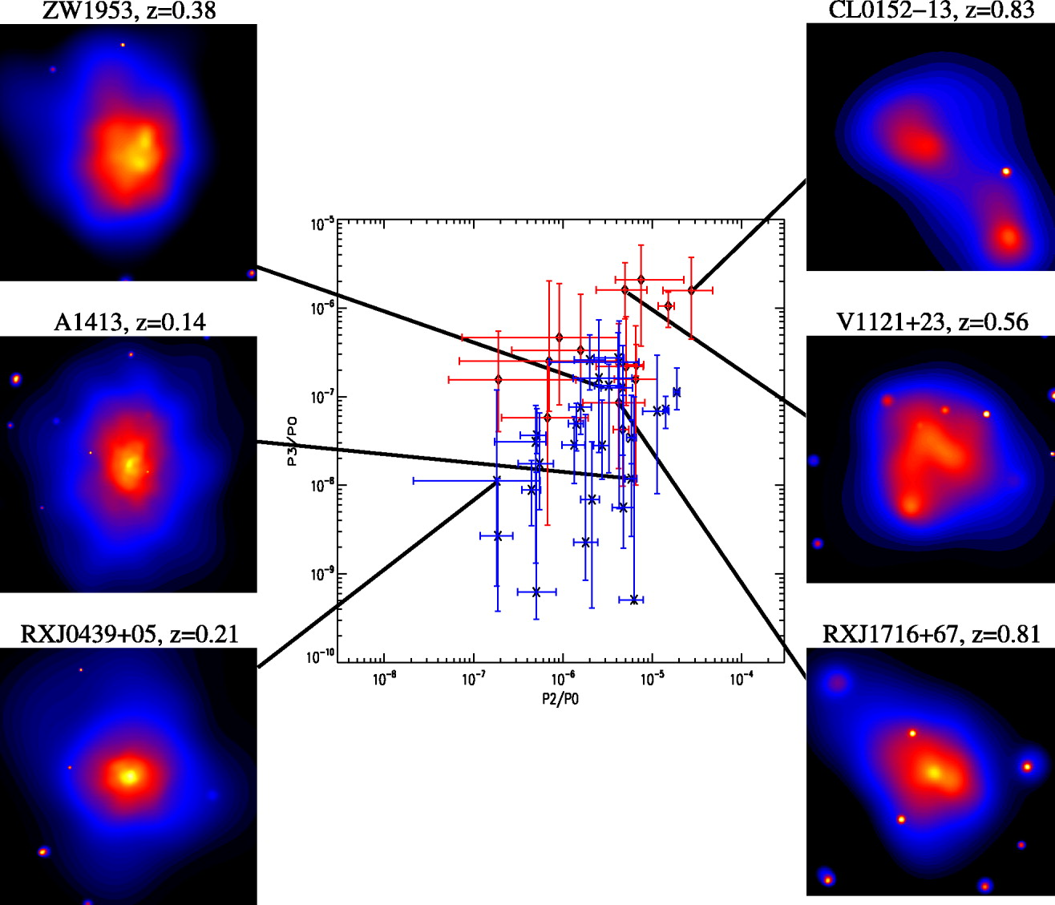
Cosmological Importance
of Relaxation
Is this problem tractable?
Quantify sub-structure through imaging analysis
What about an aspect independent measure?
Temperature skewing predicted by Mathiesen & Evrard 2001
Jeltema et al. 2005

Slide 12
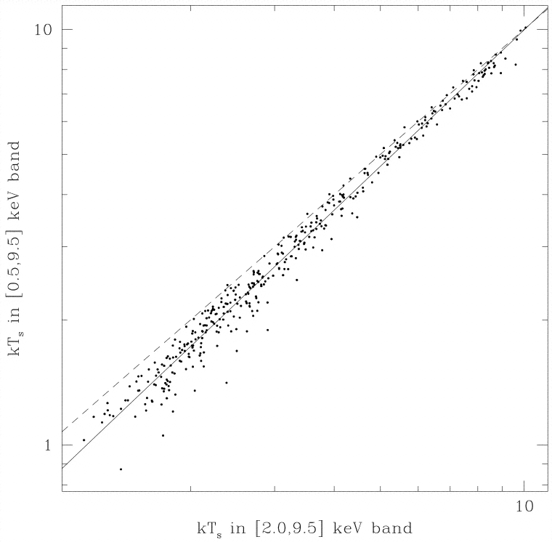
Cosmological Importance
of Relaxation
Mathiesen & Evrard 2001
Is this problem tractable?
Quantify sub-structure through imaging analysis
What about an aspect independent measure?
Temperature skewing predicted by Mathiesen & Evrard 2001
Temperature [0.5-9.5 keV]
Line of equality
Hotter hard-band temperature
Temperature [2.0-9.5 keV]

Slide 13
Temperature Inhomogeneity
How shall we quantify temperature skewing?
Broad-band temperature: 0.7-7.0 keV band
Hard-band temperature: 2.0-7.0 keV band
2.0 keV is in cluster rest frame
Define Hard-band to Broad-band Ratio:

Slide 14
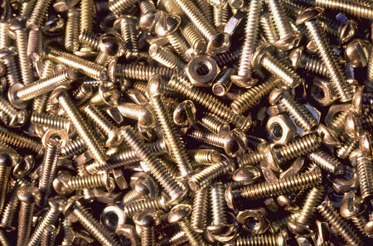
The Nuts and Bolts

Slide 15
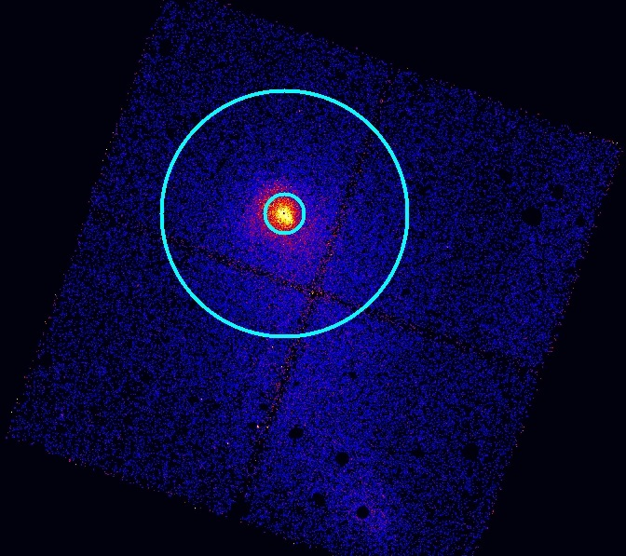
“THBR” Data Analysis
Collected clusters from Chandra Archive
+11 Msec, 300+ obs
Two apertures selected:
  R5000
  R2500
Cores excised
R₅₀₀₀
R2500
Core excluded!

Slide 16
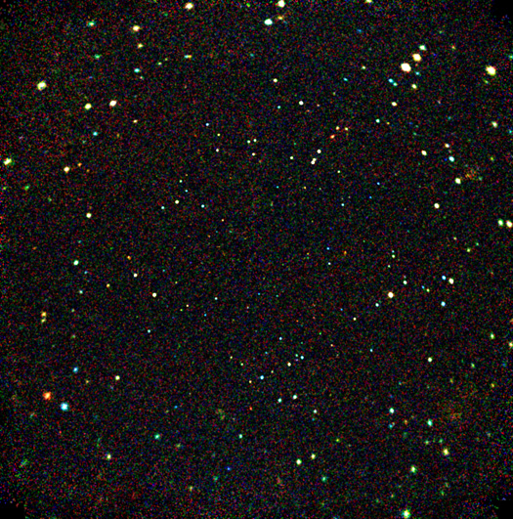
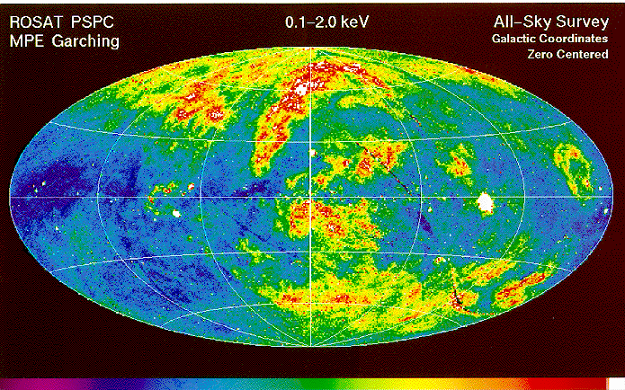
Chandra Deep Field-South
X-ray Background Consideration
Hard-particle background
Important at E > 2 keV
Correct spectral count rate
NASA / JHU / AUI / R.Giacconi et al.
Soft, local background
Spatially varying
Is problematic at E < 2 keV

Slide 17
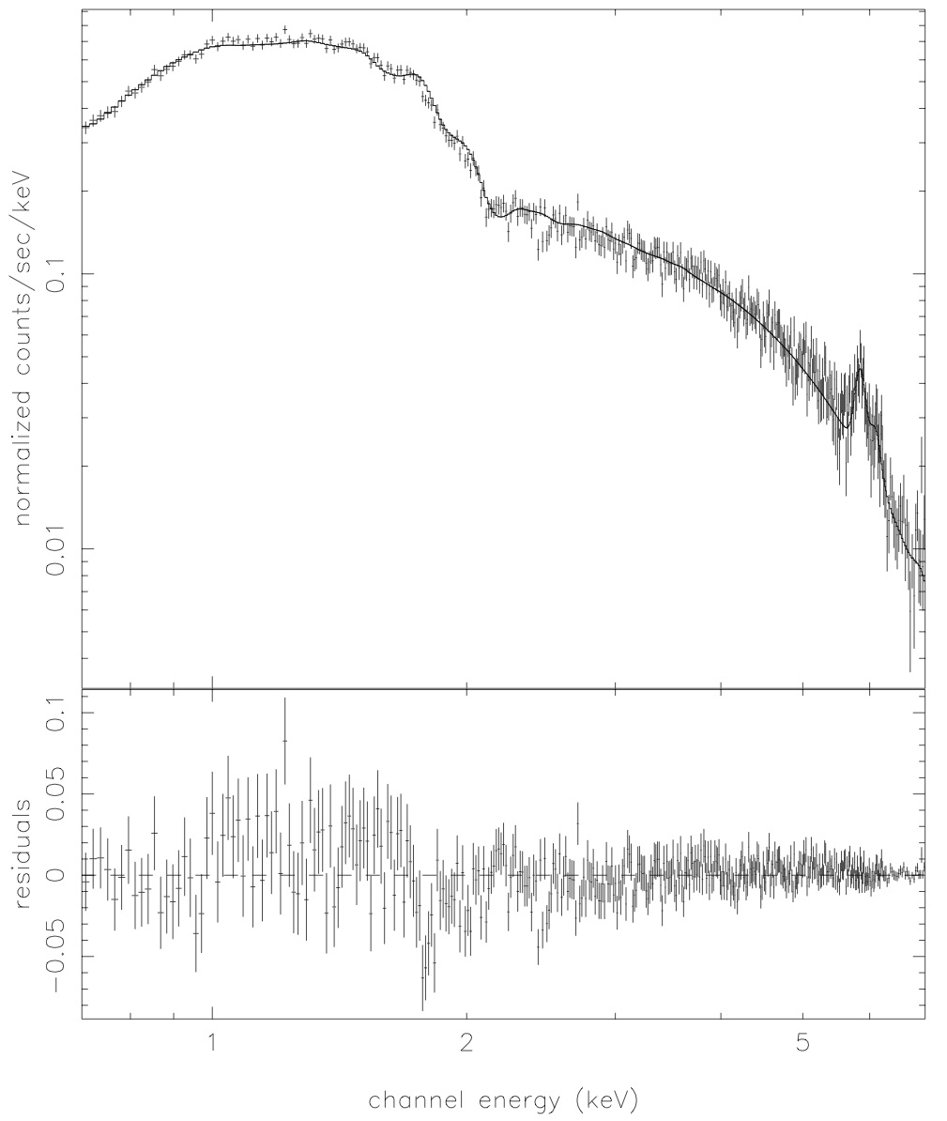
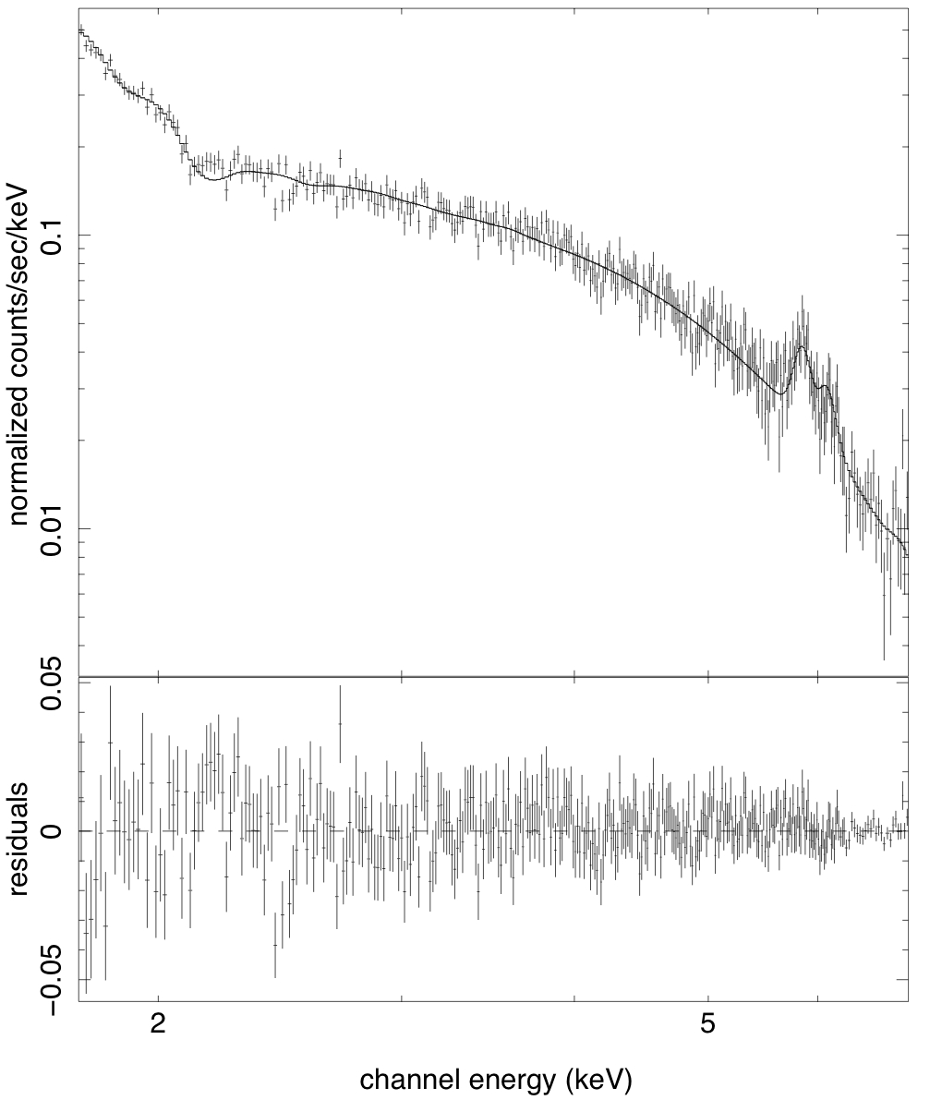
Inferring the gas temperature
Single-phase thermal plasma
Fixed absorbing NHI
Metal abundance is free
Soft background fixed and error added
Broad-band: 0.7-7.0 keV
Hard-band: 2.0'-7.0 keV
T_{X} = 7.41 ± 0.2 keV
T_{X} = 9.09 ± 0.5 keV

Slide 18
Inferring the gas temperature
Single-phase thermal plasma
Fixed absorbing NHI
Metal abundance is free
Soft background fixed and error added
Do this 180+ times,
and one finds...
Broad-band: 0.7-7.0 keV
Hard-band: 2.0'-7.0 keV
T_{X} = 7.41 ± 0.2 keV
T_{X} = 9.09 ± 0.5 keV

Slide 19
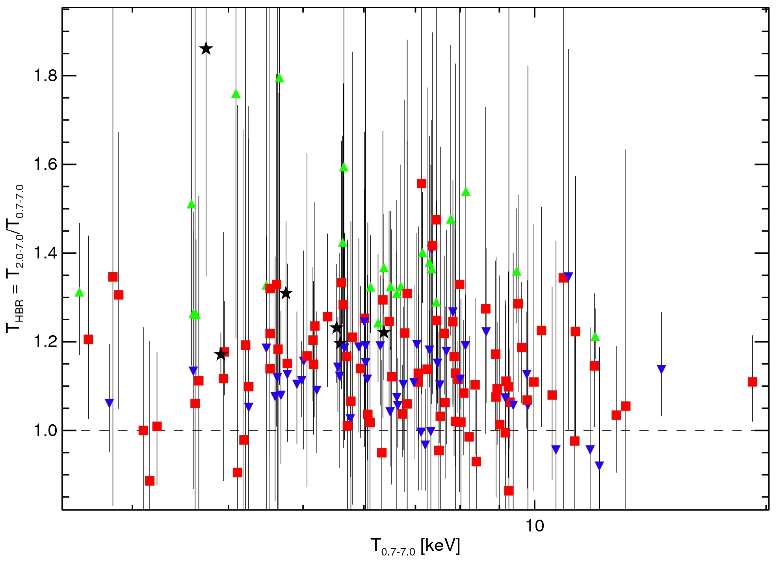
Net Skewing of THBR
Errors are large, but the number of clusters is also large.
T_{HBR} = 1.16 (SD 0.12 ; SDOM 0.01)
Black Stars: THBR > 1.1 + CC
Green Triangles: THBR > 1.1 + NCC
Red Squares: NCC
Blue Inverted Triangles: CC
Cavagnolo et al. 2008
Cavagnolo et al. 2008

Slide 20
Net Skewing of THBR
Before moving on, let's distinguish between cool core (CC) and non-cool core (NCC) clusters
T_{HBR} = 1.16 (SD 0.12 ; SDOM 0.01)
Black Stars: THBR > 1.1 + CC
Green Triangles: THBR > 1.1 + NCC
Red Squares: NCC
Blue Inverted Triangles: CC
Cavagnolo et al. 2008
Cavagnolo et al. 2008

Slide 21
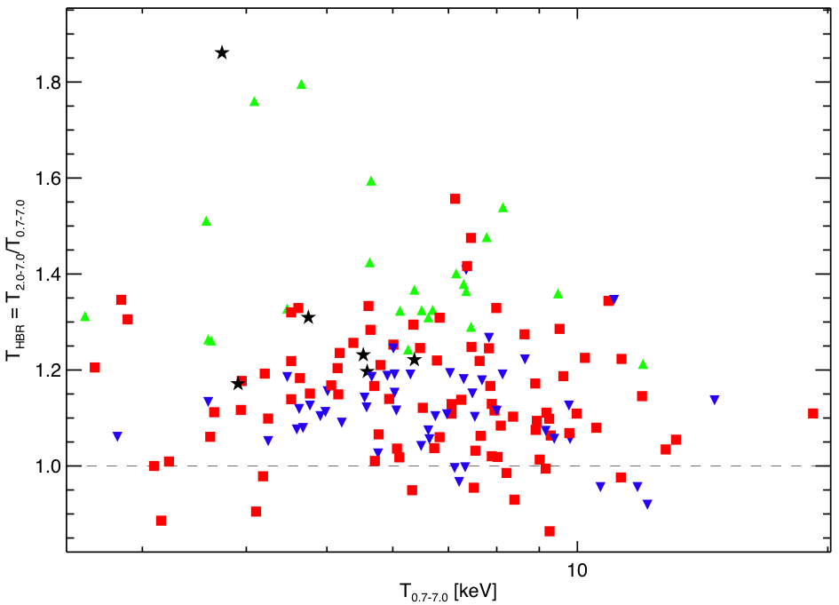
Net Skewing of THBR
T_{HBR} = 1.16 (SD 0.12 ; SDOM 0.01)
Black Stars: THBR > 1.1 + CC
Green Triangles: THBR > 1.1 + NCC
Red Squares: NCC
Blue Inverted Triangles: CC
Cavagnolo et al. 2008

Slide 22
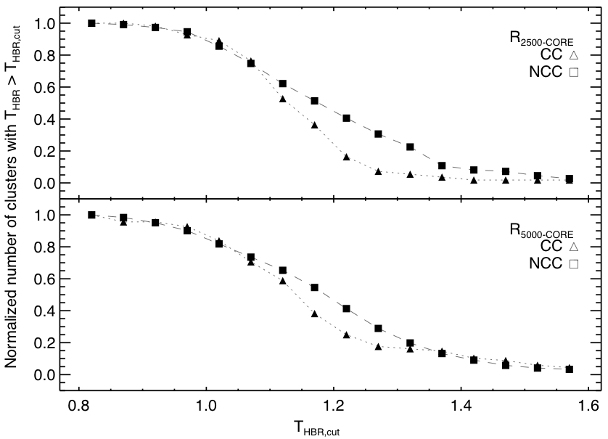
Culling out Cool Cores using T_{HBR}
Increasing values of THBR “prefer” non-cool cores
Robust against choice of cool core definition
Cavagnolo et al. 2008

Slide 23
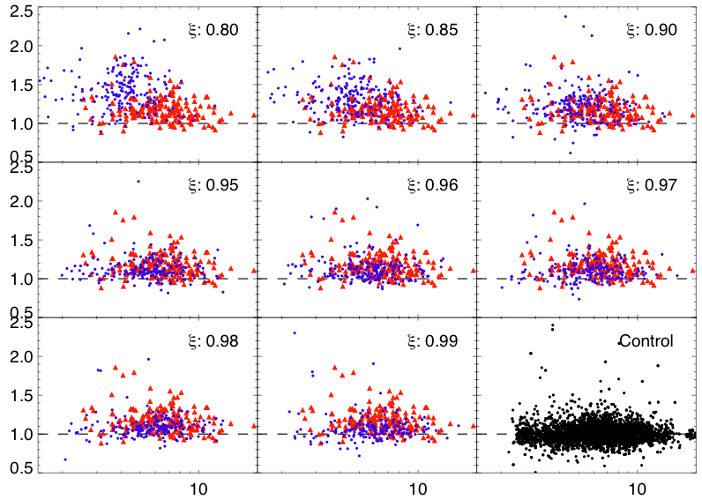
Simulations and Systematics
Simulate two-phase gas
Repeat spectral analysis
Observe skewing in sims but not in control
Dispersion in observation > control
THBR
Tfull [keV]

Slide 24
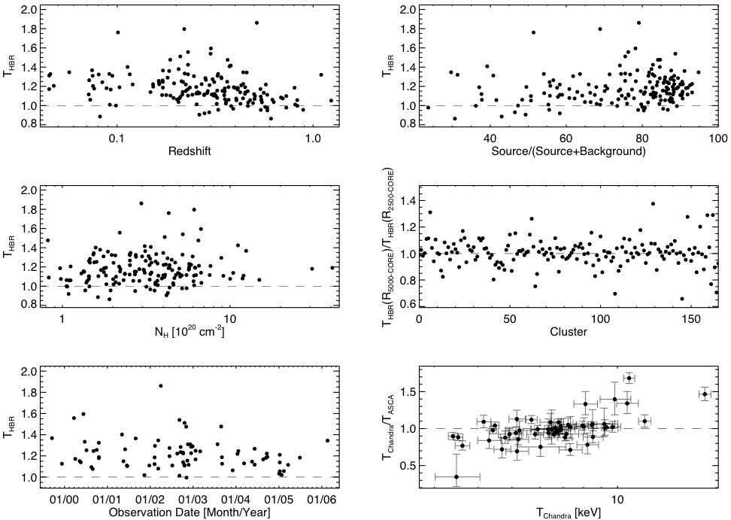
Simulations and Systematics
Trend?
No trend
No trend
No trend
No trend
Trend?

Slide 25
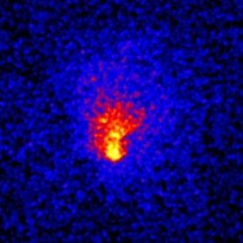
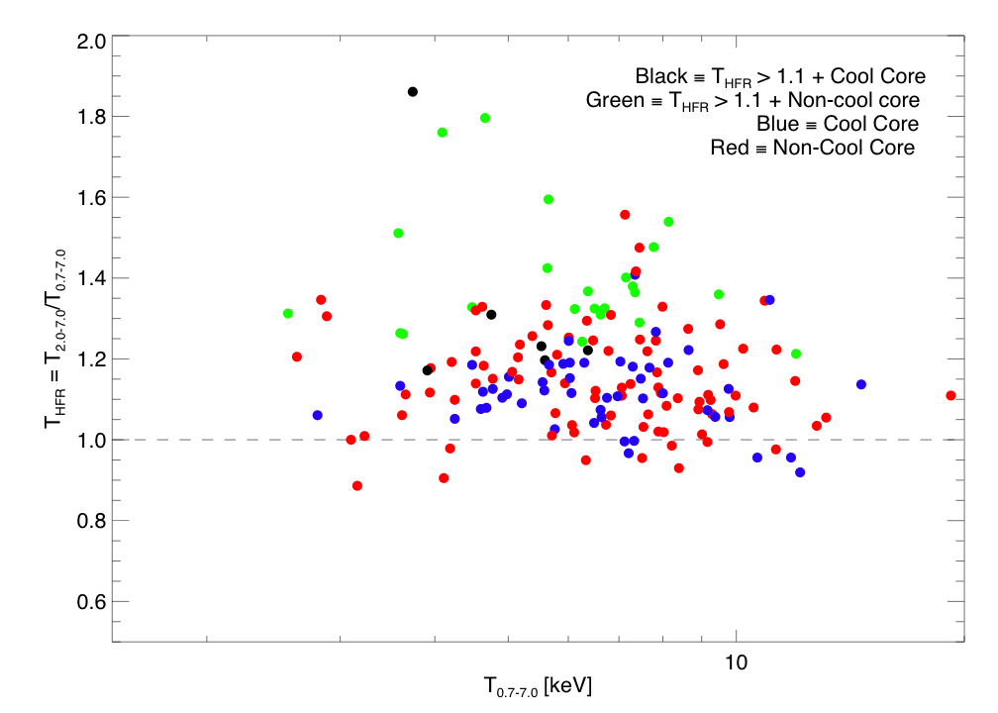
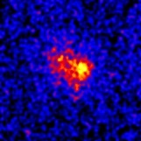
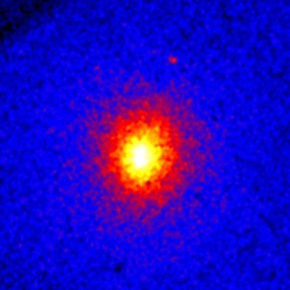
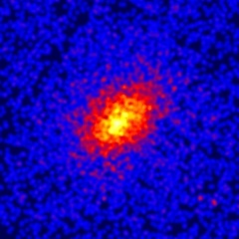
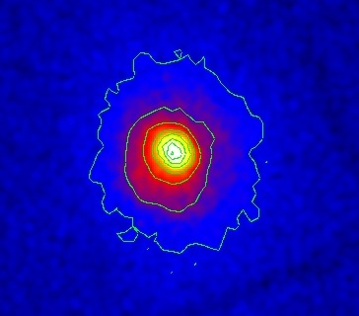
Putting It All Together
MS1008
THFR >> 1
NCC -- merger
RXJ1525
THFR >> 1
CC? -- merger?
A1689: odd 'ball'?
A963
THFR ~ 1
CC – strong lens
A68
THFR ~ 1
NCC – strong lens
RXJ1720
THFR > 1
CC – cold front

Slide 26
Abell 1689: not so relaxed
MLens ≈ 2×MX-ray (Andersson & Madejski 2004)
Non-axisymmetric temperature structure (Andersson et al. 2006)
Sub-structure in optical
Non-Gaussian galaxy redshift distribution
Low gas fraction: ~7% (XMM)
Morphological tests would never spot this as “unrelaxed”

Slide 27
Cosmological Importance
of Relaxation
Temperature inhomogeneity is a problem
Appears to be something we can quantify
Calibrate between temperature ratio and relaxation using N-body/SPH simulations
Could be very useful tool for quantifying scatter in mass-observables
Now, what of the feedback issue...?

Slide 28

Why study galaxy clusters?
Cosmology
  Structure growth
  Need accurate masses
Galaxy Formation
  Explain Hubble Sequence
  Must understand feedback
NASA

Slide 29
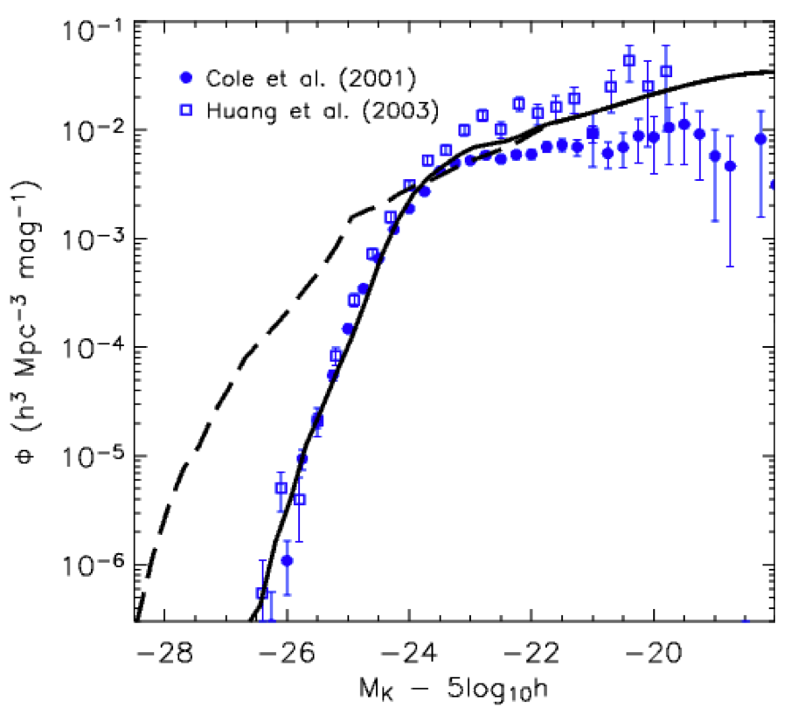
Importance of Feedback
GF theories predict:
  Too many massive, blue galaxies
  Too many dwarf galaxies
The trouble with “red and dead” galaxies
  Vigorous feedback at high-z
  “Down-sizing” problem
Central galaxy in groups and clusters are not growing unabated
Croton et al. 2006

Slide 30
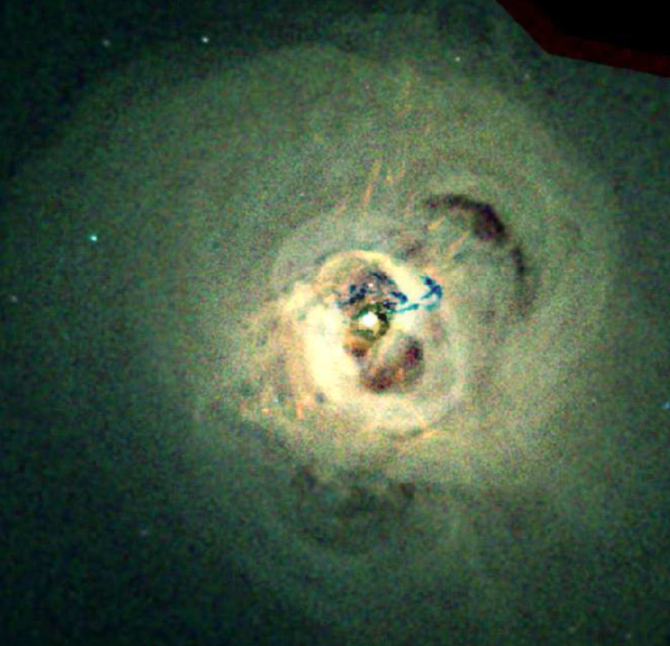
Importance of Feedback
Abell 426 (aka Perseus)
Central cooling time of ICM much shorter than Hubble age
Expect massive flows of cool gas into core
Why the theoretical-observational disconnect?
Take a look at right...
NASA / CXC / IoA / A.Fabian et al.

Slide 31
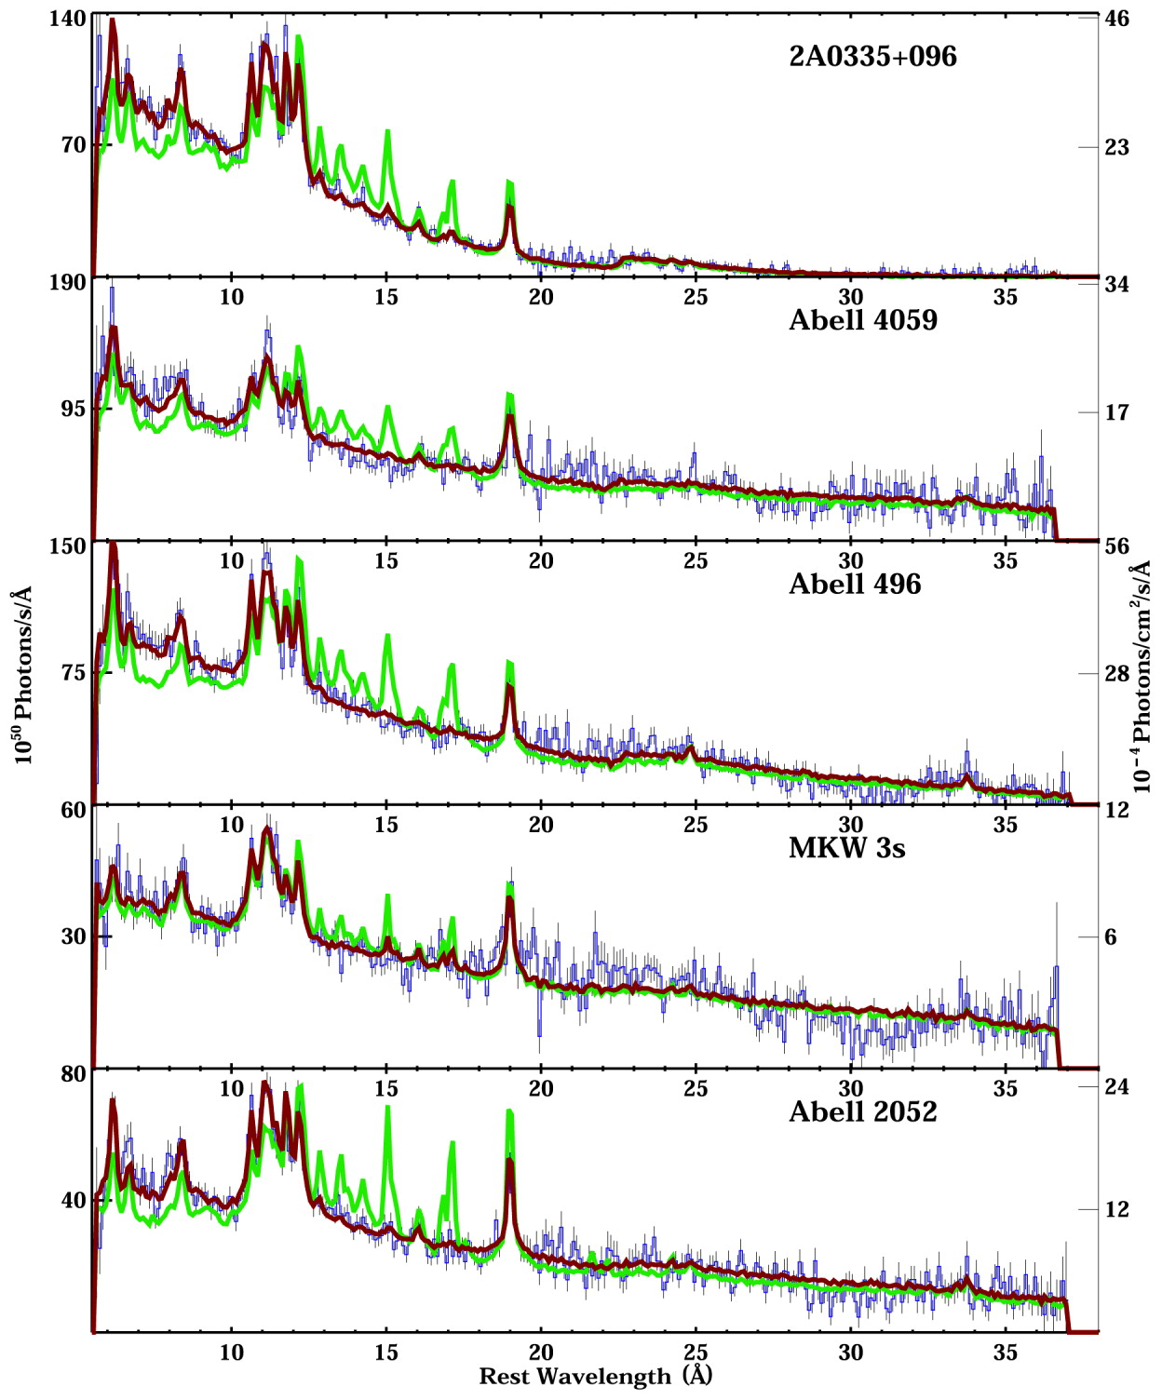
Blue: data
Maroon: best-fit
Green: predicted
Cooling
Trickles
Fe XVII, where art thou?
ICM no cooler than TX ≤ ⅓Tvirial
Implies heat balance
No other by-products either
Peterson et al. 2003

Slide 32
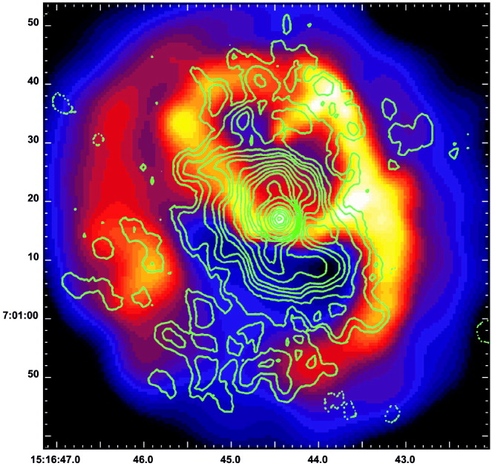
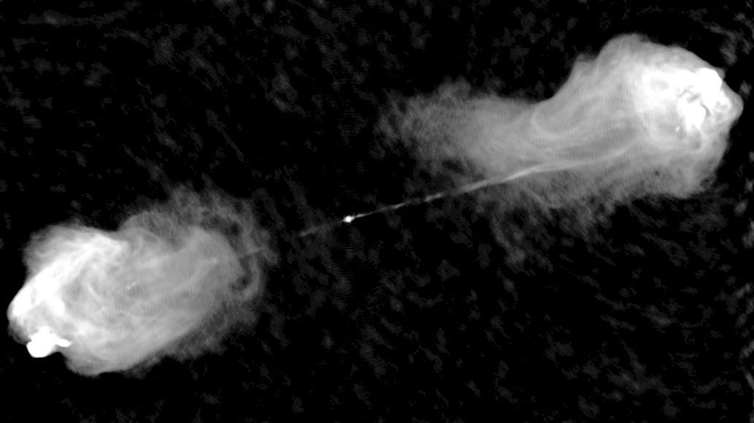
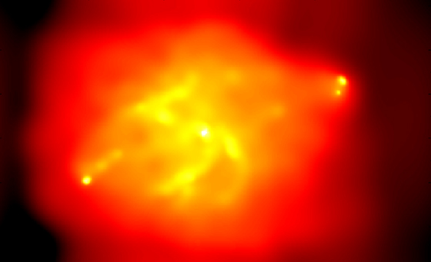
Importance of Feedback
X-ray + Radio contours
Feedback heating now widely accepted
Very, very modest star formation
AGN are active
Galaxy growth slowed
How do we make sense of all this?
Our 'close to the data' approach:
  Study cooling ICM
  Better understand feedback
  Work toward self-regulation model
  Focus on ICM entropy...
Abell 2052
Cygnus A
Radio
X-ray

Slide 33
ICM Entropy
Like PB&J, temperature and density are better together
Fundamental property of ICM
Dark matter halo and entropy structure dictate X-ray observables
Entropy is beholden to thermal history

Slide 34
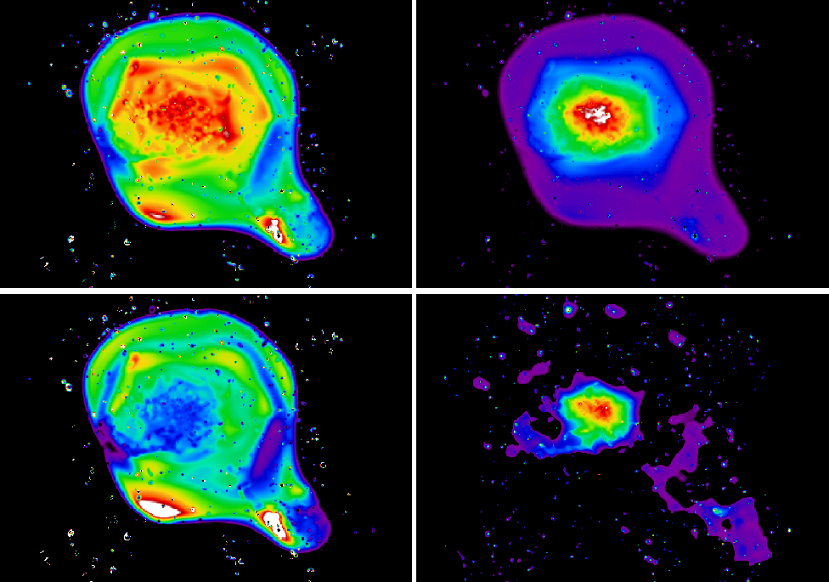
Entropy from Observables
Coma Cluster
Temperature
÷
=
Density
Entropy
Define “entropy” as adiabatic constant
K = Pρ^{-5/3} or...
K = Tnelec^{-2/3}
Schuecker et al. 2004

Slide 35
Properties of Entropy
In a gravity only Universe... radial entropy distribution follows power-law
Potential wells are entropy sorting devices
Departures from power-law indicative of past heating and cooling

Slide 36
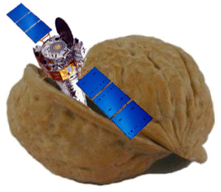
◄ Oh, hi there.
Chandra data reduction...
in a nutshell

Slide 37
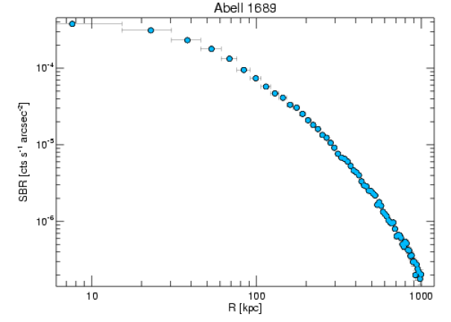
Chandra Data Reduction...
in a nutshell
Standard reduction
Extract surface brightness profiles
  Background subtracted
  Exposure corrected
  Point source cleaned
Extract and fit temperature profile
Deproject surface brightness
Monte Carlo the errors
Convert to electron density profile
Calculate entropy profile
Fit entropy models
Profit?

Slide 38
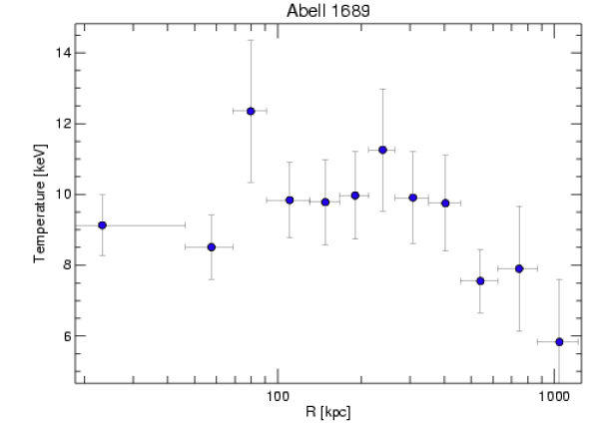
Chandra Data Reduction...
in a nutshell
Standard reduction
Extract surface brightness profiles
  Background subtracted
  Exposure corrected
  Point source cleaned
Extract and fit temperature profile
Deproject surface brightness
Monte Carlo the errors
Convert to electron density profile
Calculate entropy profile
Fit entropy models
Profit?

Slide 39
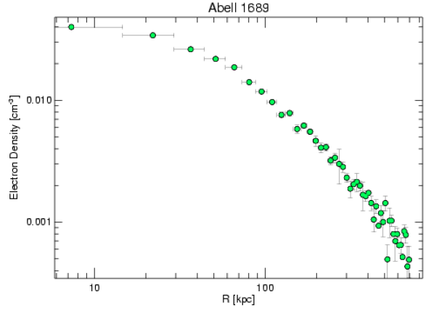
Chandra Data Reduction...
in a nutshell
Standard reduction
Extract surface brightness profiles
  Background subtracted
  Exposure corrected
  Point source cleaned
Extract and fit temperature profile
Deproject surface brightness
Monte Carlo the errors
Convert to electron density profile
Calculate entropy profile
Fit entropy models
Profit?

Slide 40
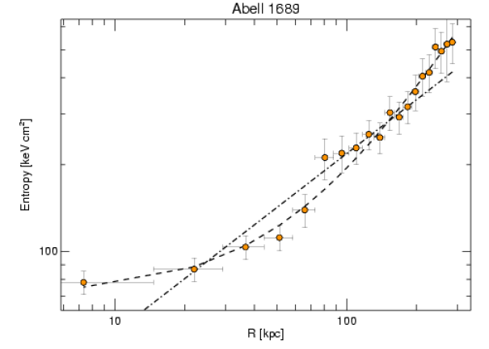
Chandra Data Reduction...
in a nutshell
Standard reduction
Extract surface brightness profiles
  Background subtracted
  Exposure corrected
  Point source cleaned
Extract and fit temperature profile
Deproject surface brightness
Monte Carlo the errors
Convert to electron density profile
Calculate entropy profile
Fit entropy models
Profit?
(A)
(B)

Slide 41
Chandra Data Reduction...
in a nutshell
Standard reduction
Extract surface brightness profiles
  Background subtracted
  Exposure corrected
  Point source cleaned
Extract and fit temperature profile
Deproject surface brightness
Monte Carlo the errors
Convert to electron density profile
Calculate entropy profile
Fit entropy models
Profit?
Do this 218 times
and one gets...

Slide 42
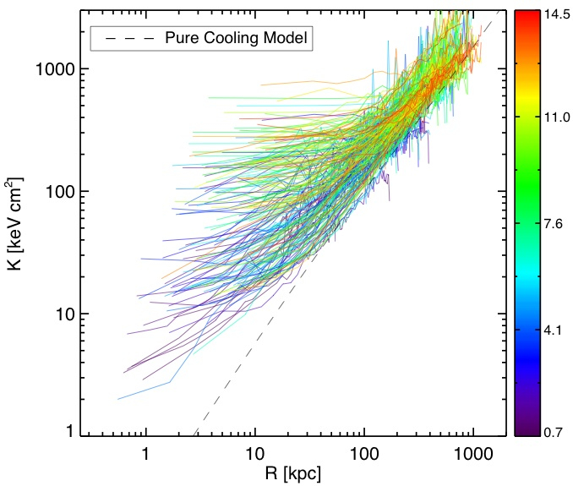
ACCEPT : Archive of Chandra Cluster Entropy Profile Tables
All results will be publicly available online.
This includes all profiles, tables, spectra, reduced data, figures, et cetera.
Cavagnolo et al. 2008

Slide 43
ACCEPT : Archive of Chandra Cluster Entropy Profile Tables
Entropy profiles do not follow power-law
Converge to self-similar model at large radii
Quasi-steady state induced by AGN every ~100 Myr
More than meets the eye?
Profiles follow form:
Cavagnolo et al. 2008

Slide 44
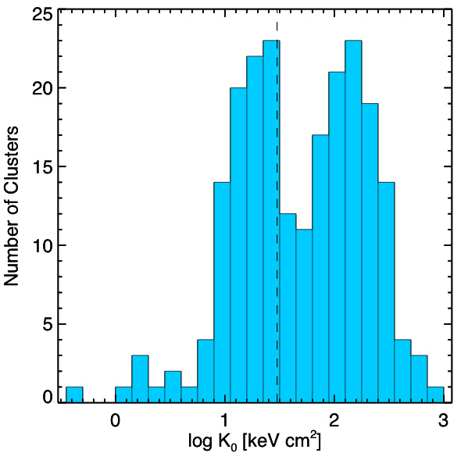
Bimodal entropy distribution
Cavagnolo et al. 2008

Slide 45
Bimodal entropy distribution
Short central cooling time; << 1 Gyr
Cavagnolo et al. 2008

Slide 46
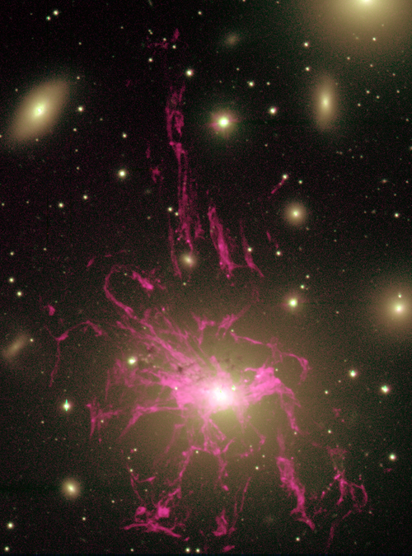
Signs of Feedback
NGC 1275
Does star formation “know” about K0?
Select robust tracer like Ha
  UV ionizing radiation from O and B stars
  Turbulent mixing layers?
  Conduction interfaces?
Assume Ha traces SF
Scour the literature; what turns up...
Conselice / Caltech / WIYN / NOAO / AURA / NSF

Slide 47
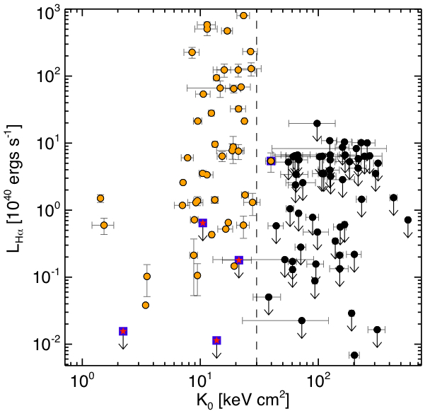
Star formation loves low entropy
Cavagnolo et al. 2008
Thermal instabilities form below entropy threshold?

Slide 48
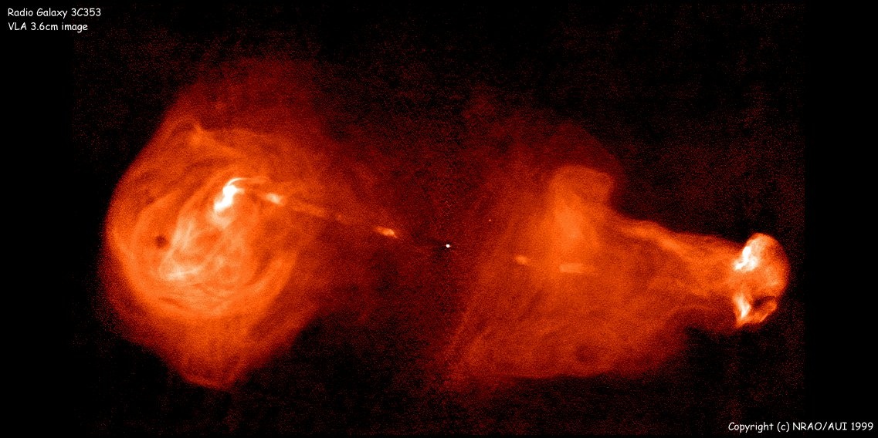
Signs of Feedback
3C 353
NRAO/AUI
Do AGN “know” about K0?
Select robust tracer like radio
Skirt some resolution issues with z<0.2 cut

Slide 49
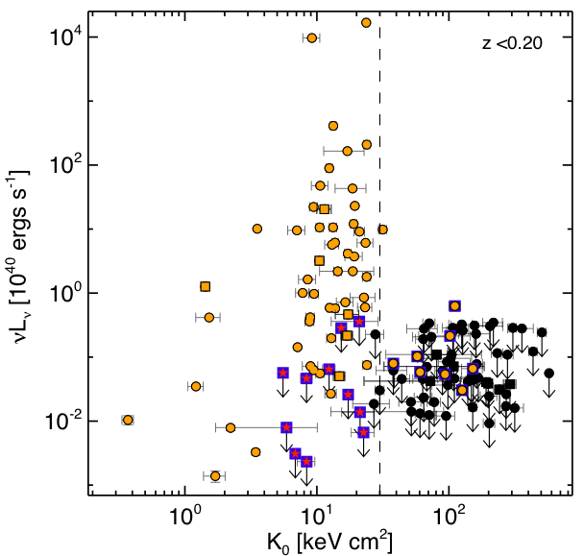
Radio sources like low entropy too!
Cavagnolo et al. 2008
Radio and Ha share similar entropy threshold; common mechanism?

Slide 50
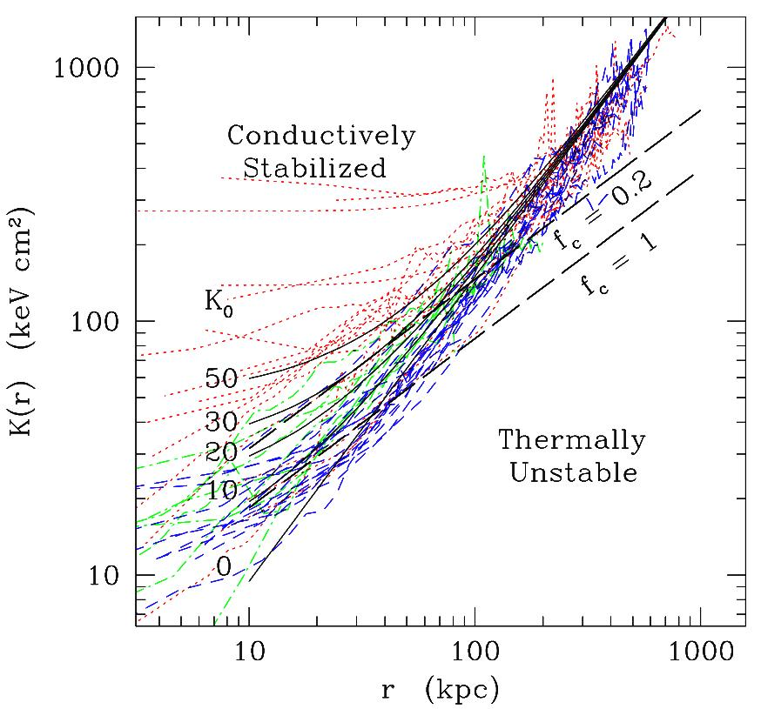
Conductive Stability
When does a multi-phase medium form?
K0 ≤ 20-30 keV cm² appears to be threshold
Conduction can't wipe out thermal instability below threshold
Are we closer to understanding feedback?
Voit et al. 2008

Slide 51
Entropy lifecycle?
Conductive
Stability
Were never cool?
10⁴⁵ AGN
Mergers
E >10⁶¹ AGN

Slide 52
Conclusions
We've found...
Hard-band to broad-band temperature ratio correlates with cluster dynamic state
Low entropy environs promote feedback
Characteristic entropy threshold for feedback activity
Lots of work left to do...

Slide 53
The road ahead
Entropy scaling relations
Further study bimodality
Study timescales with multimodality
Work to refine conduction model
Low entropy & no feedback
High entropy & with feedback
Sound waves, cosmic rays, and more
ICM metal distribution
Study BCG coronae
Low frequency radio survey?
Radio dating?
SZE study of high-z entropy?
Test various pre-heating models
Await results of simulation work
2D analysis
Online searchable database

Slide 54
Intentionally left blank

