Slide 1
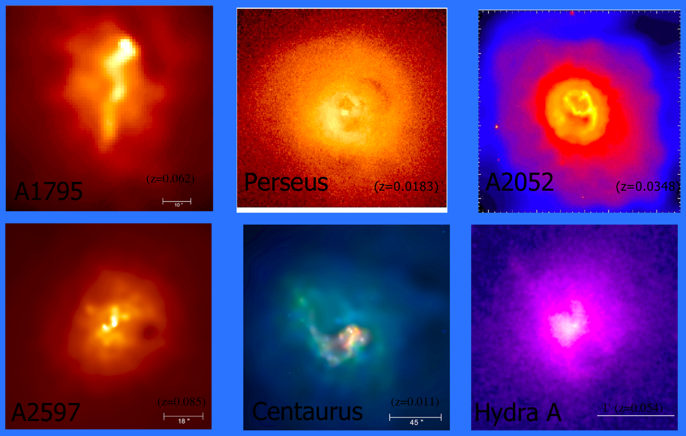
Feedback in Galaxy Clusters

Slide 2



Feedback in Galaxy Clusters
Why galaxy clusters and feedback are important
The cause and effect of cluster feedback mechanisms
The importance of understanding intracluster gas entropy
Calculating entropy from observables
Results of my Chandra archival study

Slide 3
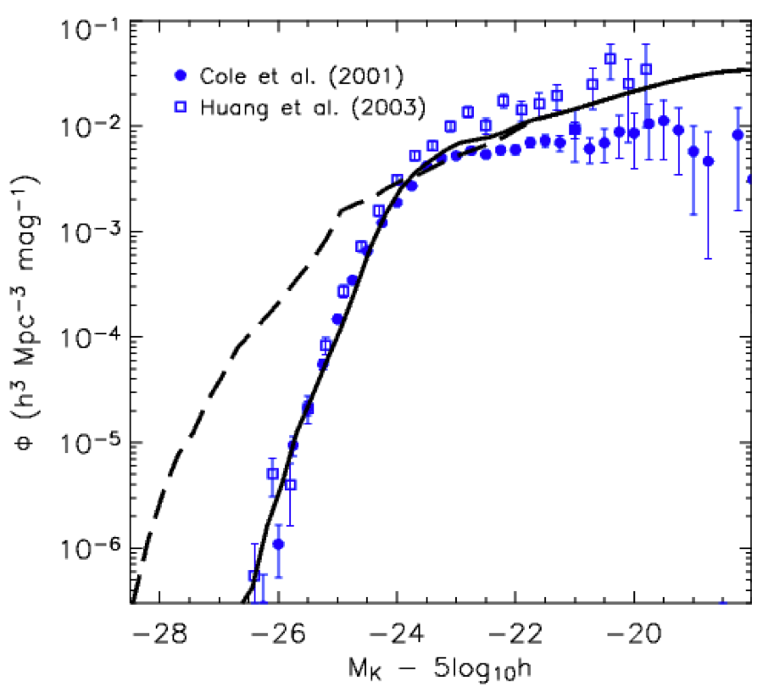

Importance of Clusters and Feedback
Cosmology tests
  Power spectrum
  Structure growth
  Observables
Galaxy formation models
Feedback affects mass-scaling relations
Supernovae
(+ AGN?)
AGN
Croton 2006

Slide 4
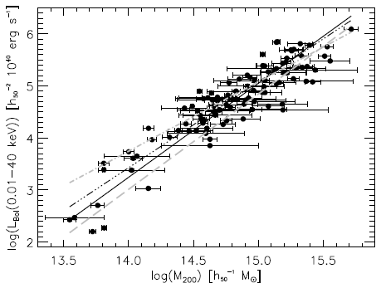
Importance of Clusters and Feedback
Cosmology tests
  Power spectrum
  Structure growth
  Observables
Galaxy formation models
Feedback affects mass-scaling relations
Large dispersion
Reiprich 2001

Slide 5
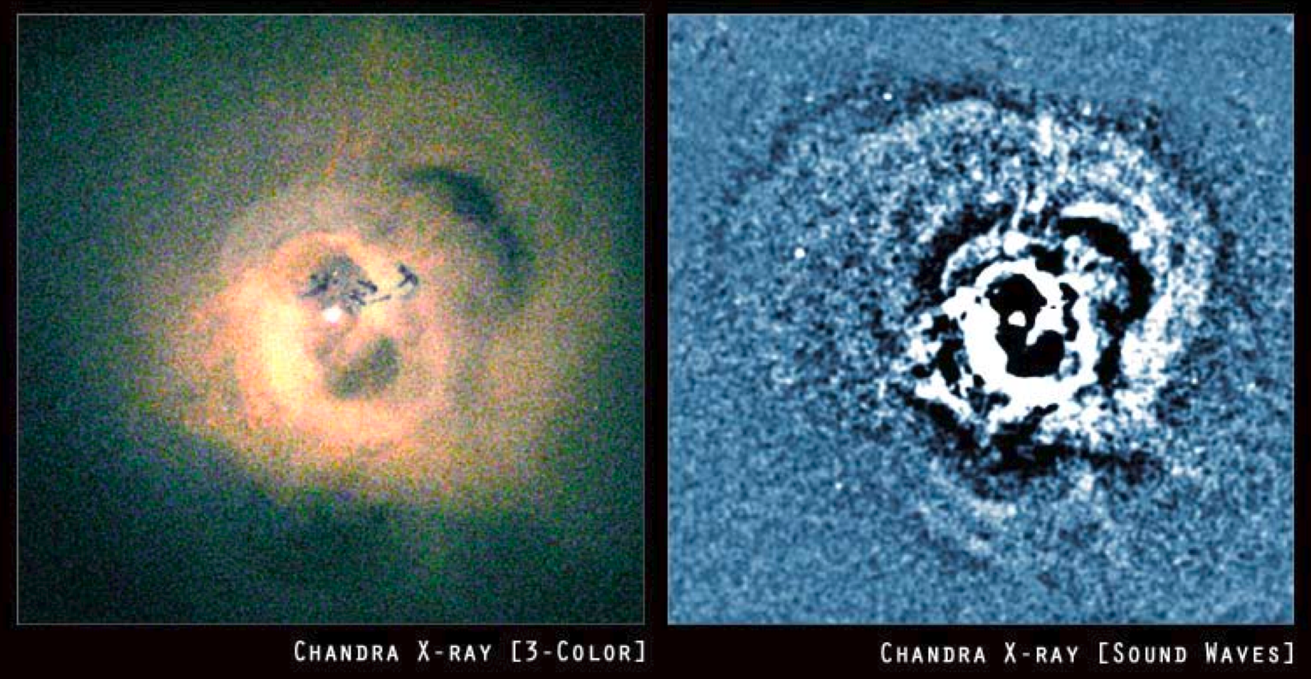
What causes feedback?
tcool ~ Λ(Τ,Ζ) ρ²
Cooling time shorter than Hubble time
Gas “flows” to bottom of potential well
Mergers can also provide fuel

Slide 6
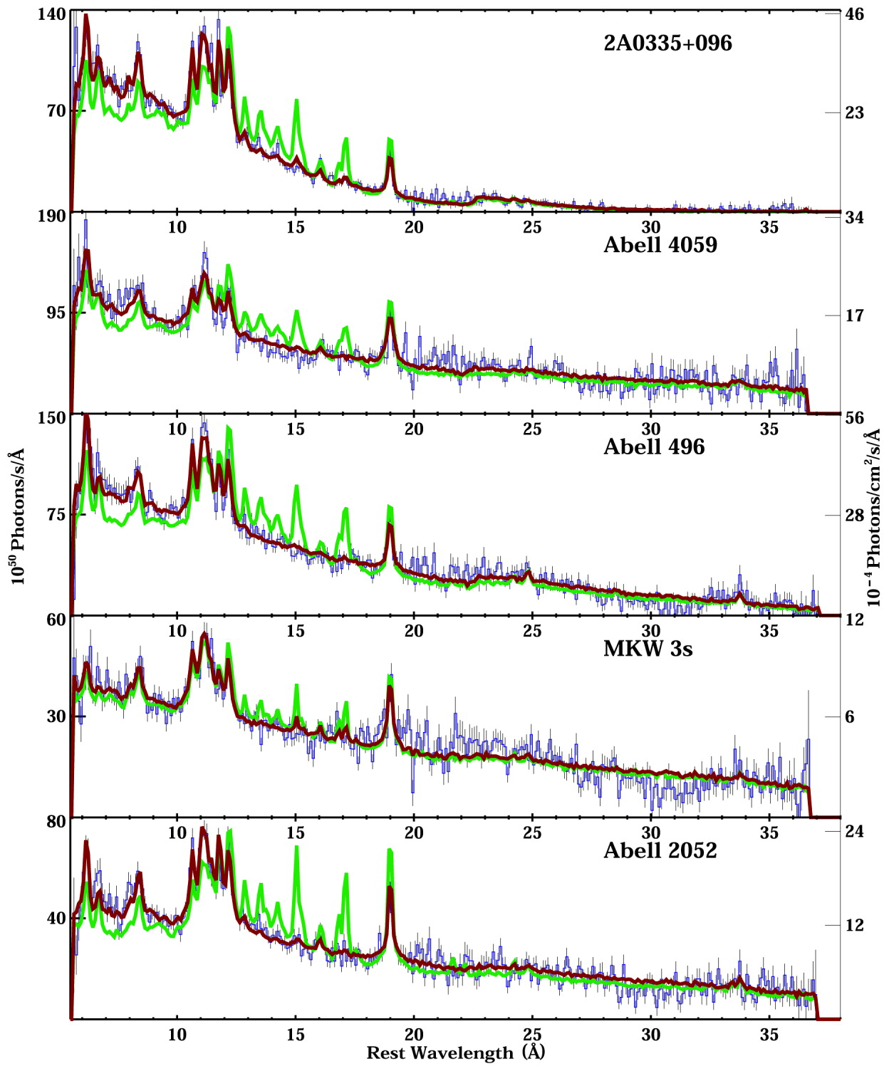
What causes feedback?
tcool ~ Λ(Τ,Ζ)ρ²
Cooling time shorter than Hubble time
Gas “flows” to bottom of potential well
Mergers can also provide fuel
Cooling
trickles
Peterson
&
Fabian

Slide 7
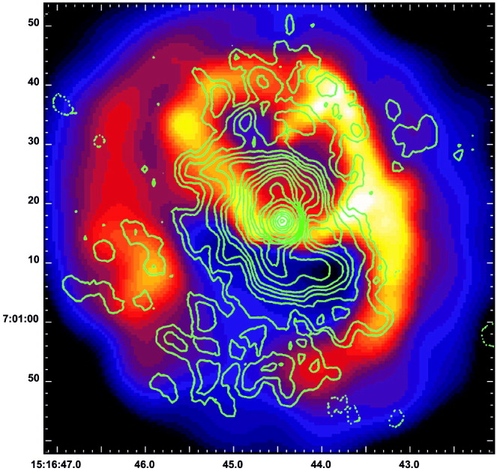
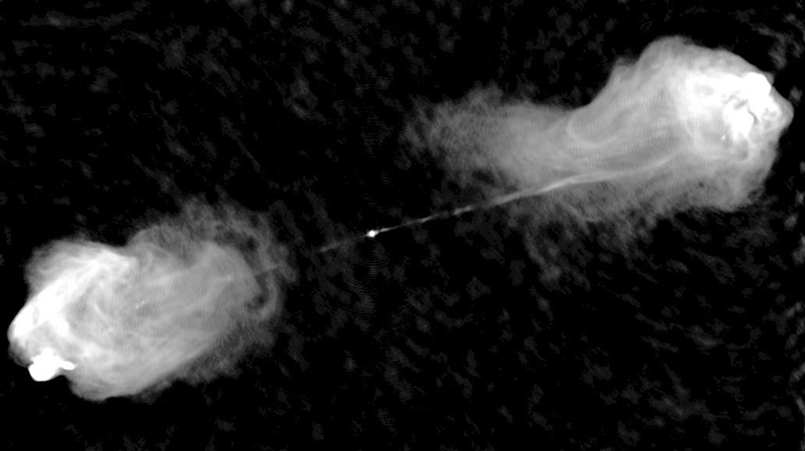
The results and effects of feedback
Star formation
Active galactic nuclei (AGN)
Heating of ICM
Self-similar scaling relations need help?
  Mass vs. TX, LX, fSZE, ...
Grassroots:
  Study cold ICM
  Understand feedback
Abell 2052
Cygnus A

Slide 8
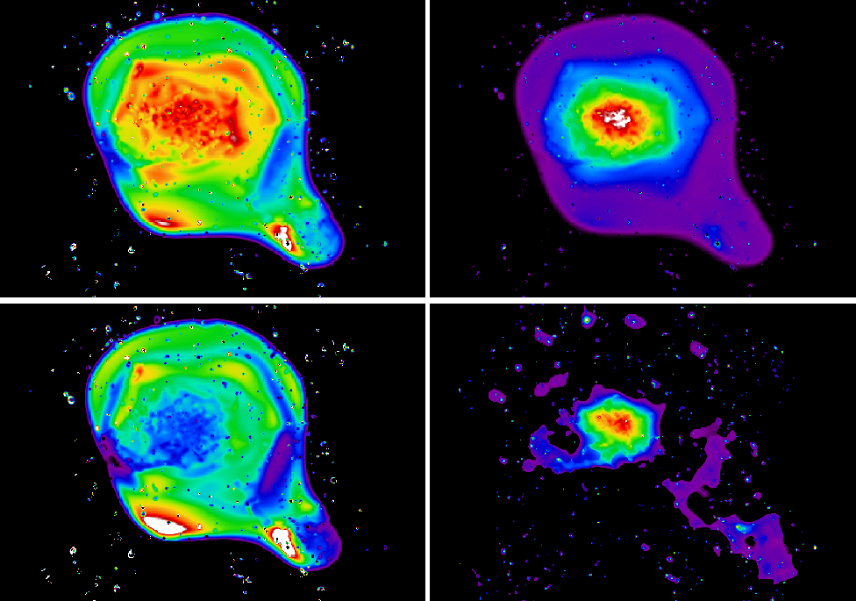

What is ICM entropy?
Entropy is a fundamental property of the ICM
Entropy dictates density in isobaric system
X-ray observables are manifestation of dark matter halo and entropy structure
Entropy is the thermal history
We define entropy as K = Tne^{-2/3}
ICM is convectively stable when dS/dr≥0
Classify clusters by entropy?
Temp.
density
Entropy
Tx
Coma Cluster
Schuecker et al.

Slide 9
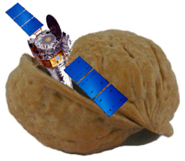
Feedback in Galaxy Clusters
or: How I Learned to Stop Worrying and Love Radiative Transfer
Why should you care about galaxy clusters and what I do?
The cause and effect of cluster feedback mechanisms
The importance of understanding intracluster gas entropy
Calculating entropy from observables
Results of my Chandra archival study
◄ Oh, hi there.
Chandra data reduction in a nutshell

Slide 10
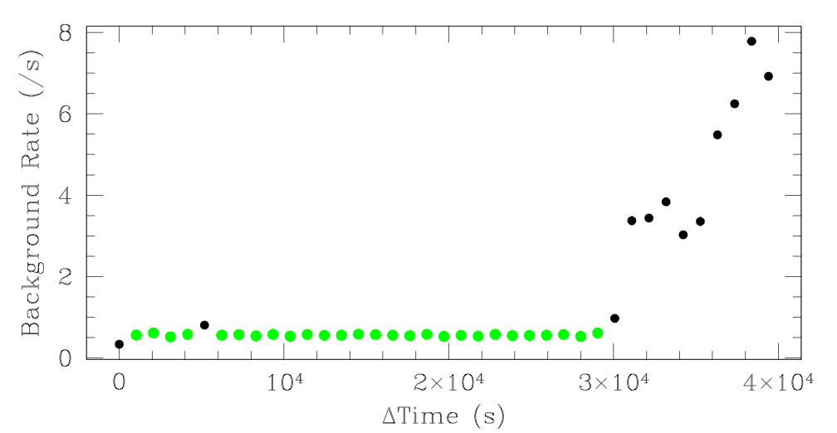
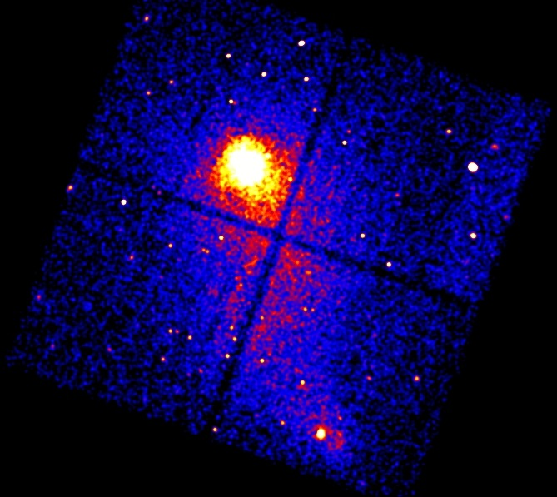
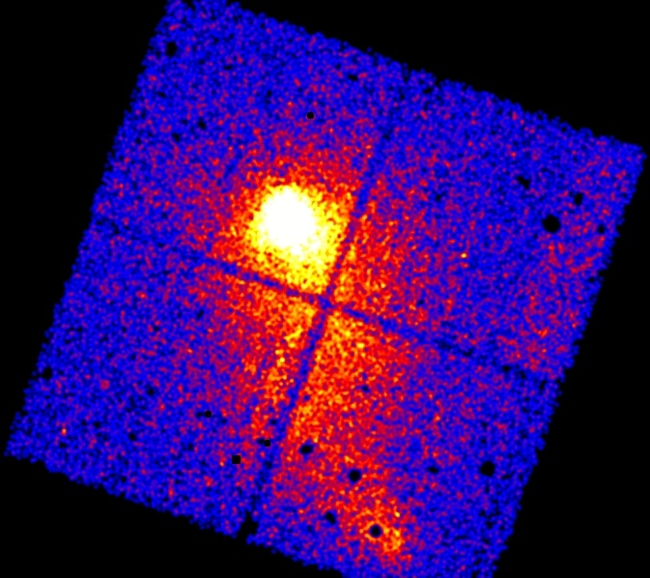
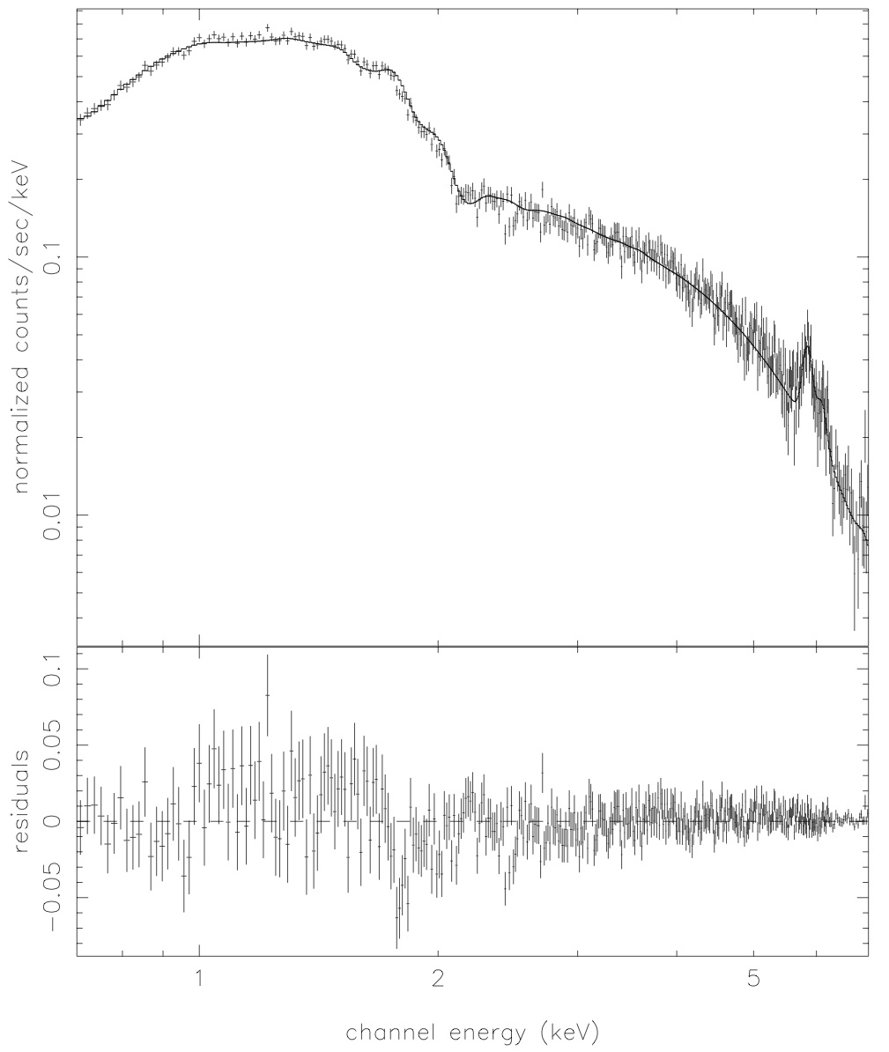
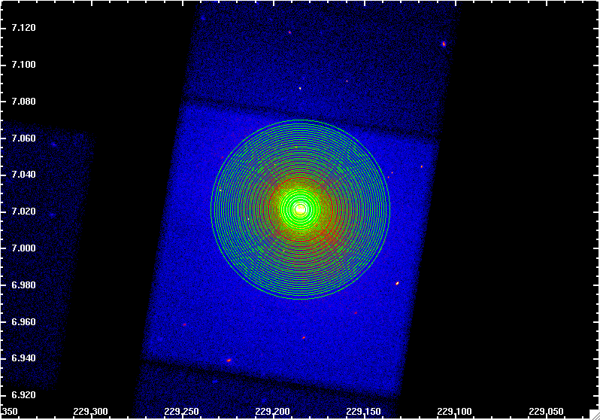
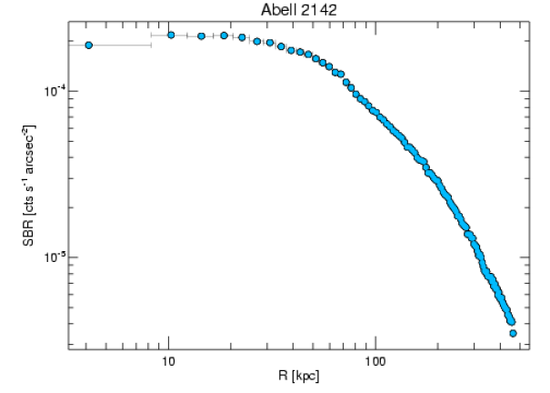
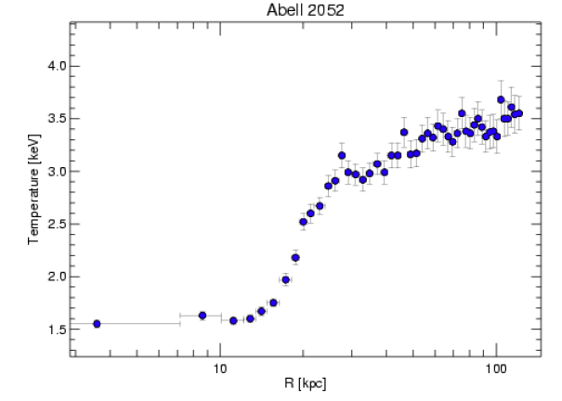
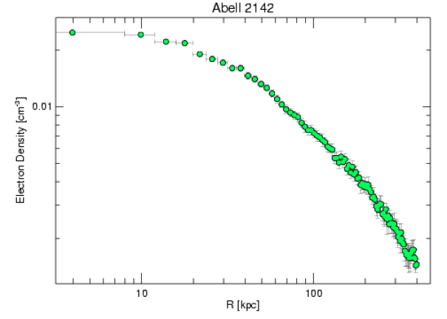

Remove afterglow
Make new bad pixel file
Apply CTI correction
Update gain
Get rid of bad grades
Use good time intervals
Remove point sources
Remove flares
Normalize
Centroid
Make blanks-sky backgrounds
Extract spectra
Adjust hard-particle background
Fit spatially varying soft background
Fit spectra
Extract surface brightness
Exposure correct
Deproject
Derive electron density
Calculate entropy
And all the other steps I hastily left off

Slide 11
Do this 190+ times,
and you get...
Remove afterglow
Make new bad pixel file
Apply CTI correction
Update gain
Get rid of bad grades
Use good time intervals
Remove point sources
Remove flares
Normalize
Centroid
Make blanks-sky backgrounds
Extract spectra
Adjust hard-particle background
Fit spatially varying soft background
Fit spectra
Extract surface brightness
Exposure correct
Deproject
Derive electron density
Calculate entropy
And all the other steps I hastily left off

Slide 12
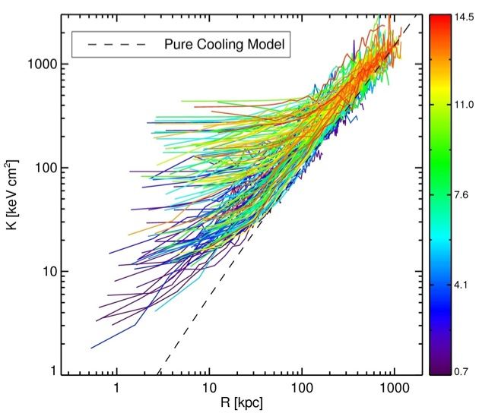
ACCEPT: Athenæum(?) of Chandra Cluster Entropy Profiles

Slide 13

Universal entropy pedestal
All clusters have been affected by feedback
Range of K0 consistent with episodic AGN heating
Timescale of ~300 Myrs
High-K0 is hard to make by just AGN

Slide 14
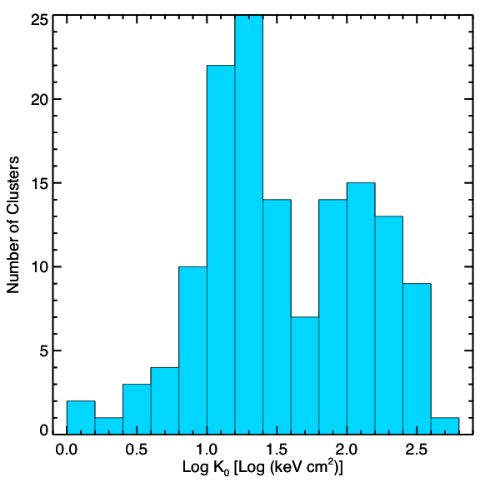
Bimodal entropy distribution

Slide 15
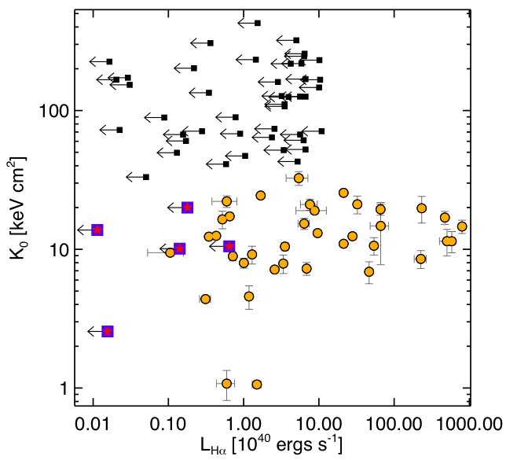
Star Formation loves low entropy
Conduction interfaces can also produce Hα

Slide 16
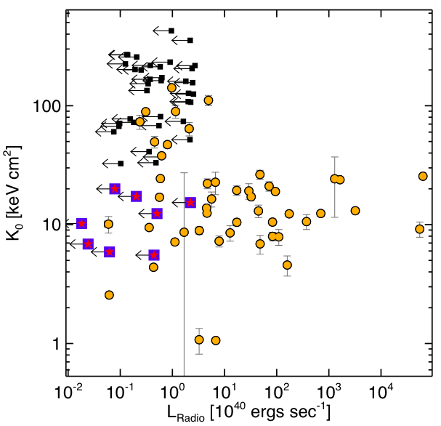
z < 0.2
Radio-loud sources do too!
Most likely AGN, but could also be relics, ghosts, detached lobes, etc.

Slide 17
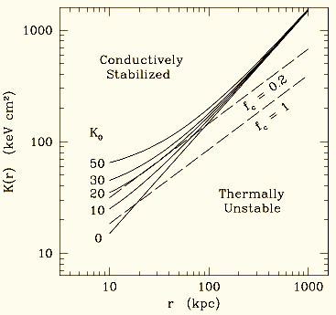
Conductive Stability
Assume free-free cooling: Λ ~ T^{1/2}
Set radiative losses equal to Spitzer conduction: κ ~ T^{5/2}
Field Length is function of entropy only: λF~ K^{3/2} σs^{1/2}
Gas cloud smaller than Field length = condensation
Gas cloud larger than Field length = evaporation
K0 = 20 keV cm² is critical length scale
Maybe AGN push ICM to conductive stability and subsequent mergers up entropy further...
Voit

Slide 18
Where to from here?
Entropy scaling relations
Explain bimodality
Model for conduction
Low entropy & no feedback
High entropy & with feedback
IR and near-UV star formation rates
Low frequency radio survey
Radio dating?
Interferometry SZE to study high-z entropy?
Test various pre-heating models
2D analyses
Online searchable database

