Slide 1
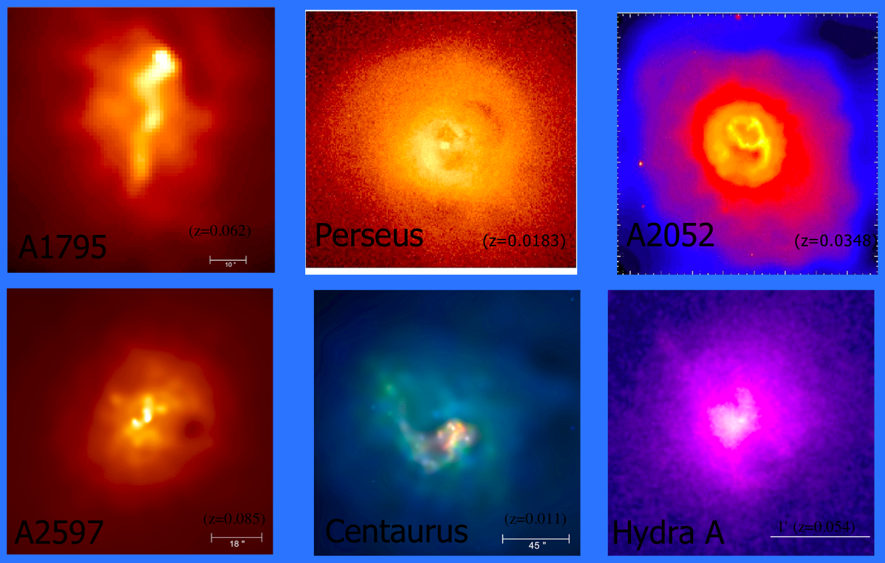
Feedback in Galaxy Clusters
or: How I Learned to Stop Worrying and Love Radiative Transfer

Slide 2



Feedback in Galaxy Clusters
or: How I Learned to Stop Worrying and Love Radiative Transfer
Why should you care about galaxy clusters and what I do?
The cause and effect of cluster feedback mechanisms
The importance of understanding intracluster gas entropy
Calculating entropy from observables
Results of my Chandra archival study

Slide 3

WHY CARE?
Additional cosmology tests:
  Power - P(k)‏
  Growth - dN/dz
  Observables - SZE, Y_{X}, lensing, ...
Galaxy formation models:
  Truncation
  Feedback testbed
AGN and SMBH physics
Need scaling relations, but...
  Shocks
  Cooling
  Mergers
  Magnetic fields
  Viscosity
  Conduction

Slide 4
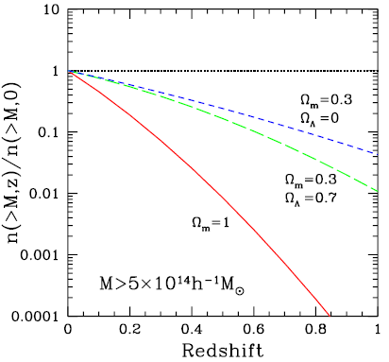
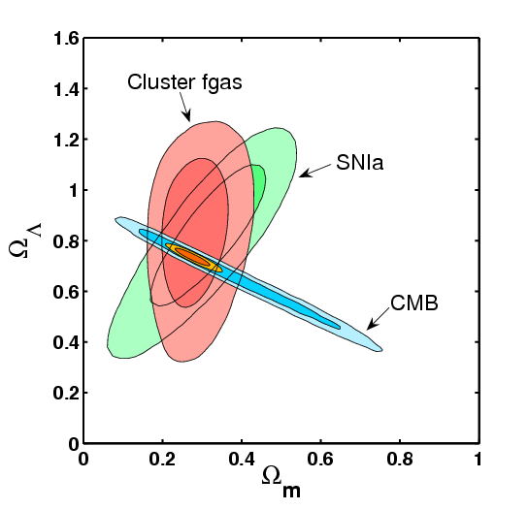
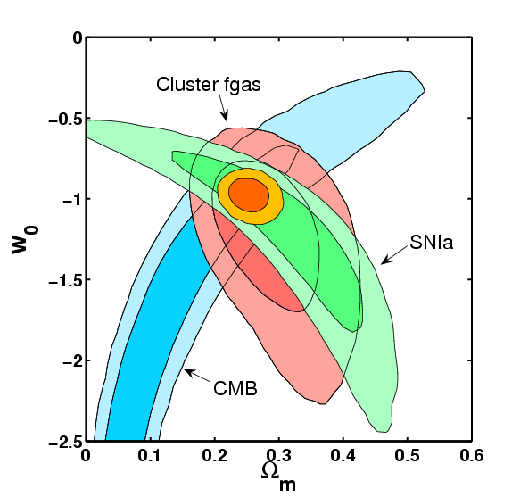
WHY CARE?
Borgani et al.
Additional cosmology tests:
  Power - P(k)‏
  Growth - dN/dz
  Observables - SZE, Y_{X}, lensing, ...
Galaxy formation models:
  Truncation
  Feedback testbed
AGN and SMBH physics
Diverse physics:
  Shocks
  Cooling
  Mergers
  Magnetic fields
  Viscosity
  Conduction
Allen et al.
Allen et al.

Slide 5
WHY CARE?
Additional cosmology tests:
  Power - P(k)‏
  Growth - dN/dz
  Observables - SZE, Y_{X}, lensing, ...
Galaxy formation models:
  Truncation
  Feedback testbed
AGN and SMBH physics
Diverse physics:
  Shocks
  Cooling
  Mergers
  Magnetic fields
  Viscosity
  Conduction
Steinmetz
http://www.aip.de/People/MSteinmetz/E/movies.html

Slide 6
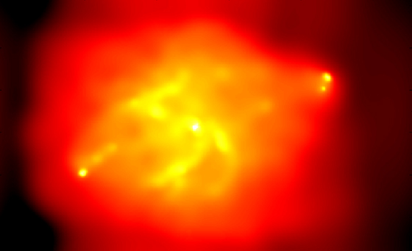
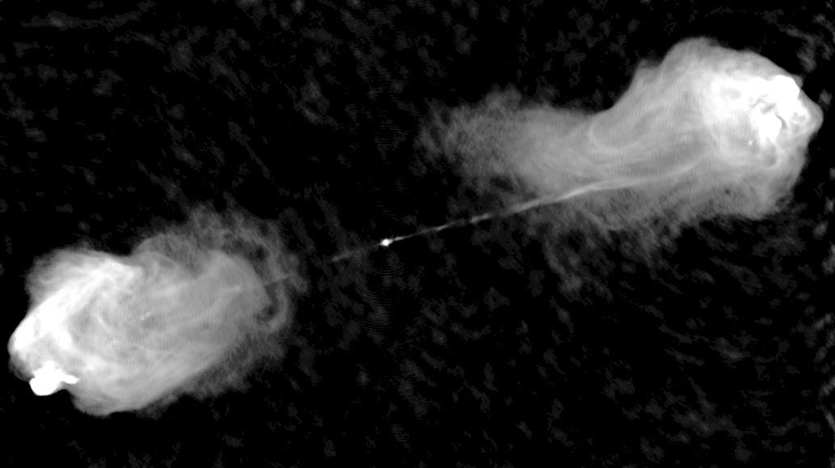
WHY CARE?
X-ray, Chandra
Additional cosmology tests:
  Power - P(k)‏
  Growth - dN/dz
  Observables - SZE, Y_{X}, lensing, ...
Galaxy formation models:
  Truncation
  Feedback testbed
AGN and SMBH physics
Diverse physics:
  Shocks
  Cooling
  Mergers
  Magnetic fields
  Viscosity
  Conduction
Cygnus A
Radio, VLA

Slide 7
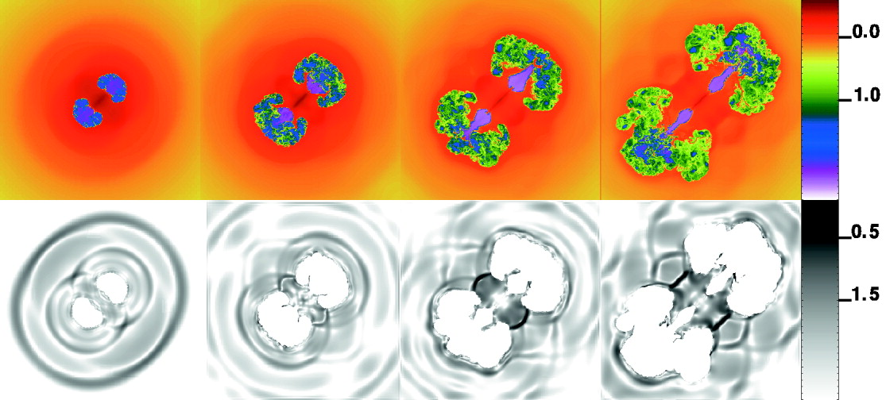
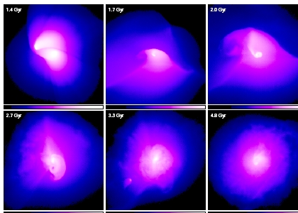
WHY CARE?
Ruszkowski et al.
Additional cosmology tests:
  Power - P(k)‏
  Growth - dN/dz
  Observables - SZE, Y_{X}, lensing, ...
Galaxy formation models:
  Truncation
  Feedback testbed
AGN and SMBH physics
Diverse physics:
  Shocks
  Cooling
  Mergers
  Magnetic fields
  Viscosity
  Conduction
Ascasibar & Markevitch

Slide 8
Feedback in Galaxy Clusters
or: How I Learned to Stop Worrying and Love Radiative Transfer
Why should you care about galaxy clusters and what I do?
The cause and effect of cluster feedback mechanisms
The importance of understanding intracluster gas entropy
Calculating entropy from observables
Results of my Chandra archival study

Slide 9
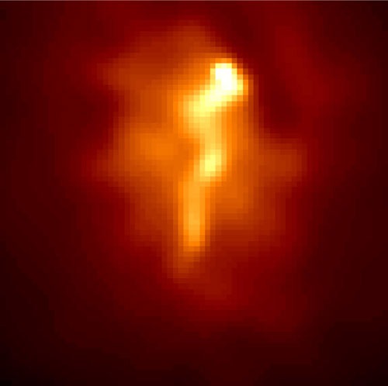
What causes feedback?
t_{cool} ~ Λ(Τ,Ζ)ρ²
Cooling time shorter than Hubble time
Gas “flows” to bottom of potential well
Mergers too
Abell 1795:
Not actually a cooling flow... but it was thought to be a for a long time!

Slide 10
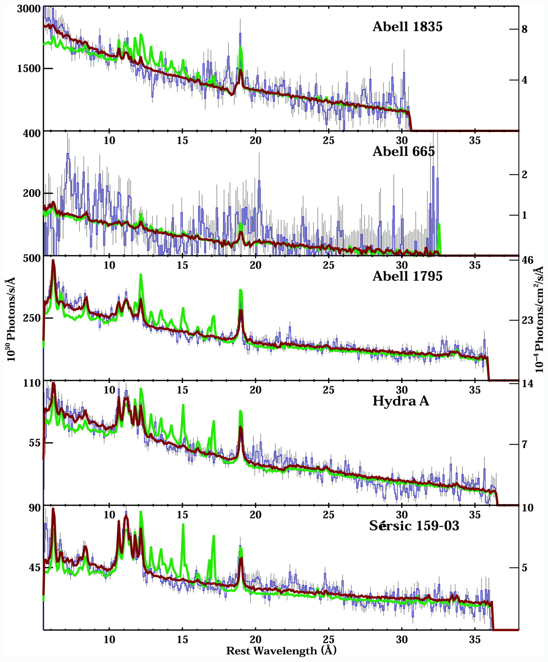
What causes feedback?
t_{cool} ~ Λ(Τ,Ζ)ρ²
Cooling time shorter than Hubble time
Gas “flows” to bottom of potential well
Mergers too
Cooling
trickles
Abell 1795:
Not actually a cooling flow... but it was thought to be a for a long time!

Slide 11
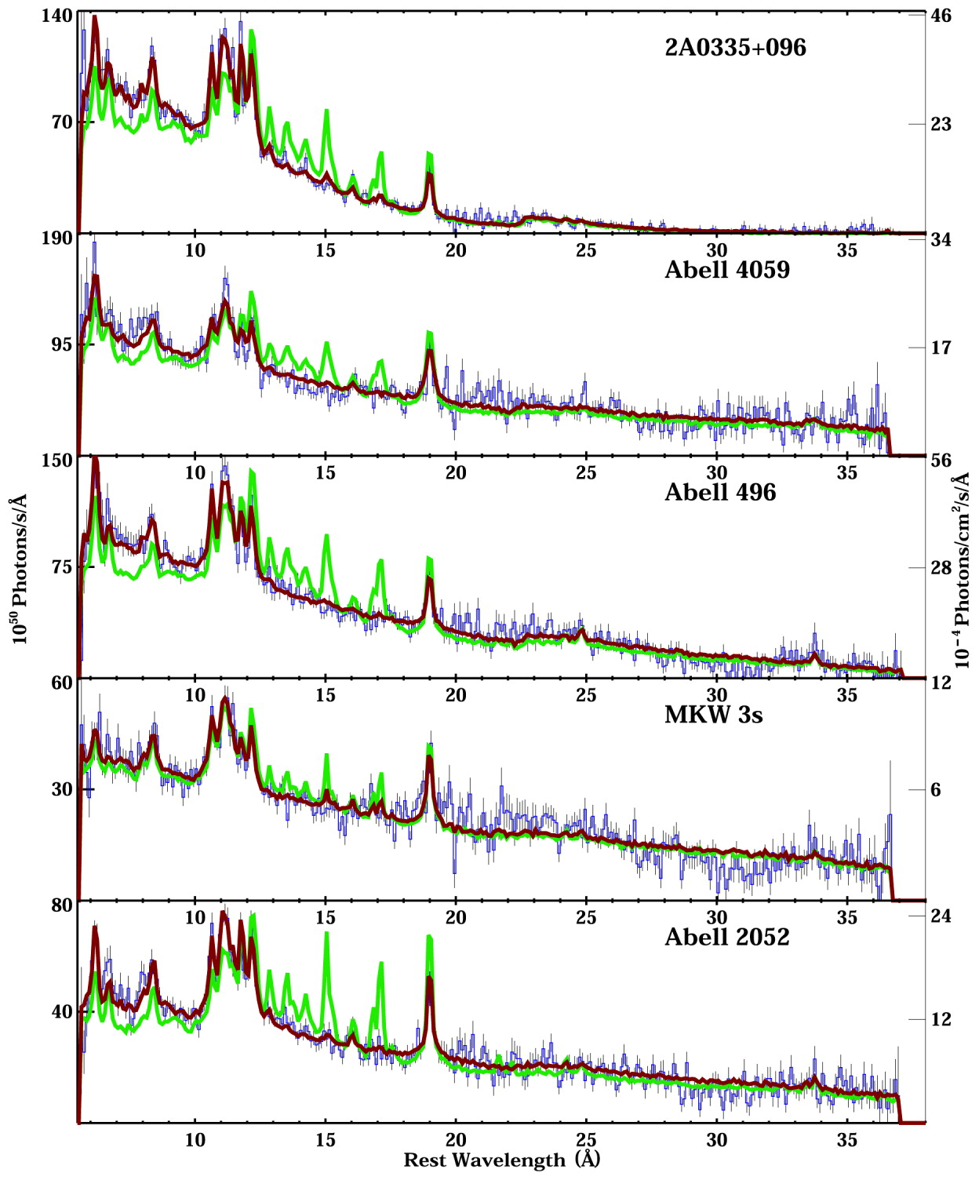
What causes feedback?
t_{cool} ~ Λ(Τ,Ζ)ρ²
Cooling time shorter than Hubble time
Gas “flows” to bottom of potential well
Mergers too
Cooling
trickles
Abell 1795:
Not actually a cooling flow... but it was thought to be a for a long time!

Slide 12
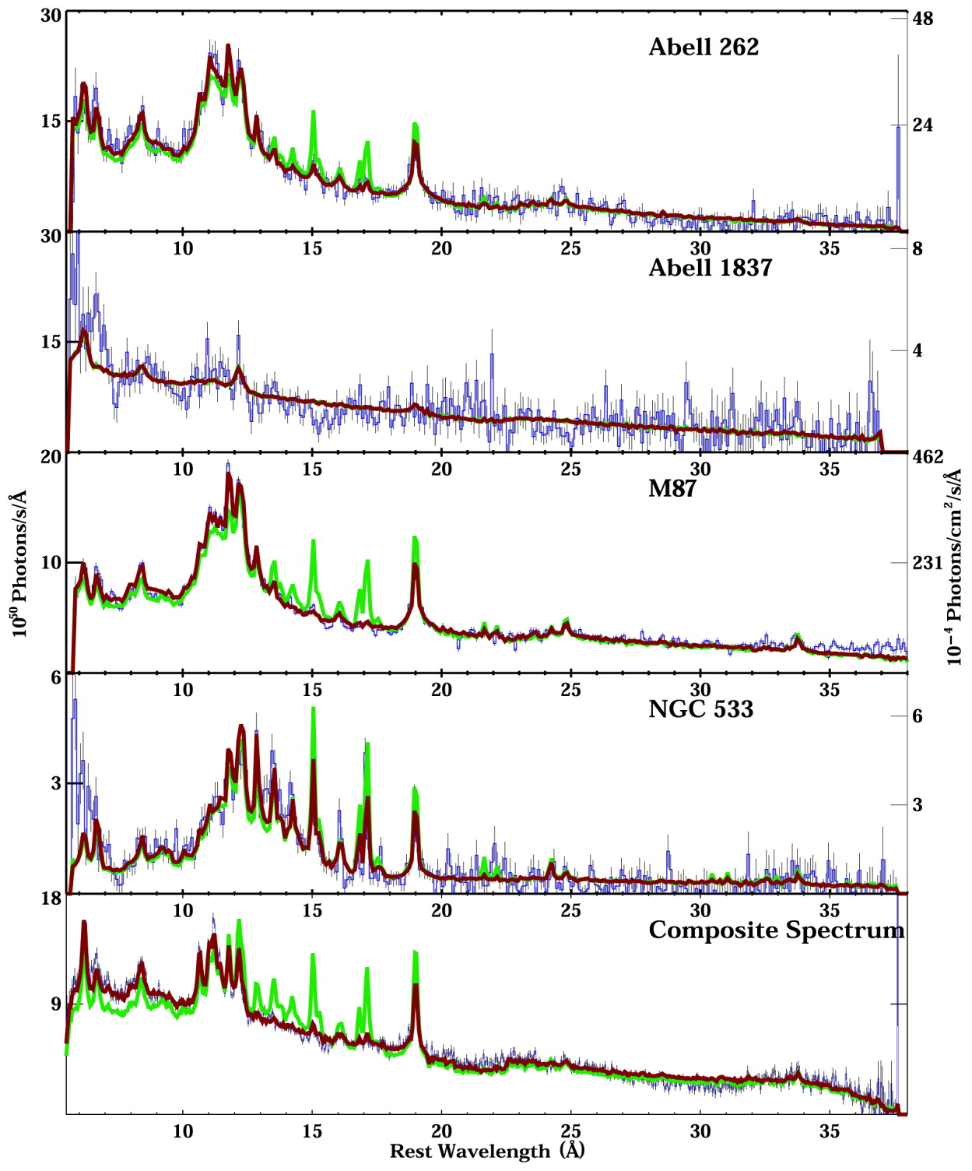
What causes feedback?
t_{cool} ~ Λ(Τ,Ζ)ρ²
Cooling time shorter than Hubble time
Gas “flows” to bottom of potential well
Mergers too
Cooling
trickles
Abell 1795:
Not actually a cooling flow... but it was thought to be a for a long time!

Slide 13
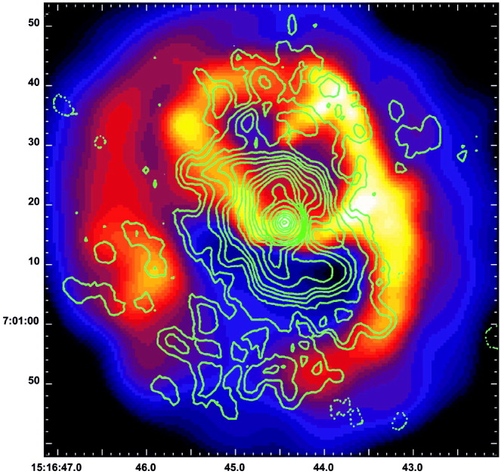
The effects of feedback
Star formation
Active galactic nuclei (AGN)‏
Heating of ICM
Self-similar scaling relations are kaput?
  Mass vs. T_{X}, L_{X}, f_{SZE}
High-precision cosmology damaged?
  Study cold ICM
  Understand feedback
Abell 2052... what a mess ----►

Slide 14

The effects of feedback
Star formation
Active galactic nuclei (AGN)‏
Heating of ICM
Self-similar relations are kaput?
  Mass vs. T_{X}, L_{X}, f_{SZE}
High-precision cosmology damaged?
  Study cold ICM
  Understand feedback
Calibrate and model
feedback, and we'll go
from there!
Abell 2052... what a mess ----►

Slide 15
Feedback in Galaxy Clusters
or: How I Learned to Stop Worrying and Love Radiative Transfer
Why should you care about galaxy clusters and what I do?
The cause and effect of cluster feedback mechanisms
The importance of understanding intracluster gas entropy
Calculating entropy from observables
Results of my Chandra archival study

Slide 16
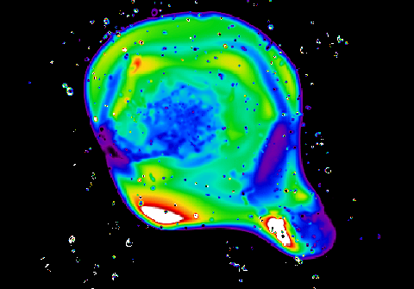

What is ICM entropy?
Entropy is a fundamental property of the ICM; more than temperature or density
Entropy dictates density in isobaric system
X-ray observables are manifestation of dark matter halo and entropy structure
Entropy is the thermal history
We define entropy as K = Tn_{e}^{-2/3}, the adiabat
ICM is convectively stable when dS/dr≥0
Entropy quantifies system dynamic state

Slide 17
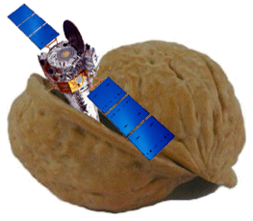
Feedback in Galaxy Clusters
or: How I Learned to Stop Worrying and Love Radiative Transfer
Why should you care about galaxy clusters and what I do?
The cause and effect of cluster feedback mechanisms
The importance of understanding intracluster gas entropy
Calculating entropy from observables
Results of my Chandra archival study
◄ Oh, hi there.
Chandra data reduction in a nutshell

Slide 18
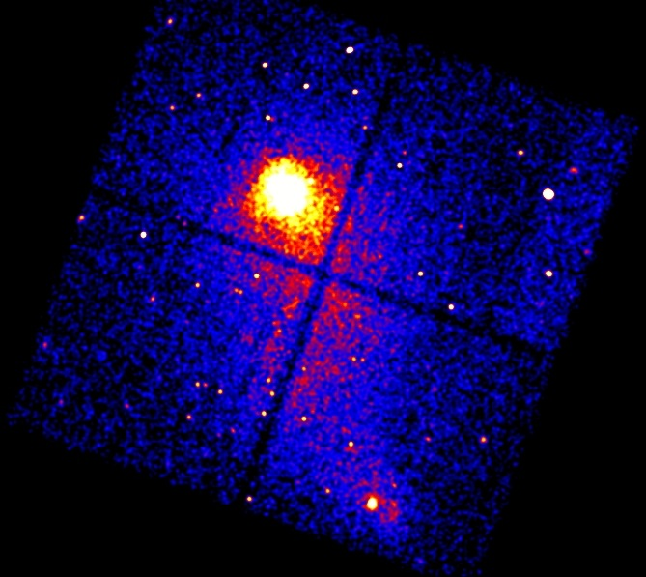
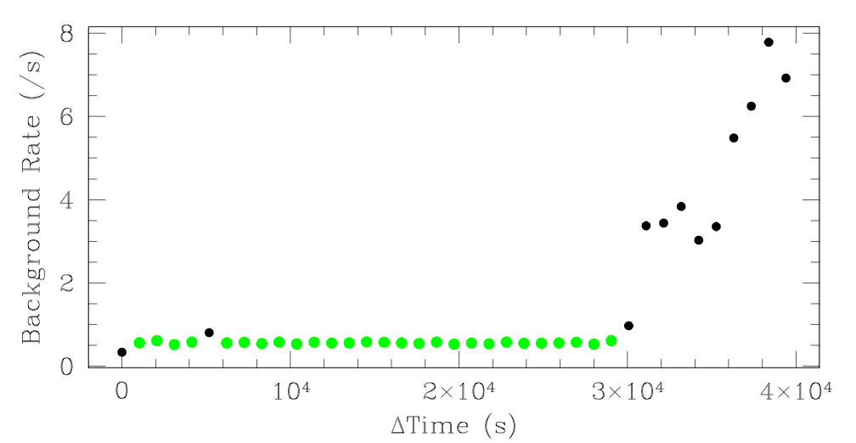
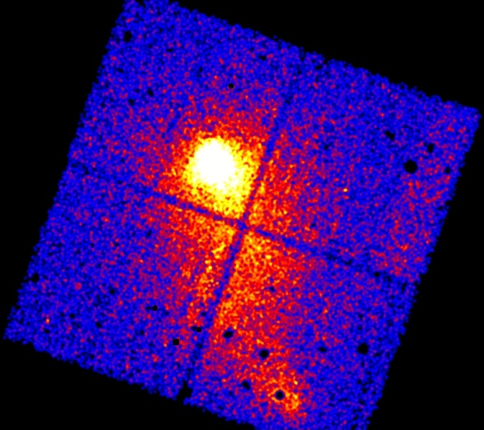
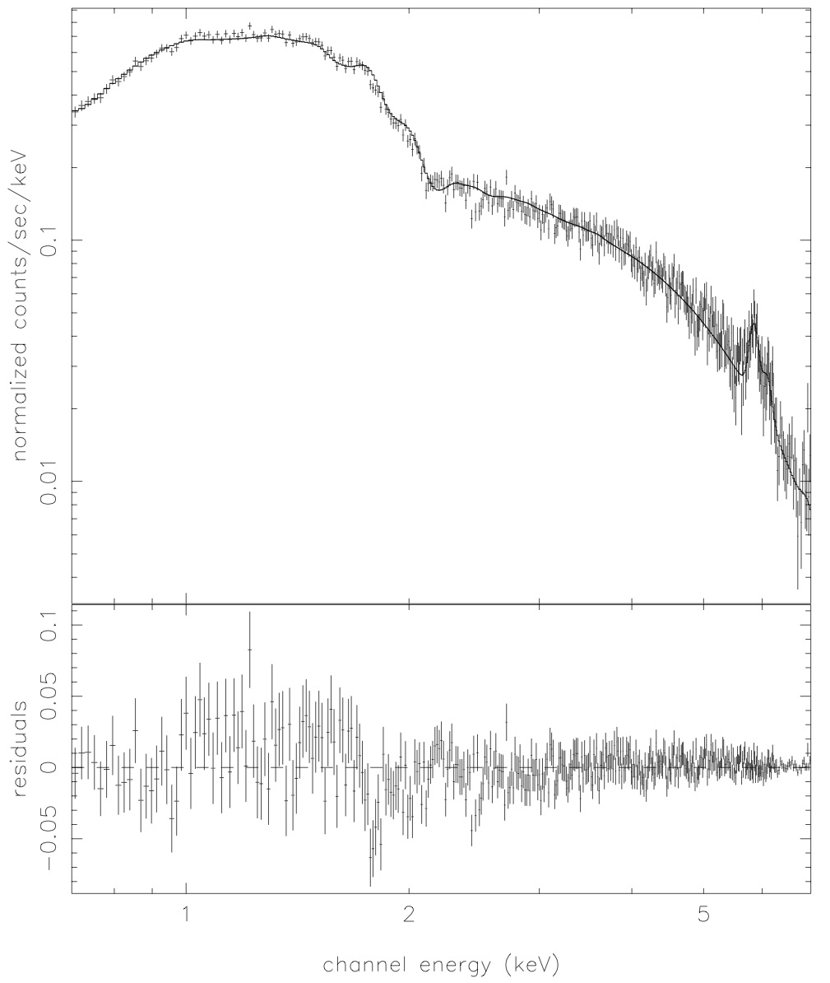
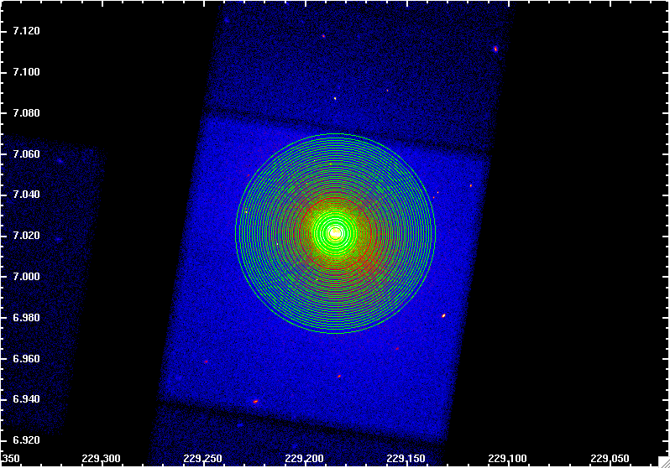
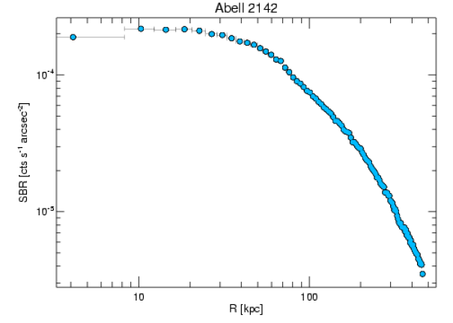
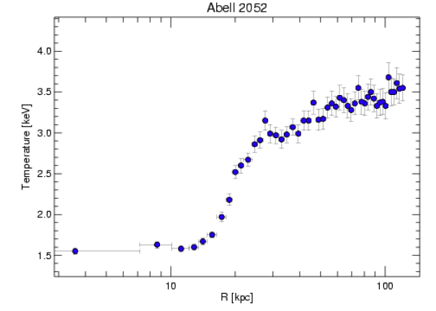
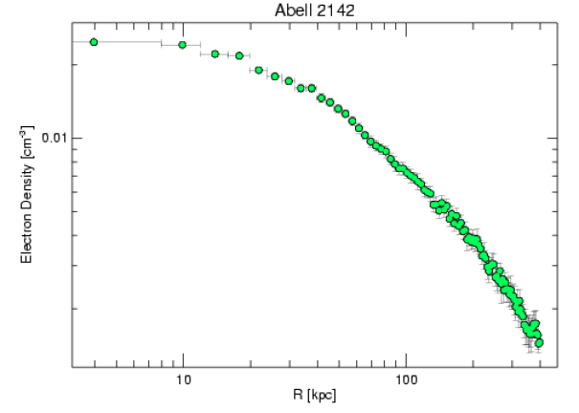

Remove background flares
Remove afterglow
Make new bad pixel file
Apply cti correction
Update gain
Get rid of bad grades
Use good time intervals
Remove point sources
Remove flares
Normalize
Centroid
Make blanks-skt backgrounds
Extract spectra
Adjust hard-particle background
Fit spatially varying soft background
Fit spectra
Extract surface brightness
Exposure correct
Deproject
Derive electron density
Calculate entropy
And all the other steps i hastily left off

Slide 19
Remove background flares
Do this 190+ times,
and you get...
Remove afterglow
Make new bad pixel file
Apply cti correction
Update gain
Get rid of bad grades
Use good time intervals
Remove point sources
Remove flares
Normalize
Centroid
Make blanks-skt backgrounds
Extract spectra
Adjust hard-particle background
Fit spatially varying soft background
Fit spectra
Extract surface brightness
Exposure correct
Deproject
Derive electron density
Calculate entropy
And all the other steps i hastily left off

Slide 20
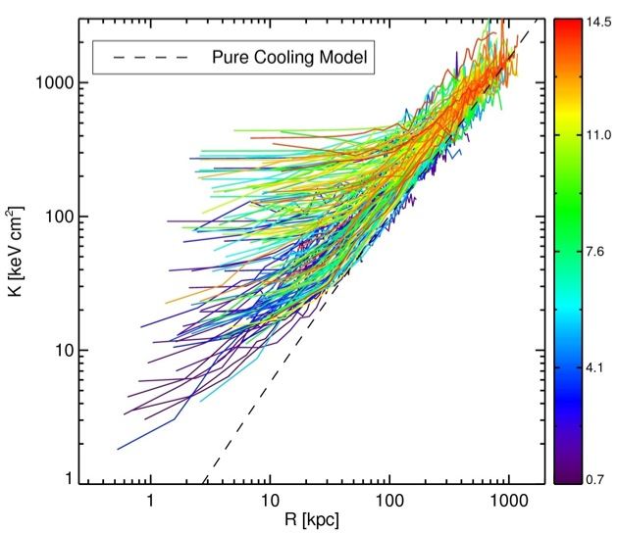
ACCEPT: Athenæum(?) of Chandra Cluster Entropy Profiles

Slide 21
Feedback in Galaxy Clusters
or: How I Learned to Stop Worrying and Love Radiative Transfer
Why should you care about galaxy clusters and what I do?
The cause and effect of cluster feedback mechanisms
The importance of understanding intracluster gas entropy
Calculating entropy from observables
Results of my Chandra archival study

Slide 22

Universal entropy pedestal
All clusters have been affected by feedback
Range of K₀ consistent with episodic AGN heating
Illuminating to feedback timescale
High-K0 is hard to make by just AGN
$K\left(r\right)=K_{0}+K_{100}{\left(\frac{r}{100}kpc\right)}^{α}$

Slide 23
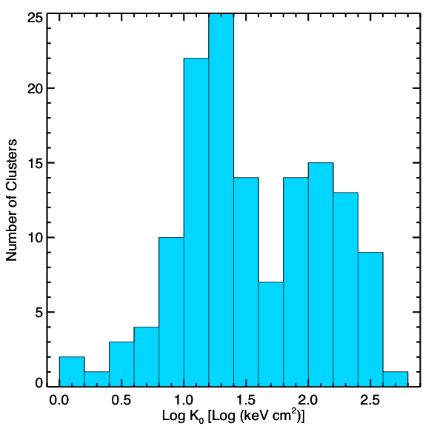
Bimodal entropy distribution

Slide 24
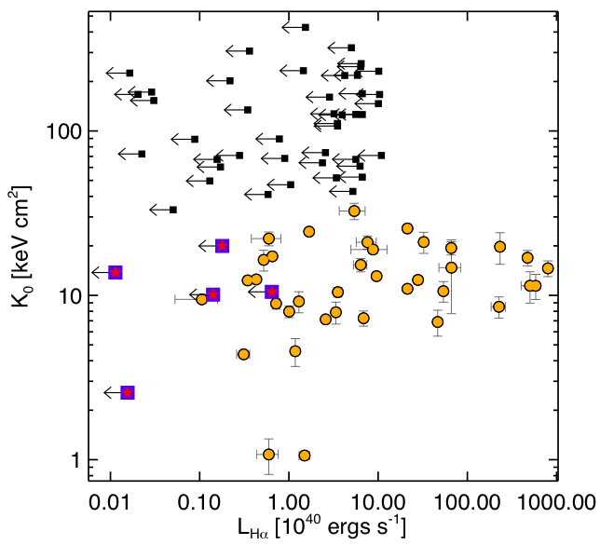
Star Formation loves low entropy
Conduction interfaces can also produce Hα

Slide 25
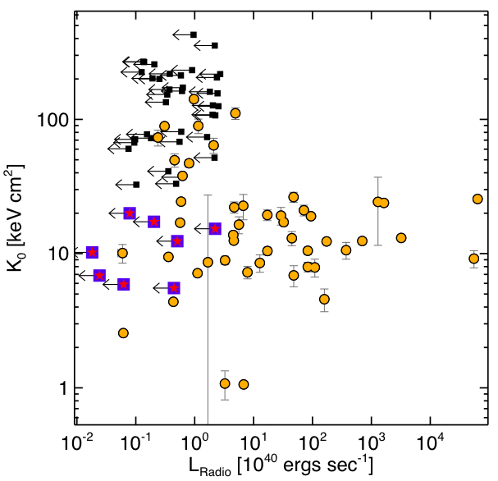
z < 0.2
Radio-loud sources do too!
Most likely AGN, but could also be relics, ghosts, detached lobes, etc.

Slide 26
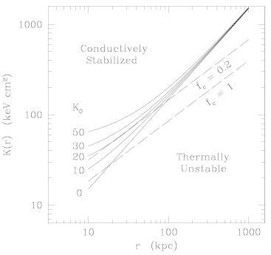
Conductive Stability
Assume free-free cooling: Λ ~ T^{1/2}
Set radiative losses equal to Spitzer conduction: κ ~ T^{5/2}
Field Length is function of entropy only: λ_{F}~ K^{3/2} σ_{s}^{1/2}
Gas cloud smaller than Field length = condensation
Gas cloud larger than Field length = evaporation
K₀ = 20 keV cm² is critical length scale
Maybe AGN push ICM to conductive stability and subsequent mergers up entropy further...

Slide 27
Feedback in Galaxy Clusters
or: How I Learned to Stop Worrying and Love Radiative Transfer
Why should you care about galaxy clusters and what I do?
The cause and effect of cluster feedback mechanisms
The importance of understanding intracluster gas entropy
Calculating entropy from observables
Results of my Chandra archival study

Slide 28
Where to from here?
Entropy scaling relations
Explain bimodality
Model for conduction
Low entropy & no feedback
High entropy & with feedback
IR and near-UV star formation rates
Low frequency radio survey
Radio dating?
Interferometry SZE to study high-z entropy?
Test various pre-heating models
2D analyses

